Slide 1

Improving Patient Trust
In Healthcare Information Exchanges
Identity Management Conference 2010
Washington DC

Slide 2
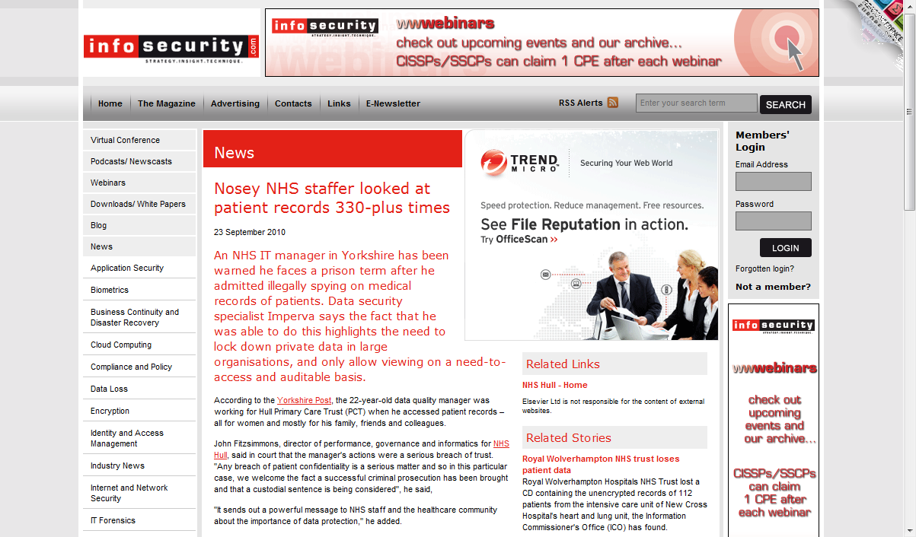
Improving Patient Trust
Identity Management Conference 2010
Washington DC

Slide 3
Improving Patient Trust
330+ Unauthorized Access Events
Identity Management Conference 2010
Washington DC

Slide 4
Improving Patient Trust
"Just six months ago the NHS were exposed when it was found that as many as 140,000 non-medical staff, including porters and housekeepers, had access to sensitive NHS patient files. When there is a problem, a responsible organization should be able to assess the scope of the damage"
Amichai Shulman, Imperva's Chief Technology Officer
NHS – National Health Service, United Kingdom
Identity Management Conference 2010
Washington DC

Slide 5
Improving Patient Trust
Fundamental breakdown of underlying security system and processes to
limit access based on;
Users identity and role
Purpose-of-use
Patients privacy concerns
Identity Management Conference 2010
Washington DC

Slide 6
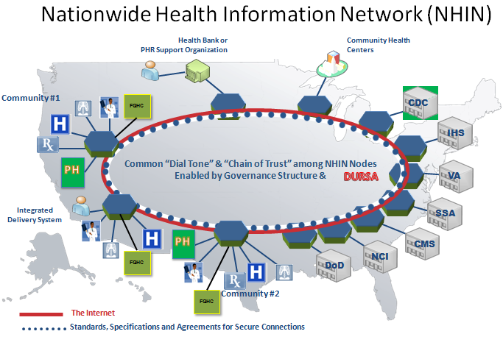
Improving Patient Trust
Identity Management Conference 2010
Washington DC

Slide 7
Improving Patient Trust
Data Use and Reciprocal Support Agreement (DURSA)
The DURSA is a comprehensive, multi-party trust legal agreement and is based upon a set of policy assumptions that bridge varying state and federal laws and regulations, as well as various policies. This legal contract, signed by all entities currently exchanging information via the NHIN, provides a framework of trust assurance to support multi-point health information exchange across the NHIN.
Identity Management Conference 2010
Washington DC

Slide 8
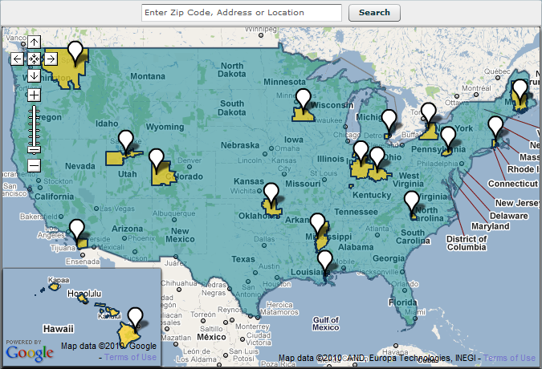
Improving Patient Trust
Beacon Communities
Identity Management Conference 2010
Washington DC

Slide 9
Improving Patient Trust
Beacon Communities
The Beacon Community Cooperative Agreement Program provides funding to selected communities to build and strengthen their health information technology (health IT) infrastructure and exchange capabilities. The program supports these communities at the cutting edge of electronic health record (EHR) adoption and health information exchange to push them to a new level of sustainable health care quality and efficiency. The program also will show how other communities can use health IT to achieve similar goals.
Identity Management Conference 2010
Washington DC

Slide 10
Improving Patient Trust
Patient Privacy
“HHS strongly believes that an individual’s personal information is to be kept private and confidential and used appropriately by the right people, for the right reasons,” said Pritts. “Without such assurances, an individual may be hesitant to share relevant health information.”
Joy Pritts Chief Privacy Officer ONC
HHS – US Department of Health and Human Services
ONC – Office of National Coordinator
Identity Management Conference 2010
Washington DC

Slide 11
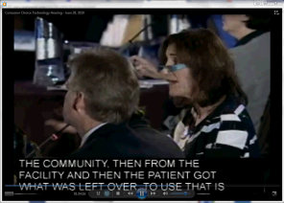

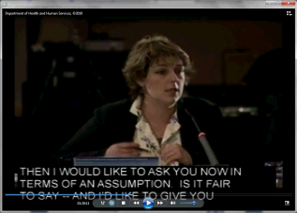
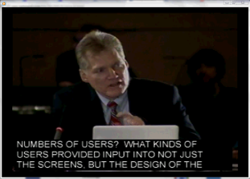
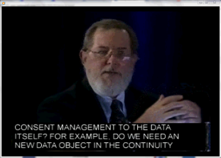
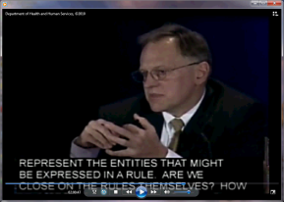
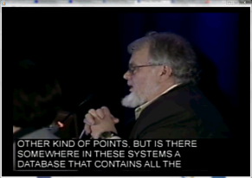
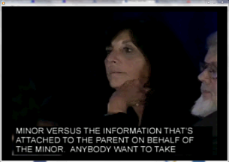
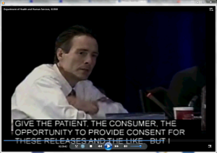
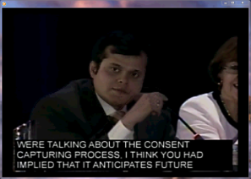
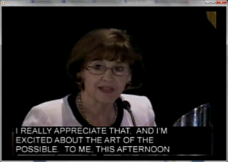
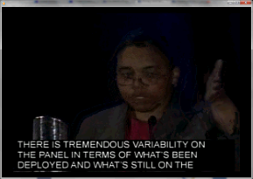
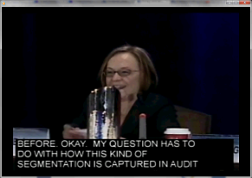
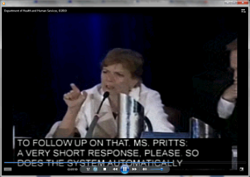

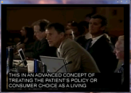


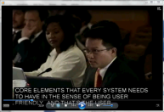


Improving Patient Trust
Privacy and Security Tiger Team
Health Information Technology Policy Committee
Consumer Choice Technology Hearing
Panel Members
Dr. Deborah Peel
Melissa Goldstein, J.D.
Ioana Singureanu
Dr. Jim Walker
Dr. David Kibbe
Tiger Team
David McCallie
Cerner Corp.
Wes Rishel
Gartner
Ms. Rachel
John Houston
Univ. of Pittsburgh
Medical Ctr.
Sumit Rana
Judy Falkner
Epic Systems Corp.
Latanya Sweeney
Carnegie Mellon Univ.
Dixie Baker
SAIC
Joy Pritts
Chief Privacy Officer ONC
Technology Implementers
HIPAAT
VA/DoD VLER
Tolven Institute
Private Access
e-MD
Intersystems
CBMHS
Identity Management Conference 2010
Washington DC

Slide 12
Improving Patient Trust
Cross-Enterprise Security and Privacy Authorization (XSPA)
Oasis Standards (November 2009)
Profile of Security Assertion Markup Language (SAML) v2.0 for Healthcare Version 1.0
Profile of eXtensible Access Control Markup Language (XACML) v2.0 for Healthcare Version 1.0
Committee Specifications (August 2010)
Profile of WS-Trust for Healthcare (ready for ballot)
Federal Adoption (September 2009)
NHIN Authorization Framework – XSPA Profile of SAML
Identity Management Conference 2010
Washington DC

Slide 13
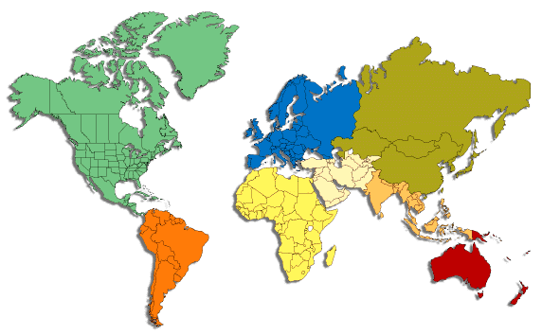









Improving Patient Trust
XSPA Demonstrations & Global Participants
RSA 2008 Healthcare Security and Privacy as a Service
Ditton Manor 2008 – Extensions to Healthcare Security and Privacy Services
HIMSS 2009– Advanced Security and Privacy in Healthcare
RSA 2010 – Protecting the Human Genome
HHS ONC HITPC “Consumer Choice Technology” Demonstrations
System and Participant Locations
RSA 2008 – San Francisco, CA
Oasis XACML Interop Demonstration – Ditton Manor, London, UK
HIMSS 2009 – Chicago, IL
RSA 2010 – San Francisco, CA
HHS ONC HITPC “Consumer Choice Technology” hearings 2010 – Washington DC
Identity Management Conference 2010
Washington DC

Slide 14

Improving Patient Trust
SAML / XACML Profile Interop
Glassfish v2.1.1
http://208.75.163.70/XACMLPatientPrivacy
Requesting Healthcare Organization
Clinical
Application
PEP
Opensso
PDP
(IBM - Australia)
PAP
SAML Callback Handler
User
XSPA Profile of SAML
Previously demonstrated
At HIMSS 2009
Healthcare Information Exchange
Authorization
Responding Healthcare Organization
Validation
XSPA Profile of XACML
Request / Response
Sun. App. Srv.
PDP
(Jericho)
PAP
SAML
Assertion
Validator
Opensso
Glassfish V2.1.1
Service Provider
Attribute Service Provider
PEP
PIP
208.75.163.71
Identity Management Conference 2010
Washington DC

Slide 15
Improving Patient Trust
WS-Trust Profile Interop
Glassfish v2.1.1
http://208.75.163.70/XACMLPatientPrivacy
Draft
XSPA Profile of WS-Trust
Requesting Healthcare Organization
Clinical Application
3/4
STS1 (IBM/SUN )
ws-trust client
User / Pwd
Validate
(User / Pwd)
Mapping
(groups/attrs.)
Issue
(SAML 2.0)
PEP
Opensso
User
Open LDAP
5/6
PDP
(IBM)
PAP
User groups and attributes
0
SAML 2.0
7
Healthcare Information Exchange
2
STS2 (Sun)
Responding Healthcare Organization
Re-direct
Validated request
Validate
Issue
1
XSPA Profile of XACML
Draft
XSPA Profile of WS-Trust
Sun. App. Srv.
PDP
(Jericho)
PAP
Opensso
Initial request
Glassfish V2.1.1
Service Provider
Attribute Service Provider
PEP
PIP
208.75.163.71
Previously demonstrated
at HIMSS 2009
Identity Management Conference 2010
Washington DC

Slide 16
Improving Patient Trust
What is XSPA?
The XSPA profiles of SAML, WS-Trust, and XACML describe the minimum set of attributes necessary to make an access control decision during a healthcare information exchange.
Identity Management Conference 2010
Washington DC

Slide 17
Improving Patient Trust
Attributes use to enforce security and privacy in an XSPA cross-enterprise exchange of patient data.
Identity Management Conference 2010
Washington DC

Slide 18
Improving Patient Trust
XSPA Profiles of SAML and WS-Trust for Healthcare – Attributes
Identifier | Required Attribute | Runtime Claim Assertion (WS-Trust Only) | Claim Asserted Externally (WS-Trust Only)
urn:oasis:names:tc:xacml:1.0:subject:subject-id | M | O | P
urn:oasis:names:tc:xspa:1.0:subject:organization-id | M | O | P
urn:oasis:names:tc:xspa:1.0:organization | M | O | P
urn:oasis:names:tc:xspa:1.0:subject:hl7:permission | O | O | P
urn:oasis:names:tc:xacml:2.0:subject:role (ASTM E1986-09 (2009) Structured Role Value) | M | O | P
urn:oasis:names:tc:xspa:1.0:subject:functional-role | O | P | n/a
urn:oasis:names:tc:xspa:1.0:subject:purposeofuse | M | P | n/a
urn:oasis:names:tc:xacml:1.0:resource:resource-id | M | P | n/a
urn:oasis:names:tc:xacml:1.0:action:action-id (HL7 Permission Catalog Resource Action Value) | O | P | n/a
urn:oasis:names:tc:xspa:1.0:resource:hl7:type (HL7 Permission Catalog Object Value) | O | P | n/a
urn:oasis:names:tc:xspa:1.0:environment:locality | M | O | n/a
urn:oasis:names:tc:xspa:2.0:subject:npi | O | O | P
Mandatory
Optional
Preferred
Identity Management Conference 2010
Washington DC

Slide 19
Improving Patient Trust
Demonstrable Patient and Organization Policy Functionality
Demonstrate the Enforcement of Patient Consent Directives
  Opt-In / Opt-Out
  Allowed Organizations
  Confidentiality Codes (Directive Template)
  Deny Access based on Role and Purpose of Use
  Deny Access to Specific Providers
  Masked Results based on Role
  Masked Results for Specific Providers
  Masked Results based on Medical Data Object/Resource requested
Demonstrate the Enforcement of Organizational Policies
  Limit access to specific organizations
  Limit access during specific hours of the day
  Require certain roles based on purpose of use and service/resource requested
  Require certain permissions based on purpose of use and service/resource requested
Identity Management Conference 2010
Washington DC

Slide 20
Improving Patient Trust
XACML Policy Examples - Organization
- <Policy PolicyId="urn:oasis:names:tc:xspa:1.0:org:allowed:organizations" RuleCombiningAlgId="urn:oasis:names:tc:xacml:1.0:rule-combining-algorithm:deny-overrides">
<Description>The organization denies the request if the subject is attempting to access a resource and is not a member of the allowed organizations.</Description>
<Target />
- <Rule Effect="Deny" RuleId="urn:oasis:names:tc:xspa:1.0:org:allowed:organizations:deny">
<Description>Evaluates the allowed-organizations (if available) against the subject's locality.</Description>
<Target />
- <Condition>
- <Apply FunctionId="urn:oasis:names:tc:xacml:1.0:function:and">
- <Apply FunctionId="urn:oasis:names:tc:xacml:1.0:function:not">
- <Apply FunctionId="urn:oasis:names:tc:xacml:1.0:function:integer-equal">
- <Apply FunctionId="urn:oasis:names:tc:xacml:1.0:function:string-bag-size">
<ResourceAttributeDesignator AttributeId="urn:oasis:names:tc:xspa:1.0:resource:org:allowed-organizations" DataType="http://www.w3.org/2001/XMLSchema#string" />
</Apply>
<AttributeValue DataType="http://www.w3.org/2001/XMLSchema#integer">0</AttributeValue>
</Apply>
</Apply>
- <Apply FunctionId="urn:oasis:names:tc:xacml:1.0:function:not">
- <Apply FunctionId="urn:oasis:names:tc:xacml:1.0:function:string-subset">
<SubjectAttributeDesignator AttributeId="urn:oasis:names:tc:xacml:2.0:subject:locality" DataType="http://www.w3.org/2001/XMLSchema#string" />
<ResourceAttributeDesignator AttributeId="urn:oasis:names:tc:xspa:1.0:resource:org:allowed-organizations" DataType="http://www.w3.org/2001/XMLSchema#string" />
</Apply>
</Apply>
</Apply>
</Condition>
</Rule>
</Policy>
Allowed Organizations
Hours of Operations
Organizational Policy
Required Roles
Required Permissions
Determine if organization is allowed access to specific resource.
Identity Management Conference 2010
Washington DC

Slide 21
Improving Patient Trust
XACML Policy Examples - Organization
<Policy PolicyId="urn:oasis:names:tc:xspa:1.0:org:required:roles" RuleCombiningAlgId="urn:oasis:names:tc:xacml:1.0:rule-combining-algorithm:deny-overrides">
<Description>The organization denies the request if the subject is attempting to access a resource and they are not a member of the required role(s).</Description>
<Target />
- <Rule Effect="Deny" RuleId="urn:oasis:names:tc:xspa:1.0:org:required:roles:deny">
<Description>Evaluates the organization roles (if available) against the subject's role.</Description>
<Target />
- <Condition>
- <Apply FunctionId="urn:oasis:names:tc:xacml:1.0:function:and">
- <Apply FunctionId="urn:oasis:names:tc:xacml:1.0:function:not">
- <Apply FunctionId="urn:oasis:names:tc:xacml:1.0:function:integer-equal">
- <Apply FunctionId="urn:oasis:names:tc:xacml:1.0:function:string-bag-size">
<ResourceAttributeDesignator AttributeId="urn:oasis:names:tc:xspa:1.0:resource:org:role" DataType="http://www.w3.org/2001/XMLSchema#string" />
</Apply>
<AttributeValue DataType="http://www.w3.org/2001/XMLSchema#integer">0</AttributeValue>
</Apply>
</Apply>
- <Apply FunctionId="urn:oasis:names:tc:xacml:1.0:function:not">
- <Apply FunctionId="urn:oasis:names:tc:xacml:1.0:function:string-subset">
<SubjectAttributeDesignator AttributeId="urn:oasis:names:tc:xacml:2.0:subject:role" DataType="http://www.w3.org/2001/XMLSchema#string" />
<ResourceAttributeDesignator AttributeId="urn:oasis:names:tc:xspa:1.0:resource:org:role" DataType="http://www.w3.org/2001/XMLSchema#string" />
</Apply>
</Apply>
</Apply>
</Condition>
</Rule>
</Policy>
Allowed Organizations
Hours of Operations
Organizational Policy
Required Roles
Required Permissions
Determine if subject is allowed access to specific resource based on ASTM role.
Identity Management Conference 2010
Washington DC

Slide 22
Improving Patient Trust
XACML Policy Examples - Organization
<Policy PolicyId="urn:oasis:names:tc:xspa:1.0:org.resource.permissions" RuleCombiningAlgId="urn:oasis:names:tc:xacml:1.0:rule-combining-algorithm:deny-overrides">
<Description>The organization denies the request if the subject does not have adequate permissions to access the resource.</Description>
<Target />
- <Rule Effect="Deny" RuleId="urn:oasis:names:tc:xspa:1.0:org:resource.permissions:deny">
<Description>Evaluates the required permissions (if available) against the subject's permissions.</Description>
<Target />
- <Condition>
- <Apply FunctionId="urn:oasis:names:tc:xacml:1.0:function:and">
- <Apply FunctionId="urn:oasis:names:tc:xacml:1.0:function:not">
- <Apply FunctionId="urn:oasis:names:tc:xacml:1.0:function:integer-equal">
- <Apply FunctionId="urn:oasis:names:tc:xacml:1.0:function:string-bag-size">
<ResourceAttributeDesignator AttributeId="urn:oasis:names:tc:xspa:1.0:resource:org:hl7:permission" DataType="http://www.w3.org/2001/XMLSchema#string" />
</Apply>
<AttributeValue DataType="http://www.w3.org/2001/XMLSchema#integer">0</AttributeValue>
</Apply>
</Apply>
- <Apply FunctionId="urn:oasis:names:tc:xacml:1.0:function:not">
- <Apply FunctionId="urn:oasis:names:tc:xacml:1.0:function:string-subset">
<ResourceAttributeDesignator AttributeId="urn:oasis:names:tc:xspa:1.0:resource:org:hl7:permission" DataType="http://www.w3.org/2001/XMLSchema#string" />
<SubjectAttributeDesignator AttributeId="urn:oasis:names:tc:xspa:1.0:subject:hl7:permission" DataType="http://www.w3.org/2001/XMLSchema#string" />
</Apply>
</Apply>
</Apply>
</Condition>
</Rule>
</Policy>
Allowed Organizations
Hours of Operations
Organizational Policy
Required Roles
Required Permissions
Determine if subject is allowed access to specific resource based on their
HL7 Permission valueset.
Identity Management Conference 2010
Washington DC

Slide 23
Improving Patient Trust
XACML Policy Examples - Patient
<Policy PolicyId="urn:gov:hhs:fha:nhinc:patient-opt-in-policy" RuleCombiningAlgId="urn:oasis:names:tc:xacml:1.0:rule-combining-algorithm:deny-overrides">
<Description>Denies the request if patient has opted-out of healthcare information exchange. This policy is acting as the "Catch-All".</Description>
- <Target>
- <Resources>
- <Resource>
- <ResourceMatch MatchId="urn:oasis:names:tc:xacml:1.0:function:string-equal">
<AttributeValue DataType="http://www.w3.org/2001/XMLSchema#string">urn:oasis:names:tc:xspa:1.0:resource:hl7:type:medical-record</AttributeValue>
<ResourceAttributeDesignator AttributeId="urn:oasis:names:tc:xspa:1.0:resource:hl7:type" DataType="http://www.w3.org/2001/XMLSchema#string" />
</ResourceMatch>
</Resource>
</Resources>
</Target>
- <Rule Effect="Deny" RuleId="urn:gov:hhs:fha:nhinc:patient-opt-in:deny">
<Description>Evaluates opt-in flag.</Description>
<Target />
- <Condition>
- <Apply FunctionId="urn:oasis:names:tc:xacml:1.0:function:and">
- <Apply FunctionId="urn:oasis:names:tc:xacml:1.0:function:string-is-in">
<AttributeValue DataType="http://www.w3.org/2001/XMLSchema#string">false</AttributeValue>
<ResourceAttributeDesignator AttributeId="urn:gov:hhs:fha:nhinc:patient-opt-in" DataType="http://www.w3.org/2001/XMLSchema#string" />
</Apply>
</Apply>
</Condition>
</Rule>
</Policy>
Opt-IN
Blacklisted Organizations
Confidentiality/Sensitive Data
Patient Policy
Blacklisted Provider – Role Based Denial
Blacklisted Provider – Unique ID Based Denial
Data Redaction – Provider Role
Data Redaction – Provider Unique Identifier
Demonstrated Advanced Concepts of Obligations
Genomics
Denial if patient choses to opt-out of the healthcare information exchange.
Identity Management Conference 2010
Washington DC
Notes:
For NHIN the resource type needs to map to their resource name…specifically the service call name…entityDocQuery etc…

Slide 24
Improving Patient Trust
<Policy PolicyId="urn:oasis:names:tc:xspa:1.0:patient:allowed:organizations" RuleCombiningAlgId="urn:oasis:names:tc:xacml:1.0:rule-combining-algorithm:deny-overrides">
<Description>Denies the request from the subject if their locality is not permitted by the patient.</Description>
- <Target>
- <Resources>
- <Resource>
- <ResourceMatch MatchId="urn:oasis:names:tc:xacml:1.0:function:string-equal">
<AttributeValue DataType="http://www.w3.org/2001/XMLSchema#string">urn:oasis:names:tc:xspa:1.0:resource:hl7:type:medical-record</AttributeValue>
<ResourceAttributeDesignator AttributeId="urn:oasis:names:tc:xspa:1.0:resource:hl7:type" DataType="http://www.w3.org/2001/XMLSchema#string" />
</ResourceMatch>
</Resource>
</Resources>
</Target>
- <Rule Effect="Deny" RuleId="urn:oasis:names:tc:xspa:1.0:patient:allowed:organizations:deny">
<Description>Evaluates the allowed-organizations (if available) against the subject's locality.</Description>
<Target />
- <Condition>
- <Apply FunctionId="urn:oasis:names:tc:xacml:1.0:function:and">
- <Apply FunctionId="urn:oasis:names:tc:xacml:1.0:function:not">
- <Apply FunctionId="urn:oasis:names:tc:xacml:1.0:function:integer-equal">
- <Apply FunctionId="urn:oasis:names:tc:xacml:1.0:function:string-bag-size">
<ResourceAttributeDesignator AttributeId="urn:oasis:names:tc:xspa:1.0:resource:patient:allowed-organizations" DataType="http://www.w3.org/2001/XMLSchema#string" />
</Apply>
<AttributeValue DataType="http://www.w3.org/2001/XMLSchema#integer">0</AttributeValue>
</Apply>
</Apply>
- <Apply FunctionId="urn:oasis:names:tc:xacml:1.0:function:not">
- <Apply FunctionId="urn:oasis:names:tc:xacml:1.0:function:string-subset">
<SubjectAttributeDesignator AttributeId="urn:oasis:names:tc:xacml:2.0:subject:locality" DataType="http://www.w3.org/2001/XMLSchema#string" />
<ResourceAttributeDesignator AttributeId="urn:oasis:names:tc:xspa:1.0:resource:patient:allowed-organizations" DataType="http://www.w3.org/2001/XMLSchema#string" />
</Apply>
</Apply>
</Apply>
</Condition>
</Rule>
</Policy>
XACML Policy Examples - Patient
Opt-IN
Blacklisted Organizations
Confidentiality/Sensitive Data
Patient Policy
Blacklisted Provider – Role Based Denial
Blacklisted Provider – Unique ID Based Denial
Data Redaction – Provider Role
Data Redaction – Provider Unique Identifier
Demonstrated Advanced Concepts of Obligations
Genomics
Denial if subject organization is member of list.
Identity Management Conference 2010
Washington DC
Notes:
This policy needs to be updated and renamed to disallowed, it should look at organization-id which is the detail name of subjects location.

Slide 25
Improving Patient Trust
XACML Policy Examples - Patient
<Policy PolicyId="urn:oasis:names:tc:xspa:1.0.resource:patient:hl7:confidentiality-codes" RuleCombiningAlgId="urn:oasis:names:tc:xacml:1.0:rule-combining-algorithm:deny-overrides">
<Description>Denies the request from the subject if the confidentiality code is set to "Sensitive". This policy is acting as the "Catch-All".</Description>
- <Target>
- <Resources>
- <Resource>
- <ResourceMatch MatchId="urn:oasis:names:tc:xacml:1.0:function:string-equal">
<AttributeValue DataType="http://www.w3.org/2001/XMLSchema#string">urn:oasis:names:tc:xspa:1.0:resource:hl7:type:medical-record</AttributeValue>
<ResourceAttributeDesignator AttributeId="urn:oasis:names:tc:xspa:1.0:resource:hl7:type" DataType="http://www.w3.org/2001/XMLSchema#string" />
</ResourceMatch>
</Resource>
</Resources>
</Target>
- <Rule Effect="Deny" RuleId="urn:oasis:names:tc:xspa:1.0.resource:patient:hl7:confidentiality-code:deny">
<Description>Evaluates the HL7 confidentiality-code.</Description>
<Target />
- <Condition>
- <Apply FunctionId="urn:oasis:names:tc:xacml:1.0:function:and">
- <Apply FunctionId="urn:oasis:names:tc:xacml:1.0:function:string-is-in">
<AttributeValue DataType="http://www.w3.org/2001/XMLSchema#string">S</AttributeValue>
<ResourceAttributeDesignator AttributeId="urn:oasis:names:tc:xspa:1.0.resource:patient:hl7:confidentiality-code" DataType="http://www.w3.org/2001/XMLSchema#string" />
</Apply>
</Apply>
</Condition>
</Rule>
</Policy>
Opt-IN
Blacklisted Organizations
Confidentiality/Sensitive Data
Patient Policy
Blacklisted Provider – Role Based Denial
Blacklisted Provider – Unique ID Based Denial
Data Redaction – Provider Role
Data Redaction – Provider Unique Identifier
Demonstrated Advanced Concepts of Obligations
Genomics
Catch-all denial if patient wishes to mask sensitive data.
Identity Management Conference 2010
Washington DC

Slide 26
Improving Patient Trust
XACML Policy Examples - Patient
<Policy PolicyId="urn:oasis:names:tc:xspa:1.0:resource:patient:dissenting:role" RuleCombiningAlgId="urn:oasis:names:tc:xacml:1.0:rule-combining-algorithm:deny-overrides">
<Description>Denies the request from the subject if their role is not permitted by the patient.</Description>
- <Target>
- <Resources>
- <Resource>
- <ResourceMatch MatchId="urn:oasis:names:tc:xacml:1.0:function:string-equal">
<AttributeValue DataType="http://www.w3.org/2001/XMLSchema#string">urn:oasis:names:tc:xspa:1.0:resource:hl7:type:medical-record</AttributeValue>
<ResourceAttributeDesignator AttributeId="urn:oasis:names:tc:xspa:1.0:resource:hl7:type" DataType="http://www.w3.org/2001/XMLSchema#string" />
</ResourceMatch>
</Resource>
</Resources>
</Target>
- <Rule Effect="Deny" RuleId="urn:oasis:names:tc:xspa:1.0:patient:dissenting:roles:deny">
<Description>Evaluates the dissenting-role (if available) against the subject's role.</Description>
<Target />
- <Condition>
- <Apply FunctionId="urn:oasis:names:tc:xacml:1.0:function:and">
- <Apply FunctionId="urn:oasis:names:tc:xacml:1.0:function:string-subset">
<SubjectAttributeDesignator AttributeId="urn:oasis:names:tc:xacml:2.0:subject:role" DataType="http://www.w3.org/2001/XMLSchema#string" />
<ResourceAttributeDesignator AttributeId="urn:oasis:names:tc:xspa:1.0:resource:patient:dissenting-role" DataType="http://www.w3.org/2001/XMLSchema#string" />
</Apply>
</Apply>
</Condition>
</Rule>
</Policy>
Opt-IN
Blacklisted Organizations
Confidentiality/Sensitive Data
Patient Policy
Blacklisted Provider – Role Based Denial
Blacklisted Provider – Unique ID Based Denial
Data Redaction – Provider Role
Data Redaction – Provider Unique Identifier
Demonstrated Advanced Concepts of Obligations
Genomics
Denial based on subjects ASTM structured role.
Identity Management Conference 2010
Washington DC

Slide 27
Improving Patient Trust
<Policy PolicyId="urn:oasis:names:tc:xspa:1.0:resource:patient:dissenting-subject-ids" RuleCombiningAlgId="urn:oasis:names:tc:xacml:1.0:rule-combining-algorithm:deny-overrides">
<Description>Denies the request from the subject if the NPI is not permitted by the patient.</Description>
<Target />
- <Rule Effect="Deny" RuleId="urn:oasis:names:tc:xspa:1.0:resource:patient:masked:problems:dissenting-subject-ids:deny">
<Description>Evaluates the dissenting-subject-id (if available) against the subject's NPI.</Description>
- <Target>
- <Resources>
- <Resource>
- <ResourceMatch MatchId="urn:oasis:names:tc:xacml:1.0:function:string-equal">
<AttributeValue DataType="http://www.w3.org/2001/XMLSchema#string">urn:oasis:names:tc:xspa:1.0:resource:hl7:type:medical-record</AttributeValue>
<ResourceAttributeDesignator AttributeId="urn:oasis:names:tc:xspa:1.0:resource:hl7:type" DataType="http://www.w3.org/2001/XMLSchema#string" />
</ResourceMatch>
</Resource>
</Resources>
</Target>
- <Condition>
- <Apply FunctionId="urn:oasis:names:tc:xacml:1.0:function:and">
- <Apply FunctionId="urn:oasis:names:tc:xacml:1.0:function:not">
- <Apply FunctionId="urn:oasis:names:tc:xacml:1.0:function:integer-equal">
- <Apply FunctionId="urn:oasis:names:tc:xacml:1.0:function:string-bag-size">
<ResourceAttributeDesignator AttributeId="urn:oasis:names:tc:xspa:1.0:resource:patient:dissenting-subject-id" DataType="http://www.w3.org/2001/XMLSchema#string" />
</Apply>
<AttributeValue DataType="http://www.w3.org/2001/XMLSchema#integer">0</AttributeValue>
</Apply>
</Apply>
- <Apply FunctionId="urn:oasis:names:tc:xacml:1.0:function:string-subset">
<SubjectAttributeDesignator AttributeId="urn:oasis:names:tc:xspa:1.0:subject:npi" DataType="http://www.w3.org/2001/XMLSchema#string" />
<ResourceAttributeDesignator AttributeId="urn:oasis:names:tc:xspa:1.0:resource:patient:dissenting-subject-id" DataType="http://www.w3.org/2001/XMLSchema#string" />
</Apply>
</Apply>
</Condition>
</Rule>
</Policy>
XACML Policy Examples - Patient
Opt-IN
Blacklisted Organizations
Confidentiality/Sensitive Data
Patient Policy
Blacklisted Provider – Role Based Denial
Blacklisted Provider – Unique ID Based Denial
Data Redaction – Provider Role
Data Redaction – Provider Unique Identifier
Demonstrated Advanced Concepts of Obligations
Genomics
Denial based on subjects Unique Identifier.
Identity Management Conference 2010
Washington DC
Notes:
We have demonstrated NPI this needs to change to X509SubjectName or Email address evaluation.

Slide 28
Improving Patient Trust
<Policy PolicyId="urn:oasis:names:tc:xspa:1.0:resource:patient:masked:medications:dissenting-roles" RuleCombiningAlgId="urn:oasis:names:tc:xacml:1.0:rule-combining-algorithm:deny-overrides">
<Description>Denies the request for medications from the subject if the NPI is not permitted by the patient.</Description>
- <Target>
- <Resources>
- <Resource>
- <ResourceMatch MatchId="urn:oasis:names:tc:xacml:1.0:function:string-equal">
<AttributeValue DataType="http://www.w3.org/2001/XMLSchema#string">urn:oasis:names:tc:xspa:1.0:resource:hl7:type:medical-record</AttributeValue>
<ResourceAttributeDesignator AttributeId="urn:oasis:names:tc:xspa:1.0:resource:hl7:type" DataType="http://www.w3.org/2001/XMLSchema#string" />
</ResourceMatch>
</Resource>
</Resources>
</Target>
- <Rule Effect="Permit" RuleId="urn:oasis:names:tc:xspa:1.0:resource:patient:masked:medications:dissenting-roles:permit">
<Description>Evaluates the dissenting-roles for medications (if available) against the subject's role.</Description>
<Target />
- <Condition>
- <Apply FunctionId="urn:oasis:names:tc:xacml:1.0:function:and">
- <Apply FunctionId="urn:oasis:names:tc:xacml:1.0:function:not">
- <Apply FunctionId="urn:oasis:names:tc:xacml:1.0:function:integer-equal">
- <Apply FunctionId="urn:oasis:names:tc:xacml:1.0:function:string-bag-size">
<ResourceAttributeDesignator AttributeId="urn:oasis:names:tc:xspa:1.0:resource:patient:masked:Medications:dissenting-role" DataType="http://www.w3.org/2001/XMLSchema#string" />
</Apply>
<AttributeValue DataType="http://www.w3.org/2001/XMLSchema#integer">0</AttributeValue>
</Apply>
</Apply>
- <Apply FunctionId="urn:oasis:names:tc:xacml:1.0:function:string-subset">
<SubjectAttributeDesignator AttributeId="urn:oasis:names:tc:xacml:2.0:subject:role" DataType="http://www.w3.org/2001/XMLSchema#string" />
<ResourceAttributeDesignator AttributeId="urn:oasis:names:tc:xspa:1.0:resource:patient:masked:Medications:dissenting-role" DataType="http://www.w3.org/2001/XMLSchema#string" />
</Apply>
</Apply>
</Condition>
</Rule>
- <Obligations>
<Obligation FulfillOn="Permit" ObligationId="urn:oasis:names:tc:xspa:1.0:resource:patient:masked:Medications:dissenting-role" />
</Obligations>
</Policy>
XACML Policy Examples - Patient
Opt-IN
Blacklisted Organizations
Confidentiality/Sensitive Data
Patient Policy
Blacklisted Provider – Role Based Denial
Blacklisted Provider – Unique ID Based Denial
Data Redaction – Provider Role
Data Redaction – Provider Unique Identifier
Demonstrated Advanced Concepts of Obligations
Genomics
Generates obligation to redact data based
on subjects ASTM structured role.
Identity Management Conference 2010
Washington DC

Slide 29
Improving Patient Trust
<Policy PolicyId="urn:oasis:names:tc:xspa:1.0:resource:patient:masked:medications:dissenting-subject-ids" RuleCombiningAlgId="urn:oasis:names:tc:xacml:1.0:rule-combining-algorithm:deny-overrides">
<Description>Denies the request for medications from the subject if the NPI is not permitted by the patient.</Description>
- <Target>
- <Resources>
- <Resource>
- <ResourceMatch MatchId="urn:oasis:names:tc:xacml:1.0:function:string-equal">
<AttributeValue DataType="http://www.w3.org/2001/XMLSchema#string">urn:oasis:names:tc:xspa:1.0:resource:hl7:type:medical-record</AttributeValue>
<ResourceAttributeDesignator AttributeId="urn:oasis:names:tc:xspa:1.0:resource:hl7:type" DataType="http://www.w3.org/2001/XMLSchema#string" />
</ResourceMatch>
</Resource>
</Resources>
</Target>
- <Rule Effect="Permit" RuleId="urn:oasis:names:tc:xspa:1.0:resource:patient:masked:medications:dissenting-subject-ids:permit">
<Description>Evaluates the dissenting-subject-id's for medications (if available) against the subject's NPI.</Description>
<Target />
- <Condition>
- <Apply FunctionId="urn:oasis:names:tc:xacml:1.0:function:and">
- <Apply FunctionId="urn:oasis:names:tc:xacml:1.0:function:not">
- <Apply FunctionId="urn:oasis:names:tc:xacml:1.0:function:integer-equal">
- <Apply FunctionId="urn:oasis:names:tc:xacml:1.0:function:string-bag-size">
<ResourceAttributeDesignator AttributeId="urn:oasis:names:tc:xspa:1.0:resource:patient:masked:Medications:dissenting-subject-id" DataType="http://www.w3.org/2001/XMLSchema#string" />
</Apply>
<AttributeValue DataType="http://www.w3.org/2001/XMLSchema#integer">0</AttributeValue>
</Apply>
</Apply>
- <Apply FunctionId="urn:oasis:names:tc:xacml:1.0:function:string-subset">
<SubjectAttributeDesignator AttributeId="urn:oasis:names:tc:xspa:1.0:subject:npi" DataType="http://www.w3.org/2001/XMLSchema#string" />
<ResourceAttributeDesignator AttributeId="urn:oasis:names:tc:xspa:1.0:resource:patient:masked:Medications:dissenting-subject-id" DataType="http://www.w3.org/2001/XMLSchema#string" />
</Apply>
</Apply>
</Condition>
</Rule>
- <Obligations>
<Obligation FulfillOn="Permit" ObligationId="urn:oasis:names:tc:xspa:1.0:resource:patient:masked:Medications:dissenting-subject-id" />
</Obligations>
</Policy>
XACML Policy Examples - Patient
Opt-IN
Blacklisted Organizations
Confidentiality/Sensitive Data
Patient Policy
Blacklisted Provider – Role Based Denial
Blacklisted Provider – Unique ID Based Denial
Data Redaction – Provider Role
Data Redaction – Provider Unique Identifier
Demonstrated Advanced Concepts of Obligations
Genomics
Generates obligation to redact data based
on subjects Unique Identifier.
Identity Management Conference 2010
Washington DC
Notes:
Again this needs to change from NPI to X509SubjectName or email address.

Slide 30
Improving Patient Trust
XACML Policy Examples - Patient
Opt-IN
<Policy PolicyId="urn:oasis:names:tc:xspa:1.0:resource:patient:masked:genome:trait-names" RuleCombiningAlgId="urn:oasis:names:tc:xacml:1.0:rule-combining-algorithm:deny-overrides">
<Description>Denies the request for immunizations from the subject if the NPI is not permitted by the patient.</Description>
- <Target>
- <Resources>
- <Resource>
- <ResourceMatch MatchId="urn:oasis:names:tc:xacml:1.0:function:string-equal">
<AttributeValue DataType="http://www.w3.org/2001/XMLSchema#string">urn:oasis:names:tc:xspa:1.0:resource:hl7:type:genomic-profile</AttributeValue>
<ResourceAttributeDesignator AttributeId="urn:oasis:names:tc:xspa:1.0:resource:hl7:type" DataType="http://www.w3.org/2001/XMLSchema#string" />
</ResourceMatch>
</Resource>
</Resources>
</Target>
- <Rule Effect="Permit" RuleId="urn:oasis:names:tc:xspa:1.0:resource:patient:masked:genome:trait-names:permit">
<Description>Evaluates the dissenting-subject-id's for immunizations (if available) against the subject's NPI.</Description>
<Target />
</Rule>
- <Obligations>
<Obligation FulfillOn="Permit" ObligationId="urn:oasis:names:tc:xspa:1.0:resource:patient:masked:genome:trait-name" />
</Obligations>
</Policy>
Blacklisted Organizations
Confidentiality/Sensitive Data
Patient Policy
Blacklisted Provider – Role Based Denial
Blacklisted Provider – Unique ID Based Denial
Data Redaction – Provider Role
Data Redaction – Provider Unique Identifier
Demonstrated Advanced Concepts of Obligations
Genomics
Generates obligation for provider to re-evaluate against most recent GWAS mappings and redact SNPs accordingly.
Identity Management Conference 2010
Washington DC

Slide 31
Improving Patient Trust
Demonstration video
Identity Management Conference 2010
Washington DC

Slide 32
Improving Patient Trust
Lessons Learned
Identity Management Systems – Healthcare centric user provisioning
Cross-Enterprise Exchange of Patient Consent Directives
Standards Based
Computable
Healthcare data must be semantically constrained.
EHR systems need to be able to define and identify sensitive data if security systems are to
enforce consumer choice regarding data sensitivity and other aspects under the control of
the EHR.
Identity Management Conference 2010
Washington DC

Slide 33
Improving Patient Trust
Moving Forward….
Standards are in place
New standards are being development to meet gaps
Underlying technologies are sound and scalable
Patient participation and trust is a function of
  Accessibility,
  Ease-of-use,
  and Accountability
Identity Management Conference 2010
Washington DC

Slide 34
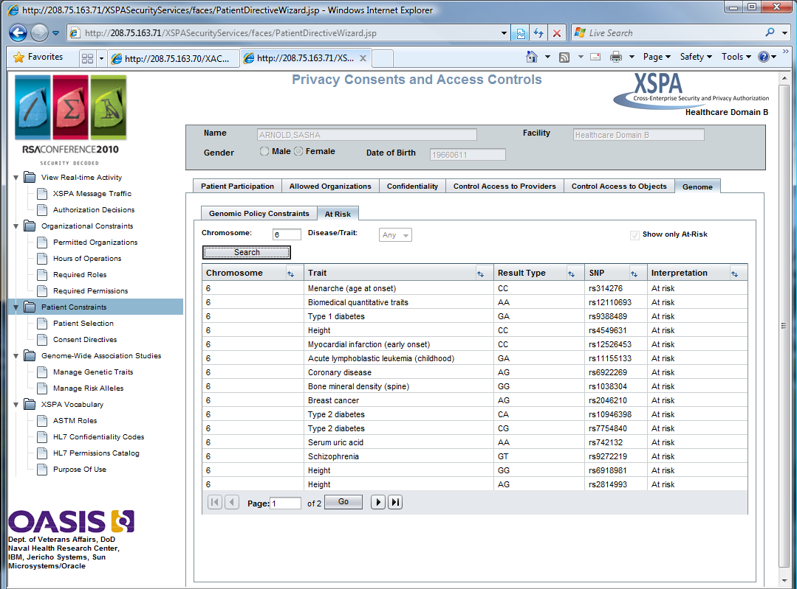
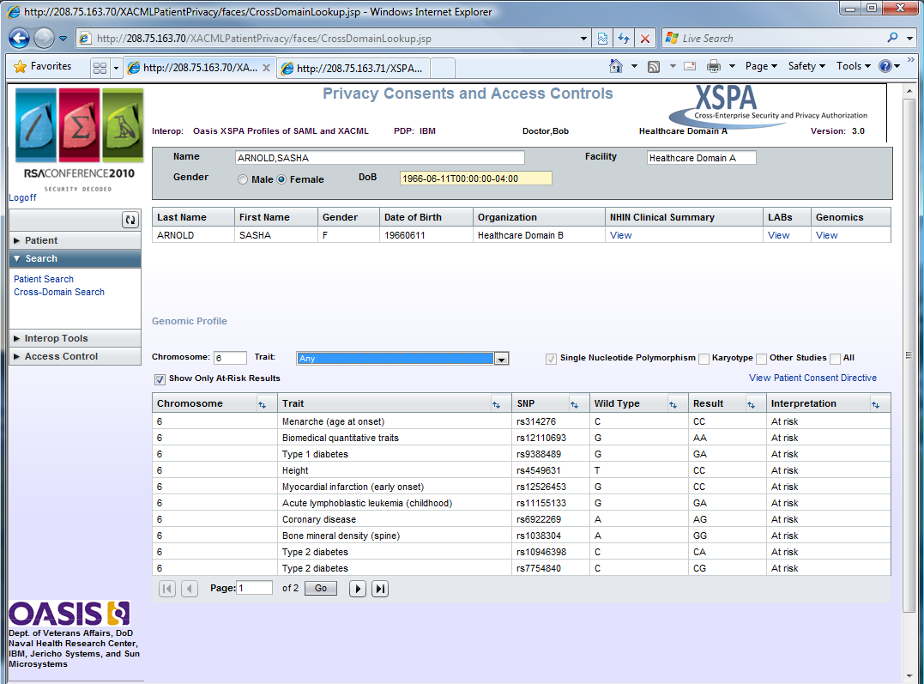
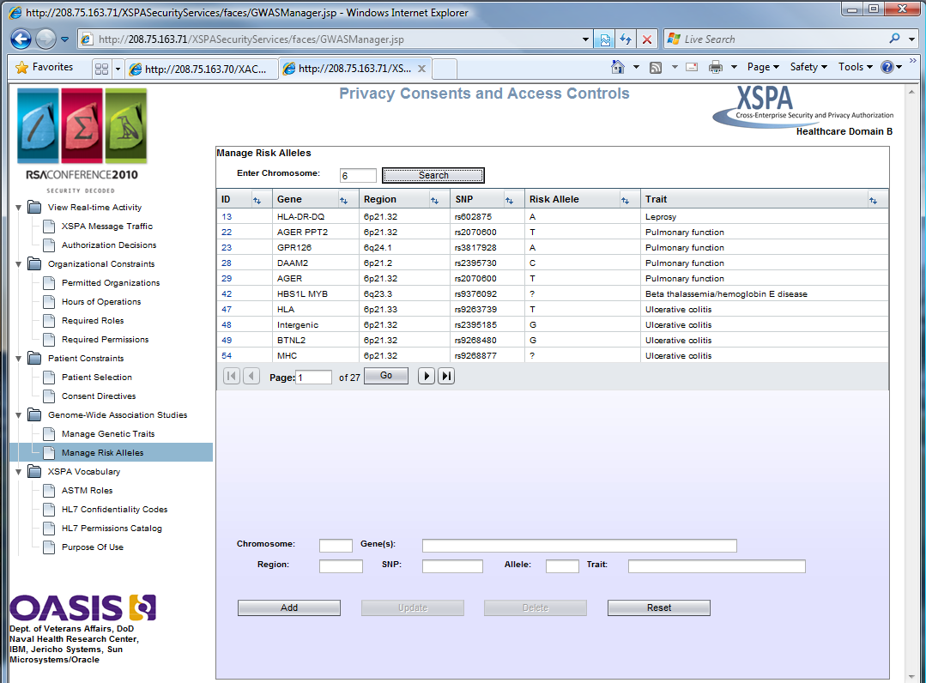
Improving Patient Trust
Protecting the Human Genome - RSA 2010
Patient
XSPA Enabled
Service Provider
Patient Policy Constrains access to specific AT-RISK SNPs based on characteristics and/or disease grouping
Access Control System
PHR Service
Patient has ability to view their Genotype and determine whether to deny access to all or portions of it.
PIP
Policy
PDP
PEP
Provider
Constraints
Request for
Patients genotype
Assertion Consumption
Clinical
Adaptive
Services
Visibility To Patient
Obligation
Response
Continuous
Re-validation of
Patient Policy Intent
Original
Mapping
Patient’s
Genotype
Genome Wide Association Studies Service
GWAS
New diseases and
characteristics
are mapped
Multiple Organizations
Contribute Findings
Identity Management Conference 2010
Washington DC

Slide 35
Improving Patient Trust
Closing video
Identity Management Conference 2010
Washington DC

