Slide 1
Modeling The Cross-organizational User Access Control Decision Space To Facilitate Secure Information Sharing
DHS Science & Technology Directorate
Command, Control and Interoperability Branch
Notes:
OASIS Identity Management 2010
September 28,2010
Tom Smith: Tom.Smith@jhuapl.edu
Maria Vachino: Maria.Vachino@jhuapl.edu

Slide 2
Problem?
 | 2
Notes:
The problem is universal, getting the right information, right person, right time

Slide 3
Problem?
 | 3
Notes:
Complicated by sovereign organizational boundaries - Federation

Slide 4
Problem?
 | 4
Notes:
For Department of Homeland Security these partners include agencies, departments, governments, etc.

Slide 5
What is needed
Share
Information
 | 5
Notes:
The government mantra is breakdown the silos, stove pipes, and information islands

Slide 6
Compliant with IA & Sharing Policy
 | 6
Notes:
Keep resources secure
Control information access
Both internally and with external partners
Maintain compliance with Information Assurance and Information Sharing policies

Slide 7
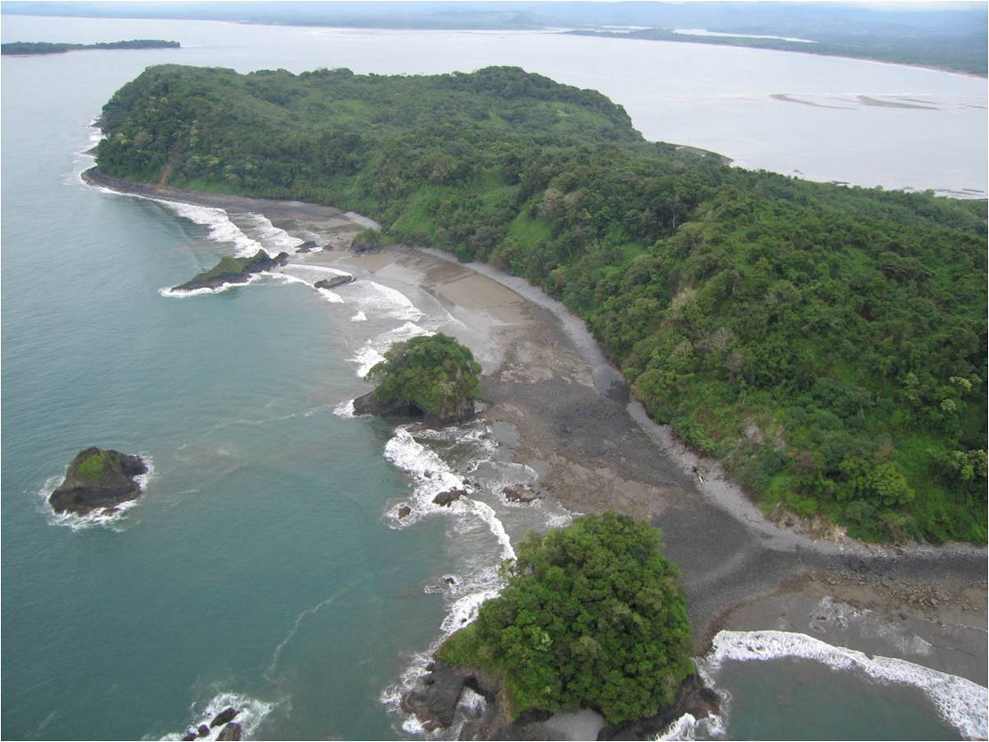
Analysis
 | 7
Notes:
Viewing this problem with a top-down perspective helps minimize the “can’t see the forest for the trees” pitfall.
Objective: access-control based on policy
So policy defines the context of the decision space!
DHS commissioned Hammer & Waterman, 2 lawyers with technical backgrounds, to study and document the policy and control relationship.
The concept model that we’re presenting is based on this work.

Slide 8
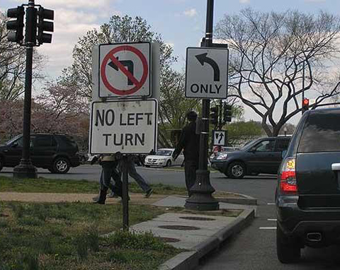
Policy ?
 | 8
Notes:
Policies have their own unique set of problems

Slide 9
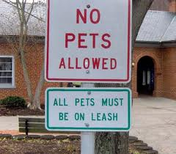
Policy ?
 | 9
Notes:
…and issues

Slide 10
Policy Compliance?
 | 10
Notes:
This effort focuses on the identify and access-control concepts and relationships that are involved in
achieving compliance for Federal Users

Slide 11
Access Control
Ensuring that requested actions on resource are only
granted in compliance with applicable policy
Attribute-Based
Fine-grained Authorization
Dynamic access
Externalized policy
Adaptability
Role-Based
Coarse-grained Authorization
Declarative access by category
Identity-Based
Basic Authorization
Declarative access by subject
Gerry Gebel, M. N. (2009). User Authorization. Burton Group: Identity and Privacy Strategy
 | 11
Notes:
Controlling access in accordance with a policy
3 prevailing models
Adaptability requires infrastructure
Identities focus access control on individuals, specific users and specific resources. They represent declarative access pairings for a specific user as granted by a particular protected resource. A protected resource declares access control by subject.
Roles define logical associations between business activities and the access control needs of protected resources. They represent a set of declarative access control categorizations (typing) that are required by activities for specific business areas. Therefore they support access control decisions for multiple subjects and protected resources to the extent that the semantics of the role are consistent across these business areas.
Attributes define a set of access control features for subjects, resources, actions, and the environment. These attributes are selected so that they can be combined dynamically to support the access control decisions of protected resources.
Each of these approaches requires more IdM infrastructure.
11

Slide 12
Access Control Essentials
Authoritative Sources
Attribute Alignment
Access
Control
Policy
 | 12
Notes:
Policy-based access control
Alignment – syntax and semantics
Sources – attestation for trust
Policy – business concerns
Access control involves authentication (establishing the requestor’s identity) and authorization (granting access to specific resources based on policies).
An access control solution has three essential concerns: attribute alignment, organizational policy , and authoritative sources.
Remove any side of the triangle and an organization’s ability to move to an ABAC environment becomes very difficult.
Organizational Policy (mandatory and discretionary) shapes the authorization needs of particular communities and information policy domains. Immaturity can result in wildly diverging authorization approaches. Often these decisions are made at a local or even application level with no mapping or traceability to the larger organizational direction. Ideally, policy defines a core set of attributes that are the key to making access control decisions within the Enterprise. Some of these attributes may be inferred or calculated from existing primary attributes.
Attribute Alignment of syntax & semantics defines the attribute contracts that need to be satisfied when exchanging information across communities, organizations etc. There may be a variety of different attribute contracts that an Enterprise like DHS requires when participating with partners and vouching for the identity of its constituents. It is not realistic to expect that DHS can mandate the attribute semantics of external entities, as such the ability to meet the external attribute contracts of multiple parties is very important to successful information sharing. At the same time, when external entities wish to access resources under DHS control, they will have to meet the a DHS Attribute Contract as well.
Defining Attributes and their Semantics without backing them to trusted Authoritative Sources is tantamount to picking attributes out of the air! Unless and until a resource can trust that the attributes that are made available to make access control decisions are valid, true and vouched for by the organization that the subject belongs to, its security and organizational policies may not allow it to grant access to the subject.

Slide 13
Why Concept Modeling?
Captures Information Requirements
Problem Specific & Technology-neutral
 | 13
Notes:
It addresses all three access-control essentials
It is information centric
Problem Specific:
The model identifies information concerns (attributes) for development and analysis
Policy and sources scope the decision space.
Technology-neutral:
It is a concept model, not a technology specific logical model. In fact it supports multiple logical models

Slide 14
Why Concept Modeling?
Semantic Alignment
Identifies Business Terms
Establishes Semantic Consensus
 | 14
Notes:
It identifies business terms and established semantic consensus – semantic alignment

Slide 15
Why Concept Modeling?
Framework
Conceptual Foundation
 | 15
Notes:
It is a problem specific information model

Slide 16
Why Concept Modeling?
Agility
Baselines Technology Insertion
 | 16
Notes:
As a concept model it the basis for Logical and Physical models.
This separation of concerns provides agility as the baseline for technology insertion.
It is implementation independent.
So it applies to equally to networks, enterprises, and federations. The information concepts and relationships are universal.

Slide 17
What is a Federal User?
Desired View
 | 17

Slide 18
Current View
What is a Federal User?
Desired View
 | 18

Slide 19
What is a Federal User?
Current View
Desired View
 | 19

Slide 20
ICAM User Concept Model
Citizenship
be
issued
by
be a
subgroup
of
country identifier
group
issue
Identity Credential
be
needed
by
Organization
certify
Skill Certificate
Person
be
identified
by
credential unique identifier
credential secret
credential name
credential issue date
credential expire date
credential status
credential status date
credential LOA
organization unique identifier
relationship to US government
organization names
certificate unique identifier
certificate type
certificate name
certificate issue date
certificate expire date
certificate status
certificate status date
certificate LOA
certification level
person unique identifier
biometrics
names
birthdate
birthplace
grant
be
certified
by
identify
be
needed
by
administer
Skill
skill identifier
skill level
Affiliation
Affiliation
Condition
person unique affiliation identifier
person association with organization
affil cond type
affil cond start date
affil cond end date
affil cond status
affil cond status date
be
be
Position
Entitlement
Position
pos entitle identifier
pos entitle permission
pos entitle start date
pos entitle end date
pos entitle status
pos entitle status date
position type
occupation
need
be managed by
Assignment
Condition
manage
Management
be
Assignment
assign cond type
assign cond start date
assign cond end date
assign cond status
assign cond status date
level
be
role
Assignment Entitlement
assign entitle identifier
assign entitle permission
assign entitle start date
assign entitle end date
assign entitle status
assign entitle status date
composed of
need
be a
member
of
Operational Domain
Activity
Technical Domain
be
granted
by
operational domain identifier
activity identifier
function
technical domain identifier
be administered by
 | 20
Notes:
20
20

Slide 21
ICAM User Concept Model
Citizenship
be
issued
by
be a
subgroup
of
country identifier
group
issue
Identity Credential
be
needed
by
Organization
certify
Skill Certificate
Person
be
identified
by
credential unique identifier
credential secret
credential name
credential issue date
credential expire date
credential status
credential status date
credential LOA
organization unique identifier
relationship to US government
organization names
certificate unique identifier
certificate type
certificate name
certificate issue date
certificate expire date
certificate status
certificate status date
certificate LOA
certification level
person unique identifier
biometrics
names
birthdate
birthplace
grant
be
certified
by
be
needed
by
administer
Skill
identify
skill identifier
skill level
Affiliation
Affiliation
Condition
person unique affiliation identifier
person association with organization
affil cond type
affil cond start date
affil cond end date
affil cond status
affil cond status date
be
be
Position
Entitlement
Position
pos entitle identifier
posl entitle permission
posl entitle start date
posl entitle end date
posl entitle status
posl entitle status date
position type
occupation
need
be managed by
Assignment
Condition
manage
Management
be
Assignment
assign cond type
assign cond start date
assign cond end date
assign cond status
assign cond status date
level
be
role
Assignment Entitlement
assign entitle identifier
assign entitle permission
assign entitle start date
assign entitle end date
assign entitle status
assign entitle status date
composed of
need
be a
member
of
Operational Domain
Activity
Technical Domain
be
granted
by
operational domain identifier
activity identifier
function
technical domain identifier
be administered by
 | 21
Notes:
21
21

Slide 22
ICAM User Concept Model
Citizenship
be
issued
by
be a
subgroup
of
country identifier
group
issue
Identity Credential
be
needed
by
Organization
certify
Skill Certificate
Person
be
identified
by
credential unique identifier
credential secret
credential name
credential issue date
credential expire date
credential status
credential status date
credential LOA
organization unique identifier
relationship to US government
organization names
certificate unique identifier
certificate type
certificate name
certificate issue date
certificate expire date
certificate status
certificate status date
certificate LOA
certification level
person unique identifier
biometrics
names
birthdate
birthplace
grant
be
certified
by
be
needed
by
administer
Skill
identify
skill identifier
skill level
Affiliation
Affiliation
Condition
person unique affiliation identifier
person association with organization
affil cond type
affil cond start date
affil cond end date
affil cond status
affil cond status date
be
be
Position
Entitlement
Position
pos entitle identifier
posl entitle permission
posl entitle start date
posl entitle end date
posl entitle status
posl entitle status date
position type
occupation
need
be managed by
Assignment
Condition
manage
Management
be
Assignment
assign cond type
assign cond start date
assign cond end date
assign cond status
assign cond status date
level
be
role
Assignment Entitlement
assign entitle identifier
assign entitle permission
assign entitle start date
assign entitle end date
assign entitle status
assign entitle status date
composed of
need
be a
member
of
Operational Domain
Activity
Technical Domain
be
granted
by
operational domain identifier
activity identifier
function
technical domain identifier
be administered by
 | 22
Notes:
22
22

Slide 23
ICAM User Concept Model
Citizenship
be
issued
by
be a
subgroup
of
country identifier
group
issue
Identity Credential
be
needed
by
Organization
certify
Skill Certificate
Person
be
identified
by
credential unique identifier
credential secret
credential name
credential issue date
credential expire date
credential status
credential status date
credential LOA
organization unique identifier
relationship to US government
organization names
certificate unique identifier
certificate type
certificate name
certificate issue date
certificate expire date
certificate status
certificate status date
certificate LOA
certification level
person unique identifier
biometrics
names
birthdate
birthplace
grant
be
certified
by
be
needed
by
administer
Skill
identify
skill identifier
skill level
Affiliation
Affiliation
Condition
person unique affiliation identifier
person association with organization
affil cond type
affil cond start date
affil cond end date
affil cond status
affil cond status date
be
be
Position
Entitlement
Position
pos entitle identifier
posl entitle permission
posl entitle start date
posl entitle end date
posl entitle status
posl entitle status date
position type
occupation
need
be managed by
Assignment
Condition
manage
Management
be
Assignment
assign cond type
assign cond start date
assign cond end date
assign cond status
assign cond status date
level
be
role
Assignment Entitlement
assign entitle identifier
assign entitle permission
assign entitle start date
assign entitle end date
assign entitle status
assign entitle status date
composed of
need
be a
member
of
Operational Domain
Activity
Technical Domain
be
granted
by
operational domain identifier
activity identifier
function
technical domain identifier
be administered by
 | 23
Notes:
23
23

Slide 24
ICAM User Concept Model
Citizenship
be
issued
by
be a
subgroup
of
country identifier
group
issue
Identity Credential
be
needed
by
Organization
certify
Skill Certificate
Person
be
identified
by
credential unique identifier
credential secret
credential name
credential issue date
credential expire date
credential status
credential status date
credential LOA
organization unique identifier
relationship to US government
organization names
certificate unique identifier
certificate type
certificate name
certificate issue date
certificate expire date
certificate status
certificate status date
certificate LOA
certification level
person unique identifier
biometrics
names
birthdate
birthplace
grant
be
certified
by
be
needed
by
administer
Skill
identify
skill identifier
skill level
Affiliation
Affiliation
Condition
person unique affiliation identifier
person association with organization
affil cond type
affil cond start date
affil cond end date
affil cond status
affil cond status date
be
be
Position
Entitlement
Position
pos entitle identifier
pos entitle permission
pos entitle start date
pos entitle end date
pos entitle status
pos entitle status date
position type
occupation
need
be managed by
Assignment
Condition
manage
Management
be
Assignment
assign cond type
assign cond start date
assign cond end date
assign cond status
assign cond status date
level
be
role
Assignment Entitlement
assign entitle identifier
assign entitle permission
assign entitle start date
assign entitle end date
assign entitle status
assign entitle status date
composed of
need
be a
member
of
Operational Domain
Activity
Technical Domain
be
granted
by
operational domain identifier
activity identifier
function
technical domain identifier
be administered by
 | 24
Notes:
24
24

Slide 25
ICAM User Concept Model
Citizenship
be
issued
by
be a
subgroup
of
country identifier
group
issue
Identity Credential
be
needed
by
Organization
certify
Skill Certificate
Person
be
identified
by
credential unique identifier
credential secret
credential name
credential issue date
credential expire date
credential status
credential status date
credential LOA
organization unique identifier
relationship to US government
organization names
certificate unique identifier
certificate type
certificate name
certificate issue date
certificate expire date
certificate status
certificate status date
certificate LOA
certification level
person unique identifier
biometrics
names
birthdate
birthplace
grant
be
certified
by
be
needed
by
administer
Skill
identify
skill identifier
skill level
Affiliation
Affiliation
Condition
person unique affiliation identifier
person association with organization
affil cond type
affil cond start date
affil cond end date
affil cond status
affil cond status date
be
be
Position
Entitlement
Position
pos entitle identifier
posl entitle permission
posl entitle start date
posl entitle end date
posl entitle status
posl entitle status date
position type
occupation
need
be managed by
Assignment
Condition
manage
Management
be
Assignment
assign cond type
assign cond start date
assign cond end date
assign cond status
assign cond status date
level
be
role
Assignment Entitlement
be a
member
of
assign entitle identifier
assign entitle permission
assign entitle start date
assign entitle end date
assign entitle status
assign entitle status date
composed of
need
be a
member
of
Operational Domain
Activity
Technical Domain
be
granted
by
operational domain identifier
activity identifier
function
technical domain identifier
be administered by
 | 25
Notes:
25
25

Slide 26
ICAM User Concept Model
Citizenship
be
issued
by
be a
subgroup
of
country identifier
group
issue
Identity Credential
be
needed
by
Organization
certify
Skill Certificate
Person
be
identified
by
credential unique identifier
credential secret
credential name
credential issue date
credential expire date
credential status
credential status date
credential LOA
organization unique identifier
relationship to US government
organization names
certificate unique identifier
certificate type
certificate name
certificate issue date
certificate expire date
certificate status
certificate status date
certificate LOA
certification level
person unique identifier
biometrics
names
birthdate
birthplace
grant
be
certified
by
be
needed
by
administer
Skill
identify
skill identifier
skill level
Affiliation
Affiliation
Condition
person unique affiliation identifier
person association with organization
affil cond type
affil cond start date
affil cond end date
affil cond status
affil cond status date
be
be
Position
Entitlement
Position
pos entitle identifier
pos entitle permission
pos entitle start date
pos entitle end date
pos entitle status
pos entitle status date
position type
occupation
need
be managed by
Assignment
Condition
manage
Management
be
Assignment
assign cond type
assign cond start date
assign cond end date
assign cond status
assign cond status date
level
be
role
Assignment Entitlement
assign entitle identifier
assign entitle permission
assign entitle start date
assign entitle end date
assign entitle status
assign entitle status date
composed of
need
be a
member
of
Operational Domain
Activity
Technical Domain
be
granted
by
operational domain identifier
activity identifier
function
technical domain identifier
be administered by
 | 26
Notes:
26
26

Slide 27
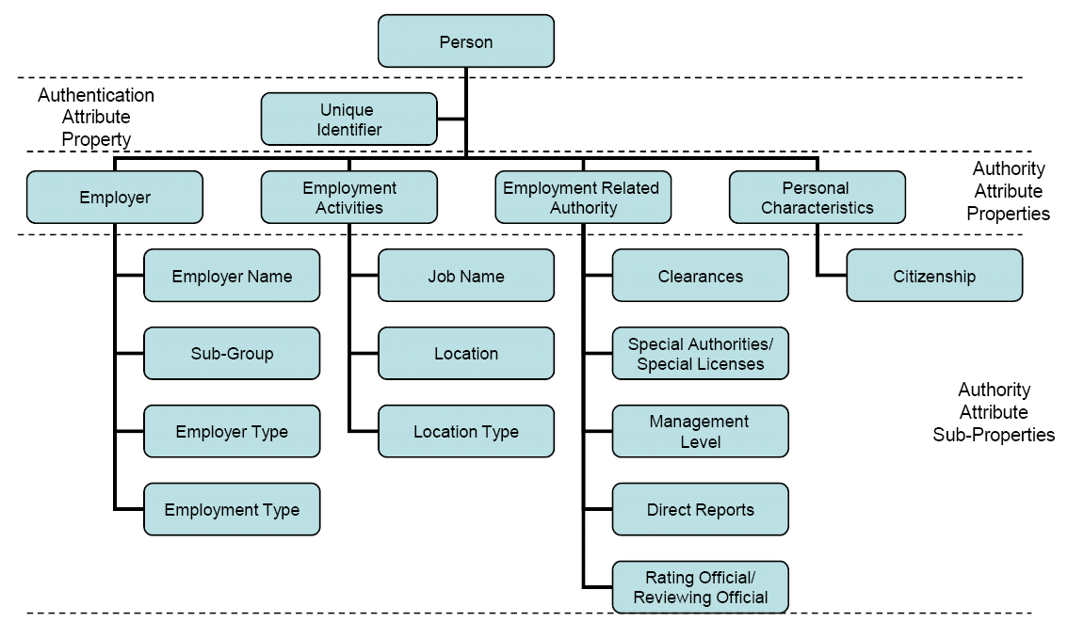
Primary Authority Attributes for Users
* DHS, Defining User Attributes for ABAC, Waterman & Hammer 5/15/07
 | 27
Notes:
27

Slide 28
User Attribute Contract Mappings
Reveal
Contract
Concept utilization and specialization
Policy focus
Unused concepts
Purpose (AuthN, AuthZ, Security, Preference) coverage
Organization and partner
Alignment
Discrepancies
Support
Federation agreements
Semantic consensus
Policy analysis and development
Identify authoritative source requirements
 | 28

Slide 29
Waterman & Hammer Mapping
Sub-group
Citizenship
be
issued
by
country identifier
group
issue
Person
Identity Credential
Employer
certify
Special License
credential unique identifier
credential secret
credential name
credential issue date
credential expire date
credential status
credential status date
credential LOA
be
needed
by
grant
organization unique identifier
Employer Type
Employer Name
certificate unique identifier
certificate type
certificate name
certificate issue date
certificate expire date
certificate status
certificate status date
certificate LOA
certification level
person unique identifier
(Personal
Characteristics)
identify
be
certified
by
be
identified
by
administer
Skill
Skill
Skill level
be
needed
by
Special Work Term
Employee / Other Group Membership
affil cond type
affil cond start date
affil cond end date
affil cond status
affil cond status date
Unique identifier
Employment Type
be
be
Position
Entitlement
Employee
pos entitle identifier
posl entitle permission
posl entitle start date
posl entitle end date
posl entitle status
posl entitle status date
position type
Job Name / Job Designation
be
need
Direct Reports
Assignment
Condition
manage
be
Management
be
Employment Activity
Location Type
assign cond start date
assign cond end date
assign cond status
assign cond status date
Clearance
Management Level
be
Authorized Purpose
Physical Location
be
Active Clearance
Employment Related
Authority
composed
of
be
Special Authority
assign entitle type
assign entitle start date
assign entitle end date
assign entitle status
assign entitle status date
be a
member
of
need
Operational Domain
Activity
Technical Domain
Work Assignment
activity identifier
function
technical domain identifier
be
granted
by
Key
Mapped Primary
Mapped Secondary
Specialized
Added
be administered by
DRAFT | 29
Notes:
29
29

Slide 30
Waterman & Hammer Values
Sub-group
Drive hazardous materials truck, prescribe narcotics
Citizenship
be
issued
by
country identifier
group
issue
Person
Identity Credential
Employer
certify
Special License
credential unique identifier
credential secret
credential name
credential issue date
credential expire date
credential status
credential status date
credential LOA
be
needed
by
grant
organization unique identifier
Employer Type
Employer Name
certificate unique identifier
certificate type
certificate name
certificate issue date
certificate expire date
certificate status
certificate status date
certificate LOA
certification level
person unique identifier
(Personal
Characteristics)
identify
State Government
Local Government
Private industry
Foreign Government
be
certified
by
be
identified
by
administer
Skill
Skill
Skill level
be
needed
by
be
utilized
by
Veteran, Volunteer,
Advisory Board Member
Probation,
Disciplined,
Weekend Shift
Special Work Term
Employee / Other Group Membership
affil cond type
affil cond start date
affil cond end date
affil cond status
affil cond status date
Unique identifier
Employee,
Contractor,
Detail
Employment Type
be
OPM Occupational Series
be
Position
Entitlement
Employee
pos entitle identifier
posl entitle permission
posl entitle start date
posl entitle end date
posl entitle status
posl entitle status date
position type
Job Name / Job Designation
be
need
Direct Reports
Assignment
Condition
Permanent, Temporary, Virtual
Supervisor,
Program Lead,
Senior Executive
Team Leader,
Military Rank
manage
be
Management
be
Employment Activity
Location Type
assign cond start date
assign cond end date
assign cond status
assign cond status date
Clearance
Management Level
be
Authorized Purpose
Physical Location
be
Active Clearance
Rater/Reviewer,
Sworn Law Enforcement Officer
Employment Related
Authority
composed
of
Perform arrests, conduct criminal investigations, system admin
be
Special Authority
assign entitle type
assign entitle start date
assign entitle end date
assign entitle status
assign entitle status date
be a
member
of
need
Al Queda,
Mexican Border,
Enron Investigation,
etc.
Operational Domain
Activity
Technical Domain
Work Assignment
activity identifier
function
technical domain identifier
be
granted
by
Key
Mapped Primary
Mapped Secondary
Specialized
Added
be administered by
DRAFT | 30
Notes:
30
30
DHS, Defining User Attributes for ABAC, Waterman & Hammer 5/15/07

Slide 31
Federal ICAM BAE Mapping
PIV Card
chuid
cardIssueDate
cardExpirationDate
cardStatus
cardStatusDate
chuidStatus
chuidStatusDate
issuedID (FASC-N CN)
IssuingSystemCode (FASC-N SC)
issuedSeries (FASC-N CS)
issuedCredentialCode (FASC-N ICI‏
cardAuthenticationCertificate
keyManagementCertificate
digitalSignatureCertificate
be a subgroup of
Citizenship
be
issued
by
issuingAgencyCode
(FASC-N AC)
personCitizenshipFIPS10-4Code
be
group
usCitizen
be
Organization
certifying
authority
Skill Certificate
Person
Identity Credential
organizationIdentifier (F-OI)
organizationCategory (F-OC) organization name
certificate unique identifier
certificationType
certificationName
certificationDate certificate expire date
certificate status
certificate status date
certificate LOA
certification level
person unique identifier
photo
fingerprintImage
personGivenName
personMiddleName
personSurname
personNameSuffixText
personSexCode
birthdate
birthplace
identify
credential unique identifier
credential secret
credential name
credential issue date
credential expire date
credential status
credential status date
credential LOA
be
needed
by
clearingAgency
be
certified
by
be
identified
by
administer
Skill
be
needed
by
skill identifier
skill level
Contact Preference
telephoneNumber
Affiliation
Condition
Affiliation
affil cond type
affil cond start date
affil cond end date
affil cond status
affil cond status date
employeeNumber (FASC-N PI)
personOrganizationAssociationCategory (FASC-N POA)
Emergency Contact Preference
be
emergencyContactPersonGivenName
emergencyContactPersonSurname
emergencyContactPersonTelephoneNumber
emergencyContactPersonEmail
emergencyContactPersonPreferenceIndicator
Position
Entitlement
be
Position
pos entitle identifier
posl entitle permission
posl entitle start date
posl entitle end date
posl entitle status
posl entitle status date
employeeRankText
occupation
need
be managed by
Assignment
Condition
manage
Management
be
Assignment
assign cond type
assign cond start date
assign cond end date
assign cond status
assign cond status date
level
be
designatedRole
Assignment Entitlement
assign entitle identifier
assign entitle permission
assign entitle start date
assign entitle end date
assign entitle status
assign entitle status date
be a
member
of
composed
of
need
Operational Domain
Activity
Technical Domain
be
nippSectorCode
esfCode
technical domain identifier
Key
Mapped
Specialized
Preference
be
be administered by
Clearance
personSecurityClearance
clearanceDate
DRAFT | 31
Notes:
31
31

Slide 32
Federal ICAM BAE Values
PIV Card
ACT - Active,
SUS - Suspended
TER - Terminated
chuid
cardIssueDate
cardExpirationDate
cardStatus
cardStatusDate
chuidStatus
chuidStatusDate
issuedID (FASC-N CN)
IssuingSystemCode (FASC-N SC)
issuedSeries (FASC-N CS)
issuedCredentialCode (FASC-N ICI‏
cardAuthenticationCertificate
keyManagementCertificate
digitalSignatureCertificate
PRO-Provisional
PER-Permanent
OC=1 – SP800-87 Code
OC=2 – State Code
OC=3 – Company Code
OC=4 – Country Code
be a subgroup of
Citizenship
be
issued
by
issuingAgencyCode
(FASC-N AC)
personCitizenshipFIPS10-4Code
be
group
usCitizen
be
SP800-87 Code
(if FASC-N OC = 1)‏
Organization
certifying
authority
Skill Certificate
Person
Identity Credential
organizationIdentifier (F-OI)
organizationCategory (F-OC) organization name
certificate unique identifier
certificationType
certificationName
certificationDate certificate expire date
certificate status
certificate status date
certificate LOA
certification level
person unique identifier
photo
fingerprintImage
personGivenName
personMiddleName
personSurname
personNameSuffixText
personSexCode
birthdate
birthplace
identify
credential unique identifier
credential secret
credential name
credential issue date
credential expire date
credential status
credential status date
credential LOA
be
needed
by
clearingAgency
be
certified
by
be
identified
by
administer
Skill
be
needed
by
1 - Federal Government Agency
2 - State Government Agency
3 - Commercial Enterprise
4 - Foreign Government
skill identifier
skill level
Contact Preference
telephoneNumber
Affiliation
Condition
Affiliation
affil cond type
affil cond start date
affil cond end date
affil cond status
affil cond status date
employeeNumber (FASC-N PI)
personOrganizationAssociationCategory (FASC-N POA)
Emergency Contact Preference
be
emergencyContactPersonGivenName
emergencyContactPersonSurname
emergencyContactPersonTelephoneNumber
emergencyContactPersonEmail
emergencyContactPersonPreferenceIndicator
1 – Employee
2 – Civil
3 – Executive Staff
4 – Uniformed Service
5 – Contractor
6 – Organizational Affiliate
7 – Organizational Beneficiary
Position
Entitlement
be
Position
pos entitle identifier
posl entitle permission
posl entitle start date
posl entitle end date
posl entitle status
posl entitle status date
1 Transportation
2 Communications
3 Public Works & Engineering
4 Firefighting
5 Emergency Management
6 Mass Care, Emergency Housing & Human Services
7 Logistics Management and Resource Support
8 Public Health & Medical Services
9 Search & Rescue
10 Oil & Hazardous Materials Response
11 Agriculture & Natural Resources
12 Energy
13 Public Safety & Security
14 Long-Term Community Recovery
15 External Affairs
1 Agriculture & Food
2 Banking & Finance
3 Chemical
4 Commercial Facilities
5 Dams
6 Defense Industrial Base
7 Emergency Services
8 Energy
9 Government Facilities
10 Information Technology
11 National Monuments & Icons
12 Commercial Nuclear Reactors, Materials & Waste
13 Postal & Shipping
14 Public Health & Healthcare
15 Telecommunications
16 Transportation Systems
17 Drinking Water & Water Treatment Systems
18 Critical Manufacturing
employeeRankText
occupation
need
be managed by
Assignment
Condition
manage
Management
be
Assignment
assign cond type
assign cond start date
assign cond end date
assign cond status
assign cond status date
level
be
designatedRole
Assignment Entitlement
assign entitle identifier
assign entitle permission
assign entitle start date
assign entitle end date
assign entitle status
assign entitle status date
be a
member
of
composed
of
need
Operational Domain
Activity
Technical Domain
be
nippSectorCode
esfCode
technical domain identifier
Key
Mapped
Specialized
Preference
be
be administered by
Clearance
personSecurityClearance
clearanceDate
DRAFT | 32
Notes:
32
32
Federal ICAM BAE (Identity Credenial & Access Management Backend Attribute Exchange): see http://www.idmanagement.gov/
Notes:
1. “Employees” includes Contractors
2. Preference attributes are not useful for access control decisions

Slide 33
DHS HSIN Mapping
Citizenship
HISN Credential
departmentName
country identifier
be
issued
by
uid/login name
userPassword
uniquePin
loginSecurityQues
answerSecurityQues
twoFactorModule
investigativeSource
group
sponsorOrg
Identity Credential
Organization
certify
Skill Certificate
Person
credential unique identifier
credential secret
credential name
credential issue date
credential expire date
credential status
credential status date
credential LOA
be
organization unique identifier
relationship to US government
name
certificate unique identifier
certificate type
certificate name
certificate issue date
certificate expire date
certificate status
certificate status date
certificate LOA
certification level
person unique identifier
Biometrics
personalTitle
givenName
middleName
sn
cn
nameSuffix
birthDate, birthplace
gender
identify
be
grant
be
certified
by
be
identified
by
be
needed
by
administer
Skill
skill identifier
skill level
agencyOrOrganizationName
be
needed
by
Contact Information
telephoneNumber
phoneExtension
street1
Street2
Street3
email
localityName
StateOrProvinceName
postalCode
co
userUrl
preferedTimeZone
Affiliation
Condition
Affiliation
affil cond type
affil cond start date
affil cond end date
affil cond status
affil cond status date
person unique affiliation identifier
person association with organization
be
be
Position
Entitlement
Position
pos entitle identifier
posl entitle permission
posl entitle start date
posl entitle end date
posl entitle status
posl entitle status date
job title
occupation
need
manage
be managed by
Assignment
Condition
Supervisor /
Sponsor
be
Assignment
applicantOrgRoleFitCoi
assign cond start date
assign cond end date
assign cond status
assign cond status date
level
be
jobRole
Assignment Entitlement
assign entitle identifier
HSIN Access
assign entitle start date
assign entitle end date
userActiveStatus
assign entitle status date
need
coiUserGroupRef
accessReason
be
apps
coiMmemberOf
be
referenced app
Operational Domain
hsinCoiGroup
Technical Domain
be
granted
by
Key
Mapped
Specialized
Preference
operational domain identifier
gid
function
technical domain identifier
be administered by
DRAFT | 33
Notes:
33
33
Note:
Preference attributes are not useful for access control decisions

Slide 34
DOD DMDC EAS Mapping
DRAFT
Citizenship
CAC/PIV
Duty Organization Sub-Code
Country Of Citizenship
be
issued
by
card authentication
certificate
card barcode id
credentialTypeCode
fingerprintimage
FASC-N
group
issuingAgencyCode
(FASC-N AC)
US Citizenship
Status
Indicator Code
Organization
Skill Certificate
Person
Identity Credential
be
OMP Standard Code relationship to US government
name
certify
certificate unique identifier
certificate type
certificate name
certificate issue date
certificate expire date
certificate status
certificate status date
certificate LOA
certification level
person unique identifier
Biometrics
SSN (PN_ID)
Person Last Name
Person First Name
Person Birth Date
birthplace
credential unique identifier
credential secret
credential name
credential issue date
credential expire date
credential status
credential status date
credential LOA
be
grant
identify
be
needed
by
be
certified
by
be
identified
by
be
needed
by
Skill
Administrative Organization Code
skill identifier
skill level
Duty Organization Code
Affiliation
Condition
Affiliation
Guard\Reserve
Status Code
affil cond start date
affil cond end date
affil cond status
affil cond status date
DOD EDI PI / Enterprise User Name
Enterprise Display Name
Persona Type Code / Personnel Category Code
be
be
Position
Entitlement
Position
pos entitle identifier
posl entitle permission
Clearance Eligibility
posl entitle end date
posl entitle status
posl entitle status date
Rank
Pay Plan, Pay Grade
Primary Occupational Code
need
be managed by
Assignment
Condition
manage
Management
be
Assignment
assign cond type
assign cond start date
assign cond end date
assign cond status
assign cond status date
level
be
Duty Occupational Code
Assignment Entitlement
assign entitle identifier
Assigned Clearance For Access
assign entitle start date
assign entitle end date
assign entitle status
assign entitle status date
be a
member
of
composed
of
need
Operational Domain
Activity
Technical Domain
be
granted
by
operational domain identifier
activity identifier
function
technical domain identifier
Key
Mapped
Specialized
be administered by
DRAFT | 34
Notes:
34
34
Based ON: DOD Enterprise Attributes Services Concept of Operations (CONOP) 03/29/2010
Defense Manpower Data Center (DMDC)
Real-Time Broker Service (RBS) – DEERS data attribute service

Slide 35
DHS F/ERO Mapping
DRAFT
be a subgroup of
Citizenship
be
issued
by
country identifier
group
issuer_id
Person
Id_Credential
Organization
certify
Skill Certificate
serial number
credential secret
credential name
(DN,FASCN card id)
create_time
expiration
status
credential status date
credential LOA
grant
organization unique identifier
relationship to US government
organization names
certificate unique identifier
certificate type
certificate name
certificate issue date
certificate expire date
certificate status
certificate status date
certificate LOA
certification level
person unique identifier
Fingerprint
Full name
birthdate
birthplace
identify
be
needed
by
be
certified
by
be
identified
by
administer
Skill
be
needed
by
skill identifier
skill level
Affiliation
Condition
Affiliation
affil cond type
affil cond start date
affil cond end date
affil cond status
affil cond status date
name (FASC-N person id)
person association with organization
be
be
Position
Entitlement
Position
pos entitle identifier
posl entitle permission
posl entitle start date
posl entitle end date
posl entitle status
posl entitle status date
position type
occupation
need
be managed by
Assignment
Condition
manage
Management
be
Assignment
assign cond type
assign cond start date
assign cond end date
assign cond status
assign cond status date
level
be
role
Assignment Entitlement
assign entitle identifier
assign entitle permission
assign entitle start date
assign entitle end date
assign entitle status
assign entitle status date
be a
member
of
composed
of
need
Operational Domain
Activity
Technical Domain
be
granted
by
nippSectorCode
esfCode
technical domain identifier
Key
Mapped
Specialized
be administered by
DRAFT | 35
Notes:
35
35
(This is based on very limited information regarding the schema of the F/ERO repository.
F/ERO = Federal Emergency Response Official

Slide 36
GFIPM V2 Concept Model
Driver’s License
represent
Driver’s license Number
Citizenship
State Government – driver license
U.S. Government – passport
NCIC
Military Branch
be
NCIC Certification
country identifier
Person
be
represented
by
be
issued
by
be a
subgroup
of
group
issue
be
be
be
person unique identifier
Photo, Signature,
Fingerprint Set
Name Prefix
Given Name
Middle Name
Sur Name
Name Suffix
Full Name
Common Name
Display Name
Birth date
Sex, Race,
Height, Weight,
Eye Color, Hair Color,
Electronic Identity
be
needed
by
Employer / Assignment /
Identity Provider*
certify
Skill Certificate
be
identified
by
credential unique identifier
Effective Date
Expiration Date
Status Code
Proofing Date
Authentication LOA;
Proofing LOA,
Category
PKI Certificate
ORI; Id
General Category Code
Name; Sub Unit Name
certificate unique identifier
certificate type
certificate name
certificate issue date
certificate expire date
certificate status
certificate status date
certificate LOA
certification level
Language
be
needed
by
grant
be
certified
by
skill identifier
primary
Contact Information
identify
Point of Contact
TelephoneNumber
FAX Number
Post Office Box
Street Address
City Name
State Code
County Code
Country Code
Postal Code
Time Zone
Email address
be
represented
by
Street Address, PO Box
City Name, Postal Code,
County, State, Country
URI
Full Name,
Email, Telephone Number
GFIPM:IDP:JNET:USER - federation
Social Security Administration
Employer – local
Hire / Start
Affiliation
affil cond type
Start Date
End Date
Status
affil cond status date
represent
Federation Id¹; Local Id²; Social Security Number³; Visa Number; Passport Id, Employee Id;
Military Status Code; Employment Category Code
be
Citizen Entry
Passport Id
Country Code
Emergency Contact Information
be
Position
Entitlement
be
Non-citizen
Entry
TelephoneNumber
Email
Full Name
pos entitle identifier
posl entitle permission
posl entitle start date
posl entitle end date
posl entitle status
posl entitle status date
be
be
Visa Number
Visa Category
be
need
Employee / Assignment *
be
Position Name;
Rank
Occupation Code; Affiliation Category Code;
Occupation Category Code
be
Federation
Resources
be managed by
Assignment
Condition
be
Federation Id
federation logon
manage
Local
Resources
Key
Mapped
Specialized
Preference
Supervisor*
be
Assignment
assign cond type
assign cond start date
assign cond end date
assign cond status
assign cond status date
be
Management Level
be
role
Assignment Entitlement
Local Id
Network logon
composed of
assign entitle identifier
assign entitle permission
assign entitle start date
assign entitle end date
assign entitle status
assign entitle status date
be a
member
of
need
be
Clearance
Organization Category Code
Operational Domain
Activity
Technical Domain
be
be
Level
Effective Date
Expiration Date
Sanction
NIPP Sector Code
activity identifier
Emergency Support Function
Organization Category Code
technical domain identifier
be
be administered by
Security Clearance
Granting Agency
Legal Jurisdiction
Employment Jurisdiction
DRAFT | 36
Notes:
36
36

Slide 37
Federal ICAM BAE & DOD DMDC Mapping Overlay
CAC/PIV Card
chuid
cardIssueDate/cardExpirationDate
cardStatus/cardStatusDate
chuidStatus/chuidStatusDate
issuedID (FASC-N CN)
IssuingSystemCode (FASC-N SC)
issuedSeries (FASC-N CS)
issuedCredentialCode (FASC-N ICI‏
cardAuthenticationCertificate
keyManagementCertificate
digitalSignatureCertificate
Duty Organization Sub-Code
Citizenship
card barcode id
credentialTypeCode
personCitizenshipFIPS10-4Code
be
issued
by
be
group
issuingAgencyCode
(FASC-N AC)
usCitizen
be
Organization
certifying
authority
Skill Certificate
Person
Identity Credential
organizationIdentifier (F-OI)
organizationCategory (F-OC) organization name
certificate unique identifier
certificationType
certificationName
certificationDate certificate expire date
certificate status
certificate status date
certificate LOA
certification level
photo
fingerprintImage
personGivenName
personMiddleName
personSurname
personNameSuffixText
personSexCode
SSN (PN_ID)
Person Birth Date birthplace
identify
credential unique identifier
credential secret
credential name
credential issue date
credential expire date
credential status
credential status date
credential LOA
be
needed
by
clearingAgency
be
certified
by
be
identified
by
Skill
be
needed
by
Administrative Organization Code
skill identifier
skill level
Duty Organization Code
Affiliation
Condition
Affiliation
Guard\Reserve
Status Code
employeeNumber (FASC-N PI)
Enterprise Display Name
personOrganizationAssociationCategory (FASC-N POA)
affil cond start date
affil cond end date
affil cond status
affil cond status date
Persona Type Code / Personnel Category Code
be
be
Affiliation
Entitlement
Position
affil entitle identifier
Clearance Eligibility entitle start date
affil entitle end date
affil entitle status
affil entitle status date
Primary Occupational Code
employeeRankText
Pay Plan, Pay Grade
occupation
need
be managed by
Assignment
Condition
manage
Management
be
Assignment
assign cond type
assign cond start date
assign cond end date
assign cond status
assign cond status date
level
be
designatedRole
Assignment Entitlement
assign entitle identifier
assign entitle permission
assign entitle start date
assign entitle end date
assign entitle status
assign entitle status date
be a
member
of
composed
of
need
Operational Domain
Activity
Technical Domain
be
nippSectorCode
esfCode
technical domain identifier
Key
Common
DoD DMDC
Federal ICAM BAE
be
be administered by
Clearance
personSecurityClearance
clearanceDate
DRAFT | 37
Notes:
37
37

Slide 38
Contact Information
Karyn Higa-Smith (DHS S&T)
Program Manager, Identity Management
Karyn.Higa-Smith@dhs.gov
Thomas Smith (JHU/APL)
Senior Engineer, DHS S&T IdM Testbed
Thomas.Smith@jhuapl.edu
Maria Vachino (JHU/APL)
Senior Engineer, DHS S&T IdM Testbed
Maria.Vachino@jhuapl.edu
 | 38

Slide 39
Backup Slides

Slide 40
Additional Information
IEEE HST 2010 Conference Proceedings:
Modeling the Federal User Identity, Credential, and
Access Management (ICAM) Decision Space to
Facilitate Secure Information Sharing
 | 40

Slide 41
Why A Conceptual Data Model?
Captures Information Requirements
Problem specific
Technology-neutral
Information representation, not process or policy
Identifies business terms
Establishes contextual consensus
Expresses data semantics
Artifacts
Entities
Attributes
Relationships
Identifiers
Problem Terms
Mind Your Business: Serving Business with Data Models that Focus Exclusively on Data, J. Maguire, 11-26-2008, Burton Group
 | 41

Slide 42
Concept Data Model Uses
Knowledge management
Framework for technology insertion – logical/physical modeling
Establishes conceptual foundation
Baselines technological insertion
Aligns organizational information perception
Identifies important & distinguishing information
Establishes artifacts – entities, attributes, relationships, identifiers, problem terms
Improve productivity and agility
Semantic consensus
Identifies schema translation requirements
Starting point for information sharing agreements
Authoritative sources
Identifies policy information requirements
Policy creation & refinement
Identifies information valued by the enterprise
Identifies policy overlaps and gaps
 | 42

