Slide 1
Methodology for Evaluating Multi-Biometric Systems
Abel Sussman
August 26, 2010
.
Notes:
Booz Allen Hamilton Standard Colors
Colors should be used in the color pairs whenever possible. Do not mix and match colors, use pairs together as shown.
Black, White and Gray can be used with any of the other colors.
Purple
Pantone 2765
R 12
G 4
B 79
Green
Pantone
357
R 15
G 67
B 24
Blue
Pantone 2
88
R 11
G 31
B 101
Black
Pantone Cool Gray 6
R 158
G 158
B 158
Red
Pantone
485
R 252
G 5
B 14
Yellow
Pantone 3965
R 232
G 244
B 4
Aqua
Pantone
319
R 126
G 204
B 189
White

Slide 2
Key Takeaways
Need for increased level of granularity for multi-biometric systems
Additional characteristics can be used to evaluate multi-biometric systems
Evaluation methodology for reviewing requirements against multi-biometric characteristics
Various types of data can be extracted from using methodology

Slide 3
Multi-Biometric Systems
Multi-biometric systems can incorporate information from multiple modalities, instances, sensors, samples, or any combination of the five
Systems may also include other sources of information including biographic, travel document-based, etc.
The trend toward multi-biometric systems has been particularly prevalent in large-scale U.S. government systems. DoD ABIS, DHS IDENT, and FBI Next Generation IAFIS are all examples of systems which are currently multi-biometric in nature

Slide 4
Traditional Biometric Characteristics
Characteristic | Description
Universality | Every individual accessing the application should possess the trait.
Uniqueness | The given trait should be sufficiently different across individuals comprising the population.
Permanence | The biometric trait of an individual should be sufficiently invariant over a period of time with respect to the matching algorithm. A trait that changes significantly over time is not a useful biometric.
Measurability | It should be possible to acquire and digitize the biometric trait using suitable devices that do not cause undue inconvenience to the individual. Furthermore, the acquired data should be amenable to processing in order to extract representative feature sets.
Performance | The recognition accuracy and the resources required to achieve that accuracy should meet the constraints imposed by the application.
Acceptability | Individuals in the target population that will use the application should be willing to present their biometric trait to the system.
Circumvention | This refers to the ease with which the trait of an individual can be imitated using artifacts (e.g. fake fingers), in the case of physical traits, and mimicry, in the case of behavioral traits.
It is possible to understand if a human characteristic can be used for biometrics in terms of the following parameters*
* Jain, A. K.; Ross, Arun; Prabhakar, Salil (January 2004). "An introduction to biometric recognition". IEEE Transactions on Circuits and Systems for Video Technology

Slide 5
Need For Additional Criteria
Evaluating the requirements of large scale federal multi-biometric systems necessitate an increased level of granularity beyond the traditional seven characteristics
Several program growth and maturity factors have necessitated the use of additional criteria such as:
  the evolution from single to multiple modalities
  increasing population and access scale
  interaction and information sharing among agencies
  driving towards increased accuracy and performance speed
  the intention to reduce cost per match

Slide 6
A New Method to Evaluate Multi-Biometric Systems
Multi-biometric System Characteristics documents several elements central to the success of a multi-biometric system are not effectively accessed by traditional rubrics
Aspects of multi-biometric must be broken out as a part of a holistic evaluation of a multi-biometric system
Displays characteristics which are tailored to the evaluation of a multi-biometric system as opposed to traditional software systems
Provides insight into distinct aspects which are measured in different ways
  For instance, considering the characteristic of performance, the definition calls out the difference between “accuracy” and “resource constraints.” While accuracy can easily be measured through rates such as FAR, FRR, FNMR, FMR, etc., these rates do not account for processing time, or financial costs of supporting hardware / software
Some of the new characteristics overlap with the traditional model

Slide 7
Multi-Biometric System Characteristics
Characteristic | Description
Acceptability | The degree in which the subject population in question agrees to use the biometric technology
Accuracy | The accuracy of the multi-biometric system as measured by FAR, FRR, FNMR, FMR, etc.
Availability | The availability of the multi-biometric information in the intended operational environment
Circumvention | The ease in which an individual can spoof, masquerade, or mask identity causing incorrect identity decisions
Convenience | The ease of use or user friendliness of the multi-biometric system
Cost | The financial cost of the multi-biometric system
Efficiency | The speed of any or all blocks of the multi-biometric system (acquisition, feature extraction, matching, searching, end-to-end processing)
Interoperability | The degree in which multi-biometric data conforms to standards and can be utilized by other systems
Legality | The degree in which the multi-biometric system sets or abides by legal precedence
Measurability | The ability to acquire and digitize the multi-biometric traits (assuming mobility)
Mobility | The degree in which the multi-biometric system (particularly acquisition, transmission, and matching) can be transported, moved, stored, etc.
Permanence | The invariance over time of the collective multi-biometric traits in question
Privacy | The degree in which the biometric system lawfully infringes on personal privacy
Scalability | The ease in which the system can handle and or adapt to growing work volume (i.e. subject population, matching throughput, etc.)
Uniqueness | The difference of the collective multi-biometric features across individuals of the population in question
Universality | The possession of suitable samples of the collective multi-biometric trait across the population in question
* Based on the whitepaper “Holistic Evaluation of Multi-Biometric Systems” by Nick Bartlow, Don Waymire, Gregory Zektser

Slide 8
Evaluation of Multi-biometric Systems
Many of the traditional characteristics have associated mechanisms for quantification
  performance and measurability
Some characteristics entail distinct aspects which are measured in different ways
  “accuracy” and “resource constraints”
Other characteristics do not have highly widely accepted measures but a new bed of research may lead to such metrics
  for instance, various forms of capacity analysis research shed light into the uniqueness of biometric input based on feature sets and or template structure
There are characteristics that cannot be easily quantified s
  convenience, legality, and privacy

Slide 9
Requirement Evaluation Against Biometric System Characteristics
Requirements can be evaluated against each biometric system characteristic
Each evaluation is coded as follows:
  E - Explicit; requirements directly applies to attribute
  I - Implicit; requirement indirectly applies to attribute
  M - Missing; requirement should address this attribute but does not
  NA - Not Applicable; requirement does not apply to attribute
E
I
M
NA

Slide 10
Multi-Biometric Characteristic and System Requirements Rubric
Rubric is create by plotting system requirements against the multi-biometric characteristics
Requirement types are used to categorize the requirements and multi-biometric characteristic relationship
Requirement |  | Multi-Biometric Characteristic
No. | High Level Requirement | Acceptability | Accuracy | Availability | Circumvention | Convenience | Cost | Efficiency | Interoperability | Legality | Measurability | Mobility | Permanence | Privacy | Scalability | Uniqueness | Universality
R-1 | Requirement 1 | E | E | I | I | M | M | NA | NA | NA | NA | NA | NA | NA | NA | NA | NA
R-2 | Requirement 2 | NA | NA | E | E | I | I | M | M | M | M | NA | NA | NA | NA | NA | NA
R-3 | Requirement 3 | NA | NA | NA | NA | E | E | I | I | M | M | NA | NA | NA | NA | NA | NA
R-4 | Requirement 4 | NA | NA | NA | NA | NA | NA | E | E | I | I | M | M | NA | NA | NA | NA
R-5 | Requirement 5 | NA | E | NA | E | NA | NA | I | I | I | I | I | I | E | E | E | E
R-6 | Requirement 6 | E | E | E | E | E | E | I | I | E | I | E | NA | NA | NA | NA | NA

Slide 11
Distribution between Explicit, Implicit, and Missing
Graph shows how the requirements are allocated between Explicit, Implicit and Missing Requirements.
A high number of implicit requirements means that the program may not be aware of the effects of implementing their requirements
A high number of missing requirements represent an opportunity to further develop the requirements

Slide 12
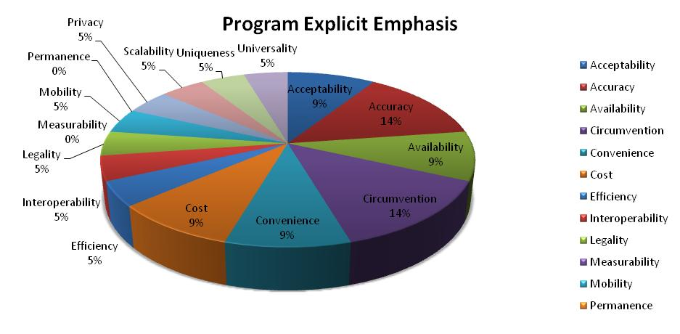
Program Emphasis
If we assume that the characteristics with the most requirements aligned to it are the most important to the programs then this aggregate view provides insight to program priorities
In this example the most important multi-biometric system characteristics are Accuracy and Circumvention, with secondary importance to Acceptability, Availability, Convenience, and Cost

Slide 13
Plotting Missing and Implicit Requirements
Graphs define areas where requirements can be enhanced
It is acceptable for the program to have multi-biometric characteristics remain implicit however the program should conduct further review to ascertain if the implicit requirement captured should be address as a main requirement

Slide 14
Further Research
Multi-biometric System Characteristics can be expanded by correlating a full set of metrics criteria used to judge the operations of the program
  For example, the Accuracy biometric characteristic can be expressed in terms of False Accept Rate and False Reject Rate
  Other areas such as Convenience are more amorphous
A standard set of measurable metrics can be developed to measure all characteristics used in evaluation.
Completion of this set of measurable metrics can then be used to create an objective scorecard that provides a mechanism for baselining and continuously improving programs.

Slide 15
Evaluation Metrics for Multi-Biometric Characteristics
Characteristics for Evaluating a Multi-biometric System
Characteristic | Description | Possible Metrics
Acceptability | The degree in which the subject population in question agrees to use the biometric technology | TBD
Accuracy | The accuracy of the multi-biometric system as measured by FAR, FRR, FNMR, FMR, etc. | FAR, FRR, GAR, FNMR, FMR, FNIR, FPIR, EER, etc.
Availability | The availability of the multi-biometric information in the intended operational environment | Up-time, MTBF, MTTF, etc.
Circumvention | The ease in which an individual can spoof, masquerade, or mask identity causing incorrect identity decisions | Zero / non-zero effort error rates
Convenience | The ease of use or user friendliness of the multi-biometric system | TBD
Cost | The financial cost of the multi-biometric system. | Cost per match, Cost per credential
Efficiency | The speed of any or all blocks of the multi-biometric system (acquisition, feature extraction, matching, searching, end-to-end processing) | Computational Complexity, Measured Speed (ms, s, m), Throughput, Turnaround time, etc.
Interoperability | The degree in which multi-biometric data conforms to standards and can be utilized by other systems | Conformance with known standards, percent of functionality which can be shared across systems
Legality | The degree in which the multi-biometric system sets or abides by legal precedence | TBD
Measurability | The ability to acquire and digitize the multi-biometric traits (assuming mobility) | FTC, FTA, FTE, FTD, Capture Volume
Mobility | The degree in which the multi-biometric system (particularly acquisition, transmission, and matching) can be transported, moved, stored, etc. | TBD
Permanence | The invariance over time of the collective multi-biometric traits in question | Years before biometric changes
Privacy | The degree in which the biometric system lawfully infringes on personal privacy | TBD
Scalability | The ease in which the system can handle and or adapt to growing work volume (i.e. subject population, matching throughput, etc.) | Subjects, matches per unit time, turnaround time, etc.
Uniqueness | The difference of the collective multi-biometric features across individuals of the population in question | Maximum sustainable population in which no two subjects have “matching” biometric data. (theoretical / practical)
Universality | The possession of suitable samples of the collective multi-biometric trait across the population in question | % of population with biometric

Slide 16
Questions
?

Slide 17
Contact
Abel Sussman
Associate
Booz Allen Hamilton Inc.
13200 Woodland Park Rd.
Herndon, VA 20171
(703) 984-7663
sussman_abel@bah.com

