Slide 1
Beyond Compliance: Advanced SmartGrid Authentication
Paul Miller
Uniloc

Slide 2
Uniloc Integrity at the Nets edge
Paul Miller
SVP Marketing
Notes:
Pre-zero day malware: no one except perpetrator knows about it. It has never been in ‘wild’
Never before seen root kit that is manually inserted
Digital certifcates have been compromised see recent Black Hat and can theoretically be moved around

Slide 3
Agenda
SmartGrid authentication vulnerability
Beyond compliance advanced authentication
White List Authentication and the Trusted SmartGrid Network
Best practices and techniques

Slide 4
SmartGrid Authentication Vulnerability
Vulnerability: weak / compromised authentication mechanisms
Users
Passwords: can be easily cracked
Tokens: lost/stolen/broken
Digital certificates: management, key gen/storage
Attack: Device and or User spoofing
Rogue access to SmartGrid devices
Malware insertion to disrupt SmartGrid network availability
Result: Rogue user access to SmartGrid network.
Notes:
Pre-zero day malware: no one except perpetrator knows about it. It has never been in ‘wild’
Never before seen root kit that is manually inserted
Digital certifcates have been compromised see recent Black Hat and can theoretically be moved around

Slide 5
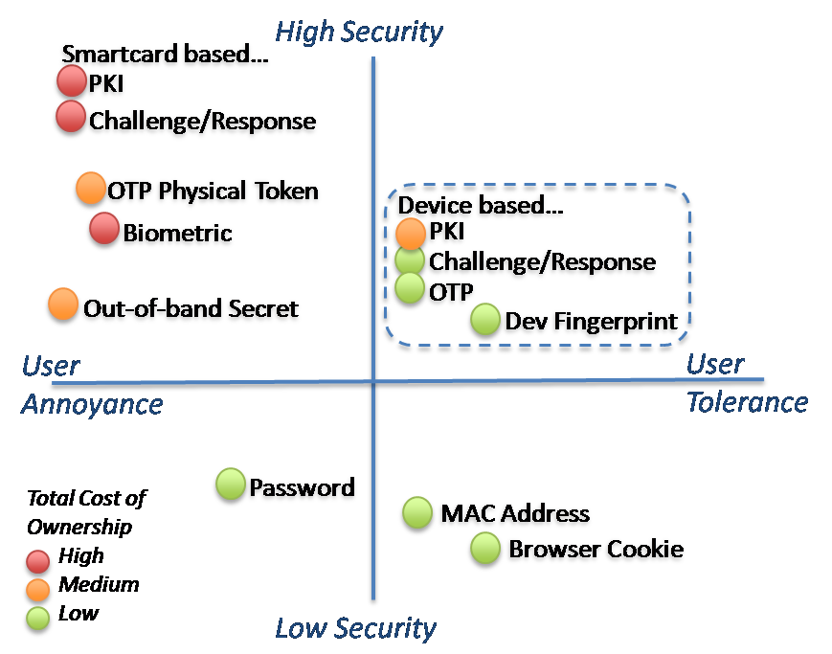
Authentication Comparison

Slide 6
Beyond Compliance
Compliance good start
Control the edge with white-list authentication
Block all else
Strong authentication: Device Fingerprint
Machine to machine authentication
Hardware device fingerprint ensures device is genuine
Two factor authentication for edge users
User Password
Hardware device fingerprint
Transparent/easy to use second factor for user
Notes:
Compliance good start, but does not guarantee security and continuous operation of SmartGrid
White-list Authentication; allow only authorized users and block all else to insure SmartGrid security and availability
80 % machine to machine, 20% user User audit capability

Slide 7
SmartGrid Device White List
Maintain SmartGrid availability by only allowing SmartGrid users, their machines, and
authorized devices access to SmartGrid network
Smart Grid Device
SmartGrid User Devices

Slide 8
SmartGrid Device White List
Maintain SmartGrid availability by only allowing SmartGrid users, their machines and
authorized devices access to SmartGrid network and block all other machines/devices
P
P
P
P
P
P
P
P
P
Unauthorized Access Attempt
P
P
?
Smart Grid Device
Edge ID Appliance
SmartGrid User Devices
Notes:
Little boxes with check mark represent legacy SCADA devices that cannot accept a fingerprint. In this case a small fingerprinted device is mounted in front of legacy SCADA device.

Slide 9
Best Practices
Use device fingerprints to control edge device integrity
White-list machine to machine authentication
Device fingerprint is transparent second factor user authentication
Insure edge devices are clean of malware
Maintain perimeter security
Monitor network for abnormal traffic
Routinely assess & mitigate network vulnerabilities

