Slide 1
Designing and Implementing
Secure ID Management Systems:
Country Experiences
JAPAN
SESSION B
Masakazu OHASHI (Chuo University)

Slide 2
Contents
e-Tendering and Procurement of Public Work and Standardization (Central and Local Government of Japan) (2000~ )
Time Authentication (Ministry of Internal Affairs and Communication)(2000~ ) Long-Term
Authentication Roaming between different Certificate Authorities. (Ministry of Internal Affairs and Communication) (2006)
Digital Citizen Project, Trusted Information Exchange Services based on Authentication Policy Extension and Proxing Assurance (Ministry of Economy, Trade and Industry) (2010)

Slide 3
Identity 5A (Final Target)
1. Authentication
  Distributed Authentication (based on SAML, OpenID )
2.Authorization
  Contract exchange (Policy Extension)
3.Attribute
  Attribute exchange (Policy Extension)
4.Administration
  CA Roaming
5.Audit
  Long Term Time Authentication

Slide 4
Gross Domestic Product and Construction Investments
Amount of Investments
Gross Domestic Product \513.7 Trillion
Consumptions \374.9 Trillion (73.0%)
Investments \131.8 Trillion
Exports \55.7 Trillion
Imports
-\48.8 Trillion
(25.7%)
(–9.5%)
(10.8%)
Construction Investments \70.4 Trillion (13.7%)
Machinery, etc.
\61.5 Trillion
Inventory
-\0.1 Trillion
Private Housing
\39.2 Trillion
Government Construction Investments \31.2 Trillion
55.7% of Construction Investments
44.3% of Construction Investments
(FY 2000)
Construction Industry
Population of employed: 6.38 million persons
Corporations licensed to engage in construction business:
Approx. 586,000* companies (as of March 31 2001)
* 99% of these corporations are small corporations less than \100 million in capital
Source: Policy Bureau, MLIT
Notes:
公共事業のうち国が行っているものは、約９兆円ほどになりますが、
そのうち７兆円あまりは国土交通省の行う事業です。
Government sponsored public works appropriate for about 9 trillion yen.
MLIT executes over 7 trillion yen of this public works.

Slide 5
Public Works of Japan
FY 2002 National Budget for Public Works in Japan (Not including supplementary budgets)
Ministry of Agriculture, Forestry and Fisheries and other ministries
\1.4 Trillion
Ministry of Land, Infrastructure and Transport (MLIT)
\7.0 Trillion
Grand Total \8.4 Trillion
(National Budget \81 Trillion)
Source: Homepages of ministries
Notes:
公共事業のうち国が行っているものは、約９兆円ほどになりますが、
そのうち７兆円あまりは国土交通省の行う事業です。
Government sponsored public works appropriate for about 9 trillion yen.
MLIT executes over 7 trillion yen of this public works.

Slide 6
Core System
Central Government 9
Prefecture 45
Major Cities 18
Local Government (City+) 372(+135)
Authentication
    Ordering Party GPKI, LGPKI, Private Sector PKI
    Order Entry Party Private Sector Authentication (9)

Slide 7
Adaptive Collaboration Empirical Study on the Cloud at 2003

Slide 8
Adaptive Collaboration
The real-time Adaptive Collaboration environment through data sharing.
1) The experiment on the Storage Management which enables users to share information located in the iDC storage
2) The experiment on data management by applying XML Web Services into the real-time collaborative work system through data sharing (Ohashi M.,edi,2004,2003).

Slide 9
the XML Web Services
1) Flexible cooperation and collaboration through sharing the ICT resources
2) Flexibility in data exchange
3) Automatic execution of modules
4) Applicability to existing internet-based technologies (vendor independent)
5) Effective utilization of existing programs
6) Low cost for implementation

Slide 10
Motivation, problem area
There are various services available that utilize the Internet. Additionally, more and more services are newly created to meet users’ diverse needs by incorporating existing services and social infrastructures.
Many of the existing services are often provided with specifications unique to each service provider, making it difficult or even impossible to integrate them with existing social infrastructures.
It is essential to develop a scheme that incorporates different services and infrastructures without boundaries of specifications.
The model we built aims to utilize different social infrastructures, and coordinates with other services regardless of their business types and industries to offer convenient and effective services for users.

Slide 11
Research Objectives
To confirm the validity of the Web Services Security
Through the experiment conducted in the B to C environment, we aim to demonstrate the effectiveness of the Web Services which incorporates various social infrastructures being developed by enterprises in the private sector
To proclaim that this is the new business model requiring less time and cost
To prove the effectiveness of the new roaming technology which shares authentication results among existing systems, as well as between different certificate authorities (CAs)

Slide 12
Research approach,Methodology
Authentication Roaming

Slide 13
Empirical Studies
1. the certificate of enrolment
2. e-Health

Slide 14
Three Technologies
1) Authentication Roaming
  the authentication roaming technology written by this paper which is currently under development by our group.
2) Biometrics for mobile phones
  The fingerprint authentication system is implemented into the mobile phone terminal
3) Tint-Block Printing
  Tint-Block Printing is a special printing technique applied on a regular printing paper that shows the paper is being duplicated. When the Tint-Block Printing paper is being duplicated, the letters such as “Do Not Duplicate” show up in bold relief on the paper, confirming the duplication. This technique allows us to distinguish the originals and those duplicated. In our study, since the certificate issued by the university as well as one that is printed at the store had to be original, the Tint-Block Printing technique was applied onto the paper.
Notes:
1) Authentication Roaming
When integrating different systems with the Web Service, some systems require authentication of users. Therefore, we implemented the authentication roaming technology which is currently under development by the NiCT. The authentication roaming is the technology that shares the information being authenticated by one Website with other Websites.
2) Biometrics for mobile phones
The fingerprint authentication system is implemented into the mobile phone terminal in our study. With this technology, university can confirm that the person who requests the certification is the same person as who prints the certification at the store.
3) Tint-Block Printing
Tint-Block Printing is a special printing technique applied on a regular printing paper that shows the paper is being duplicated. When the Tint-Block Printing paper is being duplicated, the letters such as “Do Not Duplicate” show up in bold relief on the paper, confirming the duplication. This technique allows us to distinguish the originals and those duplicated. In our study, since the certificate issued by the university as well as one that is printed at the store had to be original, the Tint-Block Printing technique was applied onto the paper.

Slide 15
B to C environment of social infrastructures
Select for Three Social Infrastructures:
a) The Internet Connection
  ( transmits authentication information)
b) Convenience Store
  (based on highly networked System)
c) Mobile Phone
  ( authenticates and verifies the individual)

Slide 16
Case Study 1 : Experimental Study 2006
Identity to print the Certificate of Studentship
Notes:
A student unlocks his mobile phone using a fingerprint reader (biometric authentication).
He logs into the Certificate Service at Chuo University, and requests the certificate of enrolment. The Printing ID which specifies the document to be printed is registered on his mobile phone.
He selects a branch of the Seven-Eleven convenience stores, and his Printing ID is sent to the printing-server at Seven-Eleven.
Once authenticated by Chuo University, he places his mobile phone onto the IC Card-Reader and shows his Printing ID at the store.
The data from the mobile phone is compared with the data received in the Printing-Server at Seven-Eleven.
He prints out and receives the certificate of enrolment at the convenience store by submitting the Printing ID at the colour-copying machine at the store.

Slide 17
the step-by-step procedure of the experiment
A student unlocks his mobile phone using a fingerprint reader (biometric authentication).
He logs into the Certificate Service at Chuo University, and requests the certificate of enrolment. The Printing ID which specifies the document to be printed is registered on his mobile phone.
He selects a branch of the Seven-Eleven convenience stores, and his Printing ID is sent to the printing-server at Seven-Eleven.
Once authenticated by Chuo University, he places his mobile phone onto the IC Card-Reader and shows his Printing ID at the store.
The data from the mobile phone is compared with the data received in the Printing-Server at Seven-Eleven.
He prints out and receives the certificate of enrolment at the convenience store by submitting the Printing ID at the colour-copying machine at the store.
Notes:
A student unlocks his mobile phone using a fingerprint reader (biometric authentication).
He logs into the Certificate Service at Chuo University, and requests the certificate of enrolment. The Printing ID which specifies the document to be printed is registered on his mobile phone.
He selects a branch of the Seven-Eleven convenience stores, and his Printing ID is sent to the printing-server at Seven-Eleven.
Once authenticated by Chuo University, he places his mobile phone onto the IC Card-Reader and shows his Printing ID at the store.
The data from the mobile phone is compared with the data received in the Printing-Server at Seven-Eleven.
He prints out and receives the certificate of enrolment at the convenience store by submitting the Printing ID at the colour-copying machine at the store.

Slide 18
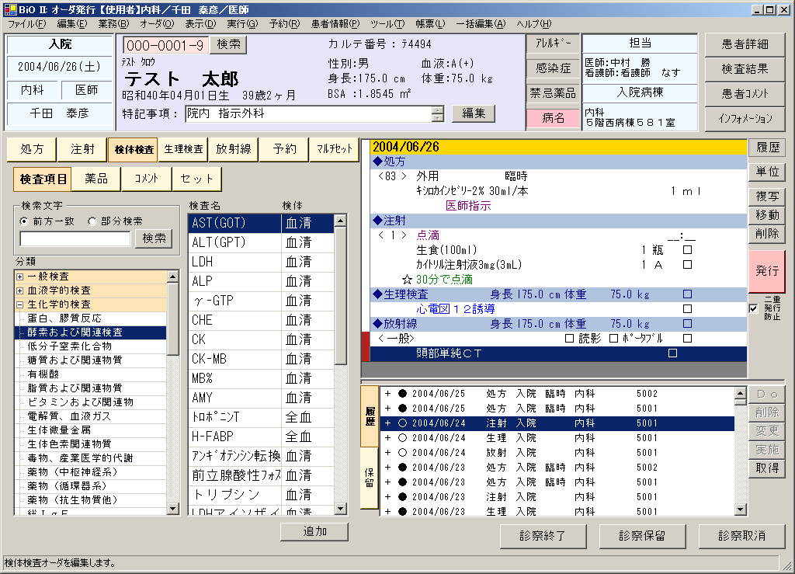
Functions of integrated system
Pharmaceutical department
Radiation ray department
・Prescription charge system
・Tablets packaging system
・Dispensation supporting
system
・Ample picker system
・Radiology Information System (RIS)
・Computed Radiography (CR)
Nutrition management department
Physical examination department
・Nutrition management system
Client machine screen
・ Physical examination system
・ Blood drawing tube preparation
system
Coverage business processes
  Patients management
  Ordering
  Medical document management
Back office
・ Medical accounting system
・ Carte management system
・ Old case acceptance system
・ Order displaying machine system

Slide 19
Overview of Private Information Box Project
2010

Slide 20
Experimental Study Sequence of OpenID CX (OpenID Get/Post Binding)

Slide 21
Empirical Study of Proxing Assurance between OpenID and SAML

Slide 22
The Sequence of proxying an OpenID request to SAML IDP

Slide 23
Japan’s Main Point on the Agenda
National Identity Management
2 Opinion for the Policy
1. Concentrated Approach
  National Security Number and IC Card
2. Distributed Approach
  Privated-provided Authentication
    SAML, OpenID +Extension

Slide 24
Identity 5A
1. Authentication
  Distributed Authentication (based on SAML, OpenID )
2.Authorization
  Contract exchange (Policy Extension)
3.Attribute
  Attribute exchange (Policy Extension)
4.Administration
  CA Roaming
5.Audit
  Long Term Time Authentication

Slide 25
Thank you

