Slide 1
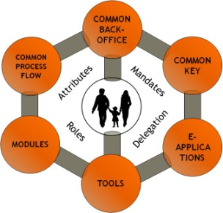
SESSION D:
What You Know - What You Have - What You Are:
The Role of Hardware Technologies to Provide Identity Assurance
BELGIUM’s Experience
Washington - September 27th, 2010
Frank LEYMAN
© fedict 2010. All rights reserved

Slide 2

MARKETING RULE:
“NEVER OUTSOURCE YOUR CORE PRODUCT”

Slide 3

Citizen Centricity
COMMON BACK-OFFICE
COMMON PROCESS FLOW
COMMON KEY
Attributes
Mandates
MODULES
Delegation
E-APPLICATIONS
Roles
TOOLS
© fedict 2010. All rights reserved

Slide 4
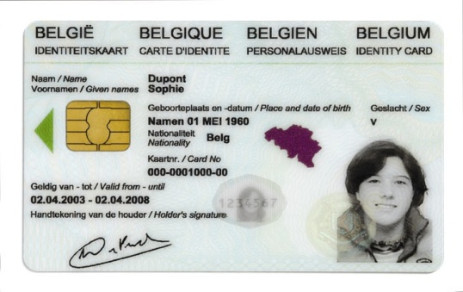
Building Blocks
ONLINE APPROACH
SECURITY LAYER
National Portal Website
Federal Service Bus
FEDMAN
Ministry
A
Ministry
B
Ministry
C
…
Ministry
Z
© fedict 2010. All rights reserved

Slide 5
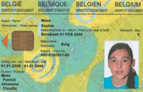
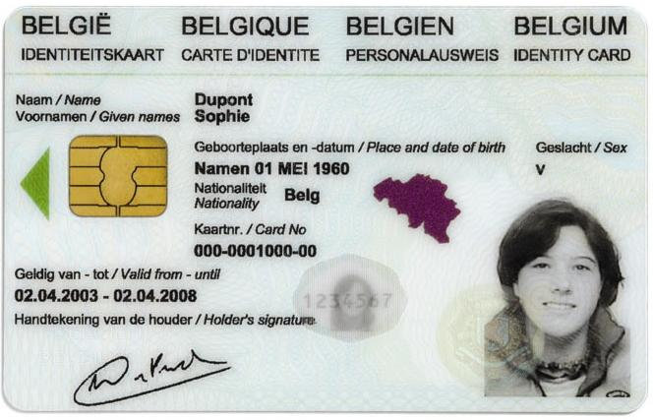
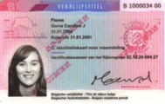
The eID Project
Provides Belgian Citizens with an electronic identity card.
Gives Belgian Citizens a device to claim their identity in the new digital age.

Slide 6
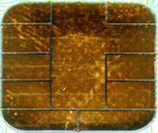


eID Digital Information
PKI
IDENTITY
“PIN protected”
Use without PIN
public
private
ID
ADDRESS
authentication
public
private
digital signature
RRN SIGN
RRN SIGN
© fedict 2010. All rights reserved

Slide 7
eID Functionalities
Visual Identification
Identification
Authentication
Electronic signature
© fedict 2010. All rights reserved

Slide 8

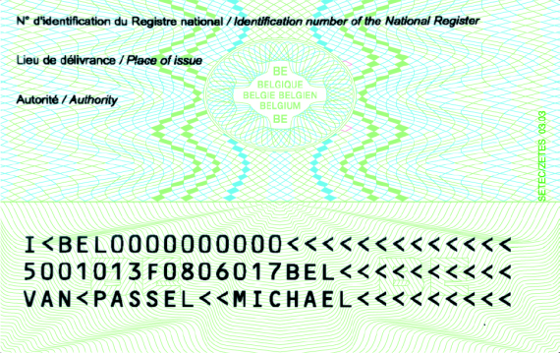
eID Information
From a visual point of view the same information is visible as on a regular identity card :
  the name
  the first two Christian names
  the first letter of the third Christian name
  the nationality
  the birth place and date
  the sex
  the place of delivery of the card
  the begin and end data of the validity of the card
  the denomination and number of the card
  the photo of the holder
  the signature of the holder
  the identification number of the National Register
Visual identification
of the card holder
© fedict 2010. All rights reserved

Slide 9
Identification
From an electronic point of view the chip contains the same information as printed on the card, filled up with:
  the identity and signature keys
  the identity and signature certificates
  the accredited certification service furnisher
  information necessary for authentication of the card and integrity protection of the data
  the main residence of the holder
No encryption certificates
No biometric data
No electronic purse
No storage of other data
Electronic identification of the holder
© fedict 2010. All rights reserved

Slide 10





Security Aspects
Outside
  Rainbow and guilloche printing
  Changeable Laser Image (CLI)
  Optical Variable Ink (OVI)
  Alphagram
  Relief and UV print
  Laser engraving
12345678
© fedict 2010. All rights reserved

Slide 11
Chip specifications
Chip characteristics: Cryptoflex JavaCard 32K
  CPU (processor): 16 bit Micro-controller
  Crypto-processor:
      1100 bit Crypto-Engine (RSA computation)
      112 bit Crypto-Accelerator (DES computation)
  ROM (OS): 136 kB (GEOS JRE)
  EEPROM (Applic + Data): 32 KB (Belpic Applet)
  RAM (memory): 5 KB
“GEOS”
JVM
Crypto
(DES,RSA)
ROM
(Operating System)
“Belpic”
Applet
I/O
CPU
EEPROM
(File System=
applications + data)
ID data,
Keys, Certs.
RAM
(Memory)
© fedict 2010. All rights reserved

Slide 12
Other specifications
Directory Structure (PKCS#15)
Asymmetric cryptography: public key and private key
Signatures put via RSA with SHA-1
eID cryptographic algorithm: RSA

Slide 13
Data Specifications
Directory Structure (PKCS#15)
  Dir (BelPIC):
    certificates & keys (PIN code protected)
      private and public key CA : 2048 bits
      private and public key citizen: 1024 bits
      Signatures put via RSA with SHA-1
      all certificates are conform to X.509 v3
    standard format (to be used by generic applications)
      Microsoft CryptoAPI (⇔ Windows)
      PKCS#11 (⇔ UNIX/Linux & MacOS)
  Dir (ID):
    contains full identity information
      first name, last name, etc.
      address
      picture
      etc.
    proprietary format (to be used by dedicated applications only)
BelPIC
ID
Card
Key
...
ID
Auth
Key
Auth
Cert
ADR
Sign
Key
Sign
Cert
PIC
...
CA
Cert
...
Root
Cert
© fedict 2010. All rights reserved

Slide 14
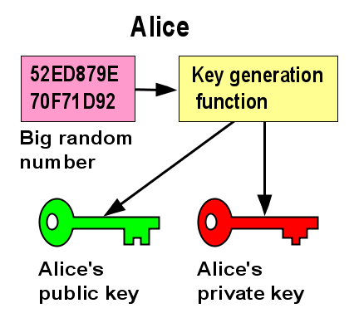
Public-key Cryptography
Asymmetric cryptography: public key and private key
eID cryptographic algorithm: RSA
© fedict 2010. All rights reserved

Slide 15
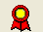
X509 Certificate
Is a signed digital statement.
Links a person to a key via a trusted party (CA)
Unique name of holder
DN:
Serial #:
Start:
End:
CRL:
Key:
Attrib:
CA DN:
Public key of holder
Signed by the CA that issued the certificate.
© fedict 2010. All rights reserved

Slide 16



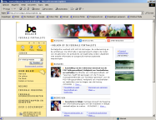
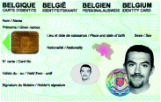
PKI Trust Hierarchy
SelfSign Belgium
Root
RootSign Belgium
Root
Admin
CA
Citizen
CA
Gov
CA
CRL
CRL
CRL
Card Admin
Cert Admin
Hierar Admin
Client Auth
Elec Sign
Server Cert
Client Cert
Object Cert
Admin
Auth/Sign
© fedict 2010. All rights reserved

Slide 17
Signature Standards
The features of a non-repudiation signature drives the need for open signature standards.
  XML signatures supported:
    ODF (Open Office 3.2)
    OOXML (Microsoft 2007- 2010)
© fedict 2010. All rights reserved

Slide 18
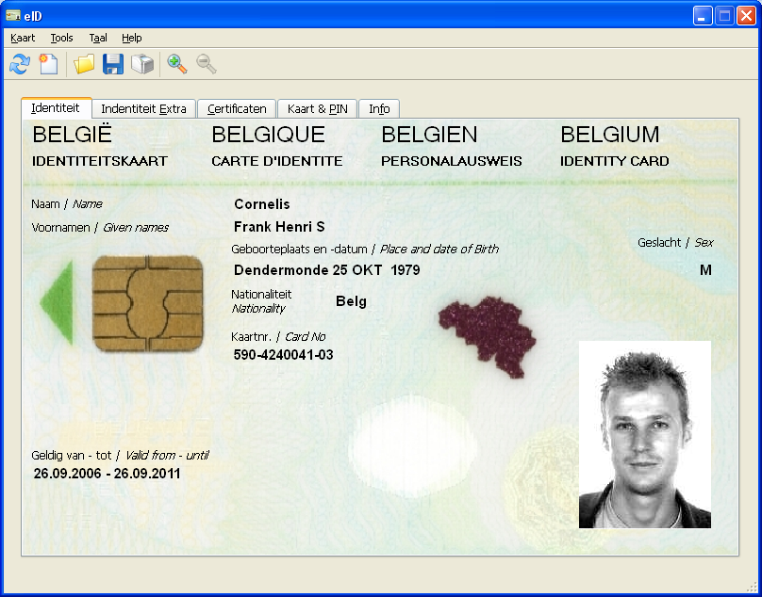
Fedict eID Middleware
Software for using the eID card on a PC
  Identification (GUI tool + SDK)
  Authentication/Signature modules:
    PKCS#11
    CSP
    tokenD
Platforms:
  Windows: XP, Vista
  Linux: Fedora, OpenSUSE, Debian
  Mac
© fedict 2010. All rights reserved

Slide 19
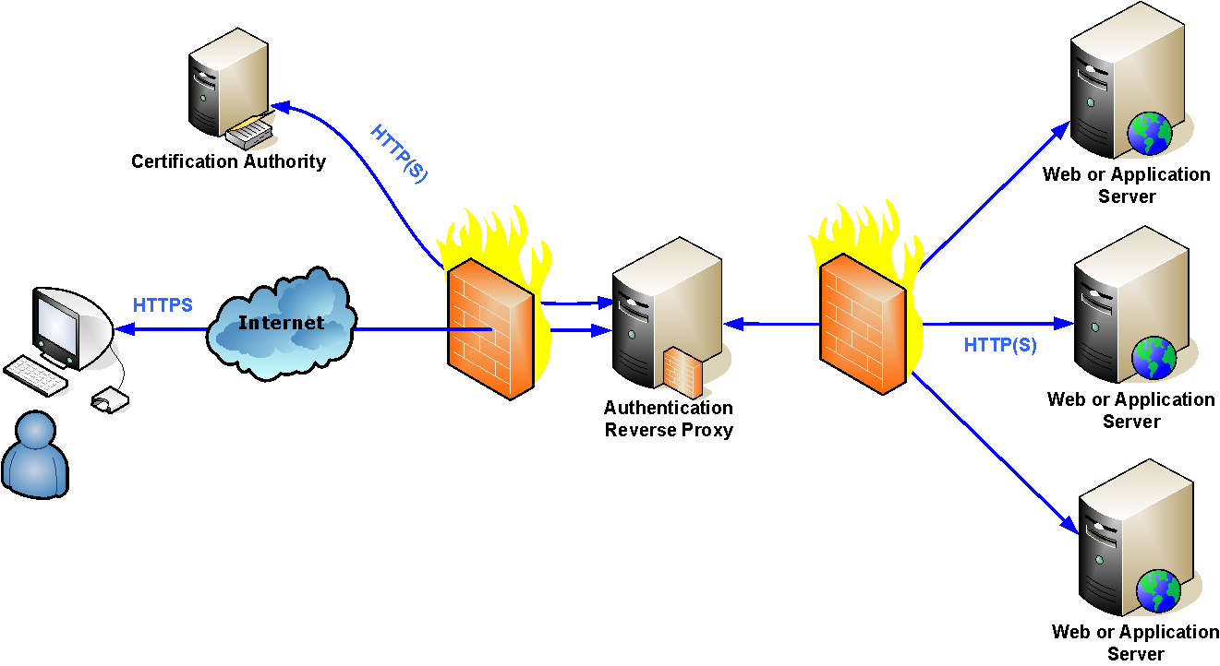
Fedict Reverse Proxy
Used to authenticate a person via eID towards a web application using SSL.
© fedict 2010. All rights reserved

Slide 20
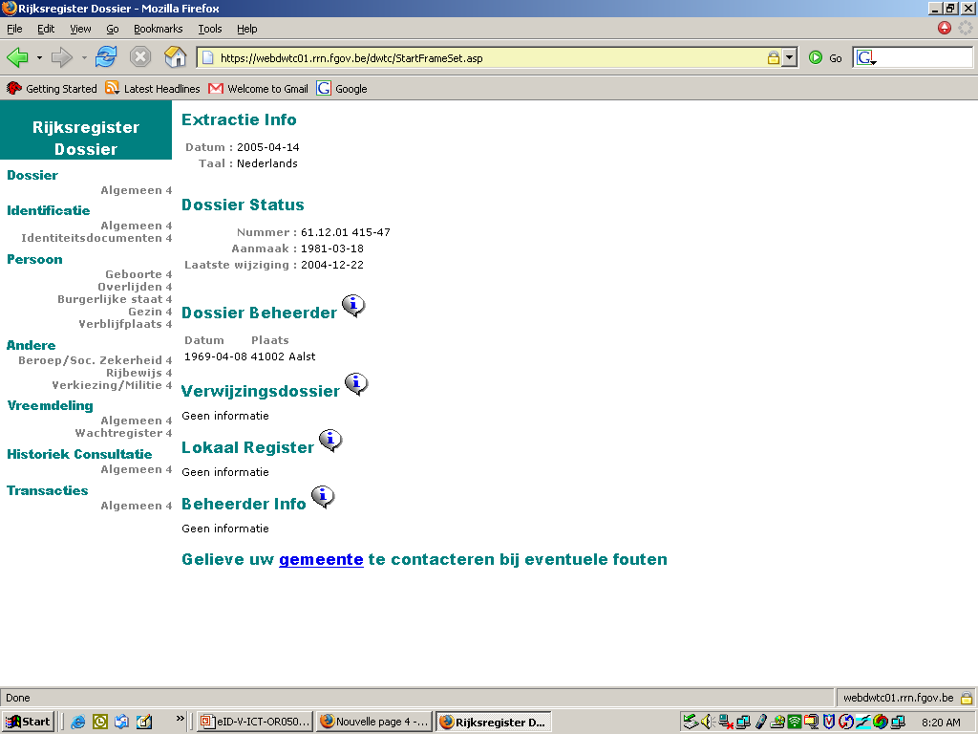
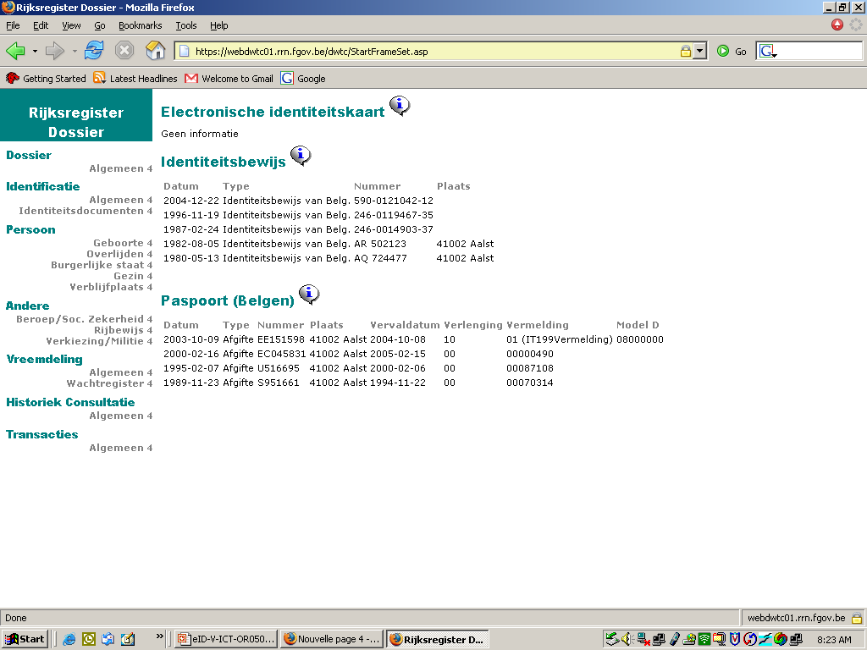
https://mondossier.rrn.fgov.be
TRUST
© fedict 2010. All rights reserved

Slide 21




EU pilots that work on cross-border interoperability
© fedict 2009. All rights reserved

Slide 22
OUR OBJECTIVES:
To be vendor agnostic
To be hardware agnostic
To give the citizen the choice of access tool
To follow Open Standards

Slide 23
Th@nk you!
FRANK LEYMAN
Manager International Relations
Maria-Theresiastraat 1/3
Bruxelles 1000 Brussel
TEL +32 2 212 96 24
FAX +32 2 212 96 99
Frank.leyman@fedict.be
www.belgium.be/fedict
© fedict 2010. All rights reserved

