Slide 1
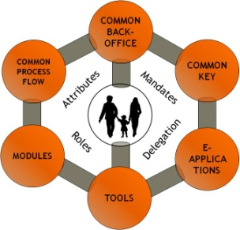
Designing and Implementing Secure ID Management Systems:
BELGIUM’s Experience
Washington - September 27th, 2010
Frank LEYMAN
© fedict 2010. All rights reserved

Slide 2

Citizen Centricity
COMMON BACK-OFFICE
COMMON PROCESS FLOW
COMMON KEY
Attributes
Mandates
MODULES
Delegation
E-APPLICATIONS
Roles
TOOLS
© fedict 2010. All rights reserved

Slide 3
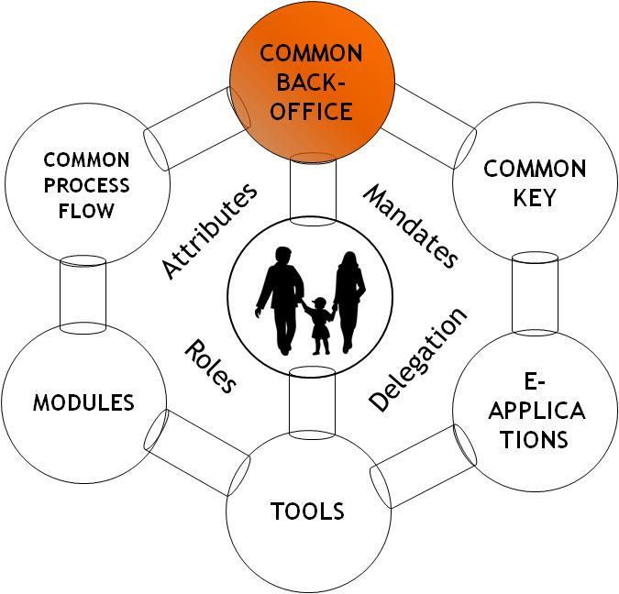
ONE COMMON BACK-OFFICE
© fedict 2010. All rights reserved

Slide 4
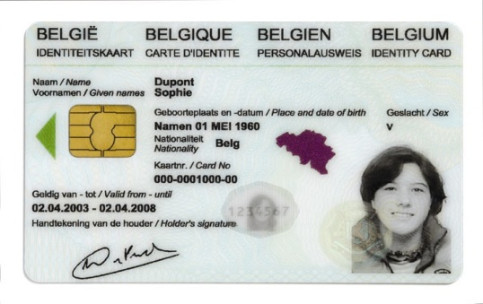
Building Blocks
SECURITY LAYER
National Portal Website
Federal Service Bus
FEDMAN
Ministry
A
Ministry
B
Ministry
C
…
Ministry
Z
© fedict 2010. All rights reserved

Slide 5
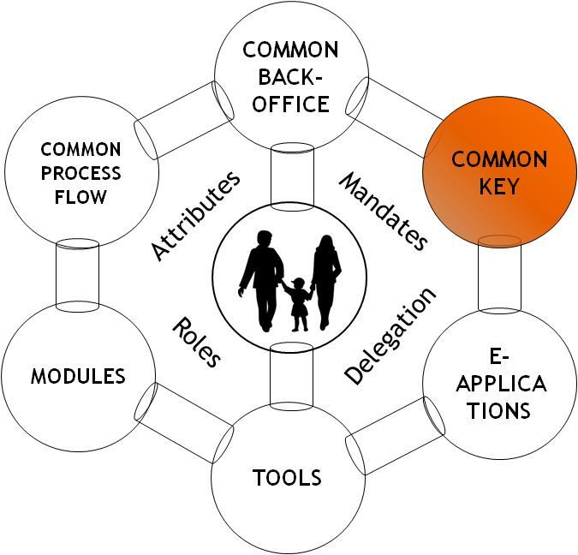
ONE UNIQUE ELECTRONIC KEY: THE BELGIAN eID
© fedict 2010. All rights reserved

Slide 6

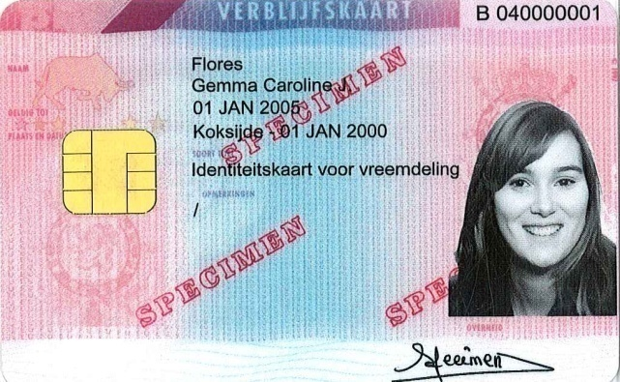
Electronic identity card (eID)
Belgian citizens >12 years old
Children <12 years old
Foreign residents
© fedict 2010. All rights reserved

Slide 7
eID Security
© fedict 2010. All rights reserved

Slide 8


eID Digital Information
PKI
IDENTITY
“PIN protected”
Use without PIN
public
private
ID
ADDRESS
authentication
public
private
digital signature
RRN SIGN
RRN SIGN
© fedict 2010. All rights reserved

Slide 9
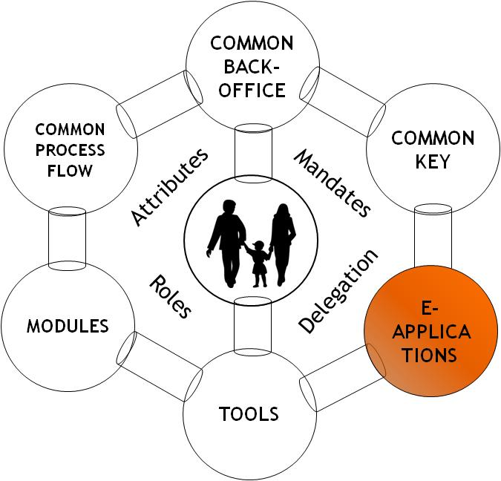
LOTS OF e-APPLICATIONS
© fedict 2010. All rights reserved

Slide 10






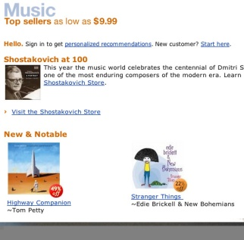
Lots of applications of the eID card
Driver’s license
Healthcare
Home banking
student cards
Proof of membership
SSO, etc.
e-commerce
© fedict 2010. All rights reserved

Slide 11
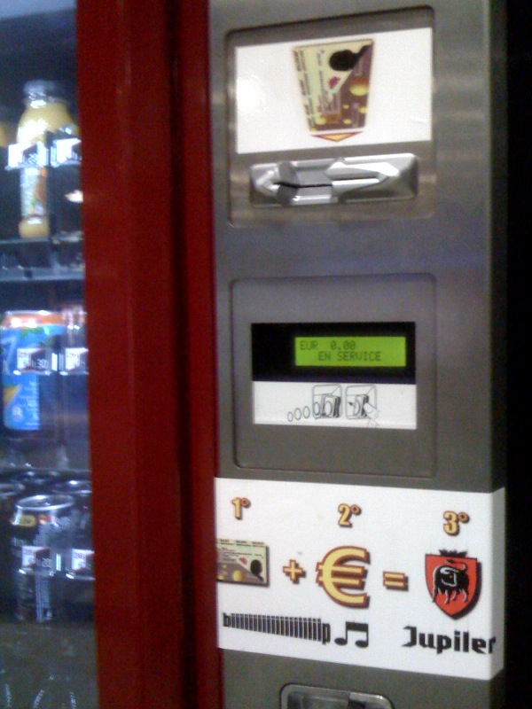
Vending machines
No alcohol under 18 year...
© fedict 2010. All rights reserved

Slide 12
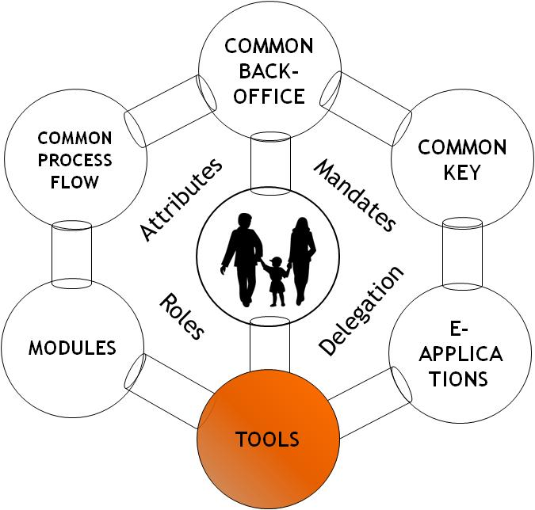
Lots of TOOLS at your disposal
© fedict 2010. All rights reserved

Slide 13

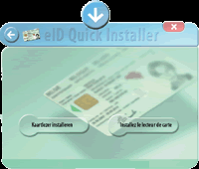

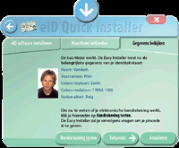
Quick Install
1. Install the eID software
2. Connect the card reader to the computer
3. Consult your data
© fedict 2010. All rights reserved

Slide 14
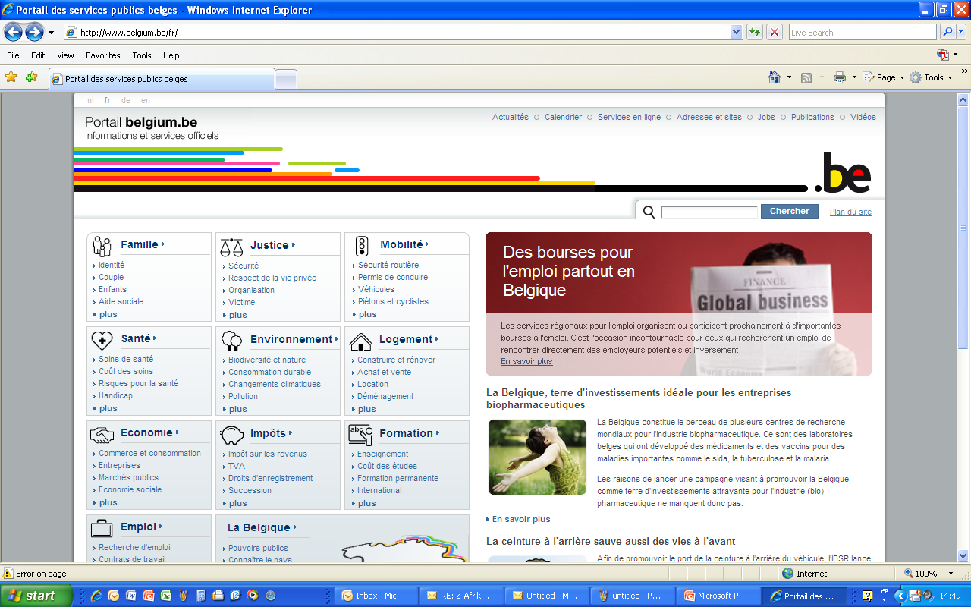
http://www.belgium.be
© fedict 2010. All rights reserved

Slide 15
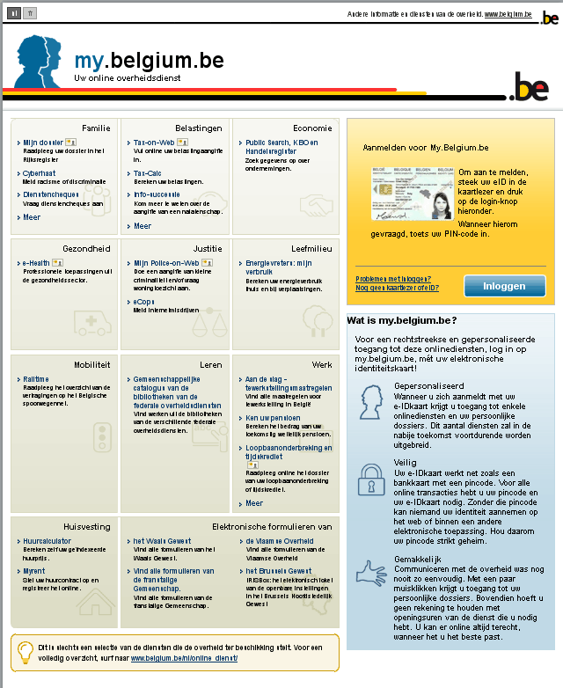
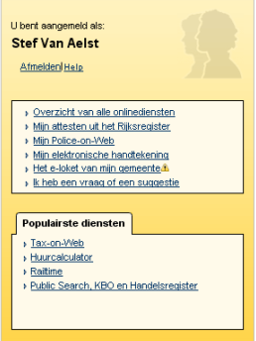
Direct access to more than
70 on-line transactions

Slide 16
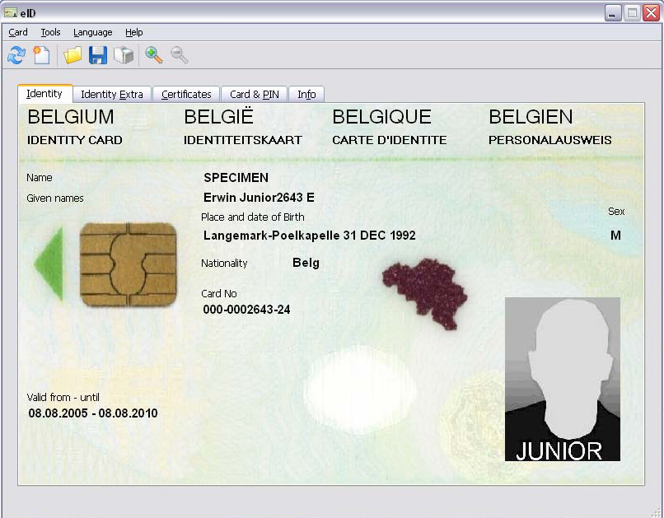
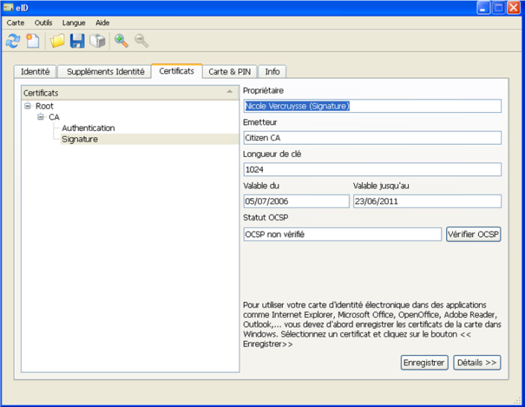
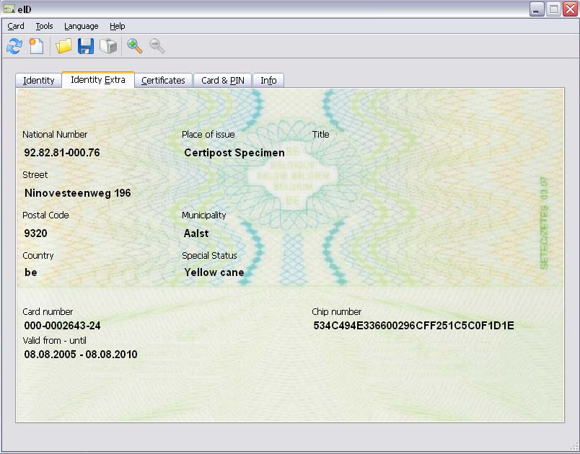
eID Middleware
Reading of the data – Certificates - Card & PIN
© fedict 2010. All rights reserved

Slide 17
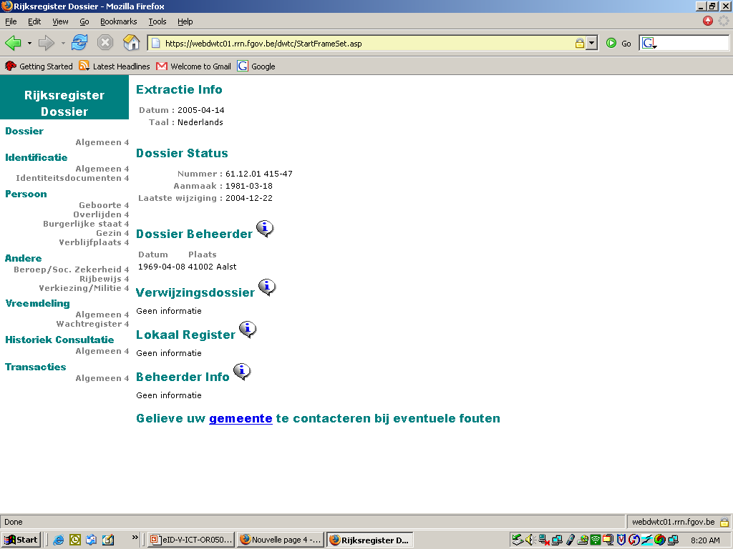
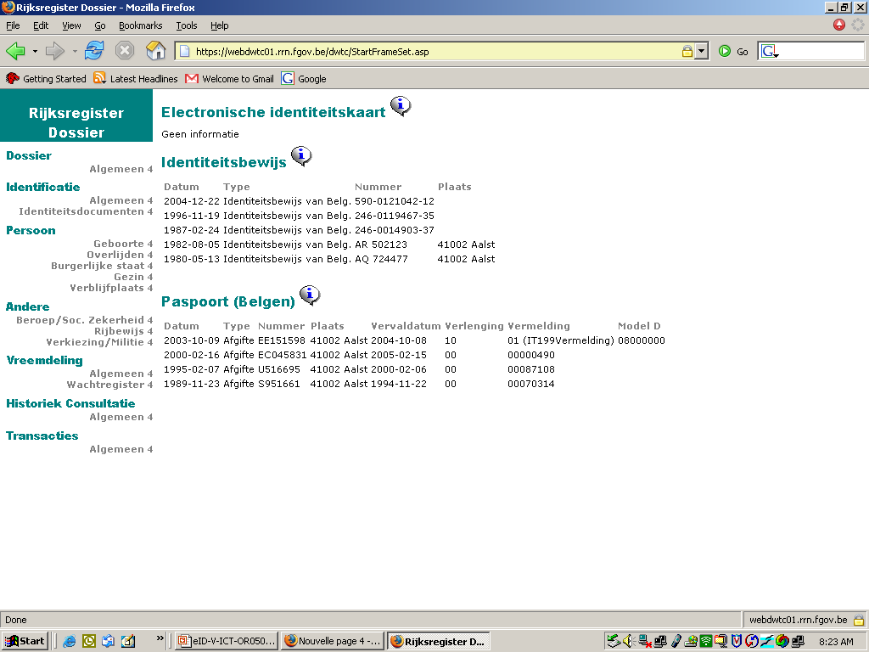
https://mondossier.rrn.fgov.be
© fedict 2010. All rights reserved

Slide 18
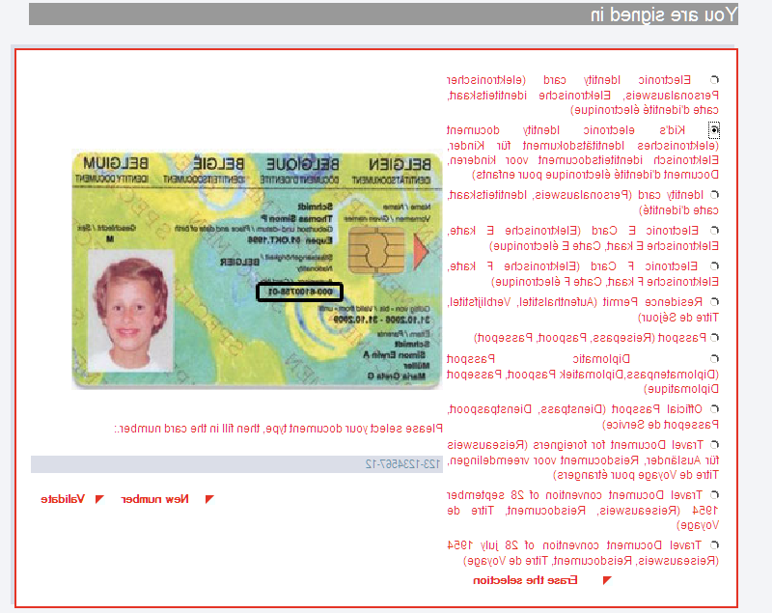
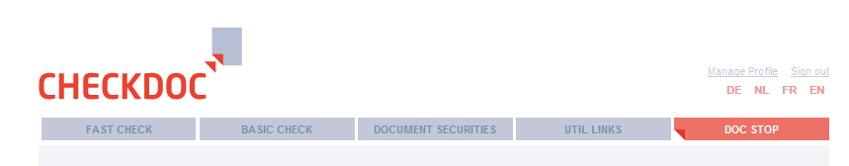

www.checkdoc.be
A website to verify whether Belgian identity documents are valid or not:
  passport
  identity card
  residence permit with chip
Registration the first time
Sources authentiques
© fedict 2010. All rights reserved

Slide 19
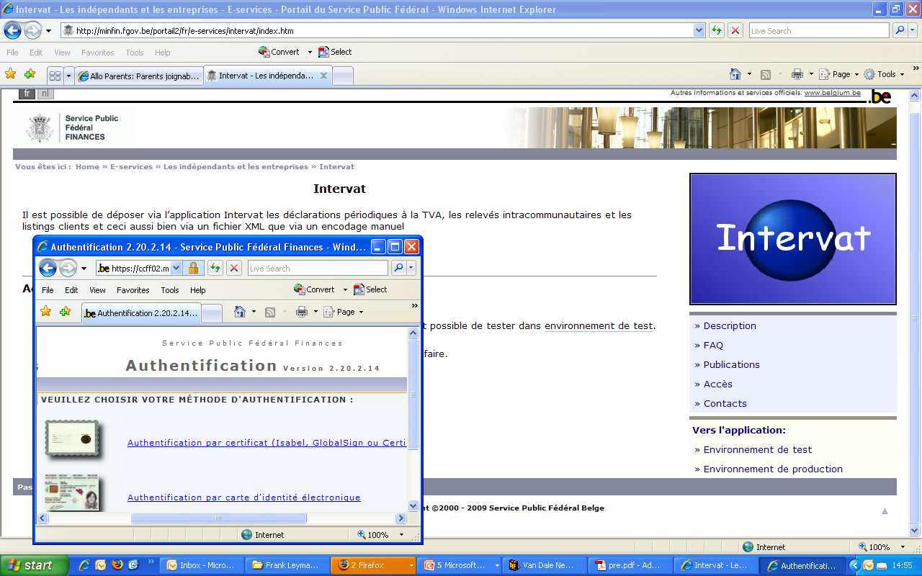
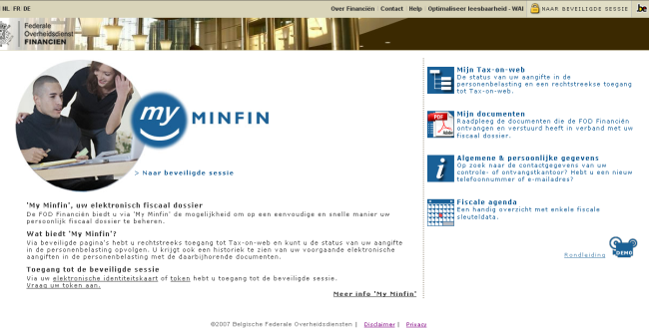
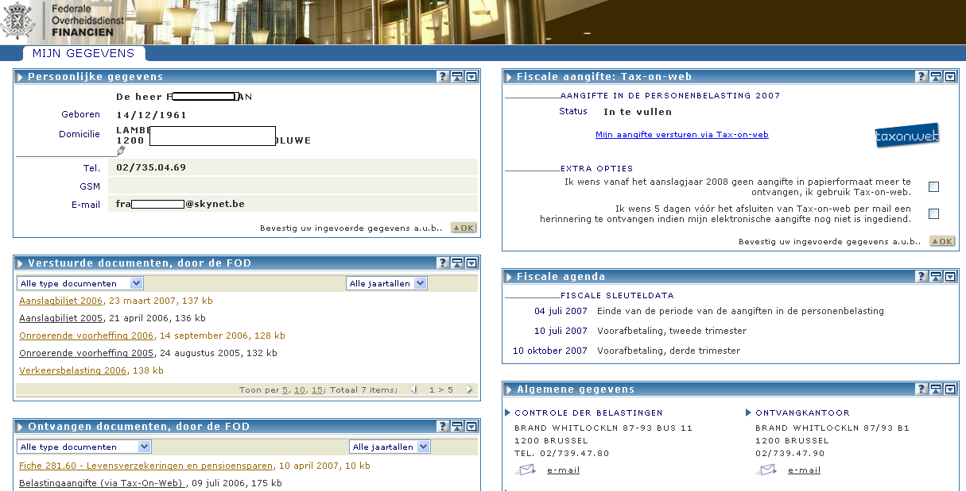
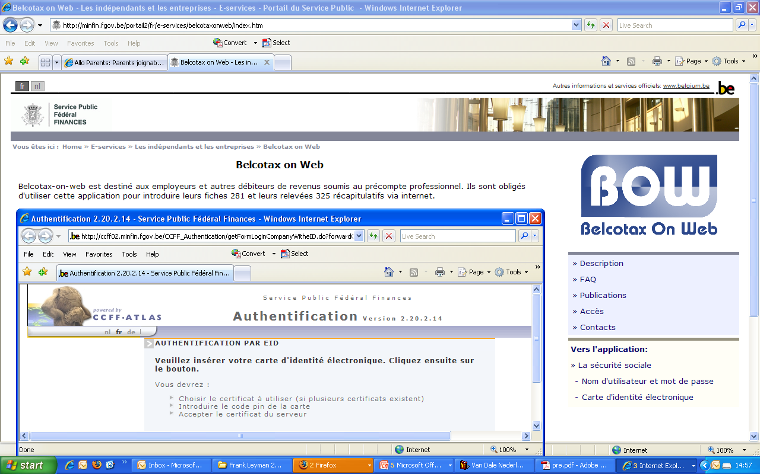
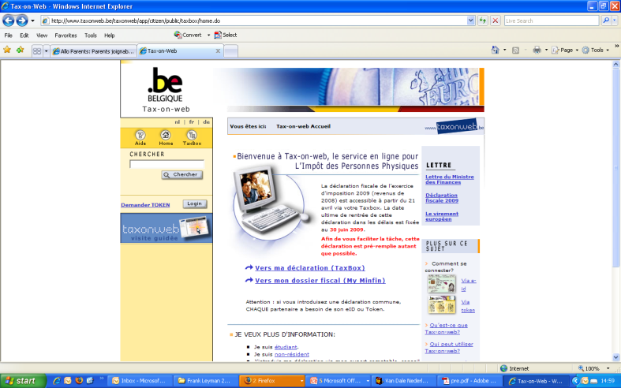
Fiscality
© fedict 2010. All rights reserved

Slide 20
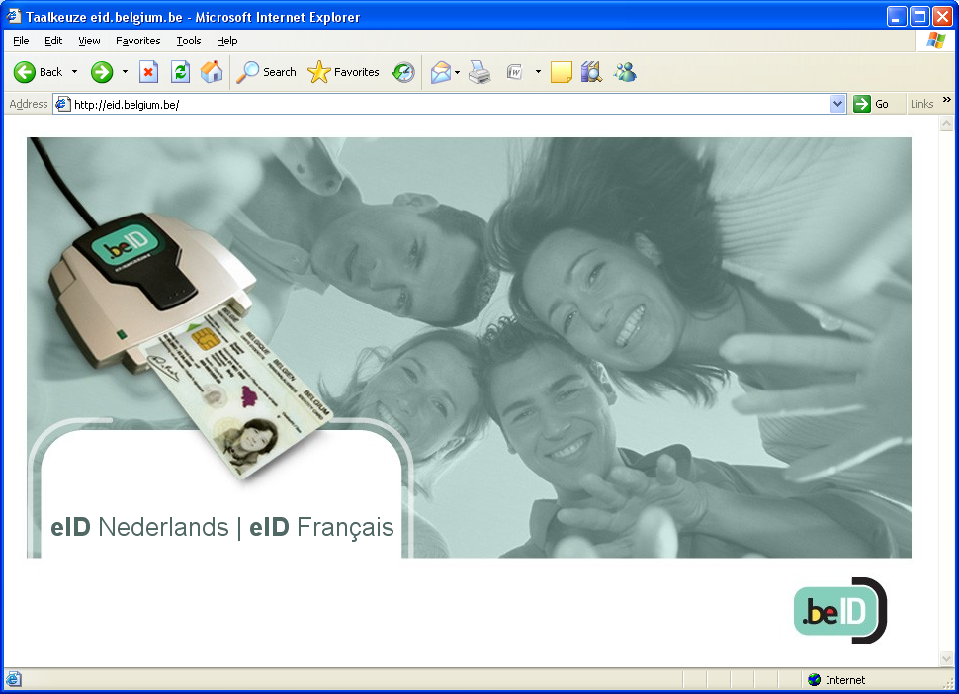
More Information?
www.eid.belgium.be
© fedict 2010. All rights reserved

Slide 21
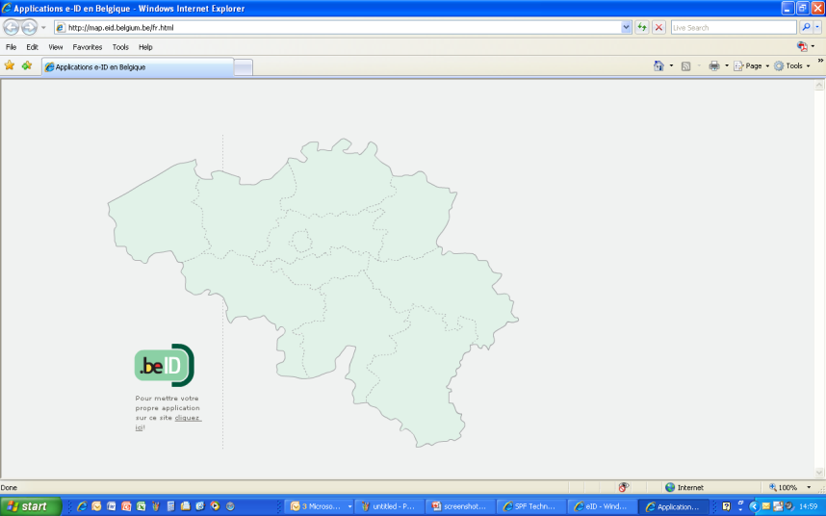
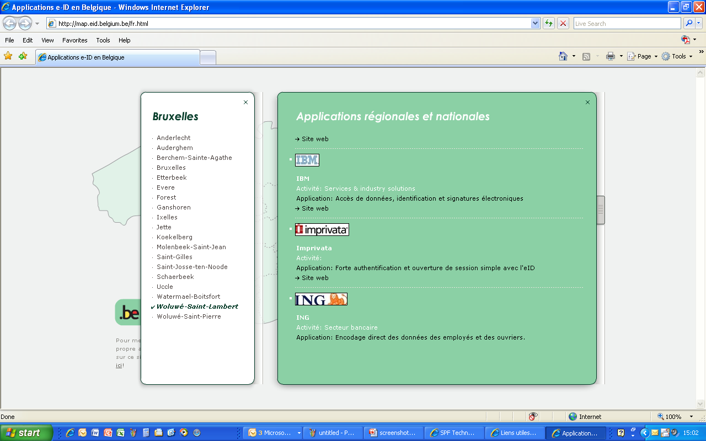
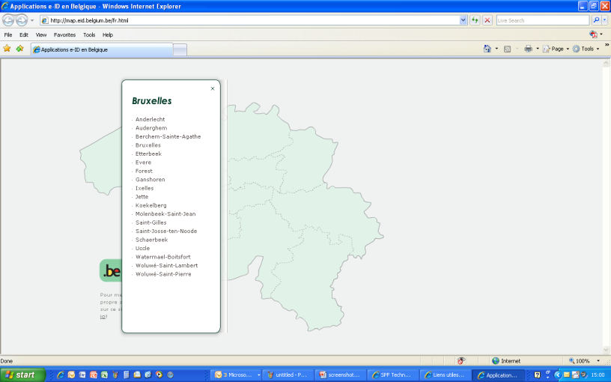
http://map.eid.belgium.be
© fedict 2010. All rights reserved

Slide 22
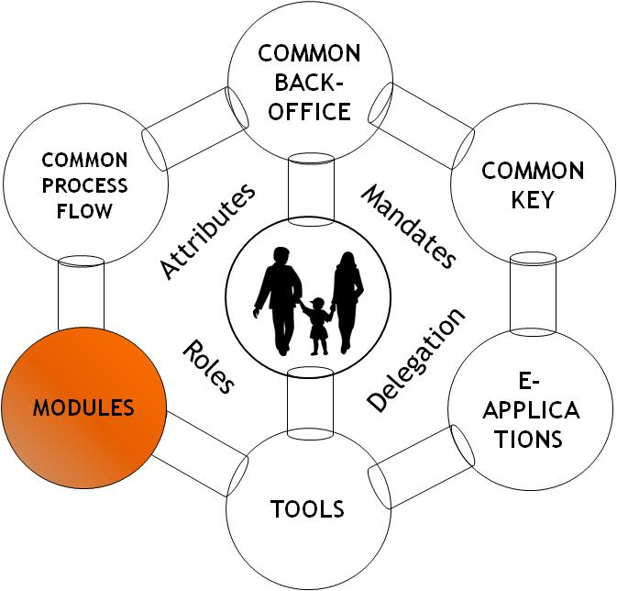
Lots of MODULES at your disposal
© fedict 2010. All rights reserved

Slide 23

MODULES
FAS:
  Federal Authentication Service via eID
e-LOKET:
  Tool to allow municipalities to offer electronic services to its citizen in a secure way
e-DEPOT:
  Service to allow notaries to faster register acts
PersonService:
  Webservice to allow fast query about physical persons in the public registers
DIGIFLOW:
  User interface the Public Sector uses to get access to the FSB
IAM:
  Identity and Access Management
MAGMA:
  Delegation of powers between two legal entities in order to allow the second to operate on-line transactions in the name of the first (accountants, social reprenstatives, ...)
e-PAYMENT:
  Service package to allow public authorities to introduce electronic transactions
© fedict 2010. All rights reserved

Slide 24
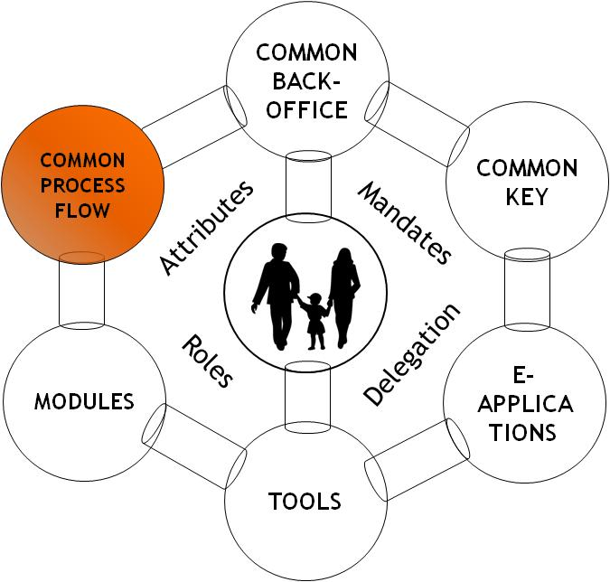
  Standard usage
  Standard Process Flows
© fedict 2010. All rights reserved

Slide 25
Standard approach
WEB
FSB
FEDMAN network
Authentic Sources
© fedict 2010. All rights reserved

Slide 26

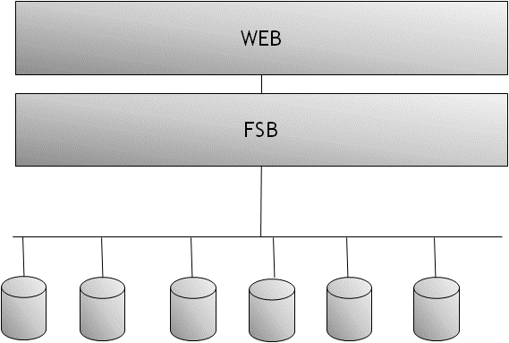
Example1: citizen files a complaint “theft”
e-LOKET
FAS
e-FORM
Ticket #
FSB
Police
Push
© fedict 2010. All rights reserved

Slide 27
Future developments
© fedict 2010. All rights reserved

Slide 28

Identity and Access Management
CEO of COMPANY
IDENTITY
NAME
MEMBER of BOARD
DATE of BIRTH
LAWYER
PLACE of BIRTH
ACCOUNTANT
GENDER
MEMBER OF
SERVICE CLUB
ADDRESS
NATIONALITY
SOCIAL SECURITY
FAMILY STATUS
DRIVING LICENSE
FATHER
© fedict 2010. All rights reserved

Slide 29
This is for Belgium, but what about the rest of Europe?
© fedict 2010. All rights reserved

Slide 30

SECURITY LAYER
Country1
Country2
Country3
…
Country
X
Gateway to EU
National Portal Website
Federal Service Bus
FEDMAN
Ministry
A
Ministry
B
Ministry
C
…
Ministry
Z
Region A
Region B
Region C
…
Region Z
Municipality A
Municipality B
Municipality C
…
Municipality Z
© fedict 2010. All rights reserved

Slide 31

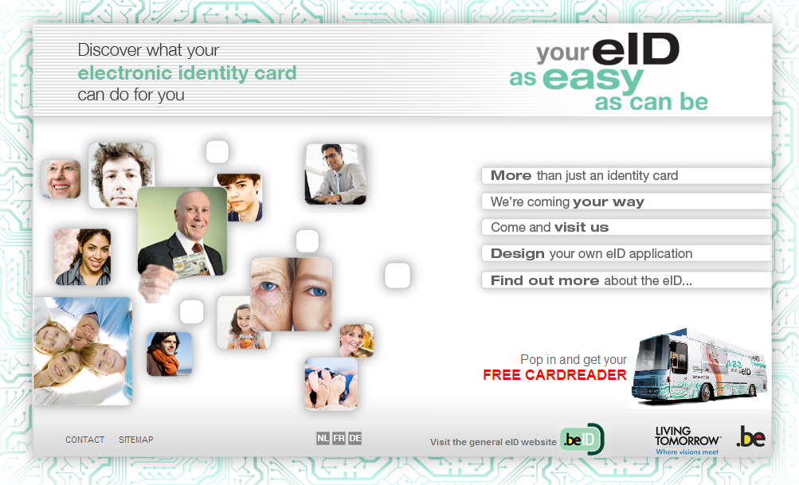
Room for improvement...
Communication & Education
Card readers
Prices of internet
Prices of PC’s
# of Applications
http://welcome-to-e-belgium.be/en/
© fedict 2010. All rights reserved

Slide 32
Th@nk you!
FRANK LEYMAN
Manager International Relations
Maria-Theresiastraat 1/3
Bruxelles 1000 Brussel
TEL +32 2 212 96 24
FAX +32 2 212 96 99
Frank.leyman@fedict.be
www.belgium.be/fedict
© fedict 2010. All rights reserved

