Slide 1
Transformational Government Workshop, Washington Case Study 2 – New Zealand Government 9 December 2010
Karen Burns
State Services Commission
New Zealand

Slide 2
What I will cover
New Zealand Government
Background/Environment
New Government ICT strategy
Initiatives underway
Use of CS Transform Model

Slide 3
NZ Government
National Government – centre right political party
Elected in 2008 this Government commits to, amongst other steps, an ongoing programme of personal tax reductions; a step-up in infrastructure investment; a reduction in government bureaucracy in favour of frontline services; an across-the-board commitment to lifting productivity growth and a renewed effort to lift education standards
The role of Central Agencies
The three central State sector agencies, the Treasury, the Department of the Prime Minister and Cabinet and the State Services Commission, work together on a number of fronts to support the Government and provide leadership within the State sector
Government Chief Information Office
The GCIO functions will support the GCIO, the chief adviser on government’s use of Information and Communications Technology, by providing leadership for government ICT and oversight of the Directions and Priorities for Government ICT.
The GCIO functions will provide advice on the strategic direction for government use of ICT to ministers, chief executives, senior stakeholders and central agencies. This will include the development and provision of advice and support to drive a cross-system approach to ICT investment.
Notes:
Labour Government between 2000-2008
Central Agencies serve the government of the day
Within the State Services Commission is the GCIO – custodian of the e-Government strategy
Go to e-Government milestones as written in 2006

Slide 4
What we wanted
E-Government Milestones (2006)
By 2007, information and communication technologies will be integral to the delivery of government information, services, and processes
By 2010, Government shared infrastructure is used to deliver user-centred services, and support joint results
By 2015, New Zealanders confirm that their experience of State Services has been transformed through technology
By 2020, people’s engagement with the government will have been transformed, as increasing and innovative use is made of the opportunities offered by network technologies
Notes:
We believed
State servants will think of themselves as part of a single, user-centred enterprise that has multiple points of delivery and interaction with the people it serves. State agencies will be highly attuned to the many opportunities of evolving network technologies and shared systems, and will seize the chance to transform the way government works with, and for, New Zealanders. Over time the nature of government services will shift in emphasis toward greater participation by New Zealanders in service design and delivery.

Slide 5
Background
Digital Strategy, E-Govt Strategy (2002 & 2006)
Mixed success
ICT spend of $1.8 Billion p.a. across government
Call for a fresh approach
Need for a framework to focus ICT activity
Context
Notes:
Further Context
Dated Strategies
This government called for a fresh approach
Priority on ICT activity across government

Slide 6
Context
Environment
Fiscal challenges
Demand for better services
Demand for greater efficiency
Costly duplicated ICT infrastructure and services
Appropriate funding models are needed
Good ideas and innovation need to be recognised
ICT more and more critical to business
ICT literacy needs to be increased
Notes:
Like you all we face
....so

Slide 7
first steps
Notes:
What did we do first

Slide 8
5 New Directions
ICT Strategy
ICT Leadership and Direction
Open and Transparent Government
Integrated Service Delivery
Cross Government Business Capability
ICT Operational Management
Notes:
Government – Ministers and CA set about producing a new ICT strategy these are the 5 new directions
The following slides take you through each direction and identify the priorities that have been agreed

Slide 9
Leadership
D1 - Provide clear leadership and direction
Enhance governance arrangements led by chief executives with stronger leadership of ICT performance across government
Align agency ICT management with ICT Directions and Priorities
Develop funding models that incentivise collaboration across government
Notes:
A new ICT structure in in force – I will show that under the initiatives section later
CE’s are taking accountability for deliver of work programmes – working collaboratively in the strategic space
Our Treasury have initiated a process for cross govt projects to request funds....involves a business case to an authority board....must be aligned to the D&P

Slide 10
Open & transparent Government
D2 - Support open & transparent government
Improve public access to government data and information
Support the public, communities and business to contribute to policy development and performance improvement
Create market opportunities and services through the reuse of government information
Notes:
Like everyone – major focus on opening up data
And again in line with global progress – mainly about getting data released, not so much linked

Slide 11
Integrated Service Delivery
D3 - Improve integrated service delivery
Prioritise investment in shared solutions for integrated, multi-channel, service delivery across government
Improve the management and content of government web presence
Notes:
Strong drive for shared solutions – DIA provide shared services for Government to purchase
On-line channel strategy being developed, though recognise the need for multi channel services
600+ websites – not worth looking to spend money to remove – rationalise on web platform and infrastructure and consider a re-useable web

Slide 12
Capability
D4 Strengthen cross-govt business capability
Rationalise investment, procurement and delivery of ICT infrastructure and software
Reduce duplication by standardising and consolidating common business processes across government
Establish authoritative data sources to improve efficiency of business processes
Align investment in training and people with ICT directions & priorities
Notes:
A technology roadmap has been developed – main focus to date in this area
The remaining bullets I hope to gain some insight from this workshop

Slide 13
ICT Management
D5 - Improve operational ICT management
Improve the effectiveness of legacy system asset management
Improve ICT cost structures by leveraging operational scale across government
Engage early with the ICT industry to improve innovation and reduce costs
Notes:
Legacy systems are reaching a stage to be replaced – replacement strategy for whole of govt
Consolidating back office operations – finance, hr etc
Promote the D& P with the market so they understand Governments approach
Develop an all of govt ICT supply strategy

Slide 14
Key Initiatives
Transformation Initiatives Underway
www.flickr.com/photos/dancingink/3758980891/sizes/transformation.jpg
Notes:
Will now show some of the driving initiatives that are either in place or developing

Slide 15
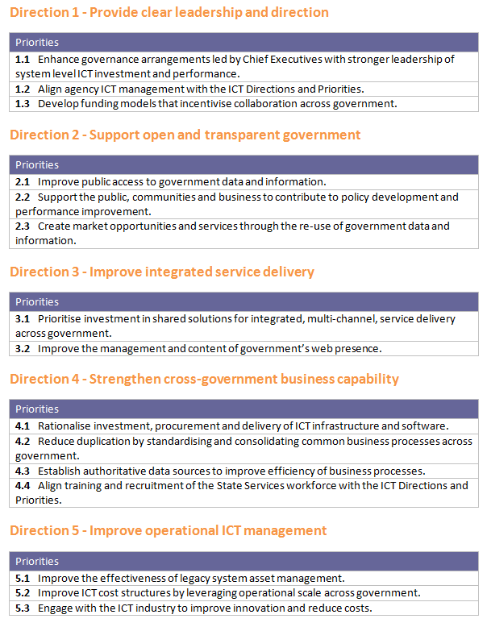
Directions and Priorities for Government ICT
ICT is central to the delivery of lower cost, higher quality public services
Current State
Tight fiscal environment – no more money for the foreseeable future.
User expectations of government services are increasing.
Government needs ICT to be more efficient, flexible, and focus on building services that are very easy to use.
80%¹ of technology spending is used to maintain current state, leaving 20% or less for improving services, innovation and opening up data.
Fragmented approach is a hand-brake on shared solutions, standardisation and freeing up money for improvement.
We are slow to exploit ICT and spread innovation. Good ideas and resources are not shared.
Funding models result in a silo approach to ICT investment.
Duplicated infrastructure and services in ICT is costly.
Poor ICT literacy, knowledge and skills in the current State Services workforce.
1- Government Use of ICT survey 2008
Future State
Government delivers services as a seamless customer experience.
ICT investment is focused and prioritised.
Government information and data is used by the market to deliver innovative services.
ICT systems are designed and run in a way that meets privacy and security requirements
Leadership puts priority on business improvement and common capability.
Customers and innovators outside government are helping to improve our services.
Common approaches are adopted for common needs, shifting the focus of agency ICT functions towards the effective delivery of core business objectives and priorities.
New and innovative ideas and resources are pooled and built on.
ICT operational management is more cost effective.
Greater ICT literacy in the State Services workforce
Notes:
The D& P put simplely

Slide 16
Enabling Directions and Priorities for Government ICT
DRIVEN BY BUSINESS NEEDS
Ministers
Agencies
Set Directions and Priorities for ICT as government policy
ICT Strategy Group
Engage with Chief Executives to set expectations of participation
Review Chief Executive and agency performance
Chief Executives commit to:
Lead agency Chief Executive is accountable for delivering a suitable cross-government product.
ICT Strategy Group will provide advice to Ministers on agency participation and fitness-for-purpose of cross-government products
Service provider agencies
Provide directive leadership for specific initiatives where appropriate
align agency ICT strategies with Directions and Priorities for Government ICT
participate in common capability services appropriate to their business
Cross-government products must be fit for purpose for the business needs of agencies
collective leadership through suitable governance arrangements
Early engagement with the ICT industry to enable collective problem solving
Agencies will manage ICT using common processes wherever possible and tailored processes where necessary
Efficiency
Agencies use standardised business processes
(e.g. BASS, debt management)
Agencies use common ICT infrastructure services
(e.g. igovt, ONE.govt, IAAS, procurement)
Common Capability
Cross-agency initiatives to deliver integrated service delivery using lower cost online channels and phasing out other channels
(e.g. MSD/IRD Service Link, Health, JBMS)
Service Delivery
Private sector service initiatives and contributions to government policy development are informed by data
Agencies apply NZGOAL and release non-personal data.
Open Govt
Leadership
Funding model that changes agency behaviour and enables cross-agency initiatives
Chief Executives participate in ICT governance arrangements to lead collaborative behaviour to achieve better defined outcomes
Value Equation
What will be different?
Work programme
Sector-based strategies
Common ICT Capabilities Roadmap
Work programme
Sector-based strategies
Common ICT Capabilities Roadmap
Enablers
Enablers
Notes:
The approach to enabling the D&P – who will be accountable for what

Slide 17
ICT Governance
Ministerial Committee on Government ICT
ICT Strategy Group
Government Business
Reform Group
Government Enterprise Architecture Group; ICT Supply Management Group
Government ICT Council
Data and Information Re-use CEs Steering Group
System Governance
Open Government Data
and Information Working Group
CCPG
1
CCPG
2
CCPG
3
Data 1
...
Data 2
Lead Agencies
,
Programme
Programme
Programme
Programme
Programmes and
Delivery Programmes and Initiatives
Initiatives
Notes:
The Governance structure
Still bedding in
Definite Buy in locked in the top – Ministers collaborating – walking the talk
Newly formed ICT Council – trend – work through any wrinkles
Danny.mollan@dia.govt.nz

Slide 18
Policy work
Understand agency mandates and capability
Operational work
Pilot data.govt.nz to expose data already released
Identify barriers to opening up non-personal structured and unstructured data
Engagement pilot – making supporting data available during policy consultation
Develop a common licensing framework
Identify priority datasets to be made open
Data & Reuse Programme
Notes:
Government is unlocking non-personal government data for some very compelling reasons
Make government’s performance as open and transparent as possible
Make policy papers and supporting data more available to more can contribute to its development
Release source data in formats that make it easy for others to download and create new business
Re-use it innovatively
Access research results, cultural material, etc, and use these in new ways
Next steps are about applying the NZ Government Open Access and Licensing framework (NZGOAL)
Providing training to all key stakeholders – legal first, then govt. And so on

Slide 19
Welfare/Revenue/Technology (MSD/IR/DIA)
Service Link
Citizen-centricity — putting the citizen at the centre of our Universe across government and designing around their needs
Self-service — giving the citizen the means and motivation to do things for themselves as much as possible for their convenience and empowerment
Privacy-respectfulness — leveraging igovt to provide transparency and privacy-centric information sharing
Mashed-up government — creating organic cross-agency/government connections that join up government despite the gaps and disparate interfaces
Multi-channel strategy — acknowledging that whilst ServiceLink is about online access, it doesn't deny the fact that other channels must continue to exist
Improve the effectiveness of legacy system asset management
Improve ICT cost structures by leveraging operational scale across government
Engage early with the ICT industry to improve innovation and reduce costs
Notes:
The New Zealand approach we describe as a “combo-hybrid”....an aspect of single integrated window....the “site” and its mashups, appls and features.......and franchised as it is pushed out to where people are. We hope we can prove this.
Only at conceptual stage, haven’t moved into the architectural design and standards......
Contact: richard.foy003@msd.govt.nz

Slide 20
Service Transformation and Information sharing Project
Information Sharing
Required to enable integrated service delivery
Proactive identification of entitlements/wrongdoing
Risk Profiling
Current Privacy Act not easily facilitating this
Ad-hoc Information sharing across Govt
Project Team
International benchmarking
Review of NZ information sharing initiatives
Input into Law Commission Privacy Act review
Notes:
There is uncertainty about what the Act allows
Compliance costs due in part to misunderstanding by agencies/public
A perception that current privacy principles/info matching arrangements require too high a threshold
The matching has limitations, info matching regime requires legislative change which is slow and resource intensive
Presents barriers to agencies identifying or working closely around common clients
A major enabler of the previous initiative requires extensive information sharing to operate efficiently – so a project team was set up
Had a look around what was occurring in overseas jurisdictions
What current or planned activities occurring in NZ
Privacy Act review – info sharing options and agency responses to these
Carried out some research into Nzers attitudes to info sharing
All this was presented to a steering committee with some recommendations for further work that could take another couple of years.....SC approved the recommendations but wanted them commenced and finished sooner....
Contact: Ros.coote@ssc.govt.nz

Slide 21
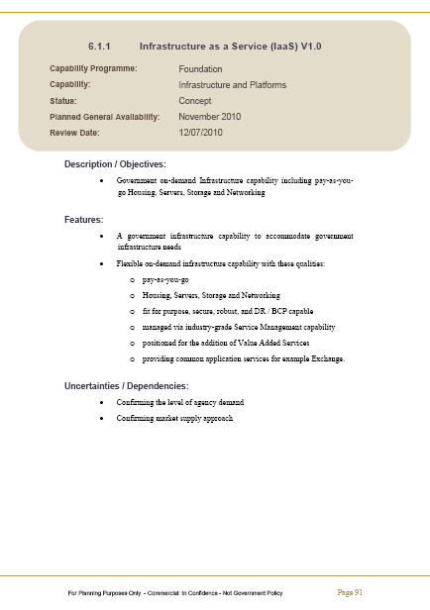
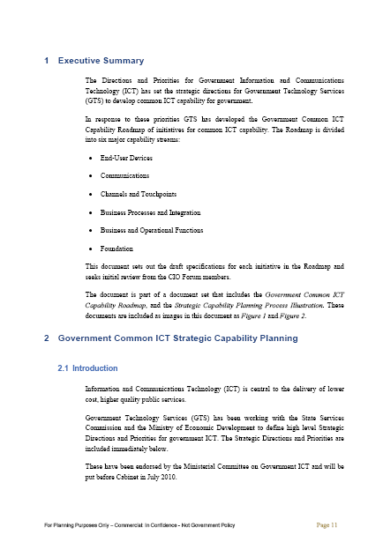
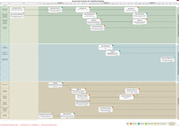
Common Capability Roadmap
GOVERNMENT – not GTS, nor DIA, but all-of-government, with capabilities led by lead agencies from across government.
COMMON – is any capability that can potentially be used across more than one agency. This also includes core capabilities, such as infrastructure and security services.
ICT CAPABILITY – these are common technology capabilities or building blocks, which enable business outcomes.
ROADMAP – the Roadmap lays out what ICT capabilities are already available, what are planned to be delivered when, what high-level features each capability has, and what dependencies exist.

Slide 22
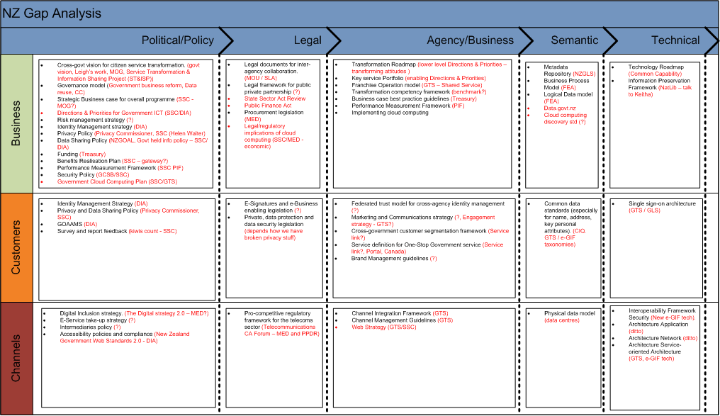
CS Transform Framework
Notes:
My role is to update our current dated e-GIF. This framework reminds our Govt that GIF’s are more than just about technology. I have left off the technology section. At this stage, I have attempted to map the NZ environment against the good practice promoted in the framework. This will highlight where we have no activity, where our resources should go, and provide at a glance what is happening across the board.

Slide 23
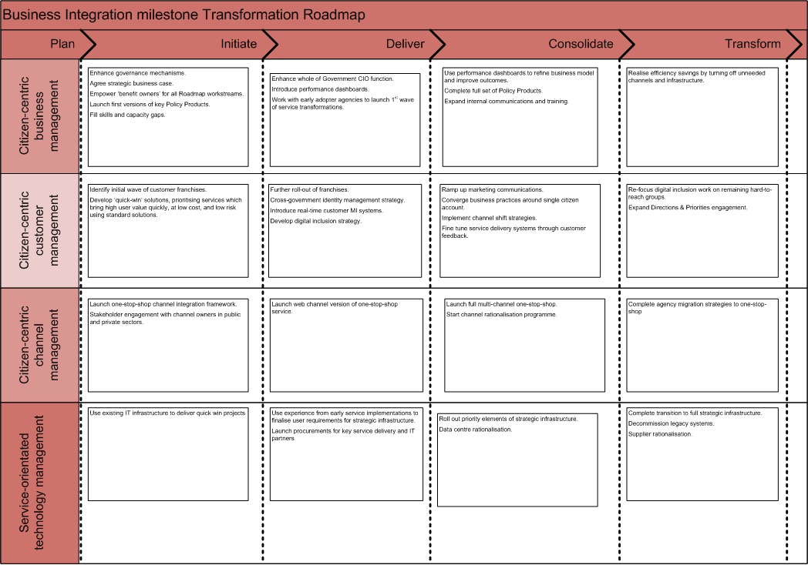
CS Transform Roadmap
Notes:
This is still left pretty much as the original. The intention is for the governance groups to be able to use this to monitor the progress and pace we are attempting change.
The challenges are: why have a e-GIF, surely having the governance structure in place, having minutes available is sufficient.....govt says we want it all in one place....we want an e-GIF. Resourcing.....not enough, priority of work......look and listen to what everyone else has to say and where we can collaborate – think tank, resourcing, material already developed. CS Transform into NZ.

Slide 24
Thank you
Karen Burns
State Services Commission
100 Molesworth Street
Wellington NZ
+64 4 495 6717
+64 29 248 3789
karen.burns@ssc.govt.nz

