Slide 2
Levels of Identity Verification
Knowledge based Authentication
Is this person who they claim to be?
Identity Verification
Is this a real identity? Are they of a minimum age?
Address & Credit Card Verification
Is the credit card active? Does the address on card match the consumer?
The Honesty Policy
I trust this information to be truthful

Slide 3
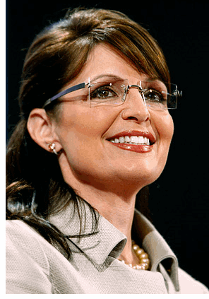
Social Networking Risks increase without identity verification
Account hijacking
Identity Theft and Fraud
Protecting Minors

Slide 4
Identity Working in Social Networks

