Slide 1
Context The shift from e-Government to Transformational Government

Slide 2
What I will cover
A little bit about CS Transform
A personal perspective on the emerging shift from e-Government to Transformational Government
Why it matters
Why we need a Transformational Government Framework
Towards future best practice

Slide 3
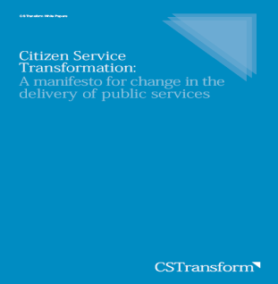
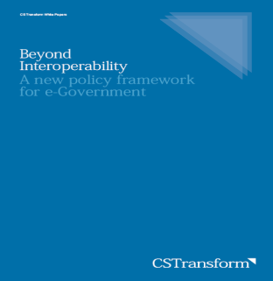
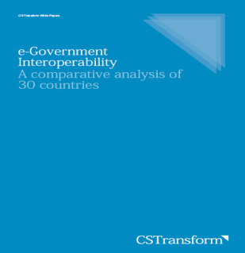
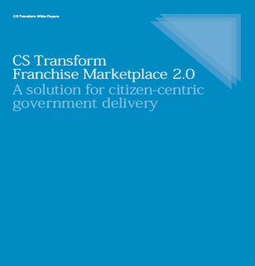
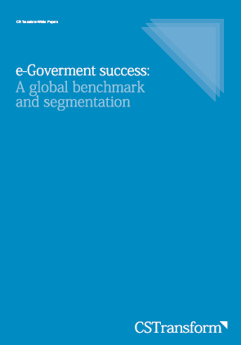
Who we are
A global consulting business, specialised in citizen-centric transformation of public services
Led by the senior management team from the UK Prime Minister’s office that delivered the UK’s e-transformation strategy between 1999 and 2004
Our consultants are senior ex-government people from around the world
Our team has supported over 35 governments around the world since 2004
Have published a series of white papers on Transformational Government, which we are contributing to the OASIS TGF process

Slide 4
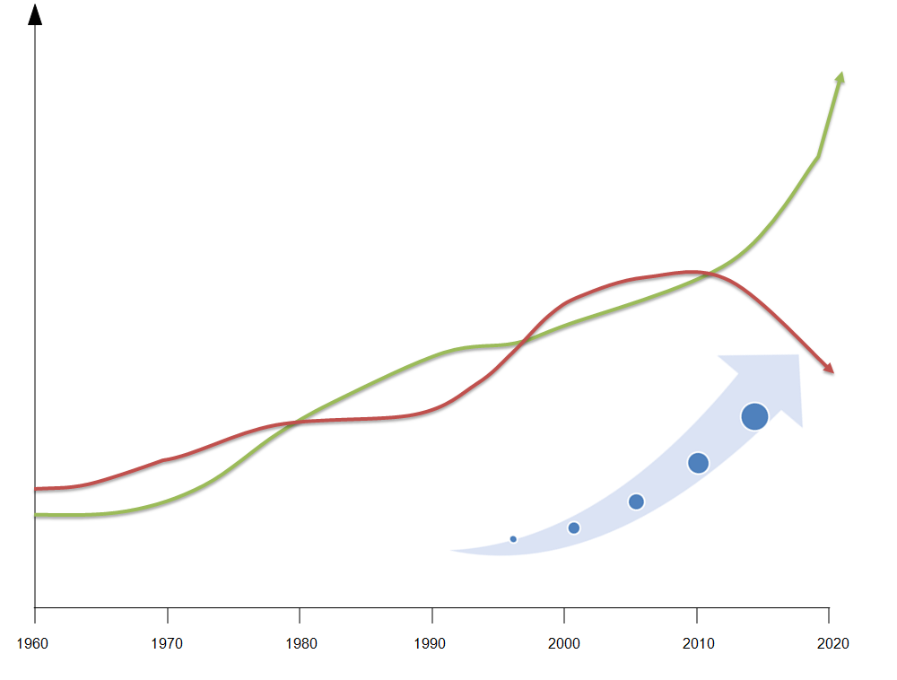
A brief history of e-Government From automation to transformation
eGov 2.0:
Transformational Government
Costs/ benefits of public sector IT
eGov 1.0:
Online Service Delivery
Computerisation:
databases and back office automation
Benefit realisation
Governance maturity

Slide 5
e-Government
No critical mass of users
Wasted resources
Duplicated IT expenditure
?
Little impact on core public policy objectives
$
$
$
$

Slide 6
Transformational Government
Business
Happier
customers
Customers
Citizen-
centric
business
model
Channels
Technology
?
Business
Lower cost
Customers
Channels
Technology
Business
Empowered
citizens
Customers
Channels
$
Technology
$
Business
Customers
Higher
policy impact
Channels
$
Technology
$

Slide 7
Two enablers of change
eGov 2.0:
Transformational Government
Costs/ benefits of public sector IT
eGov 1.0:
Online Service Delivery
Computerisation:
databases and back office automation
Benefit realisation
“Governments are shifting from a government-centric paradigm to a citizen-centric paradigm”
Governance maturity
Citizen-enabled
Citizen-focused
Integrated
Interoperable
Rethinking e-government services: user-centric approaches, OECD, 2009
Fragmented
Automation
Transformation
Mainframe
PC
Internet
Cloud

Slide 8
Some features of this shift
E-Government | Transformational Government
Government-centric | Citizen-centric
Supply push | Demand pull
Government as sole provider of citizen services | Government also as convener of multiple competitive sources of citizen services
Unconnected vertical business silos | New virtual business layer, built around citizen needs, operates horizontally across government
“Identity” is owned and managed by government | “Identity” is owned and managed by the citizen
Public data locked away within government | Public data available freely for reuse by all
Citizen as recipient or consumer of services | Citizen as owner and co-creator of services
Online services IT as capital investment | Multi-channel service integration IT as a service
Producer-led | Brand-led
Bolting technology
onto the existing
business model
of government
Focusing first on the business changes needed to unlock benefits for citizens, and only then on the technology

Slide 9
Why this matters

Slide 10
What we tried first in the UK
Multiple access channels
Internet
site
Internet enabled device
Kiosk
Interactive
TV
email
Telephone
Local govt. portals
Private sector portals
ukonline.gov.uk
Portal infrastructure
Life events
Government Gateway
Common web services
Registration and enrolment
Authentication
Secure e-mail
Rules engine
Circumstances and personalisation
Payments
Notifications
Appointments
Inter-operable departmental systems
E-Government Interoperability Framework
Notes:
10

Slide 11
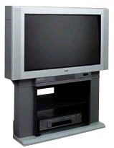
Impact
60
Multiple access channels
Buying online
50
DTV
Mobile
Call Centre
PC
40
40
Local govt. portals
Banking online
30
30
Private sector portals
Portal infrastructure
ukonline.gov.uk
20
20
Government Gateway
Government online
10
10
Common web services
Registration and enrolment
Authentication
Secure e-mail
Rules engine
Circumstances and personalisation
Payments
Notifications
Appointments
0
Q3
Q4
Q1
Q2
Q3
Q4
Q1
Q2
Q3
Q4
Q1
E-Government Interoperability Framework
Inter-operable departmental systems
2002
2003
2000
2001
Notes:
11

Slide 12
Impact of addressing the business model
Average monthly visits

Slide 13
Business model transformation is the universal key to success
Headline results from new research by CS Transform
Countries which have made most progress in transforming the governance of their key service delivery processes around the needs of citizens score most highly on the United Nations benchmark of e-Government performance
Business
management
Customer management
Channel
management
Technology management

Slide 14
e-Government performance is strongly correlated with broader market maturity
More advanced
e-governments
Developing
e-governments
Early e-governments
Citizen
Service Transformation

Slide 15
But “governance maturity” is more important
1. Maturity of current government business processes
Rate this country from 0-4 for each of the 5 business processes listed in column B below, using the ratings in the row below, based on the statement which is most appropriate for this country:
 | No Government-wide service delivery strategy. Services managed independently by separate agencies. No sharing of channels or infrastructure. | Government wide service delivery strategy established. But mechanisms to ensure compliance are weak, and performance by agencies is variable. | Service strategy is now underpinned by coordination systems to enable inter agency collaboration, with common benchmarking and measurement. But governance and funding levers are still agency based. | Governance and funding systems have been transformed to focus around needs of the customer not the structure of government. | Governance and funding systems now in place to give citizens direct influence over overall strategy. Real-time feedback loops are in place to drive service improvement.
 | No integrated view of the customer, either across agencies or across the channels of an individual agency. Personal data is managed in agency silos, with authentication for e-services done separately for each service. | Still no integrated view of the customer. But common standards defined on how to segment the customer base and measure customer satisfaction, and some standardization of key data sets across agencies. | Government-wide customer measurement system in place. Citizens can access a single place to register and enroll for multiple services. Cross-trust arrangements between agencies allow users automatic access to other services requiring similar levels of authentication. | Government has a single view of the customer, able to learn about the citizen and ‘cross- sell’ services to them. Real time customer intelligence. Citizens manage their own data, are able to see who in government is using it, and can choose to manage all of their engagements with government through a single account. | Citizens are able to create services through government channels, uploading own data and networking with others. User feedback and customer satisfaction ratings are visible to citizens, informing service choice in real time.
 | Little choice of channels for citizens. Each agency manages its own channels, leading to cost duplication and customer confusion. | Some ‘thin’ channel integration in place e.g. ‘Government Portals’ but only signposting. Some cross-channel service integration starts, but at an agency level only. Still significant channel duplication. | Several channels are provided on a government wide basis, and start to converge around a common web-based infrastructure. “Directed choice” strategies are in place to encourage shift to lower cost channels, but services are still driven on an agency basis. | Integrated, cross-government, multi- channel “one stop” system. Services designed around citizen needs, not the structure of government.. Legacy channels close, unlocking efficiency savings Strategies in place to ensure access to and use of digital channels by all citizens. | In addition to the one-stop system, Govt services are widely available via private sector channels. And govt channels are open for citizen-to-citizen and community-created services.
 | Little significant e-Government infrastructure, and what there is is managed on an agency-by-agency basis with no common framework. | Some robust and secure e-Government infrastructure, delivering back office automation, and content and services to citizens. Managed at agency level, with some coordination around standards. | Significant e-Government IT infrastructure with advanced features such as transactional services, critical e-Government applications (e.g. payment/authentication/ forms engines etc) for a substantial number of government services. Full eGIF in place. | Government-wide enterprise architecture, with some shared services. Joining-up (central/regional/ local) and connection to private and third sectors. Federated ID management for a significant number of services. Govt-wide knowledge capture/ management. | Government-wide service oriented architecture. Optimised technology with shared services/cloud, collaboration/web 2.0. Fully joined-up (central/regional/ local) and connected to private and third sectors. Single sign-on with knowledge capture/ management.
Fragmented (1)
Interoperable (2)
Integrated (3)
Citizen-focused (4)
Citizen-enabled (5)
Business management
Results from CS Transform’s analytical model
R² = 0.84 | F = 0.00
Co-efficient of variables: ICT infrastructure Human Development GDP GDP per head Complexity Governance |  | 0.36 0.03 0.15 0.00 0.00 0.65
These internal governance transformations are the single most important factor in driving higher levels of performance
Customer management
Channel management
Technology management

Slide 16
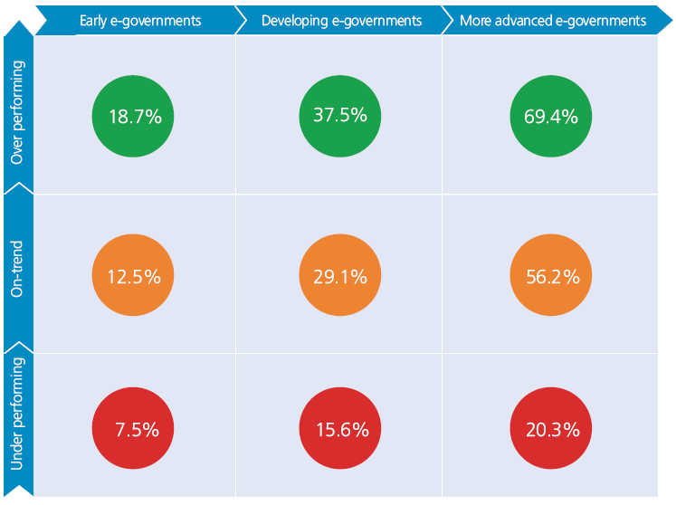
“Governance maturity” is a differentiator at all levels of development

Slide 17
Why the need for a Transformational Government Framework?

Slide 18
The problem
eGov 2.0:
Transformational Government
Costs/ benefits of public sector IT
eGov 1.0:
Online Service Delivery
Computerisation:
databases and back office automation
Benefit realisation
Governance maturity
Most governments are still here
Getting this right is hard, and there is little guidance

Slide 19
In theory, current e-government frameworks address governance and business change
European Interoperability Framework v 2.0

Slide 20
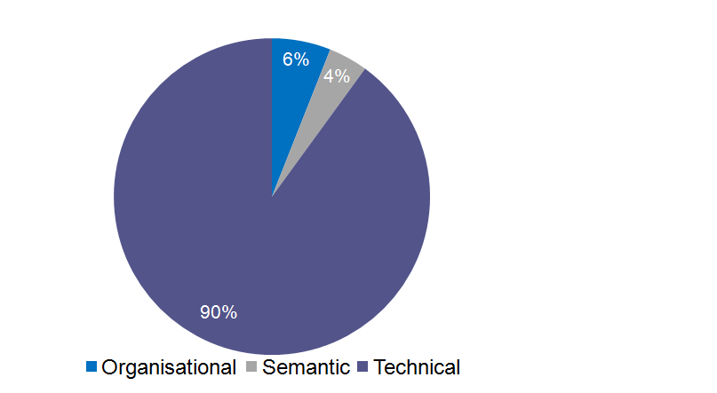
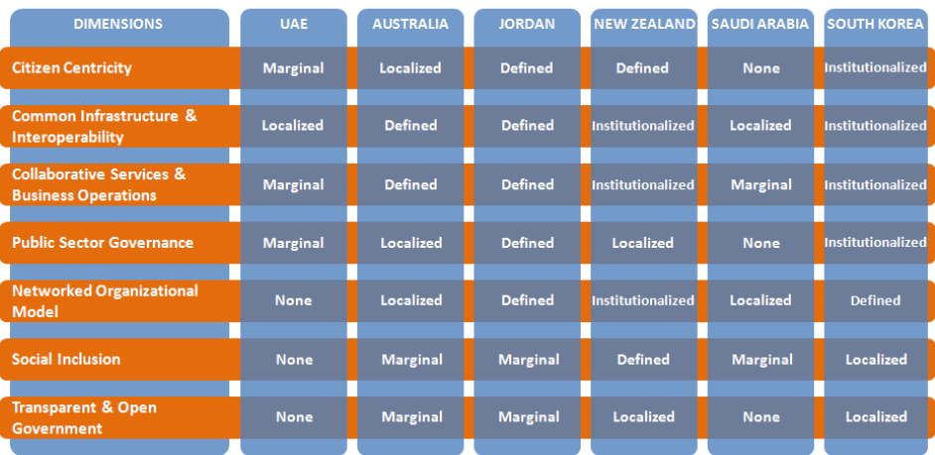
In practice, most policies focus on technology not business
CS Transform research across 30 national government Interoperability Frameworks found a 90% focus on technology
Research by the National University of Singapore into Government Enterprise Architectures found most are technically focused, and disconnected from key dimensions of government transformation.
Source: E-Government Interoperability: a comparative analysis, CS Transform, 2010, www.cstransform.com
Source: Understanding the impact of Enterprise Architecture on Connected Government: a qualitative analysis, National University of Singapore, 2010

Slide 21
There are significant gaps in best practice frameworks
Interoperability Domains
Political
Legal
Organisational
Semantic
Technical
Business
Cross-government vision for citizen service transformation
Governance model^{1,2,3}
Strategic Business Case for overall programme¹
Risk Management Strategy
Legal vires for inter-agency collaboration
Legal framework for public private partnership
Transformation Roadmap
Key Services Portfolio¹
Funding model
Franchise Operating model
Transformation competency framework
Business case best practice guidance¹
Performance Measurement Framework²
Benefits Realisation Plan¹
Metadata Repository^{1,3}
Business Process Model^{2,4}
Logical Data model^{2,4}
Technology Estate Map¹
Technology Roadmap¹
Information Preservation Framework¹
Channels
Digital Inclusion strategy
E-Service take-up strategy
Intermediaries policy
Accessibility policies and compliance¹
Pro-competitive regulatory framework for the communications sector
Channel Integration Framework²
Channel Management Guidelines^{2,3}
Web Accessibility Guidelines^{1,3}
Presentation Architecture⁴
The Citizen Service Transformation value chain
Customers
eSignatures and e-Business enabling legislation^{1,2}
Data protection and data security legislation^{1,2}
Federated trust model for cross-agency identity management^{1,2}
Marketing and Communications strategy
Cross-government customer segmentation framework
Service definition for One-Stop Government service
Brand Management guidelines
Common data standards (especially for name, address, key personal attributes)^{1,2,3}
Single-sign on Architecture³
Identity Management Strategy¹
Data Sharing Policy^{1,2}
Technology
Supplier management guidelines
Service level agreements¹
Physical data model⁴
Interoperability Framework^{1,3}
Security Architecture^{1,3}
Application Architecture⁴
Network Architecture⁴
Service-oriented Architecture¹
Information Security Policy^{1,2,3}
Procurement legislation¹
Framework contracts¹
Sources for reference models
1: European Interoperability Framework v1 draft, http://ec.europa.eu/idabc/en/document/2319/5644
2: US Federal Enterprise,
Architecture www.whitehouse.gov/omb/e-gov/fea/
3: UK GovTalk, www.govtalk.gov.uk
4: Zachmann, http://zachmaninternational.com/index.php/home-article

Slide 22
Towards future best practice

Slide 23
A starting point for discussion
The Citizen Service Transformation Value Chain
Guiding Principles for
Citizen Service Transformation
Citizen-centric
business management
Citizen-centric
customer management
Citizen-centric
channel management
Internet
Walk-in
DiTV
Phone
(and mobile device)
Mail
Front-line staff
Lower
cost
Key service delivery process
Strategy >
Business Model
Channel Management Strategy
Policy
outcomes
Policy Products
Delivery Roadmap
Identity Management
Vision >
Marketing and branding
Citizen empowerment
Impact
Transformed customer experience
Service-oriented IT architecture
Strategic clarity
Skills
Stakeholder
engagement
Future-proofing
Critical success factors
Benefit
realisation
Leadership
User focus
Supplier partnership
Do-ability

Slide 24
Key features which led to OASIS approaching us
Citizen-focused and business driven
Demonstrably leads to significant levels of citizen take-up
Has been shown to work in many different types of government:
National, state and city level
Deployed in Western Europe, Eastern Europe, Middle East, Far East and Australia
Is standardised so it can be delivered by many partners and embedded in software tools

Slide 25
Summary
The OASIS Transformational Government Framework is necessary, because:
Transformational Government strategies are the essential next step to deliver real benefit from e-Government
But there are significant gaps in the existing reference models and frameworks which governments can draw on, particularly in terms of business change and governance models
The OASIS Transformational Government Framework is possible, because:
Success of CS Transform’s model in widely differing governments proves that a replicable, standardised approach to citizen-centric business change is possible.
We don’t claim that our model is the finished product.
But we are committed to helping deliver the shift to Transformational Government as rapidly as possible - so are delighted to make all the IP in our White Papers freely available for use by OASIS.

Slide 26
Thank you
chris.parker@cstransform.com

