Slide 1
International Grid Trust Federation
Jens Jensen, STFC (www.stfc.ac.uk)
Int’l cloud symposium, 10-13 Oct 2011, Ditton Manor, Langley, Berks, UK

Slide 2
Background(s)/Acknowledgments
Rutherford Appleton Laboratory
Needs of diverse research communities
High end data/compute/networks
UK Grid for Particle Physics
Need for global grid identity
High LoA
National Grid Service/(Initiative)
Need for national identity
Selected global collaborators
Contrail project
Federated identity to cloud
Building on existing authentication A(A(A))I

Slide 3
Overview
IGTF
Trust
Reputation
Audit
Scope
LoA
Processes
Global
Technology
Standards
Interop
X.509
PKIX
OGF
Self
Ext’l
Use
Infra structure
Operations
Software
HSMs
NIST
Mapping
Nat’l feds

Slide 4
Structure
IGTF
PMA
Americas
“EU”
(EU++)
Packaging processes
Asia Pacific
RAT
OGF CAOPS

Slide 5
Decisions
Identity vetting, privacy
Auditing
Fed’d id mgmt
Policy mapping, LoA
Credential mgmt
Implementation: software
(Ab)use of standards
Statistics and growth
Trust and W&F
Global perspective
Projects, OGF, CAOPS
Id mgmt over time
Politics...
Technical limitations
Users, usability
Authorisation, delegation
Purpose – use of certs
PMA policies, RP policies
ALL SLIDES WILL BE MADE AVAILABLE

Slide 6
1. Identity, privacy

Slide 7
Identity
Core IGTF rule:
Users have proved their (natural) identity to a trusted person using photo id
This can be:
Bring passport, site pass, or driver’s licence, to registration authority (“classic”)
Prior validation by trusted identity manager
Immediate validation by suitable SAML assertion

Slide 8
Naming of People
Names are usual X.500y names
printableString
Names are public (certs are sometimes)
commonName contains a reasonable representation of the user’s validated name
Reasonable to map ß→ss, é,ê,ë→e, ø,ö→o or oe, etc.
Can add disambiguating string
But don’t use apostrophe, slash, comma, equal sign, ...

Slide 9
Personal certificates vs shared
Strong tradition for individual certs
Learning curve for credential management
See usability (16)
See certificate use (17)
Also case for “shared” certificates
E.g. portals
EGEE WG on portal authentication
E.g. canned jobs vs open

Slide 10
2. Auditing

Slide 11
Auditing
Operational review
Audits are self-audits
Result of ~2nd audit presented to PMA
Two reviewers assigned
A-D classification (A=OK, D=MUSTFIXNOW!!)
Self auditor usually harsher ☺
Supplemented with opportunistic on-site audits
Some CAs have audits already (eg WebTrust)

Slide 12
Audits
RAs (if applicable) are audited (“classic”)
Annually
But slightly less so for large CAs
(UK: ~3 year cycle)
Travelling salesman problem ☹
Audits are on-site!

Slide 13
Audits
Identity Providers (MICS and SLCS)
MUST be audited!
(By whom?)
Tricky for data protection reasons?

Slide 14
3. Fed’d Identity Management

Slide 15
Credit: David Groep, NIKHEF

Slide 16
Initiatives
Shibboleth federations: e.g. Switzerland
Shibboleth superfederations: TCS
Comprising nordic countries, Netherlands, ... http://www.terena.org/activities/tcs/
Note distinction between hosts and users
Moonshot – JANET, CESNET, Painless Security, ...
http://www.project-moonshot.org/
UK pilot (just) launched

Slide 17
The need for fed’d identity
Contrail:
Federated identity accessing multiple clouds
http://contrail-project.eu/
PanData:
Federated identity for neutron/synchrotron
Single IdP at umbrella.psi.ch

Slide 18
Standards in fed’d id mgmt
HTTP(S), SAML, XML(+sig)
Moonshot: GSS, EAP, RADIUS, SAML
WS-Federation... ask me later!
Lots of glue...

Slide 19
4. Policy Mapping, LoA

Slide 20
CP/CPS
MUST (SHOULD) use RFC 3647
And/or 2527
Aid policy evaluations
In theory, should aid mapping across CAs

Slide 21
Proposed
Inter-federations
CA-2
CA-1
CA-2
CA-3
HE BR
CA-1
AusCert
CAUDIT
PKI
CA-n
NIH
HE JP
FBCA
Cross-cert
Cross-certs
C-4
DST
ACES
Dartmouth
HEBCA
Texas
Cross-certs
IGTF
Wisconsin
UVA
Univ-N
USHER
CertiPath
SAFE
Other
Bridges
CA-4
Scott REA,
DigiCert
CA-1
CA-2
CA-3

Slide 22
FPKI
HEBCA/USHER
High
Medium Hardware CBP
High
Medium Software CBP
Medium
Basic
Basic
Rudimentary
Rudimentary
IGTF
C-4
Classic Ca
Foundation
SLCS
Scott REA,
DigiCert
MICS

Slide 23
LoA
How identity is validated
Credential issuance/delivery
Keys generated, managed
Quality of crypto: key size, algo
User’s ability (and motivation)
To multifactor or not to multifactor
The role of auditing

Slide 24
5. Credential management

Slide 25
X.509 certificates
Users generate their own private keys
PKCS#8
PKCS#5
PKCS#10 or SPKAC requests
PKCS#12

Slide 26
“Remote” key generation
Allowing key generation on managed host
Allowing key generation in advance
Allowing key generation by “trusted 3rd party”
Needs revision! But it’s already permitted...!

Slide 27
Secure key generation
FIPS140-2 level 2 validated key tokens
Or “close to validation”
CA (RA) must witness key generation
Occasional driver issues...
Variously combined with
OTP (token gen’d)

Slide 28
6. Implementation software, countries

Slide 29
Option 1 (a and b)
Running own CA on own infrastructure
Need to physically secure CA key
Offline, or HSM (FIPS140-2 L3 ... or L2?)
Many using OpenCA
Perl, Apache
Browser based
Options beyond grid CAs (e.g. server side key generation)
Occasional customisations, intertia

Slide 30
Option 2, 3
Option 2
Commercial hosting
Needs funding beyond most ☹
Gets you browser-friendly certs ☺
Option 3
NATO funded code: open source CA
See (13)

Slide 31
7. (AB)use of standards History, policy mgmt

Slide 32
Standards
ITU X.500 – X.509, certificates
IETF: PKIX, RFC 5280
... OGF: GFD.125
Example: use of UTF-8 by “Jan 2004”
printableString vs UTF-8
UTF-8 in ASCII log files...
PKCS – see (5)

Slide 33
History
CA collaboration group
Grew out of HEP needs
Led by David Kelsey (STFC)
Eventually grew into EU PMA
But even then had US and Canada
Other PMAs came later

Slide 34
Early (external) input
NIST SP 800-63 (and -39, -53, -57, -60, etc.)
Various FIPS docs (e.g. 140, 199, 200)
ABA: PAG v.0.30
PKI Assessment Guidelines
Other PKI practices (e.g. DFN)

Slide 35
8. Statistics and future

Slide 36
IGTF survey (as of ~April ’11)
76 issuing CAs and 13 non-issuing
Most have 1-10 RAs
4 have 70 or more...
Most authorities have 20-200 valid users
Average 471; median 91
~5-8 have thousands
Much of stats: credit David Groep, NIKHEF

Slide 37
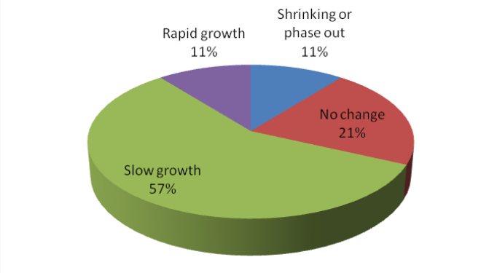
Future (expected)

Slide 38
Attributes
~80% join a VO (at least for UK certs)
VOs exp dist’d
At least as logged by EGI
Some large
A number of VOs with a single member!

Slide 39
9. Trust and W&F

Slide 40
Trust
Ultimately a human decision
The famous “warm and fuzzy feeling”
Technology mediates
Trust: need processes for
establishing
maintaining
and repairing

Slide 41
Trust
Establishing
New CA manager to appear before PMA and present their country/institute/CA
Maintaining
Presenting audits, “presence”
Responding to RAT comms challenges
Repairing
Plans for fixing
Reviewed by peers
Everything that can go wrong, will ☹

Slide 42
The role of PKI
PKI technology does help scaling
(Shameless plug)
J Jensen, D Groep: “Managing Authentication in the Global Research Infrastructure”, in Handbook of Research on Computational Science and Engineering: Theory and Practice

Slide 43
10. global perspective

Slide 44
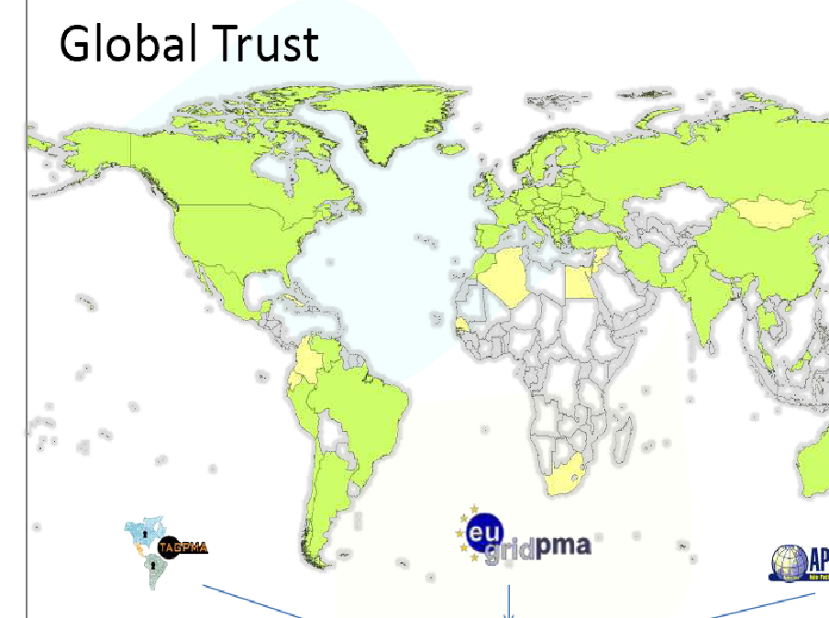
Credit: David Groep, NIKHEF

Slide 45
Members
Members are (national) CAs
Sometimes supernational
Sometimes subnational
~1 CA per country
Also national RPs, via their CAs (Marseille accord)
Supernational RPs: EGI, WLCG, (DEISA), OSG, (TeraGrid)/XSEDE

Slide 46
11. Projects, OGF, CAOPS
Who does the work?

Slide 47
Who does the work...
No work gets done without tea and coffee
Tea and coffee cost money
Therefore money is needed to get work done

Slide 48
OGF activities
CAOPS: operating CAs (not policy)
Documenting middleware quirks
Also hosts IGTF (policy, not operations)
OGF formal home for “blessing” docs
Unifying considerable expertise (globally)
Also brings in software interop/dev/test
Ensure process is open (PMAs closed)

Slide 49
The People Question
Varying level of skill in nat’l reps.
Some mentoring at startup time
Learn on the job

Slide 50
12. identity over time

Slide 51
What is the identity
Distinguished Name
One year lifetime (or 13 months)
“Renewal” (usu. rekey) after 12 months
Maintains link to original id verification
Maintain traceable records
Maintains “uniqueness” of DN
Resurrection of “dead” DN only via orig. id

Slide 52
The Roaming Identity
Identity federations providing persistent attrs
E.g. Australia...
Canada (to appear)
Can move id (at user’s request) to new home
Not the ePTID, ePPN which tie to the IdP

Slide 53
The need for the name
DNs are used for authorisation
Usu. indirectly, mapping DNs to attrs: groups, roles
Data protection: need to keep data while needed
And destroy ~3 yrs after no longer needed
(Use case: 2.5 years)
Can also re-establish old key
How long do you keep/remember old key?

Slide 54
13. politics

Slide 55
“Official(?) roles”
EU
Ack’d by e-IRG (Dublin) www.e-irg.org
US
DoESG: OSG
NSF: XSEDE
Brazil
Semi gov’t

Slide 56
Continuing growth in CA/(ountries)
Science follows money
E.g. EU funding to work with China (EUChinaGrid), India (EUIndiaGrid), South America (EELA, and the new one)
But also crosses boundaries
Iran, Syria, Jordan ... and Israel
Taiwan and China
India and Pakistan
Africa: Tunisia, Algeria

Slide 57
Continuing growth
NATO Science for Peace and Security
“Cybersecurity” for NATO Partners
“Silk road” -
CLG 983430
Collaboration between YerPhi, Armenia, and STFC
A Hayrapetyan, et al: open source CA

Slide 58
No key escrow
Keys not used for encryption (see usage (17)).
Data release for law enforcement

Slide 59
14. technical limitations

Slide 60
Entertaining Technical Limitations
printableString
BMPString caused stuff to break
As did T61 ☹
UTF-8 has separate issues
Funny characters: é broke XML
Apostrophe (‘) with DN in SQL

Slide 61
What’s in a name
Printed representation of names used
emailAddress in DN
emailAddress=, or Email=, or E= ?
Re-encode from stringified repr.
VOMS...
No guarantee of original encoding
What is displayed by browsers?
CN, O, OU,...

Slide 62
Not just DNs
Extensions:
Use of SMIME for signing non-email
The presence of CDP in non-root CAs
CRLs
Need CRLs for non-revoking CAs
Number of CA certs in distro
Cross certs, OCSP, bridging

Slide 63
“Interesting” design decisions
VOMS authenticating on subject and issuer DN...
But the issuer DN changes
Because X.0, X.1, ..naming not supported
Using hyphens in CN as wildcard sep.

Slide 64
15. authorisation, delegation

Slide 65
ABAC – outside IGTF
Attribute authorities often VOMS
V Ciaschini (et al) http://www.ogf.org/documents/GFD.182.pdf
RFC 3281 ACs
Also a SAML version (needs doc)
Embedded as ext in X.509 (proxy) certificates

Slide 66
Delegation (or, “delegation”)
Irritates the purists ☺
RFC 3820 (and its forerunners)
Certificates signed by an end entity cert
Restrictions on names
Add or remove attributes
Supported in OpenSSL
Compile time flag

Slide 67
Delegation and credential mgmt
MyProxy (J Basney et al, NCSA)
Credential repository
Can generate keys – act as CA
Or stores – and delegates – proxies
Principle: private key doesn’t cross the wire
Also acts as trust anchor repository
Username/password authentication
Or Kerberos, Shibboleth (NGS), ...

Slide 68
16. users, usability

Slide 69
Certificates “difficult”
openssl pkcs12 –in foo.p12 –clcerts
–nokeys –out mycert.pem
Browsers
Import/export .p12
... ugh!

Slide 70
Usability – certificates
NGS: “CertWizard”
Java tool for friendly cert mgmt (+MyProxy)
http://www.ngs.ac.uk/news/e-science-certificates-the-easy-way
Making certificates easier
Exports PKCS#12, PKCS5+8, ...
Revocation, rekey
Allows rekey after expiry
Using ReST-XML
Tailored to UK, though...

Slide 71
Usability – Keys
Never-ending (and often heated) debate
Users managing their own keys
Or keys “taken away” from users
Find a compromise
Preserve the W&F (9)
Without compromising security...(!)
And improving usability

Slide 72
17. Purpose: use of certificates

Slide 73
Certificate Usage
Personal certificate:
Main purpose: authentication
Digital signatures (simple)
Signed email (sometimes)
Hosts
Main purpose: authentication
(Clients: rekey themselves)
(Need to sign usage records!)

Slide 74
Certificate usage
“Robot” certificates
Automated agents acting for a user
Portals running jobs
Automated tests
Mail encryption
Timestamping...
Other trusted signatures
General usage:
Grids and e-Science – no financial txns

Slide 75
Grids and Clouds
RPs are grids and other e-science, e-research, e-*
Certificates finding surprising uses ☺
Not all of which are permitted ☹
UK – used to be 50%NGS, 20% GridPP, ... and who knows what the rest are doing...

Slide 76
18. PMA and RP policies
Tying the “federation” together

Slide 77
PMA policies
Continuous process to adapt, improve
Often heated discussions ☺
Sometimes triggered by new members
“Policies expressed in technology” – getting away from this (slowly)
Supertanker inertia

Slide 78
The Scientific Approach
Interfacing with new technologies
OGF PGI
→ OGF fedsec-cg
Shameless plug #2
“Soapbox” lecture series
Q, R, S series
Need some work to make more widely available...

Slide 79
RP Policies
The group formerly known as the Joint Security Policy Group
www.jspg.org
The path beyond the IGTF
User sign up, VOs
Use of resources

Slide 80
Conclusion
Thought he would never get to the:

Slide 81
IGTF
International Grid Trust Federation
Global PKI, operating at mostly the same level of assurance
Practical: little time for stuff that doesn’t work
Innovating and improving – within the framework
PMA (closed) ⬄ OGF (open)
Policies ⬄ Operations

Slide 82
Further Information
www.igtf.net
D Groep, M Helm (eds):
http://www.ogf.org/documents/GFD.125.pdf
www.ogf.org: caops-wg, fedsec-cg
Email: j.jensen.ral (*) gmail.com or jens.jensen (*) stfc.ac.uk
THESE SLIDES WILL BE MADE AVAILABLE
ON http://www.ngs.ac.uk/ (and OASIS?)

