Slide 1


Building Trusted Transactions
Identity Authentication & Attribute Exchange
In Public and Private Federations
OASIS Conference September 2010
Joni Brennan, Kantara Initiative
Don Thibeau,
OpenID Foundation
Open Identity Exchange

Slide 2
Overview
What’s all this fuss about Trust Frameworks?

Slide 3
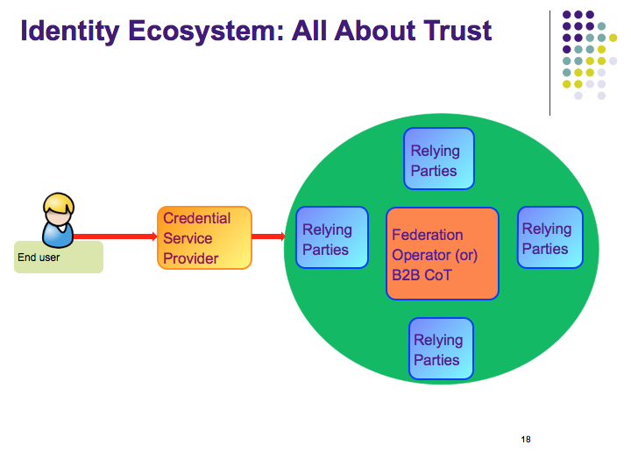

Slide 4
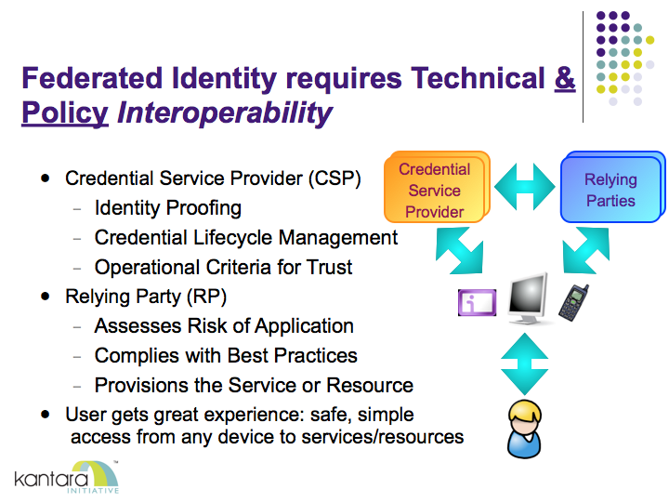
The Trust Community
Four main roles involved in making online exchanges trustworthy:
  End-Entities who are the subjects of identity credentials
  Credential Service Providers (CSPs)
  Auditors
  Entities that rely upon the credentials issued by CSPs, referred to as “relying parties.”
Our Identity Assurance Framework is targeted to address each of these community roles…

Slide 5
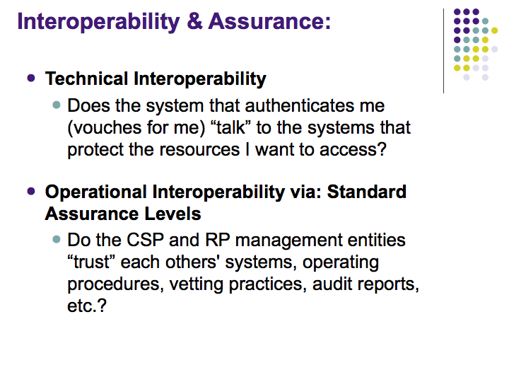

Slide 6
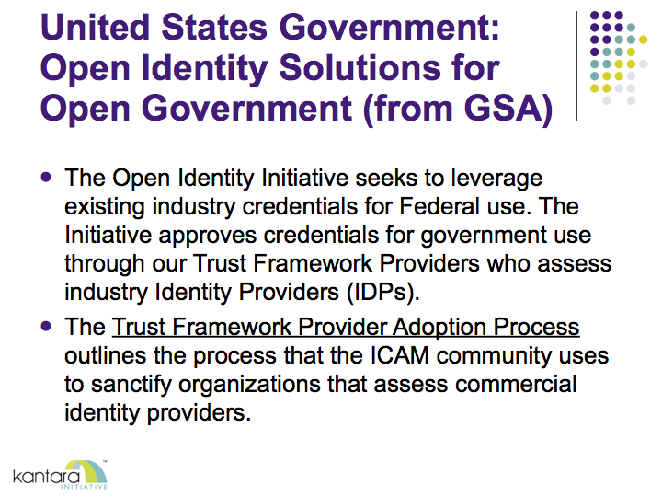

Slide 7
Kantara Initiative approach to Federated Identity
Identity Assurance Framework – one stop policy shop…

Slide 8
Identity Assurance Framework Components

Slide 9
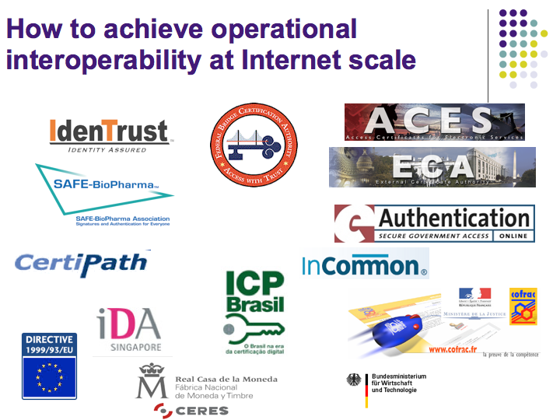

Slide 10
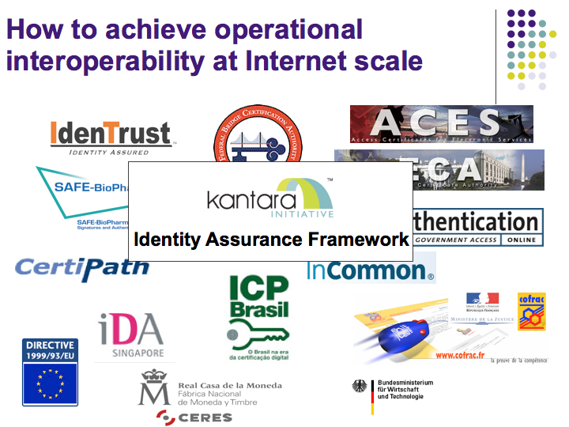

Slide 11

Kantara Initiative Accreditation and Certification
Who should apply and how?
  Assessors / Auditors
  Credential Service Providers, Identity Providers
For More Information
  Visit our Assurance Certification Center: http://bit.ly/assurance_certification
  Connect with me: joni@ieee-isto.org

Slide 12
What’s Next?
Profiles, profiles and more profiles
  Jurisdictional (governments), HealthCare, Financial, Telecommunications, etc
Federation Interoperability Work Group (FIWG)
  With input from international stakeholders FIWG developing tools for Federations to use for Interoperation.
  Enabling communication of Meta-Data between Federations
  Open for adoption by communities world-wide via Creative Commons IPR

Slide 13
Benefits of Adoption
US Government ICAM Adopted Level 1, 2, 3 non-crypto
Identity Assurance Framework (IAF) is technology Agnostic
  Can be adopted as organizational policy framework regardless of the technology protocol in place.
  Lowers cost to jurisdictions and entities enabling eased transition in to Trust Framework Model
Has Kantara Initiative international community input
  Austria, Canada, Denmark, France, Japan, New Zealand, Sweden, United Kingdom, United States – the list keeps growing
Enables Inter-federation through trusted and certified credentials
  Could be applied across jurisdictional federations like the European Union.
Enables Government entities to leverage private-sector activities

Slide 14
Working Together
Building Trust…

Slide 15
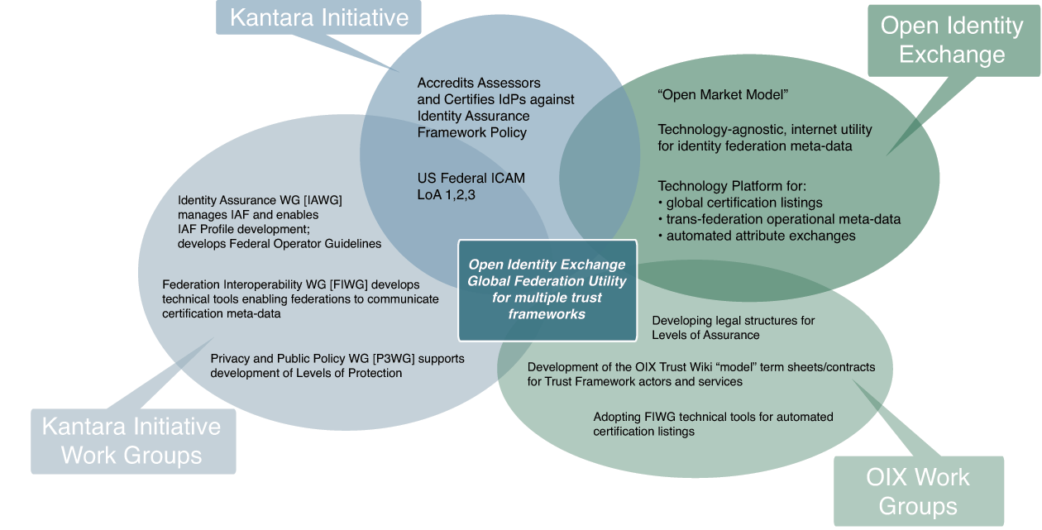
Collaboration

Slide 16
Kantara Initiative
Work Groups
Kantara Initiative –
Identity Assurance (IAWG)
    http://kantarainitiative.org/confluence/display/idassurance/
eGovernment (eGovWG)
    http://kantarainitiative.org/confluence/display/eGov/
Federation Interoperability
    http://kantarainitiative.org/confluence/display/fiwg/
Privacy and Public Policy (P3WG)
    http://kantarainitiative.org/confluence/display/p3wg/

Slide 17
Open Identity Exchange (OIX)
Work Groups
Telco Data Work Group
Verizon, AT&T, TNS, Pacific East, etc.
Public Media
    National Public Radio, Public Broadcasting Service, etc.
Librarians, Authors, Publishers
    National Institute of Health, National Library of Medicine, ORCID, APA, etc
Identity Attributes Trust Framework
    Google, Yahoo!, AOL, Hot Mail, etc.

Slide 18
OIX/Kantara Collaborative Work Groups
US ICAM Higher Levels of Assurance
OIX, KI, US GSA, US NIH, etc.
A public private partnership to define new technical /policy profiles for higher levels of assurance (NIST LoA 2 and 3)
A forum and forcing function to map policy and legal issues to government and citizen interaction over the web
A collaboration among leading industry organizations to break new ground in trust framework development

Slide 19
Introduction to OIX
A Market Solution to Online Identity Trust…

Slide 20
A Matter of Trust
Relying Parties must be able to trust that the Identity Provider is providing accurate customer data
Identity Providers must be able to trust that the Relying Party is legitimate (i.e., not a hacker, phisher, etc)
Direct RP-to-IDP trust agreements
are a common solution, but are
impossible to manage at Internet
scale

Slide 21


The Trust Framework Solution
OIX Trust
Framework
Identity
Service
Provider
Relying
Party
user
Trust Community

Slide 22





Proven Trust Frameworks Exist!
Credit Card Trust
Framework
Trust Community

Slide 23
The OIX Identity Trust Framework Model
Identity
Service
Provider
Relying
Party
Open Identity Exchange
Trust framework agreements
user
Notes:
23

Slide 24

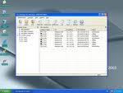
What OIX Provides
Referee
  Neutral, technology agnostic provider of trust frameworks
Certification Listing Service
  Machine-readable information about trust framework participants and certifications

Slide 25
OIX Drives Adoption
By improving market efficiency
By providing openness and transparency
By ensuring credibility and accountability in the system
By enabling improved user experience
Notes:
25

Slide 26
Real World Examples
OIX U.S. ICAM (Identity, Credential, and Access Management) Trust framework
  For U.S. federal government agencies
OIX Telecom Data Trust Framework
  For Telco Data Services providers
  For Data Aggregators

Slide 27
Summary
OIX and KI work together to provide
an Internet-scale solution
to enable trusted online
digital identities

Slide 28
Thank You!
Get in touch with us…
Joni@kantarainitiative.org
Don@openidentityexchange.org

