Slide 1
A Transformational Government Framework – why now?
Peter F Brown
Independent Consultant
Chairman of Board of Directors, OASIS

Slide 2
Personal Background
Public Sector
  European Parliament – Political Advisor, Communications Policy, ICT Strategy, Standards & Information Architecture
  Austrian Government – eGovernment Strategy, eIdentity
  ICT Capacity-building in African Parliaments (UNDESA)
Private Sector
  Founder and CEO of a semantic technologies start-up
  Active in CEN and OASIS, Editor of SOA Reference Model and Reference Architecture Foundation, contributor to many others
  Independent Consultant
Professional Interests
  Information architecture & design, semantics, interaction design
  SOA, Cloud Computing, Identity Management

Slide 3
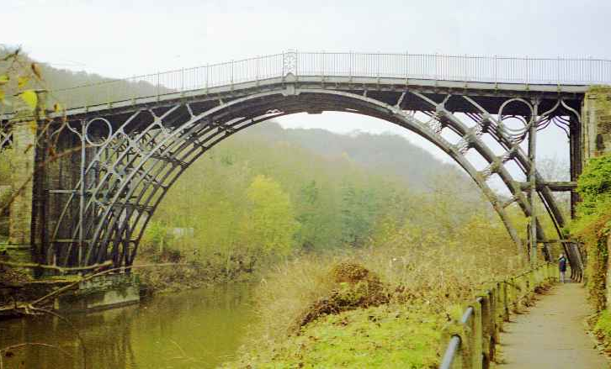
The Problem
Notes:
What can the original Iron bridge tell us about eGovernment and business transformation?

Slide 4

The Opportunity

Slide 5
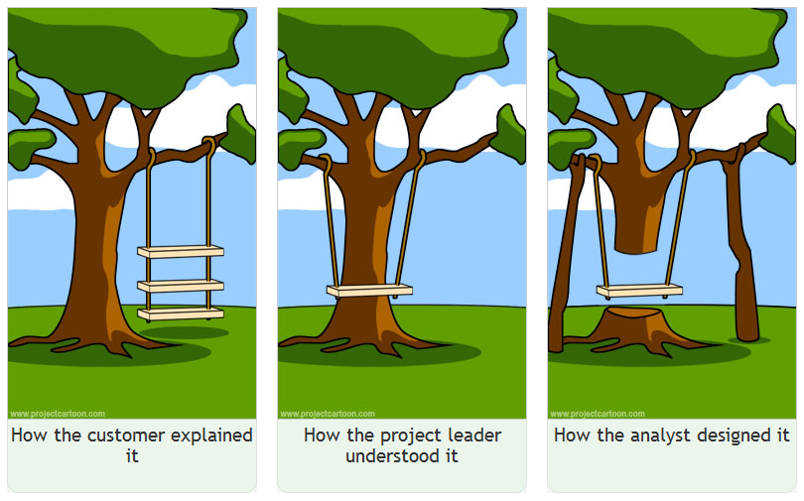
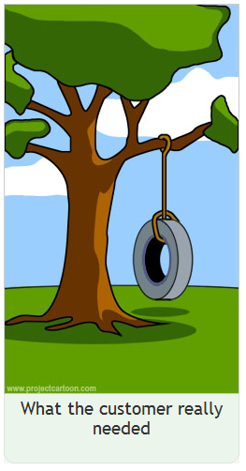
The Challenge

Slide 6



Peter F Brown, Independent Consultant
Transforming our Relationships with Information Technologies
peter@peterfbrown.com
http://public.xdi.org/=Peter.Brown
Pensivepeter.wordpress.com
@pensivepeter

