Slide 1
Every Silver Lining Has A Cloud
Peter F Brown
OASIS Board of Directors
http://xkcd.com/908/

Slide 2
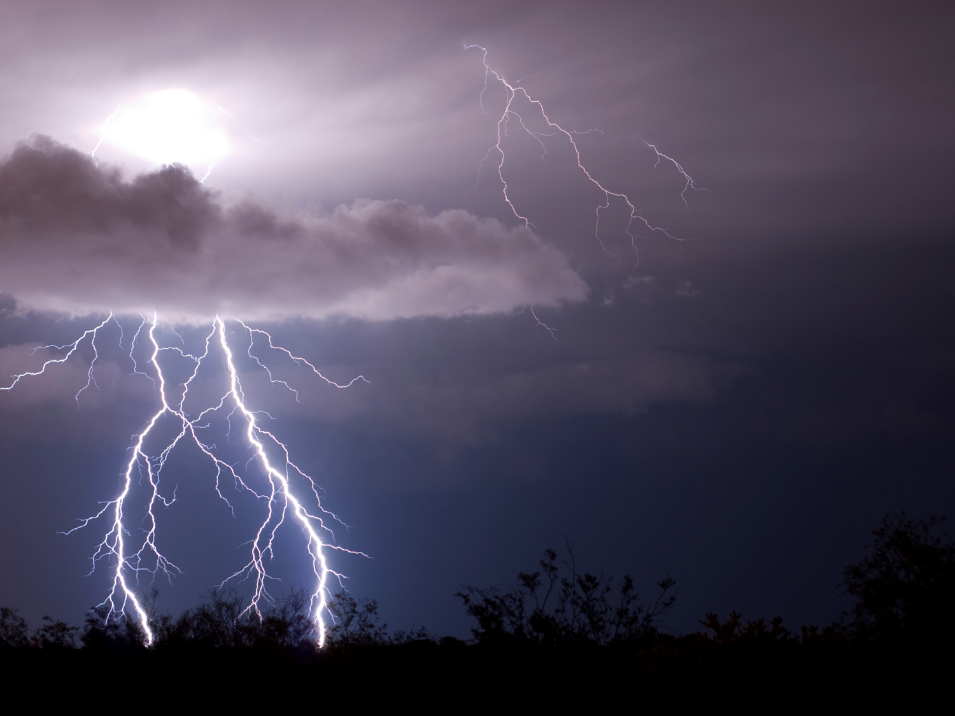
The Opportunity
The Cloud
The Pipe
The Interface
The Ecosystem
The Perfect Storm

Slide 3
http://xkcd.com/908/

Slide 4
http://xkcd.com/908/

Slide 5
http://xkcd.com/908/

Slide 6
http://xkcd.com/908/

Slide 7
http://xkcd.com/908/

Slide 8
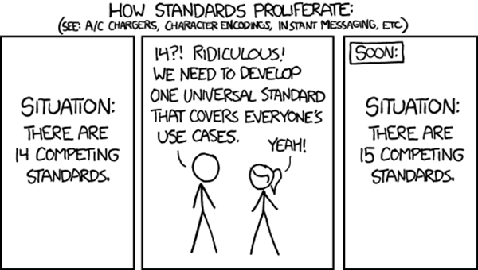
Standards Dilemma
http://xkcd.com/927/

Slide 9
Standards Dilemma
http://xkcd.com/927/

Slide 10
Standards Dilemma
http://xkcd.com/927/

Slide 11
Standards Dilemma
http://xkcd.com/927/

