Slide 1
www.oasis-open.org
e-GOVERNMENT IN GHANA AND THE ADOPTION OF OPEN STANDARDS: EXPERIENCES, CHALLEGNGES AND PERSPECTIVES
Presented by Dr. Sam Somuah
Ghana Information and Communications Technology Directorate
17th April 2009
Notes:
OASIS (Organization for the Advancement of Structured Information Standards) produces global standards that have both

Slide 2
OUTLINE
Introduction
Background
Ghana Country Perspective
e-Readiness
e-Government in Ghana
e-Ghana Project
e-legislation
e-government initiatives
Development of e-GIF for Ghana
Benefits of Open Standards
Challenges and perspectives
Conclusions

Slide 3
LOCATION OF GHANA

Slide 4
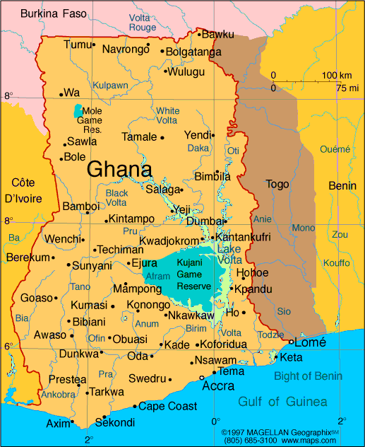
Ghana – Country Profile
Population - 23M (approx)
Population density - 101 per sq km
Literacy rate – 75% (2003 est.)
Average per capita income - $661
GDP growth rate – 6.5%
Currency - Ghana Cedis approx.
1US$: 1.4170 GH₵
Political System –
Multi-party democracy

Slide 5
Ghana ICT4AD Policy
A policy statement for the realization of the vision to transform Ghana into an information-rich knowledge-based society and Economy through the development, deployment and exploitation of ICTs within the economy and society.
It takes into account provisions of key socio-economic development framework documents including:
Vision 2020 –Achievement of middle income status
Ghana Poverty Reduction Strategy (GPRS 2002 -2004)
Co-coordinated Program for Economic and Social Development of Ghana (2003-2012).
Notes:
ICT4AD policy was developed based on policy framework document namely – ‘ an integrated ICT-led socio-economic Development policy and plan development framework for Ghana.
It represents the vision for Ghana in the information age

Slide 6
Focus Areas of ICT Policy
14 Pillars of ICT4AD
Accelerated Human development | Promoting ICTs in Education
Developing a globally competitive value-added services sector | Rapid ICT and enabling physical infrastructure Development
Promoting E-Government and Governance | Promotion of National Health
Facilitating the development of the Private Sector | Promoting local and foreign direct investment drive in ICTs
Developing an Export-Oriented ICT products and Services Industry | Facilitating National security and law and order
Modernization of Agriculture and the Development of an Agro-business Industry | Research and Development, Science and Industrial Capacity Research Development
Legal, Regulatory and Institutional Framework provisions | Development and spread of ICTs in the Community

Slide 7
E-Government Roadmap
Transform
Change Management
Strategic Direction
Integrate information, Service Delivery, and governmental processes
Information and Services customised to particular needs of the individual and businesses
Information and Services accessed through a single point of contact which is independent of MDA
Transact
Benefits/Costs
Service Delivery
Identify service migration and integration possibilities
Develop business process/service integration techniques and tools
Web
Presence
Interact
Construct
Shared
Workspace
Government Portal
MDA Websites
Web Guidelines
E-Govt. Organisation
BRM, PRM
DRM, SRM, TRM
Infrastructure, Middleware
VPN, Back Office Ops
Metadata Repository (Metalogue)
Disaster Recovery Site
Interoperability
Framework
Electronic Procurement
Authentication Policy Framework and Implementation
Train CIO
Metadata Standards
Key Challenges
(Political Will, Trust, Governance, Funding, Data Quality, Agency Capability, Digital Divide Bandwidth, Participation, Architecture, Channel Strategy, Measuring Success, Emerging Opportunities, and E-Govt. for Business)
Secure Electronic Environment
Time/Complexity
Notes:
BRM – Business reference model, The BRM is a functional-driven framework for describing the business operations of government independent of the MDAs that perform them
PRM – Performance Reference Model, The Performance Reference Model is a standard framework to measure performance of major ICT initiatives and their contribution to program performance
SRM - The SRM is a component-based framework that can provide – independent of business function– a leverage-able foundation for reuse of applications, application capabilities, components, and business services.
TRM - The Technical Reference Model (TRM) outlines the standards, specifications, and technologies that collectively support the secure delivery, exchange, and construction of business and application components
DRM - The Data and Information Reference Model (DRM) will describe, at an aggregate level, the data and information that support program and business line operations

Slide 8
E-Government Implementation Timeline
Establish Metadata
And Technology Standards
Identify and Deploy Common and Specific Applications
Finalise and Communicate Reference Models
Identify Service Migration and integration possibilities and Develop Business Process/Service Integration Techniques and Tools
Establish
E-GMS, Policies, Procedures, Processes and Procedures
Enable an MDA Independent Single Point of Contact for Access to Information and Services
Create Disaster Recovery Sites
Establish Interoperability Framework
Deploy Electronic Procurement, Authentication Policy Framework and Implementation
Government Portal
MDA Websites
Web Guidelines
Create a Metadata Repository and a Data Warehouse
Integrate Service Delivery and Governmental Processes
Build Infrastructure for Communications, Server, Virtual Private Networks, Middleware, Security, Knowledge, Applications
Customise Information and Services to needs of individuals and businesses
Select and Train CIOs
Change Management
Phase 1
3 Years
Phase 2
2 Years
Phase 3
3 Years
Phase 4
3 Years

Slide 9
e-Ghana Project
Goal :
1. Improve Delivery of Government Services,
2. Leverage ICT for accelerated growth and poverty reduction.
Objectives :
1. Improved service delivery in MDAs through PPP,
2. Development of ICT/ITES industry ,
3. Development of conducive environment for ICT investments

Slide 10
Component 3: e-Government Applications and Government Communications
Architecture and interoperability standards
Government Wide Area Network
National Data Center
Government Portal/Gateway
ICT Training and Capacity Building
e-Government Applications

Slide 11
e-Government Interoperability Framework (e-GIF)
A set of Policies, Technical Standards, as well as Guidelines covering ways to achieve interoperability among MDAs and other Government organizations

Slide 12
e-Government Interoperability
The ability to transfer and use information in a uniform and efficient manner across multiple organizations and information technology systems.

Slide 13
Why e-GIF
Citizen-centric services: ensuring the provision of improved public services and information in ways that are more beneficial to citizens
Operational efficiency: enabling the GoG to streamline business and technology processes and work more effectively as a collective organization rather than a set of separate silos
Delivering a return on investment: interoperability between new environments and existing systems enables any move to new platforms to be gradual, efficient, and evolutionary.
Notes:
It is clear that the ability to interoperate is key to reducing ICT integration
costs and inefficiencies, increasing business agility, and enabling the adoption of new and
emerging technologies. Leading ICT industry players are very actively working together through industry associations and standards
organisations to advance the development and adoption of open standards

Slide 14
e-GIF – Guiding Principles
GICTeD as custodian
Working groups to manage e-GIF
MDAs in the public/civil sectors must comply with the e-GIF
All new public/civil sector information systems must be accessible through browser-based technology
Framework to be vendor-neutral and open standards-based . All standards and guidelines must therefore conform with open standards principles.
Notes:
The problems of interoperability are not unique to government. The interoperability problems
of integrating disparate databases, distributed networks, e-procurement solutions, B2B data
exchanges, enterprise application integration, portal integration, B2C (consumer/citizen)
solutions, mobile communications, and others all exist in private industry as well as the public
sector. In general, there is a common need across all industries for research, new
technologies, and improved standards to address interoperability.

Slide 15
e-GIF – Policy Guidelines
Use Internet and World Wide Web standards for all public sector systems
Use XML as the key standard for data interchange
Make the browser the key interface for access and manipulation of all information
Assign metadata to government information resources
Adopt open, international standards that are well supported by the market
Internet based implementation strategy through e-Gif website

Slide 16
Components of e-GIF
Policy and scope
• Technical policies
• Implementation support
• Technical Standards Catalogue
• E-Government Metadata Schema
• Management process
• Change management
• e-GIF compliance

Slide 17
e-GIF Scope

Slide 18
Working Groups

Slide 20
Technical Standards
e-Services Access: standards and technologies for computer hardware, mobile phones, conferencing over Internet Protocol (IP), Voice over IP, smart cards, biometric data interchange, and accessibility and usability.
Interconnectivity: standards and technologies for connecting systems (e.g. connection protocols, web services message exchange protocol, simple object access protocols, etc).
Security: standards and technologies for supporting secure interoperation (e.g. data encryption, public key infrastructure, digital signatures, and secure transmission protocols).

Slide 21
Technical Standards
Business Areas: standards and technologies for business-specific content materials.
Discovery: standards and technologies for supporting the discovery and location of resources (metadata standards, thesaurus standards, directory standards).
Data Exchange and Data Integration: standards and technologies for the description of the structure and encoding of data exchange (e.g. email protocols, resource syndication protocols, data markup languages, and basic character-set encodings).

Slide 22
Open Standards
Subject to full public assessment and use without constraints in a manner equally available to all parties;
Without any components or extensions that have dependencies on formats or protocols that do not meet the definition of an Open Standard themselves;
Free from legal or technical clauses that limit its utilization by any party or in any business model;
Managed and further developed independently of any single vendor in a process open to the equal participation of competitors and third parties

Slide 23
Next Steps
Finalize Enterprise Architecture for GOG
Set standards for infrastructure and back office systems
Define data architecture for GoG systems
Develop shared service facilities (Data Centre, GoVNET)
Implement Portal/Payment Gateway
Deploy e-services

Slide 24
CONCLUSIONS
ICT provides Ghana with opportunity to meet development Goals
The e-Government initiative on Interoperability will support improved service delivery to citizens; reducing the cost to government of delivering services and sharing information; and delivering greater economic efficiencies for the wider economy
Collaboration with bodies such as OASIS, W3C etc will facilitate GoG efforts

