Slide 1
International Cloud Symposium 2011
Privacy Management Reference Model
11th October 2011
London
Gershon Janssen

Slide 2
Privacy Management Reference Model
2
A formal Reference Model for data privacy
Why are standard privacy methods and tools needed
Why its difficult
What is the PMRM
Use case analysis
Current status of TC work
Notes:
2

Slide 3
Why standard privacy methods and tools?
3
Why are standard privacy methods and tools needed by architects, designers and implementers of systems and processes?
Privacy principles and practices (such as notice, consent, collection limitation, etc) and policies provide the verbal description for the privacy requirements that apply in a given context (Use Case)
These verbal statements provide little or no clue as to HOW a system designer should build these requirements into a privacy management system.
Privacy requirements tend to be non-operational and typically describe the desired OUTCOME, but not the HOW.
What is needed is a complete set of privacy services that can be implemented into systems and invoked on command.
The system designer would then need to map a given set of privacy requirements into these operational services.
The PMRM provides the HOW.
Notes:
3

Slide 4
Security standards exist; why is privacy difficult?
4
Standard security methods and tools exist. Why is it so difficult to develop privacy parallels?
Security is a technically mature discipline: algorithms and operational implementations have been around for some time and maturity models exist. Also standards for operational security mechanisms and tools exist and offer complete coverage of security requirements.
Not so for privacy. Privacy requirements are not as well-defined and certainly not as codified as for security.
Privacy has remained largely in the policy domain, with legislation, best practices, and principles defining the requirements for privacy.
Since privacy deals with the life-cycle management of PI, privacy management goes well beyond standard security controls; e.g., even after gaining access to PI, privacy deals with what can be done with the PI.
PMRM helps to move privacy management from the policy domain to operations.
Notes:
4

Slide 5
What is the Privacy Management Reference Model?
5
PMRM is a formal reference model for data privacy
where we move away from the terminology as used in high level Privacy Principles and Guidelines
and define a set of operationally-focused privacy management Services
Background for this is that when working towards an operational definition of privacy management, one finds that the language used to express privacy policy, principles, and practices is far from standardized.
Even the simple-sounding requirement for Notice has many different meanings, depending on context and jurisdiction.
Understandable: policies, practices, and principles are requirements for OUTCOME (and represent the sometimes ambiguous “voice of the customer”)
With PMRM we are taking any set of privacy requirements and map those requirements into a well-defined set of privacy Services
Notes:
5

Slide 6
PMRM risk mitigation and controls
6
What privacy risks is the Privacy Management Reference Model intended to mitigate? What controls is it intended to put in place?
The operational definition of privacy is: the assured, proper, and consistent collection, processing, sharing, transmission, minimization, use, retention, and disposition of Personal Information (PI) throughout its life cycle, consistent with information protection principles, policy requirements, regulations, and the preferences of the individual.
The 10 operational Services of the PMRM have been derived by examining this definition in lengthy detail. “Risks” result from potential violations of any tenet of the definition; e.g, improper actions, inconsistent with individual preferences, etc. The “controls” result from implementing the appropriate functions under each selected Service.
Notes:
6

Slide 7
PMRM outline
7
PMRM consists of:
the Reference Model
a formal methodology for applying the model and expressing use cases
one or more use cases showing how to utilize the PMRM
Reference Model describes Privacy Services and Functions
The Methodology is for analyzing the uses of Personal Information and applicable rule-sets within a Use Case context
Notes:
7

Slide 8
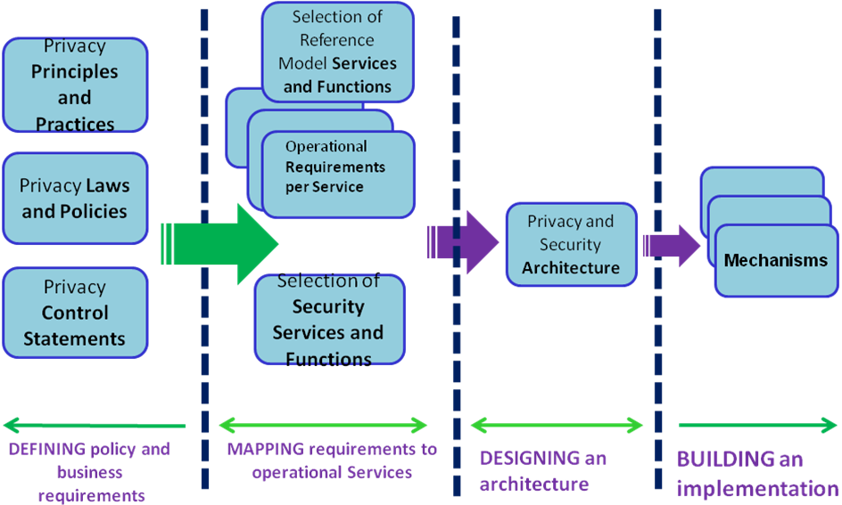
Where does the Reference Model fit in?
8
Notes:
8

Slide 9
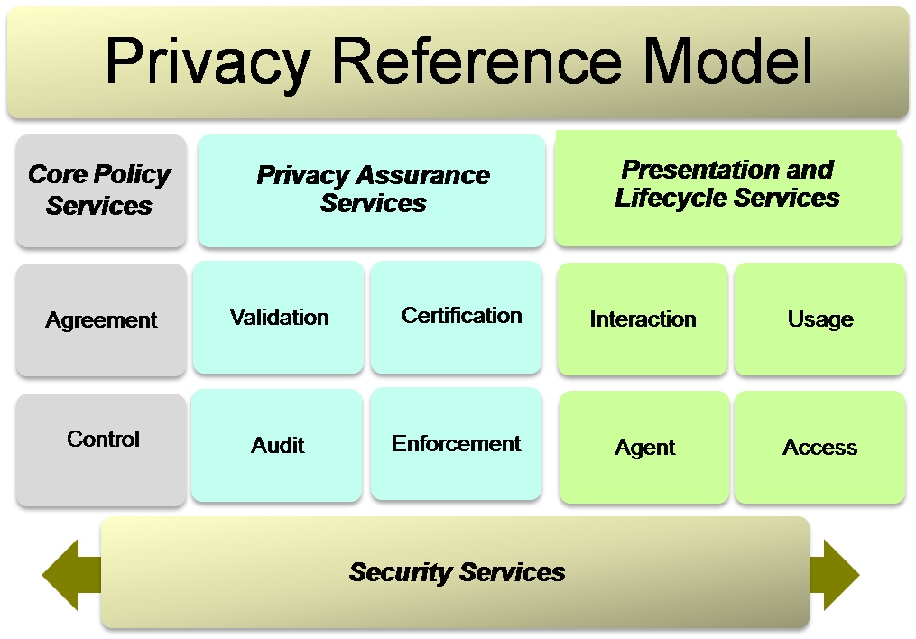
The Privacy Reference Model
9
Notes:
9

Slide 10
Use Case analysis
10
The methodology consists of two parts:
The High Level Privacy Analysis
Descriptions of Applications and Business Processes
Statutory, Regulatory and Other Applicable Privacy Requirements
The Detailed Privacy Management Reference Model Description
Privacy Domains
Domain Owners
Data Flows
Touch Points
Systems and Subsystems
Actors
PI in Use Case Systems (collected, communicated, processed; incoming, internally generated and outgoing)
Operational Privacy Controls (inherited, internal and exported controls)
→ Select Privacy Management Services
Notes:
10

Slide 11
Emergency Responder Use Case: On Site Care
11
Notes:
11

Slide 12
Where are we now?
12
Steps in the development of the Privacy Management Reference Model:
First meeting September 2010
The ISTPA has donated the PMRM v2.0 to the Technical Committee
Initial Deliverables:
the Reference Model
a formal methodology for applying the model and expressing use cases
one or more use cases showing how to utilize the PMRM
Standards-based technical privacy framework which enable development and implementation of privacy and associated security requirements
Notes:
12

Slide 13
Summary
13
PMRM delivers a standards-based technical privacy framework which enable development and implementation of privacy and associated security requirements
for both enterprise and cloud-based environments
Notes:
13

Slide 14
Links and References
OASIS website:
www.oasis-open.org
IDtrust Member Section:
www.oasis-idtrust.org
OASIS Technical Committee Homepage
http://www.oasis-open.org/committees/pmrm/
Gershon Janssen
gershon.janssen@gmail.com
www.gershonjanssen.com

