Slide 1


Framing the Policy Exercise
Presenter: Norm Paulsen
Date: May 1, 2012
Session: 1
Notes:
Thank you’s
Washrooms
Lunchs and Dinner
Montreal student protest
Microphone’s / Interpretation

Slide 2


Presentations
We have no challenges!
Notes:
2
All presenters for a session come up and be seated before the session starts
Speak from the podium
Hopefully talk about challenges
Won’t be able to control where all the presentations go

Slide 3
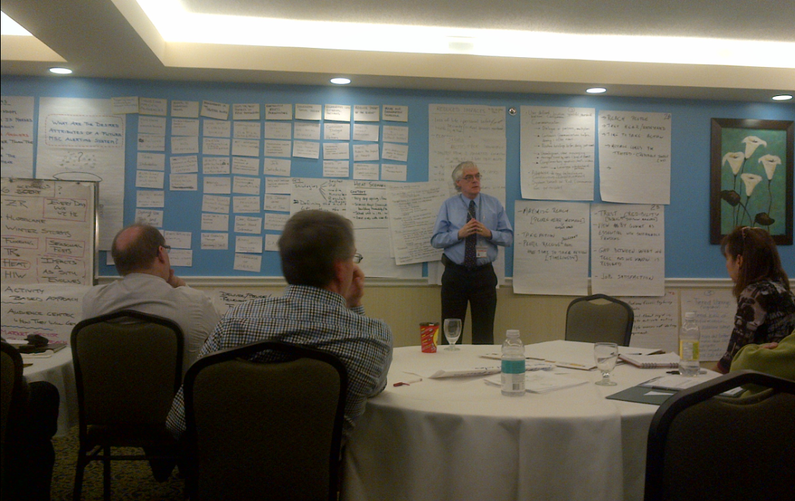
Goals of the Workshop
To produce a vendor-neutral forum to identify and discuss the government policy aspects of alerting
(with respect to the issues of authority and responsibilities)
To discuss the challenges of emergency management
(with respect to the CAP Standard that makes it possible for jurisdictions involved with these concerns, to exchange such information on the national, cross-border and global scales)
To foster growth and open communication in a community of like minded organizations
(recognition of need for interoperability between systems and countries)
To identify policy-related issues and resulting good practices
(that could, but aren’t constrained to, being formalised using processes such as those created by OASIS for such purposes)
Notes:
3

Slide 4










Panel Sessions
Should alerts
be pink?
something that is frowned upon in most, actually virtually all Internet societies, including forums, chat boards, and Uncyclopedia. You should not make walls of text because it can get you banned anywhere unless it is a place that encourages walls of text. I highly doubt any place does support something so irritating and annoying, but anything can exist, but not really because unless you are in heaven then that can happen. But no one actually knows that was just a hypothesis, a lame one that is. Actually not really lame. You can create a wall of text supporting site, but you would be hated if you do that, so do not. But you can if you like, but I discourage that. Now on to the actual information of walls of texts. The wall of text was invented when the Internet was invented, but actually it was slow at that time. So whenever it became fast. But there would need to be some free or not free community for people, and that community would be able to have walls of text. But that community probably wouldn't have actually invented the wall of text. So basically, no one except God and Al Gore knows when or where or how the wall of text existed/was invented. Noobs probably invented, but probably not. Who knows. Walls of texts are usually filled with a lot of useless information and junk. Information and junk can be. ans. These are boring and patient people who have no life or have all the time in their hands, which are the same, but not really. The punishment of what making walls of text varies of the strictness of the community. But it doesn't really matter. Nobody cares. Walls of texts should be free of links, different font colors, strange characters, which are those other symbols used in society, and capital letters because it ruins the whole purpose of the infamy of walls of texts. It makes them look fucking dumb and weird. Walls of texts are obviously free of huge spaces and outstanding things like capital letters. Of course, paragraphs should never be in a wall of text. Walls of text are known to create nausea, confusion, head explosion, and others. The others being something I can not think of either because I am lazy or if I do not feel like it or I can not actually think of anything. Like what the fuck? That was a rhetorical question right there. What the fuck? You are actually not requesting a satisfactory answer, you just say that because you try to be funny or you feel like it or if you are pissed off. You must get a proper bitch-slapping to stop making walls of text, but if you are weird then that doesn't apply to you. Walls of text are defeated by deleting them or splitting them into paragraphs.
It depends
Yes
No

Slide 5
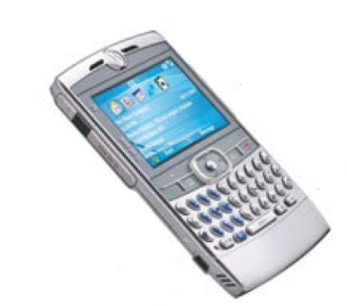




Short Primer on Alerts
In the context of CAP (Common Alerting Protocol), an Alert is a formalized electronic version of an Alert (a digital file set to Standards)
<?xml version="1.0" encoding="UTF-8" ?>
<alert xmlns="urn:oasis:names:tc:emergency:cap:1.2">
<identifier>CA-EC-CWTO-2008-7</identifier>
<sender>Toronto@MSC@ec.gc.ca</sender>
<sent>2010-07-17T20:00:00-00:00</sent>
<status>Actual</status>
<msgType>Alert</msgType>
<scope>Public</scope>
<code>profile:CAP-CP:0.4</code>
<info>
<language>en-CA</language>
<category>Met</category>
<category>Env</category>
<category>Health</category>
<event>air quality</event>
<eventCode>
<valueName>profile:CAP-CP:Event:0.4</valueName>
<value>airQuality</value>
</eventCode>
<expires>2010-07-18T01:00:00-00:00</expires>
<senderName>Environment Canada</senderName>
<headline>air quality alert</headline>
<urgency>Immediate</urgency>
<severity>Moderate</severity>
<certainty>Observed</certainty>
<area>
<areaDesc>Misssissauga</areaDesc>
<geocode>
<valueName>profile:CAP-CP:Location:0.3</valueName>
<value>3521005</value>
</geocode>
</area>
<area>
<areaDesc>Oakville</areaDesc>
<geocode>
<valueName>profile:CAP-CP:Location:0.3</valueName>
<value>3524001</value>
</geocode>
</area>
</info>
</alert>
The understanding is that the form the signal takes is contingent upon the characteristics of the medium employed to grab the attention of the audience
beep
An Alert is a Signal; from one party to another (about something both parties deem significant)
A Signal can also be continuous
(and even change from one form to another)
Notes:
5
Several mediums?
So who has authority to issue an alert?
How do we recognize authority?
Alert by definition, and Alert as defined by all parties in the Business?
From a business of Alerting context, a CAP Alert implies a hazardous event with declared risks and associated impacts
Defining Partnerships?

Slide 6
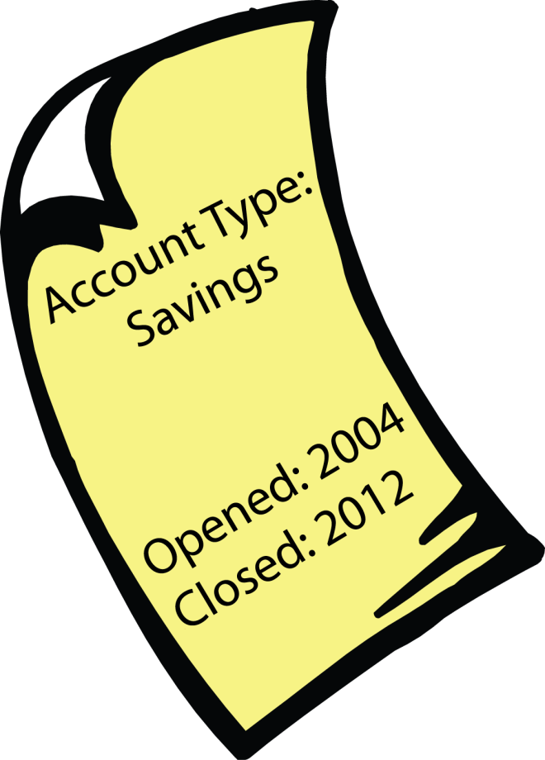
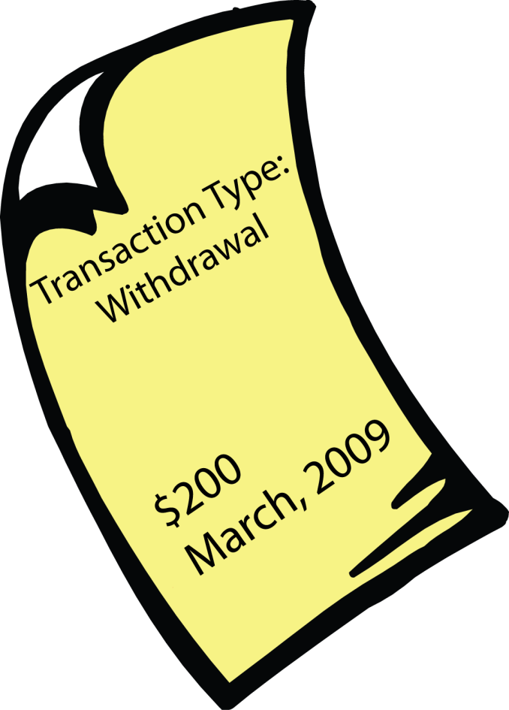

Alerts are Alive
At any given time, the current state of the Alert is known and can be reported on (much like a bank account statement showing a current balance)
Alerts are instantiated, live for a period of time, and then end (much like a bank account)
The state of an Alert can change while its alive (much like when posting a transaction to a bank account)
Notes:
6
In Alerting, we tend to report on the current state immediately after a transaction
Which practices are preferred?
What are the constraints and why?
What goes into the reports?
USGS accounts are more like savings bonds (no transactions, and end at a pre-described point in time without modification)

Slide 7
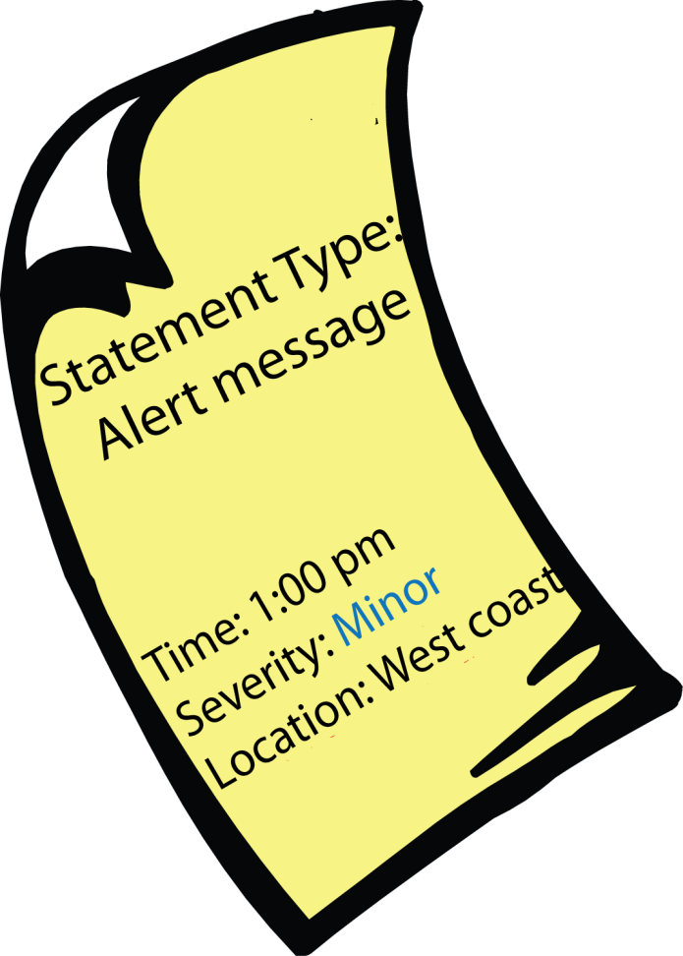
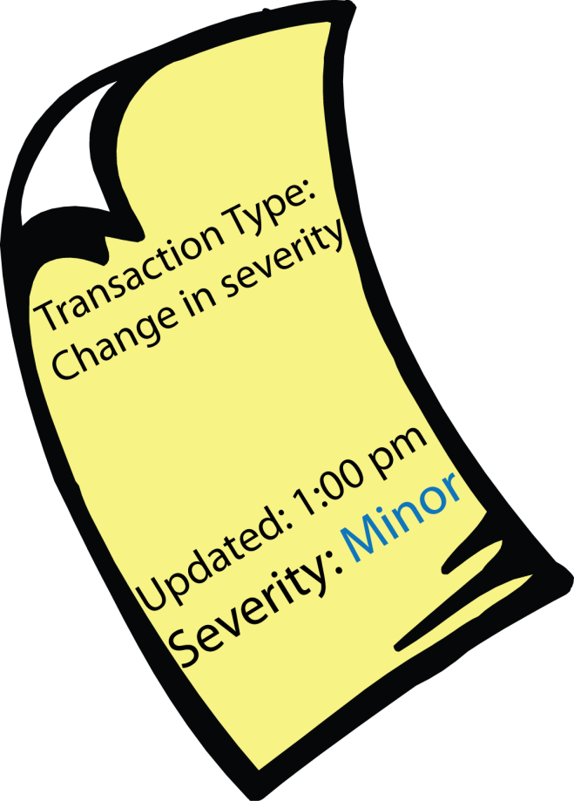

So what is a Message?
CAP Messages are primarily sent out after an Alert has been initiated, or has had a change posted to it, or it has been cancelled
A CAP message contains structured information about an alert allowing for automated processing of the alert
CAP Messages are statement reports showing the current state of an Alert
Notes:
7
Customized reports?
Language of the reports?
Added value in the reports?
Responsibilities of the Issuer?

Slide 8
The Alerting Community
<?xml version="1.0" encoding="UTF-8" ?>
<alert xmlns="urn:oasis:names:tc:emergency:cap:1.2">
<identifier>CA-EC-CWTO-2008-7</identifier>
<sender>Toronto@MSC@ec.gc.ca</sender>
<sent>2010-07-17T20:00:00-00:00</sent>
<status>Actual</status>
<msgType>Alert</msgType>
<scope>Public</scope>
<code>profile:CAP-CP:0.4</code>
<info>
<language>en-CA</language>
<category>Met</category>
<category>Env</category>
<category>Health</category>
<event>air quality</event>
<eventCode>
<valueName>profile:CAP-CP:Event:0.4</valueName>
<value>airQuality</value>
</eventCode>
<expires>2010-07-18T01:00:00-00:00</expires>
<senderName>Environment Canada</senderName>
<headline>air quality alert</headline>
<urgency>Immediate</urgency>
<severity>Moderate</severity>
<certainty>Observed</certainty>
<area>
<areaDesc>Misssissauga</areaDesc>
<geocode>
<valueName>profile:CAP-CP:Location:0.3</valueName>
<value>3521005</value>
</geocode>
</area>
<area>
<areaDesc>Oakville</areaDesc>
<geocode>
<valueName>profile:CAP-CP:Location:0.3</valueName>
<value>3524001</value>
</geocode>
</area>
</info>
</alert>
Issuer
interfaces with
input form, mapping application, etc.
Issuing System
produces
CAP-CP
Aggregators/
Re-originators
Collects, (modifies?), (filters?), and shares
CAP-CP
Distributor
(filters?) and converts CAP-CP to common and proprietary protocols
Recipient
interfaces with common products and services. Ex. Email, map, RSS, TV, ...
8
Notes:
8
Roles of each
Declare constraints
Scope, global threats
Cancel messages, Test Messages
8

Slide 9



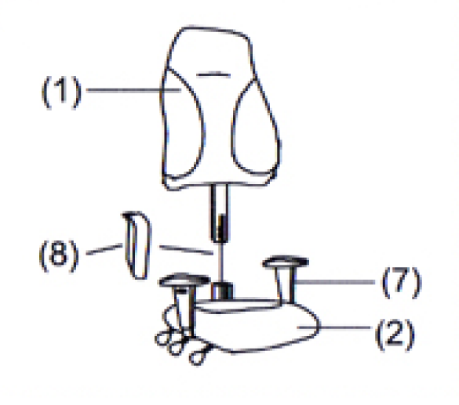
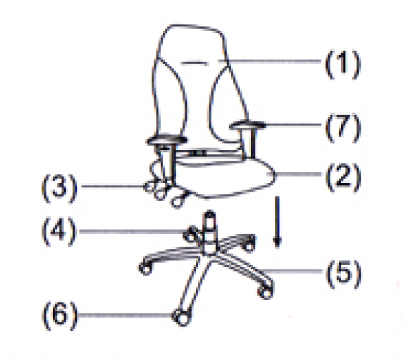
Environment Canada
(manufactures CAP message)
Last mile distributor
(presents final
formatted message)
SHIP TO:
Name: Norm Paulsen
Address: 4905 Dufferin Street
City: Toronto
Country: Canada
Postal/Zip: M3H5T4
Shipping label
URGENT
(delivery)
(assembly)

Slide 10
Environment Canada
(manufactures CAP message)
Last mile distributor
(presents final
formatted message)
(delivery)
Aggregator/Re-originator
(pre-assembly)
(final assembly)

Slide 11


Question and Answers
Is it
ready?
How can I know if the alert is authentic?
Sources of funding?
Where’s the donuts?
Notes:
11
- Moderator will control the floor for Q&A
- Interpretation considerations

Slide 12
Demonstrations
Issuer
interfaces with
input form, mapping application, etc.
Issuing System
MASAS (ESRI)
IPAWS
MYSTATE
Aggregators/
Re-originators
MASAS
IPAWS
MYSTATE
Distributor
GOOGLE
CELLCAST
MYSTATE
Recipient
interfaces with common products and services. Ex. Email, map, RSS, TV, ...
12
Notes:
12
12
MASAS & ESRI
IPAWS & ALERTSENSE/MYSTATEUSA
GOOGLE
CELLCAST
12

