Slide 1
Notes:
Source: http://www.teachengineering.org/collection/cub_/lessons/cub_images/cub_air_lesson08_activity2_image1.jpg

Slide 2
“Our mission is to fight poverty with passion and professionalism…”

Slide 3
Last year donor agencies funded $5 billion for ICTs – roughly half by the World Bank. World Bank’s ICT portfolio nearly $8 billion.
Source: Development Finance International

Slide 4
The fast pace of change brings new opportunities
Notes:
http://img.brothersoft.com/screenshots/softimage/f/free_3d_abstract_screensaver-196213-1228457499.jpeg

Slide 5
5bn mobile phones globally (>3bn in developing countries)
Notes:
http://fortunetechland.files.wordpress.com/2008/10/storm_front.jpg

Slide 6
Social Networking
The rise of collaborative and participative technologies
Notes:
http://www.infovark.com/blog/wp-content/uploads/2008/10/social-network.jpg

Slide 7
Cloud Computing
Notes:
http://www.free-pictures-photos.com/clouds/cloud-10.jpg

Slide 8
1. Global expertise
2. Knowledge
3. Financing facility
4. Global Forum

Slide 9
Communities of Practice and global experts
Notes:
http://mandalatherapy.files.wordpress.com/2010/02/bands.jpg

Slide 10
MoUs
Private Sector partners
Notes:
http://www.ifca.unican.es/Imagenes/SC07/ibm_negativo.jpg
http://www.rdribitzky.com/ribitzky/images/stories/intel-logo.jpg
http://vhirsch.com/blog/wp-content/uploads/2010/01/gemalto_logo.jpg
http://www.thesecurityanalyst.com/images/L-1IDS_Logo_rgb_300dpi%20(2).jpg
http://www.aiesec.org/australia/images/Partnerlogo/microsoft.jpg
http://www.epilepsyfoundation.org/local/massri/images/Pfizer_5.gif

Slide 11
Strategic Technology Accelerator Program
Partnership with Singapore for technical assistance to developing countries
Notes:
https://www.cia.gov/library/publications/the-world-factbook/docs/flagsoftheworld.html

Slide 12
Australia: Jane Treadwell
Canada: Corinne Charette
Estonia: Arvo Ott
EU: Francisco Garcia-Moran
UK: John Suffolk
India: R.Chandrashekar
USA: Stephen Fletcher
Gartner: Andrea Di Maio
Singapore: James Kang
Notes:
https://www.cia.gov/library/publications/the-world-factbook/docs/flagsoftheworld.html

Slide 14
1. Institutional arrangements for eGovernment
2. Cloud computing
3. Open Data
4. First 100 days for a Government CIO

Slide 15
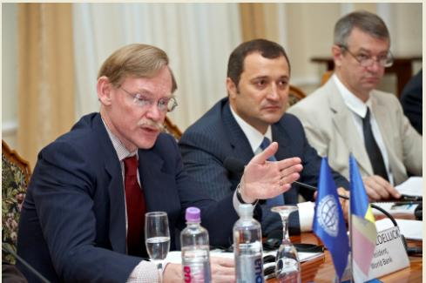
Chisinau: August 12, 2010
PM Filat, Robert Zoellick, Mart Laar, John Suffolk, Anthony Townsend,
Andrea Di Maio, Chin Siong Seah, Cabinet of Ministers

Slide 16
Capturing Knowledge

Slide 17
Korean Trust Fund
$15 million for innovative ICT initiatives
Notes:
https://www.cia.gov/library/publications/the-world-factbook/docs/flagsoftheworld.html

Slide 18
Finland, Nokia, infoDev Partnership
€11.9 million for enhancing the competitiveness of emerging market SMEs in the ICT and agribusiness sectors
Notes:
https://www.cia.gov/library/publications/the-world-factbook/docs/flagsoftheworld.html

Slide 19
Pfizer
$600,000 for designing e-health projects in Africa
Notes:
http://www.dfas.mil/careers/benefits/healthbenefits/healthben.jpg

Slide 20
1. Participate in expert groups
2. Connect country expertise
3. Contribute to knowledge
4. Help access resources

Slide 21
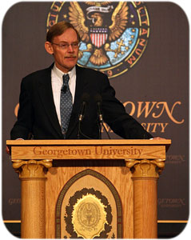
The Bank’s Vision
“Imagine this: A health care worker or parent in a village, with a laptop or mobile device, can access development knowledge in real time through geo coding and geo mapping. She can see which schools have feeding programs and which go without, and what is happening to local health. She can access 20 years of data on infant mortality for her country and its neighbors. She can dig deeply and compare her village with others. She can upload her own data, throw light on the likely effect of new interventions, and mobilize the community to demand better or more targeted health programs.”
“Our aim is for Open Data, Open Knowledge, and Open Solutions.” RBZ, Sept 28, 2010
http://intranet.worldbank.org/WBSITE/INTRANET/INTRANETHOME/0,,contentMDK:22717873~menuPK:6513437~pagePK:6426483~piPK:6402841~theSitePK:86048,00.html

Slide 22
Notes:
http://www.strawberryearth.com/wonderland/images/news/Thank-you-2.png

