Slide 1
Emergency Data Exchange Language – Distribution Element (EDXL-DE)
David E. Ellis
Sandia National Laboratories

Slide 2
Overview
The Emergency Data Exchange Language is a Family of Standards which addresses two fundamental needs.
  Interoperable content for emergency situations
  Secure policy-based distribution of any content type
Most advanced EDXL-DE capacities use SOA-based publish/subscribed software on jurisdictionally controlled routing hardware to create a communications grid to accomplish diverse interoperability solutions for both now and for the future.
Today’s discussion will cover the basic capabilities of EDXL-DE distribution with emphasis of the versatility of non-emergency information delivery.
Please hold questions to panel discussion or contact me after is session
Notes:
Interoperable content for emergency situations
NIEM
UCORE
Secure policy-based distribution of any content type
XML based documents
Non-XML based content including still and streaming picture, videos, sensor tracks and VOIP
The EDXL-DE is designed to uses by SOA-based publish/subscribed software on jurisdiction controlled routing hardware to create a communications Grid to accomplish diverse interoperability solutions.
FEMA IPAWS Spiral One (delivered CAP messages, VOIP and other content)
DNDO SETCP (delivered policy-based N25 and e-mail alerts of sensor, image and XML encoded assistance requests to state and federal agencies.)

Slide 3
Structure of EDXL-DE
The EDXL-DE is designed to encapsulate multiple content objects with metadata allowing policy-based distribution to recipients regardless of network or reception technology
EDXL-DE is an XML schema which has the following:
  Header section <EDXLDistribution>
  One or more target sections <targetArea>
  One or more content sections <contentObject>
Each content section has the following:
  Header section with either
    xmlContent (using schema and namespace of content) or
    nonXMLContent ( embedded or referenced elsewhere)
Signing and/or encrypting of document and/or content

Slide 4
EDXL-DE Schema Structure
EDXLDistribution
distributionID
senderID
dateTimeSent
distributionStatus
distributionType
combinedConfidentiality
language
senderRole *
recipientRole *
keyword *
distributionReference *
explicitAddress *
targetArea
circle *
polygon *
country *
subdivision *
locCodeUN *
Specific
Message Content
CAP 1.0
CAP 1.1
EDLX-RM
HAVE
N25
EDXL-SA
VOIP
Images
Sensor
track data
etc.
0..*
nonXMLContent
mimeType
size
digest
uri
derefUri
0..*
contentObject
contentDescription
contentKeyword *
incidentIdentifier
incidentDescription
originatorRole *
consumerRole *
confidentiality
0..1
OR
xmlContent
keyXMLContent
embeddedXMLContent
Bold indicates required element.
* indicates multiple instances allowed

Slide 5
Delivery Concepts
Each EDXL-DE delivery solution will tailor the requirements for distribution grid based on publisher injection capability and potential recipient capability.
  Human created EDXL-DE documents can tailor content
  Sensor and other fixed content sources need adapters
For non-trivial point-to-point information exchanges,
the EDXL-DE document acts like an IP Packet where:
  EDXL-DE documents are network agnostic
  EDXL-DE document elements must conform to COI and grid specific syntax and semantics
  Mediation hardware and software must:
    understand EDXL-DE structure
    Implement policies on transiting EDXL–DE document

Slide 6
EDXL-DE Element Usage
Message Identification
  distributionID
  senderID
  dateTimeSent
  distributionReference
Delivery Filtering
  distributionStatus
  distributionType
Security Filtering
  combinedConfidentiality
  confidentiality
Redistribution Routing
  explicitAddress
Complex Policy Formation
  senderRole
  recipientRole
  keyword
  contentKeyword
  originatorRole
  consumerRole
Area for Content delivery
  circle
  polygon
  country
  subdivision
  locCodeUN

Slide 7
Notional Layout of Grid

Slide 8
Decoupling Sender - Receiver

Slide 9
EDXL-DE Conclusion
EDXL-DE enables unprecedented XML and nonXML document-based information exchange flexibility
Distribution can include diverse content and even translate synchronous to asynchronous protocol
Grid communities can develop solution specific delivery policies, topologies and EDXL-DE semantics and syntax
OASIS Infrastructure sub-committee is developing next generation of the EDXL-DE based on developmental pilots like:
  Integrated Public Alert and Warning System (IPAWS) Spiral One testbed
  South-east Transportation Corridor Pilot (SETCP)

Slide 10
SETCP and Usage Backup Slides
South-east Transportation Corridor Pilot Coverage
  These are some content type from SETCP
    Columbia County, GA – 35 Attachments
    Weigh Station Camera
    Gamma and Neutron Location
    Detection Information
    Uniform Hazard Waste Manifest
XML Element Usage
  EDXL Header Usage
  contentObject Elements Usage
  Payload Element Usage

Slide 11
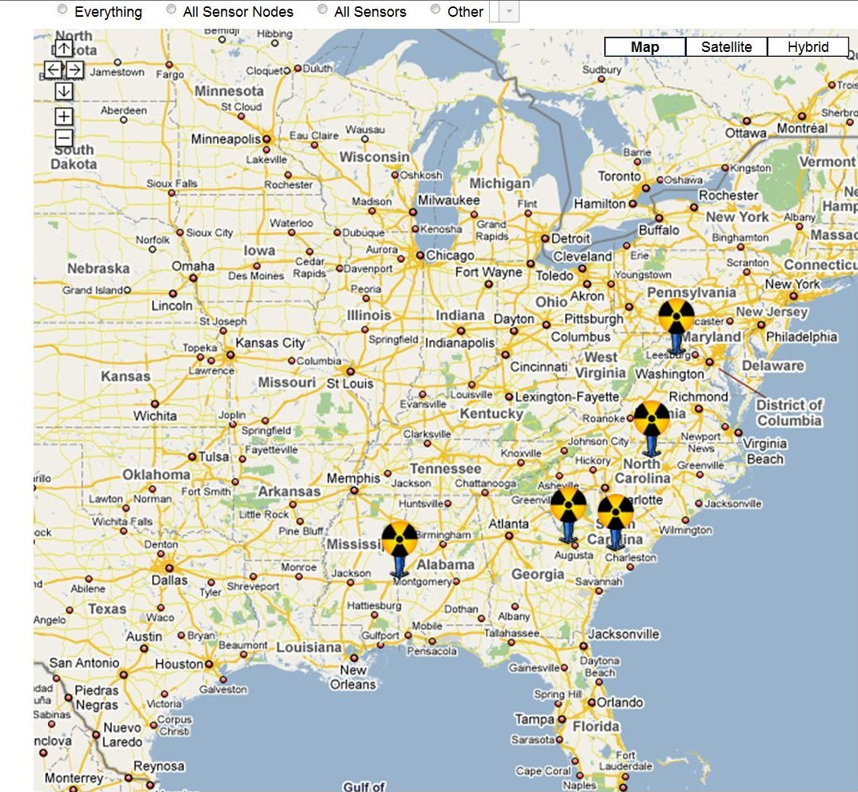
SETCP Coverage

Slide 12
Columbia County, GA – 35 Attachments
Caller Information:
  Officer Name:
  Agency:
  Call Back #: ( ) –
Incident Information:
  Case ID: A9d93d5de-9665-4d07-bc05-c11d96212a3e
  Time: 2008-10-31T20:31:32.948Z
  How may JAC assist you?
Alarm Information:
  Radiation Type: Gamma & Neutron Primary Screen
  Equipment: SAIC RPM PRD
  Reading:
  Secondary Screen
  Equipment: n/a
  Distance From Source:
Additional Information:
  Narrative:
  Comments:
  Spectroscopic Findings:

Slide 13
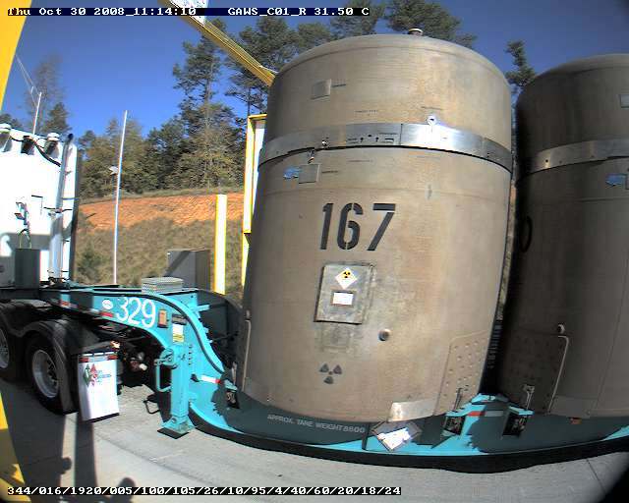
Weigh Station Camera

Slide 14
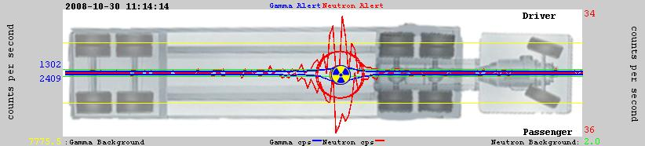
Gamma and Neutron Location

Slide 15
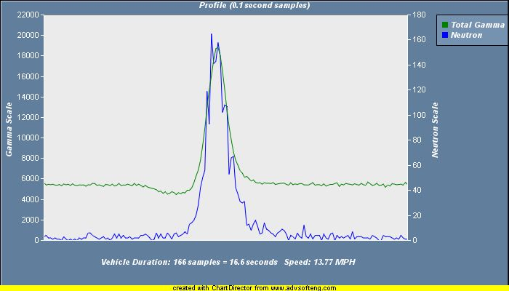
Detection Information

Slide 16
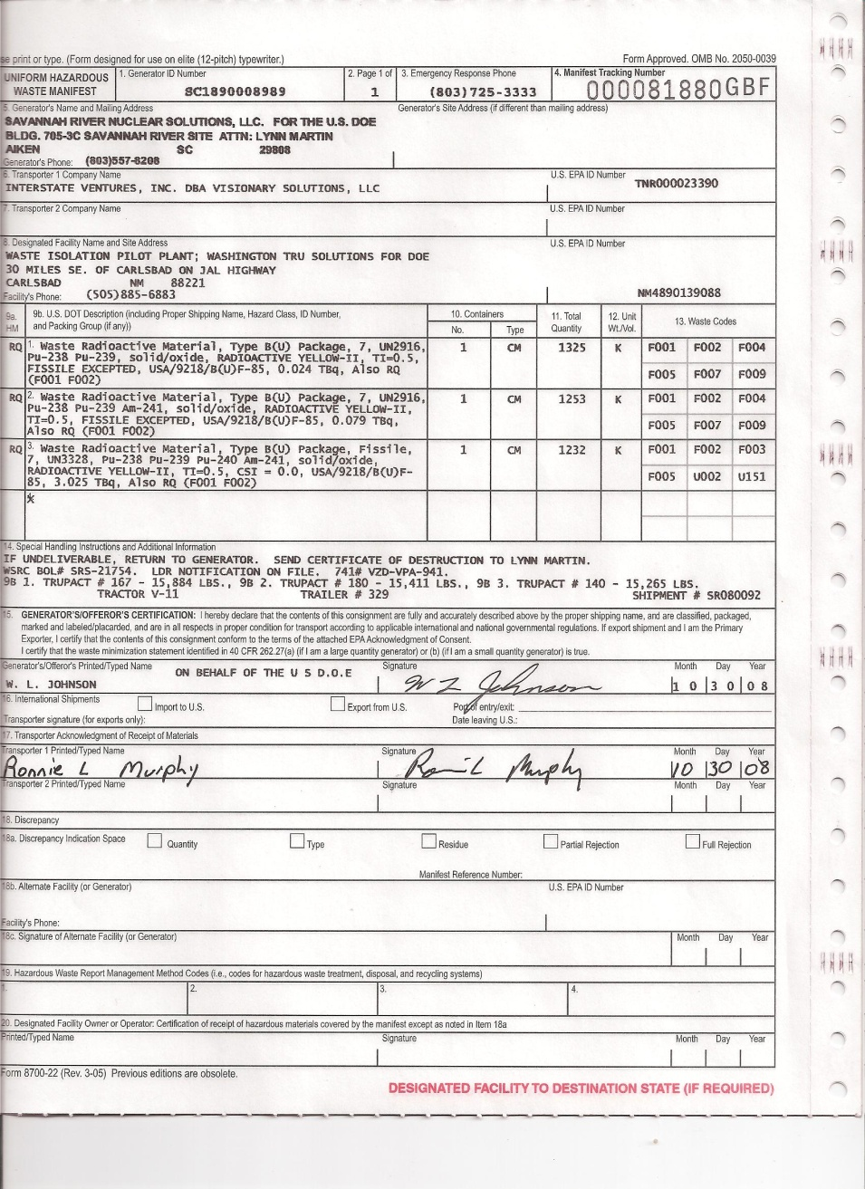
Uniform Hazard Waste Manifest

Slide 17
EDXL Header Usage
Element | Element Purpose | Core Message Routing Usage | Delivery Selection
distributionID | Message Identification | None | None
senderID | Message Identification | None | None
dateTimeSent | Message Identification | None | None
distributionStatus | Action Level | None - TBD | Application Filtering
distributionType | Functional Type | None - TBD | Application Filtering
combinedConfidentiality | Informational | None | Security Filtering
language | Informational | None | Nationality Filtering
senderRole | Functional Role | Exp/Imp Pub/Sub | COI Filtering
recipientRole | Functional Role | Exp/Imp Pub/Sub | COI Filtering
keyword | Content Identification | Exp/Imp Pub/Sub | COI Filtering
distributionReference | Message Identification | Experimenting | Fixed
explicitAddress | External delivery | Explicit | Fixed

Slide 18
contentObject Elements Usage
contentObject Element | Element Purpose | Core Message Routing Usage | Delivery Selection
contentDescription | Informational | None | Special *
contentKeyword | Content Identification | Exp/Imp Pub/Sub | COI Filtering
incidentID | Informational | None | None
incidentDescription | Informational | None | None
originatorRole | Functional Role | Exp/Imp Pub/Sub | COI Filtering
cosumerRole | Functional Role | Exp/Imp Pub/Sub | COI Filtering
confidentiality | Informational | None | Security Filtering
any* | Message Security | None | Certificate Holders

Slide 19
Payload Element Usage
nonXMLContent Element | Element Purpose | Core Message Routing Usage | Delivery Selection
mimeType | Content Identification | None | Application Filtering
size | Informational | None | Distribution Filtering
digest | Message Security | None | None
uri | Informational | None | None
contentData | Payload | None | None
xmlContent Element | Element Purpose | Message Routing Usage | Delivery Selection
keyXMLContent | Expose specific Payload elements | None | COI Filtering
embeddedXMLContent | Payload | None | None

