Slide 1
Why ‘NZ Gov’ needs the Transformational Government Framework

Slide 2
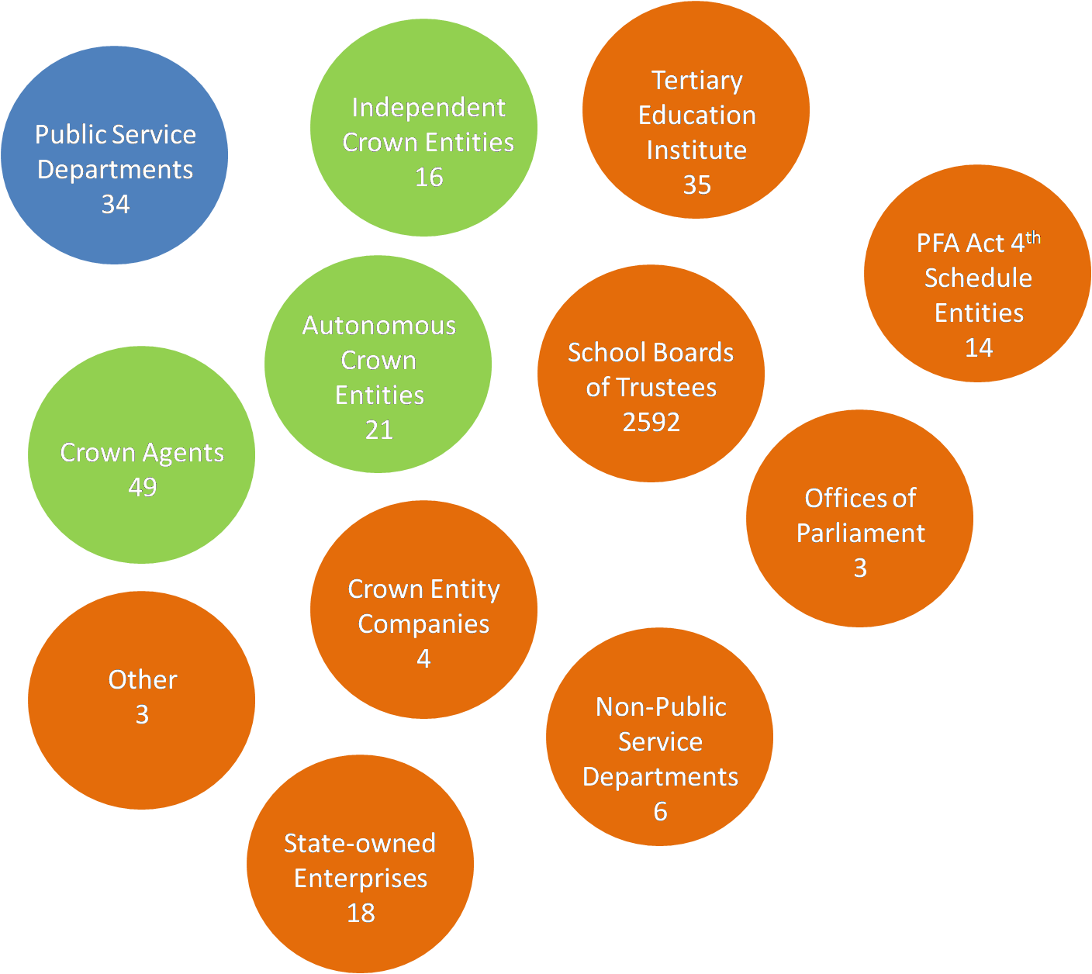
The ‘many houses’ of NZ government.

Slide 3
Several playing a central role in strategy and/or implementation..

Slide 4
The Dept of Internal Affairs is..
Processor and Holder of authoritative information on New Zealand citizens – registers for births deaths, marriages, issues passports, citizenship
The home of Government Technology Services (GTS), the designer and implementer of most All of Government IT initiatives…
..from service desk, project management, inter-networking & hosting through architecture, web development & Cloud development to centralised Authentication & Identity Verification Services – and a bit of strategy too

Slide 5
NZ Gov has a range of plays…
NZ’s School of eGovernment
Govt CIO and (recently) Govt Tech Services (GTS)
Directions & Priorities for Government ICT
Common ICT Roadmap
‘Systems thinking’ (John Seddon Vanguard, UK)
‘Service Link’ - the Service Transformation Project
eGIFs old and (soon) new
Keeping an eye on what Australia’s doing (different eyes see different things to mimic)
Keeping an eye on what the ROW is doing

Slide 6
..but no framework to contextualise them…

Slide 7
..until the Transformational Government TC was proposed...

Slide 8
..whereupon Internal Affairs said..
“The Department supports this initiative because it’s strategically smack dead centre in what we are trying to do’
(and closer to SA’s ‘Just Ask once’ which GTS passed over in favour of Vic’s ‘CenITex’ as a start point)

Slide 9
..and State Services said...
“this is what we saw in Australia’

Slide 10
..and the ‘planets’ began to align…

Slide 11
Thank you! For more detail on some of these points see Karen Burns or myself
Colin.wallis@dia.govt.nz
Colin_wallis@hotmail.com

