Slide 1
UK’s transformational journey – as seen from the side
Dr Andrew Hopkirk
National Computing Centre (NCC)
9 December 2010
@ OASIS workshop
@ World Bank , Washington DC

Slide 2
The National Computing Centre www.ncc.co.uk
Founded 1966
Promote industry best practice in IT/IS
Support end user organisations make effective use of IT
Private/ Public/ Other
~ 50/ 40/ 10%
independent and impartial advice
personal and professional development
advisory services
awareness raising
best practice and standards
experience sharing & networking
100,000’s website hits p.a.
10,000’s end-user contacts
1000’s supply-side contacts
100’s paying end-user members (~300)
engage
with like minds
learn
from experience
share
give to get
3 membership levels
Professional
Premium
Corporate Advisory
Activities often open to non-members too
Independent of government
E-gov active since 2002
Notes:
900,000 employees
700,000 end-users
turnover/revenue of £160 billion p.a.
IT spend £4 billion p.a.
IT spending ~£3,300 per end-user
~2.5% of turnover/revenue committed to IT spending
Total IT spending is calculated by adding together the IT staff spending, the adjusted operational IT spending, IT capital/development spending and end-user/other IT spending.

Slide 3
Time, people, collective memory
I’ll be talking about...

Slide 4
Time it takes to effect change

Slide 5
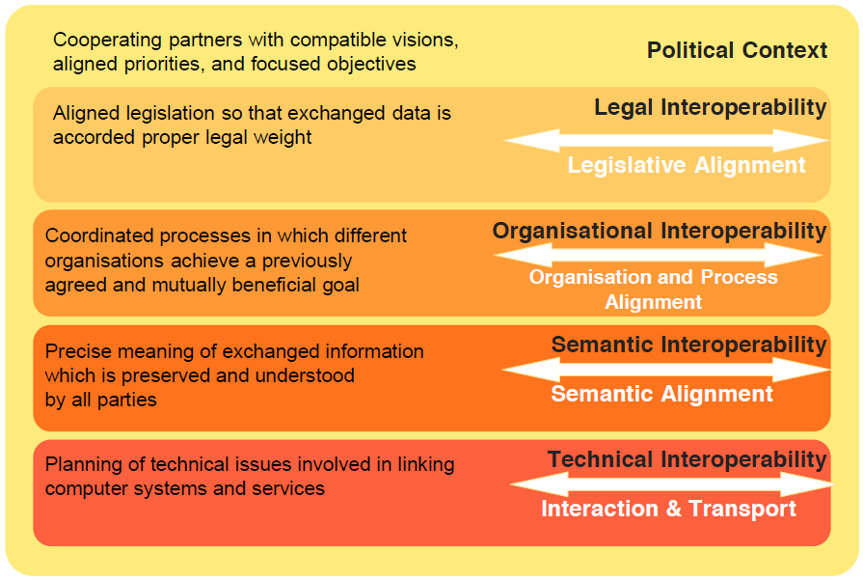
technology
Technology & Social Change Context
is a barrier to…
is a barrier to…
is a barrier to…
is a barrier to…
is a barrier to…
Notes:
PCs (1980) – Internet/WWW (1990-95) – e-Commerce (1995) – e-Government (2000) – t-Government Phase I (2005-20) – SmartMobile+Cloud (2007-2010) - t-Government Phase II (2010 – 2020?) (see original T-gov strategy graphic)
(only really entering t-gov now)
+ economic pressures (less money, economics of IT getting much cheaper at same time)

Slide 6
technology
Slow 20-50 year waves
Technology & Social Change Context
Governments change every 4-6 years
Administrations (Civil Services) don’t change except reluctantly
10-15 years cycle time
(need 2-3 governments’ terms)
3-5 years cycle time
(organisational change programmes)
2-3 years cycle time
(akin to organisational change projects)
1-2 years product/ services cycle times
2-5 years standards setting / adopting cycle times

Slide 7
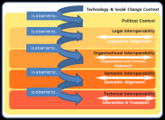
technology
Technology & Social Change Context
is a barrier to…
is a barrier to…
Long cycle times
.v.
Rapid tech change
=
Problem
is a barrier to…
is a barrier to…
is a barrier to…
PCs
www technology
Smart Mobile + Cloud technologies
Internet
e-Commerce
e-Government – culture changing projects
t-Government - preparing
t-Government - doing
10 years
10 years
10 years
1980
1990
2000
2010
2020
Notes:
PCs (1980) – Internet/WWW (1990-95) – e-Commerce (1995) – e-Government (2000) – t-Government Phase I (2005-20) – SmartMobile+Cloud (2007-2010) - t-Government Phase II (2010 – 2020?) (see original T-gov strategy graphic)
(only really entering t-gov now)
+ economic pressures (less money, economics of IT getting much cheaper at same time)

Slide 8
The uk plan
- engage and organise the many
2005-2015

Slide 9
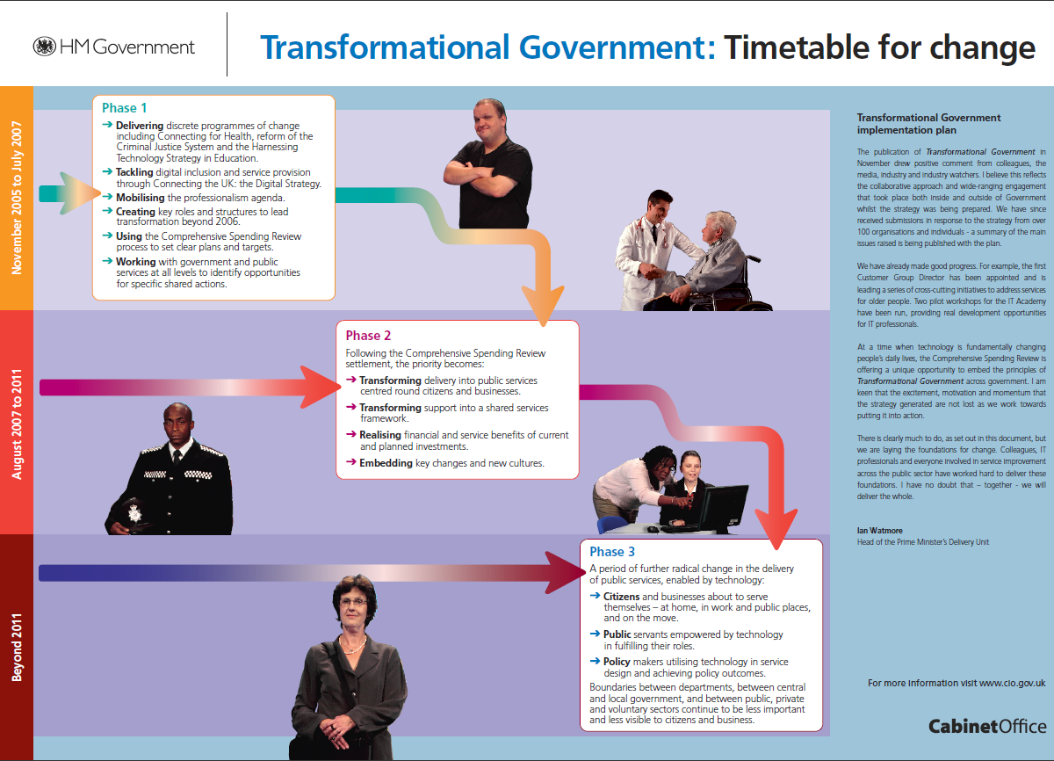
drafted
summer 2005
X
e-gov 2000-05

Slide 10
The Wider Governance Levels

Slide 11
How we work across public sector
Organisation
CTO Council
Organisation
Organisation
Organisation
Architecture
Review Board
Communications
Organisation
Organisations’
(Technical)
Architecture
Team
Organisations’
(Technical)
Architecture
Team
Organisations’
(Technical)
Architecture
Team
Public Sector Domain Teams
Organisations’
(Technical)
Architecture
Team
Strategy
Organisation’s
(Technical)
Architecture
Team
Channels
Process
Information
Services Management
Integration
Information Assurance
Application
Infrastructure
Clearing House
Exemplar Repository

Slide 12
The Overall Approach to focus xGEA activity
Business Needs and Programmes
Citizens able
to tell HMG
once
Reducing
Business Red
Tape
Contact Point
Portal
Org
Index
Key Capabilities
Customer
Management
Processes
Citizen
Account
Citizen
ID&V
Integration
Hub
Employee
ID&V
Plan for
Project
work
CTO Domains: Mapping to ARM, detailed ‘as-is view, production of exemplars, capability strategy, patterns
P
‘As-is’
Needs of
Interest
Delivery: Working with cross cutting projects to influence the delivery of the key capabilities through agreement of exemplar/champions
‘What If’
Patterns

Slide 13
And The product of all this After 10 years of e-t-government investment…

Slide 14
House of Commons public accounts committee
After 10 years of e- t-government investment…
...warns that the coalition's plans to reduce spending by £81bn by 2014 – an average cut of 20% for each department – could be unrealistic as only £1 in every £7 of savings promised [in the past] had been delivered.
"Departments were in general unable to make real value-for-money savings of 3% a year and that was at a time of increasing budgets.
"Now that much more radical cost-cutting measures are required across government, my committee is gravely concerned about the ability of government to make efficiency improvements on the scale needed.”
(Margaret Hodge MP, chair of the public accounts committee)

Slide 15
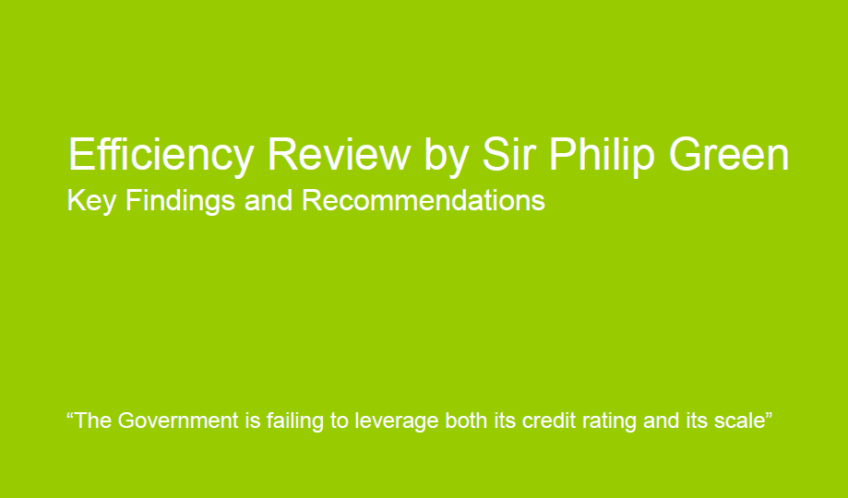
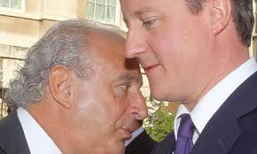

A view from outside government…
Government Business Processes
August-October 2010
Sir Philip Green is a British billionaire businessman who owns some of the United Kingdom's largest retailers.

Slide 16
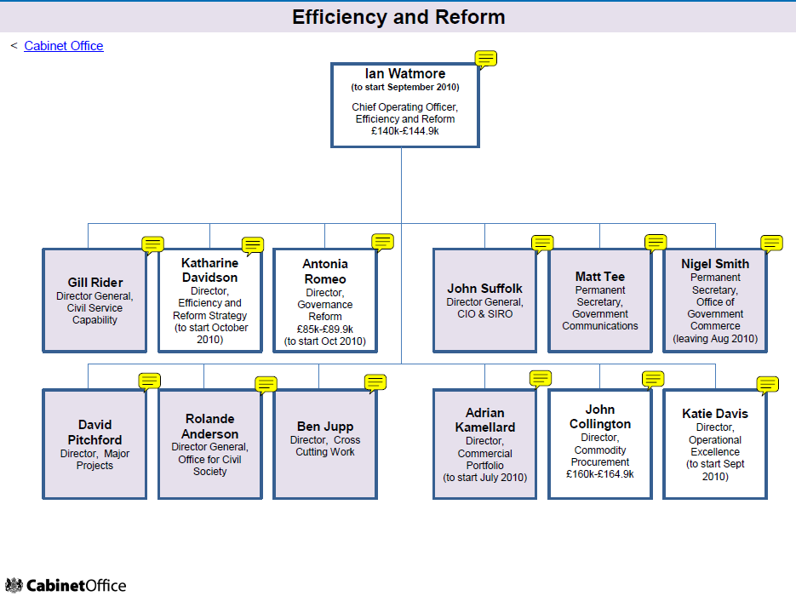
...and from inside the engine room...
“Reasons for failure of UK Government projects:
Political pressure
No business case
No agreed budget
80% of projects launched before 1,2 & 3 have been resolved
Sole solution approach (options not considered)
Innovation gamble (never been done before)
Lack of commercial capability – (contract / administration)
No plan
No timescale
No defined benefits”
APM Conference (Oct’10)
Tony Collins, blogs.computerworlduk.com
What hope for IT-enabled change in this continuing context?
new, November 2009

Slide 17
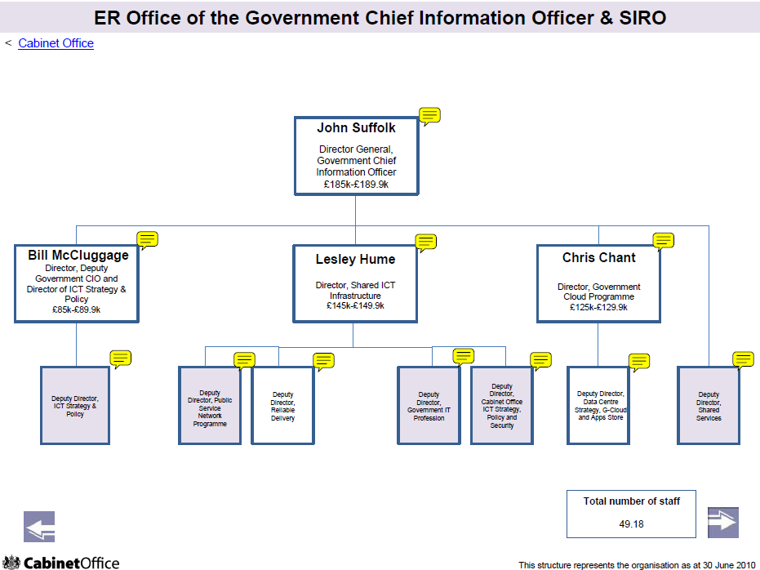


“My team and ministers have only limited control over rationalising the public sector's annual IT spend (£7bn out of £17bn).”
John Suffolk (resigned Nov. 2010)
vacancy
?

Slide 18
Capable people, capable departments – Improving knowledge, skills and experience to deliver the demands placed upon us
Delivering better projects with greater certainty of delivery and benefits - Portfolio Management, Programme Assurance, benchmarking & Benefits Realisation
Information Assurance and Security
Better value and performance from all parties - Supplier Management, 2-way assessment & Collaborative Procurement
Green IT Strategy
Data Centre Strategy
Shared Services building once, using many – sharing front middle and back office systems and services and moving applications to the Government Cloud
Open Source, standards, reuse
130+ centres in central government reduced to 9-12
£900m saving over 5 years
£300m pa saving thereafter
Extend to Local
Authorities & Police
Purchasing at Crown level
No repurchase of our IPR
Government Secure “Cloud” G-Cloud
Shared Services/Systems,
“Tell us Once”
Simplified, standardised
Available to all
Currently c£1.5bn spend pa
£500m pa saving from the 1.5bn
A “Network of Networks”
Will be extended to mobile
TCO benchmark £1k/pa
£100pa saving = £400m pa.
Oct 2005 median cost £2,300
Public Sector Network Strategy
Common Desktop Strategy

Slide 19
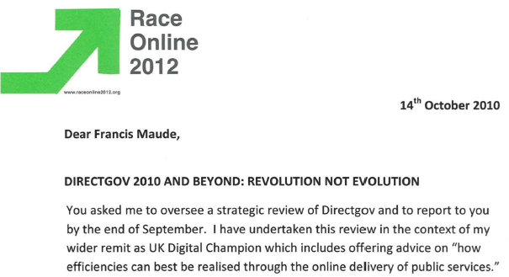

Martha Lane Fox
– UK Digital Champion
...and so another turn of the cycle begins...
(From MARTHA LANE FOX – UK DIGITAL CHAMPION)
Again !!?

Slide 20
People churn & lack of Collective memory
What’s going on here?

Slide 21
People churn
Thro 2002 - 2010
  4 ‘directors of interoperability policy’
  3 ‘government CIOs’
  3 (or is it 4?) ‘organisational units’ of Cabinet Office
  3 ‘lead governments’ (2 Labour, 1 Coalition)
We keep going back to the same starting points because nothing much changes in one ‘people cycle time’
We keep forgetting what we have learned
Our collective memory is very poor, = OPPORTUNITY

Slide 22


Culture Wars
.v.
unresolved
The Radicals
view the Innately Cautious with deep suspicion
strongly welcome the Minister’s reformist zeal
see much of the present IT-related spend as wasteful
instead compel simplification and standardization through control of the purse strings and avoiding being locked into long-term contracts
want SMEs to have 25% of government contracts (by numbers of contracts)
see the status quo as Latin for "the mess we're in".
The Innately Cautious
view the Radicals with deep suspicion
are reluctant to meddle with the major IT systems of government
advocate slow change
see a very limited role for the G-Cloud (and any other radical, new technologies)
want SMEs kept in their place - as subcontractors to the big suppliers (easier to manage just the latter)
Adapted from Tony Collins, blogs.computerworlduk.com

Slide 23
technology
Slow 20-50 year waves
Technology & Social Change Context
Governments change every 4-6 years
Administrations (Civil Services) don’t change except reluctantly
10-15 years cycle time
(need 2-3 governments’ terms)
3-5 years cycle time
(organisational change programmes)
2-3 years cycle time
(akin to organisational change projects)
1-2 years product/ services cycle times
2-5 years standards setting / adopting times

Slide 24
Is it all hopeless then?

Slide 25
Town & City Planning analogy
We depend on safe, smooth running infrastructures and carefully planned developments over long periods of time
We have legal/ regulatory frameworks that reflect society’s broad expectations and we publically fund planning authorities to see them through
We develop and implement national/ regional/ local planning policies to ensure that what is built or renewed is fit for purpose
We already have successful ‘patterns standards’ for these envisioning and persistence in implementation tasks.
The opportunity is to capture the same in our domain?

Slide 26
summary

Slide 27
Summary
This is long game, complex territory
  no simple, universal, quick fixes
People churn and process re-invention are therefore serious problems that have to be short-circuited at best or lived with at worst
The opportunity is to ‘short-circuit’ by capturing and systematizing the collective memory
Standards making is a process of capturing and systematizing the collective memory
The opportunity is therefore to make a standard?

