Slide 1
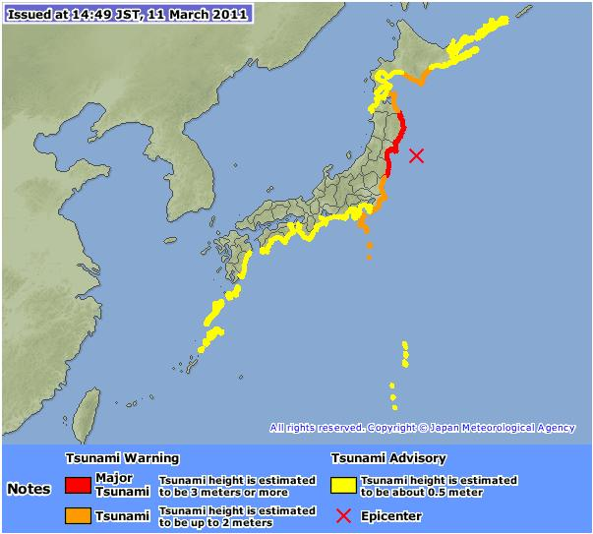
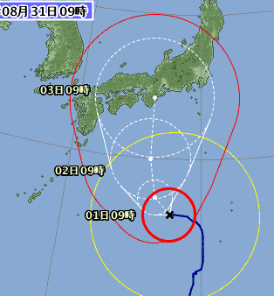
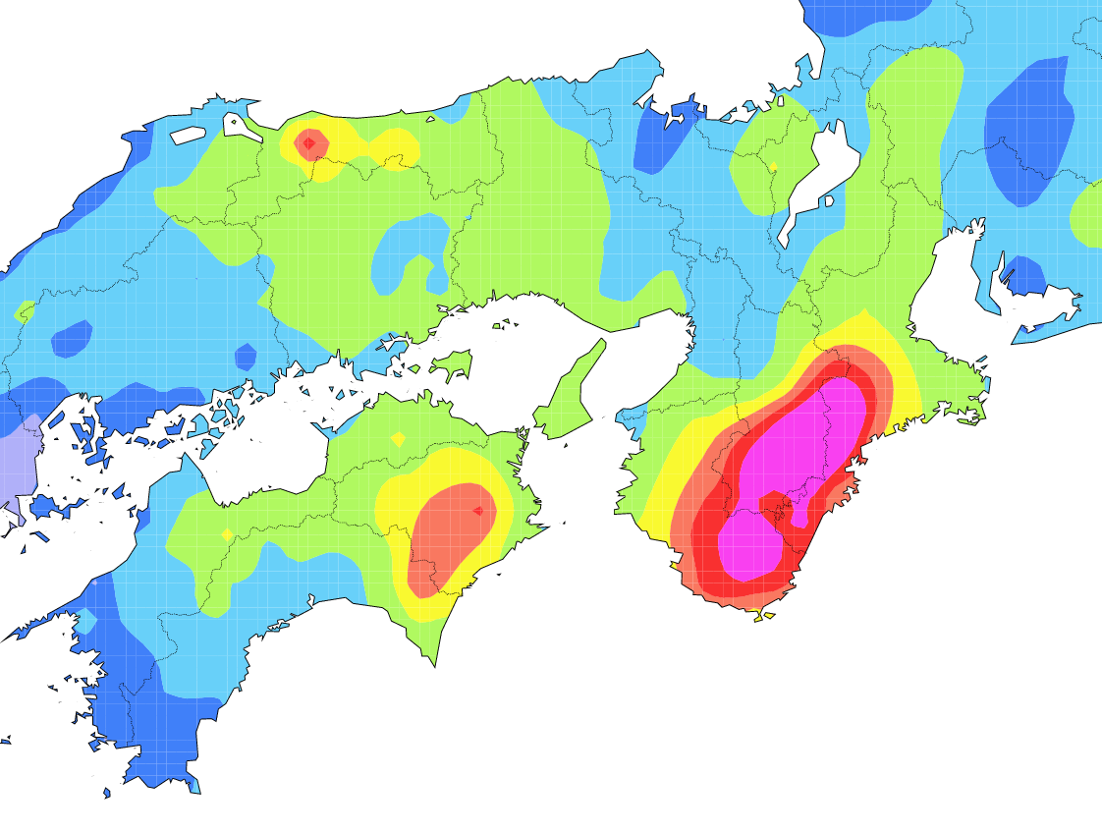
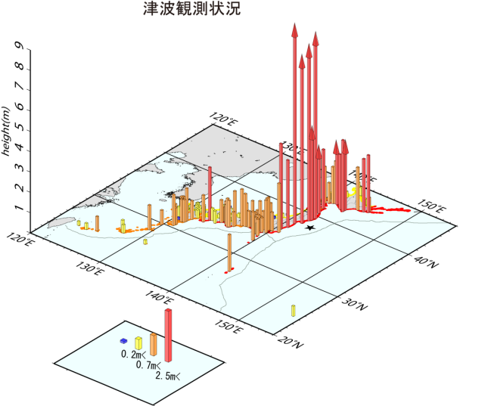


Disaster Prevention Information
Provided by Japan Meteorological Agency
-- Our perspective to XML and CAP --
Kenichi Kuma
Counsellor, Administration Department
Japan Meteorological Agency (JMA)

Slide 2
Today’s presentation
Natural disaster management in Japan
  Japan as a disaster prone country
  Disaster mitigation and prevention framework in Japan
  The role of Japan Meteorological Agency
  Legal framework
Disaster mitigation and prevention information provided by JMA
  Weather related disaster
  Earthquake / Tsunami / Volcanoes
  Our contribution to the world through the international framework
Dissemination of information to public
  Multiple media such as TV, radio, mobile phone
  What we have learnt from massive disasters in 2011
  Our activities on JMX (JMA XML) and our future approach to the global standard
Our perspective to the global standard
Notes:
Last year, we experienced two extraordinary catastrophes.
Off the Pacific Coast of Tohoku Earthquake in March and,
Tropical Cyclone Talas in September.
Both of them caused devastating damage to the country.
Both cases reminded us that
information should be not only accurate but also…
- properly disseminated
- appropriate to user’s needs
- directly linked to disasters
In this scientific lecture, I will share JMA’s experience and you will see what JMA did and what JMA learnt.

Slide 3
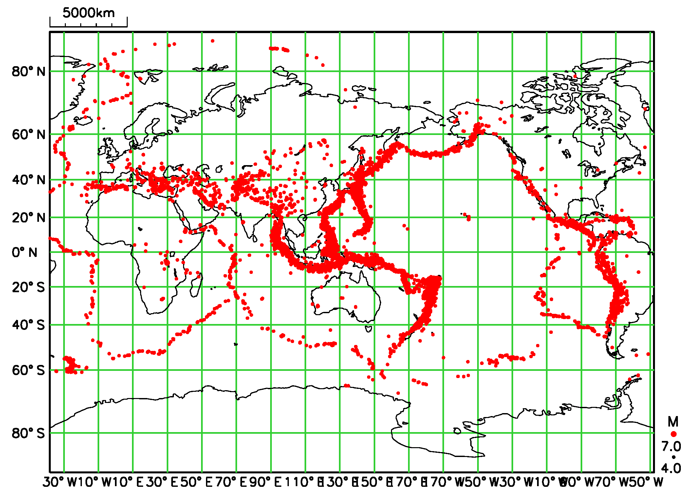
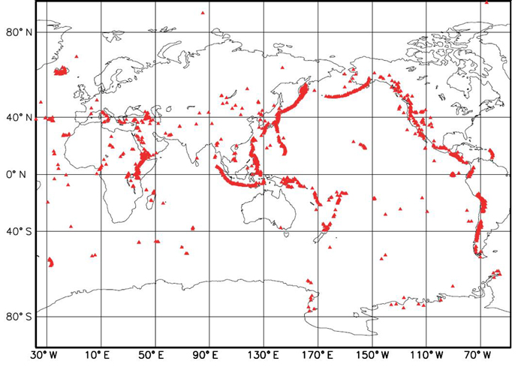
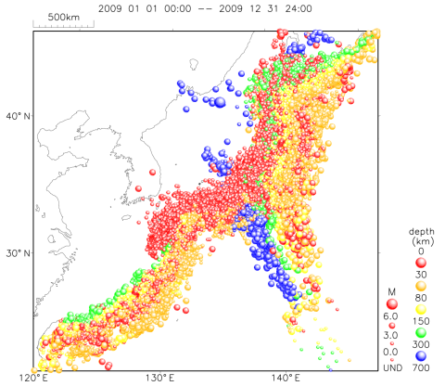
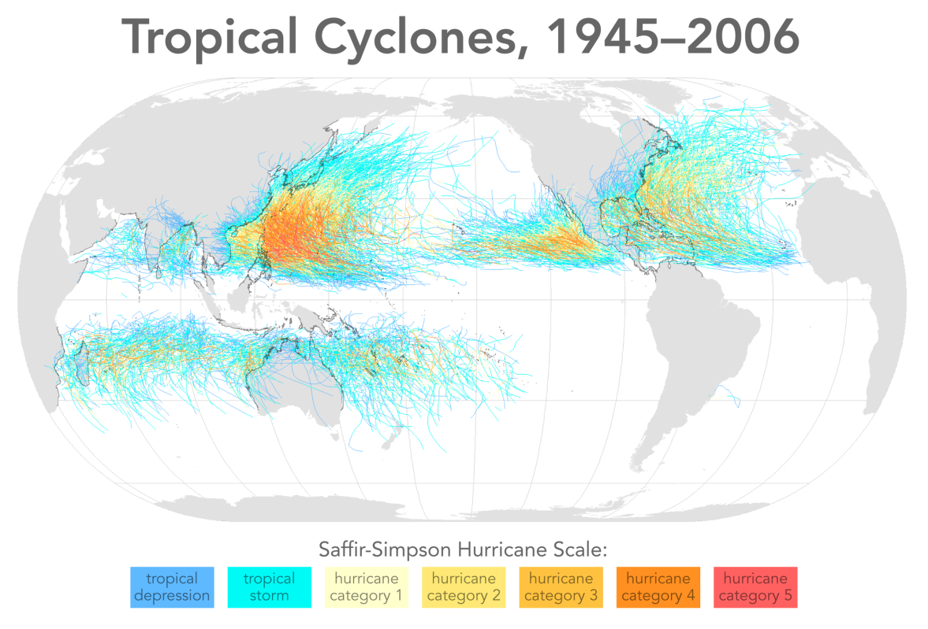
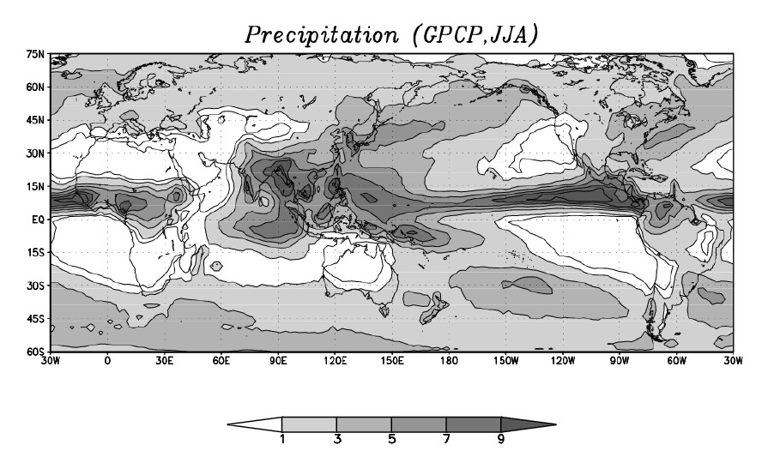
Japan - disaster prone country -
Earthquakes
Volcanoes
Needs Multi-Hazard Risk Management!
JMA covers for all natural hazards
Hypocenters around Japan
135,700 quakes in 2009
(approx. 370/day)
110 volcanoes in Japan
We can contribute to world-wide communities on disaster mitigation / prevention
Tropical Cyclones
11 TCs / year (approach)
3 TCs / year (landfall)
Asian Monsoon :heavy rain/snow
Notes:
You may know…
Japan has a lot of earthquakes, a lot of volcanoes, and
a lot of tropical cyclones.
After the earthquake and tsunami, the risk of another disaster became higher.
Please image what may happen if tropical cyclone attacks after the earthquake.
Please image what may happen if we have heavy rain soon after tsunami.
The disaster may become more complicated and more serious.
So, multi-hazard risk management is very important.

Slide 4
Natural disaster management
Combination is required for disaster management
Structural Measures
Non-Structural Measures
No needs for evacuation as long as hazards do not exceed the limit
The cost is unlimited if we consider the extremely rare cases
Residents need to be educated so that they can act properly.
Coordinated action is crucial
Two aspects of Collaboration are important for Met service
  Collaboration among non-structural measures (media, evacuation authorities)
  Collaboration with structural measures (river/coast/sediment control/life lines)
Structural
measures
Collabo
ration
Non-structural
measures
Met. service
Notes:
This chart shows you the role of JMA in national disaster management.
Weather information is transmitted to the related authorities and the general public.
JMA’s information is used as a trigger to start national disaster management.
The important thing is that evacuation instruction is issued by municipalities, not JMA, not central government.
So, it will be very important to have good communication with municipalities. If they don’t understand JMA’s information properly, they can’t make a good decision.
気象情報は図のように防災機関や一般市民へと伝達される。
日本の災害対応において、避難指示・勧告を出すのは市町村であり、気象情報はそれらの活動のトリガーとなる。

Slide 5
Role of JMA in natural disaster management
Preparing against natural disasters
Natural Disasters Prevention/Mitigation
Preventive Actions
Disaster Management Headquarters
Chair; Prime Minister
Build robust infrastructure
Increase public awareness
Improve quality of information
JMA
Warnings / Advisories
Weather information
Emergency Team
Related Authorities
Prefectures
River Management Authorities
Municipalities
(Cities, Towns)
JMA
Observation, Monitoring, Forecasting
Evacuation Instruction
Media
Citizens
JMA’s information is used as a trigger to start national disaster action
Natural Disaster Recovery
Notes:
This chart shows you the role of JMA in national disaster management.
Weather information is transmitted to the related authorities and the general public.
JMA’s information is used as a trigger to start national disaster management.
The important thing is that evacuation instruction is issued by municipalities, not JMA, not central government.
So, it will be very important to have good communication with municipalities. If they don’t understand JMA’s information properly, they can’t make a good decision.
気象情報は図のように防災機関や一般市民へと伝達される。
日本の災害対応において、避難指示・勧告を出すのは市町村であり、気象情報はそれらの活動のトリガーとなる。

Slide 6



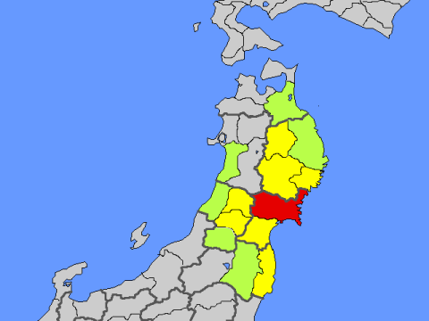

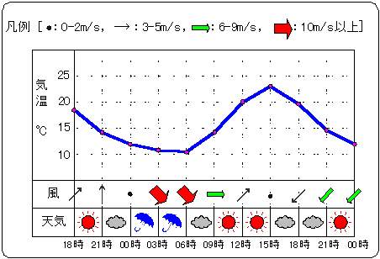
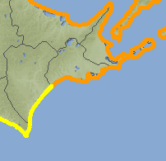
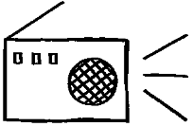

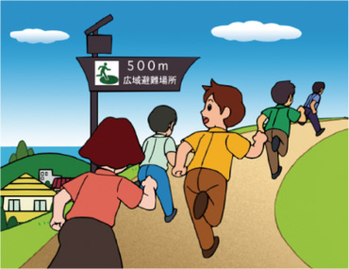
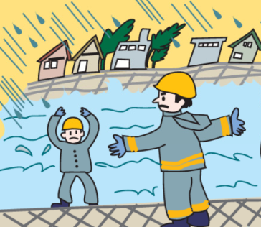
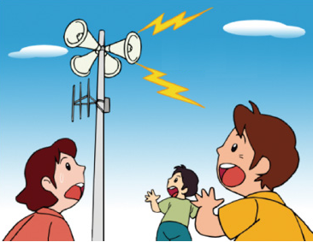

Action of local governments and citizens
Public-Help
JMA
Headquarters
JMA Local Offices
Self-Help
Co-Help
Forecast
Warnings
火山名 ○○山 噴火警報（火口周辺）
平成20年X月X日X時X分 △△管区気象台
＜○○山に火口周辺警報（噴火警戒レベル２、火口周辺規制）を発表＞
○○山では火口周辺に影響を及ぼす噴火が予想さ
対象市町村等 △△県：□□市、◇◇村
＜噴火警戒レベルを１（平常）から２（火口周辺
津波警報
津波注意報
Information
・Prefectures
・Municipalities
Citizens
Evacuation Order
and Instruction
Staff assembling
Patrol/Caution
Evacuation

Slide 7
The Basic Act on Disaster Control Measures (1961)
After Ise-Bay Typhoon in 1959
Provides basis for disaster management in Japan
  Such as “Definition of responsibilities for disaster management”
Provides mission of both national and local governments for disaster management
Description related with JMA responsibility
  To observe and to forecast meteorological, terrestrial, and oceanographic phenomena.
  To improve forecast and warning against disaster.
  To cooperate internationally to enhance global observation system.

Slide 8
The Meteorological Service Act (1952)
JMA’s mission
  To contribute to extend public welfare
  Prevention and mitigation of natural disasters
  Safety of transportation
  Development and prosperity of industry …
  To cooperate internationally
Provides duties and services of JMA
  Observations (Meteorology, Seismology, Volcanoes)
  Framework for warnings and information on natural disasters
    Including tsunami and storm surge
  Promotion of private weather businesses
  Duties for issue and dissemination of warnings
    Asks relevant parties to re-distribute warnings
    (National authorities, Local authorities, TV, T&T etc.)

Slide 9
Warning and advisory
--- Weather related disasters ---
Warning
Heavy Rain (Sediment disaster, Inundation), Heavy Snow, Storm, Snow-storm, Flood, High Wave, Storm Surge,
(Tsunami, Earthquake motion, Volcanic phenomena)
Advisory
Heavy Rain (Sediment disaster, Inundation), Heavy Snow, Gale, Gale and Snow, Flood, High Wave, Storm Surge, Thunderstorm, Dense Fog, Frost, Dry Air, Avalanche, Low Temperature, Snow-melting, Ice (snow) accretion,
(Tsunami, Earthquake motion, Volcanic phenomena)
Information jointly issued
Joint Flood Warning for designated river with the river authority
Joint Sediment Disaster Alert with the sediment control authority
Notes:
To support evacuation of the people, JMA issues various information depending on the different types of disasters as shown in this table.
(Pink color means the information target is municipalities.) ←スライドに記載あり
(Blue color means the information target is rivers.) ←スライドに記載あり
JMA issues advisories and warning for each target disaster such as sediment disaster, inundation, flooding or storm surge.
For example, to prevent sediment disaster by Talas, JMA issued heavy rain advisory first, then heavy rain warning, and finally sediment disaster alert, by increasing the alert level.
気象庁はこれら土砂災害、浸水害、洪水害、高潮害に対してそれぞれ注意報・警報等を発表している。
これら注意報や警報は、自治体の避難勧告など防災機関の対応や住民の自主的な避難行動の判断の目安となるように、位置づけられている。
時々刻々とかわる状況に呼応して、注意報・警報のレベルを段階的に事前にあげていくことで注意を促してきたものの、多くの死者・行方不明者が出た。
(参考）
注意報、警報、土砂災害警戒情報との段階分けの説明。
また、防災機関に対して、それぞれのレベルに応じて避難勧告、避難準備、防災体制の立ち上げの目安となることを説明。

Slide 10
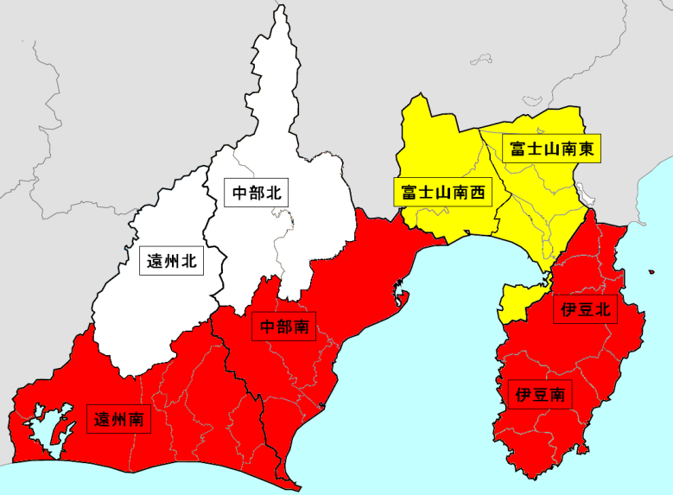
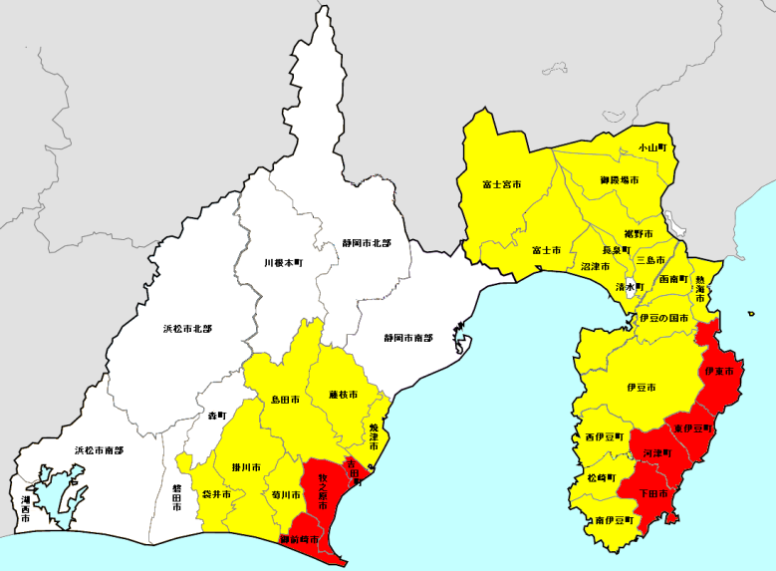
Warning and advisory for each city
warning
Mar. 2001 ２２６
Mar. 2002 ２９４
Mar. 2003 ３５６
Mar. 2004 ３６２
Mar. 2005 ３６８
Mar. 2006 ３７０
Mar. 2007 ３７３
Mar. 2008 ３７４
Mar. 2010 ３７５
May. 2010 １７７７（municipalities）
advisory
Number of subdivisions
No warning or advisory
8
warning
Disaster prevention organizations and citizens to narrow down the area of required caution.
According to “Basic Act on Disaster Control Measures”, a mayor of municipality is responsible for evacuation advisory.
Easier to understood by public
advisory
No warning or advisory
27
Notes:
Last year, we experienced two extraordinary catastrophes.
Off the Pacific Coast of Tohoku Earthquake in March and,
Tropical Cyclone Talas in September.
Both of them caused devastating damage to the country.
Both cases reminded us that
information should be not only accurate but also…
- properly disseminated
- appropriate to user’s needs
- directly linked to disasters
In this scientific lecture, I will share JMA’s experience and you will see what JMA did and what JMA learnt.

Slide 11
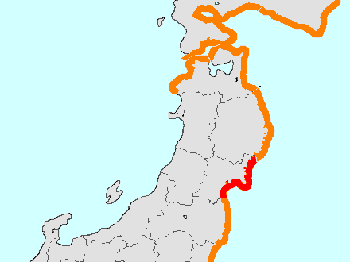

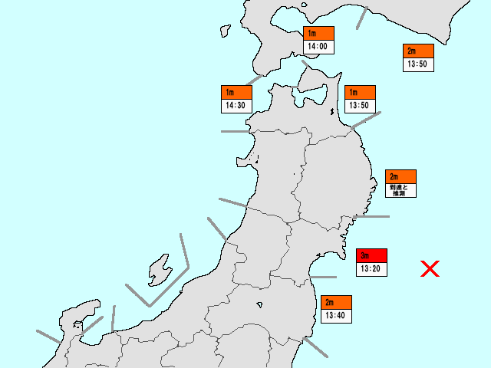
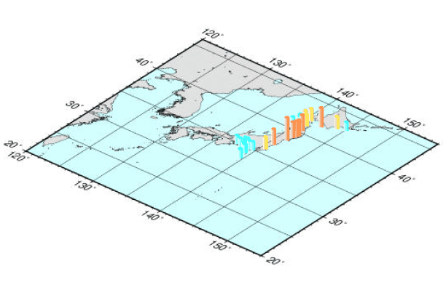

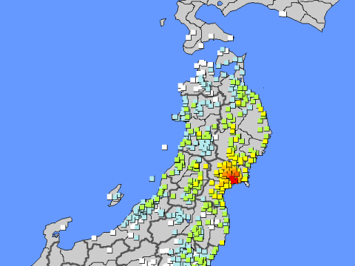
Time Sequence of Earthquake Information and Tsunami Warning in JMA
Focus, P-wave
S-wave
Earthquake
Earthquake Early Warning
Automatic processing
Tsunami
Warning
1.5min.
Seismic Intensity Information
Tsunami Information
(Estimated Tsunami Heights and Arrival Times)
2～3min.
Automatic processing
Earthquake Information
(Hypocenter and Magnitude )
5min.
Earthquake and Seismic Intensity Information
Tsunami Information
(Observed Tsunami Heights and Arrival Times)
Seismic Intensity Information at each Site

Slide 12
Tsunami Warning Classification
Leave coastal areas immediately and evacuate to a safe place
Leave coastal areas and do not engage in fishing or swimming
Will be updated in the near future based upon the investigation of 3.11

Slide 13
Response to the earthquake
6-lower | Cabinet Secretariat ➔ call of an urgent gathering team
5-lower | Ministry of Defense ➔ investigation of damages Japan coast guard ➔ investigation of damages
4 | Cabinet Office ➔ estimation of damages Metropolitan Police Department, Fire and Disaster Management Agency ➔ investigation of damages

Slide 14
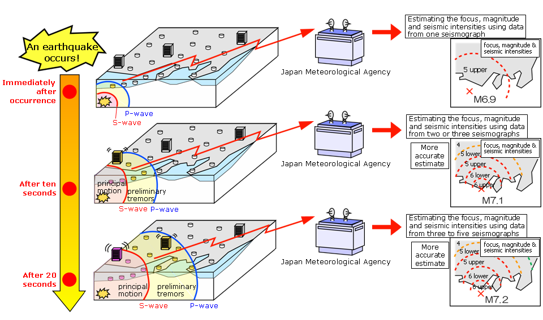
The Concept of Earthquake Early Warning (EEW)
JMA is providing residents in Japan with Earthquake Early Warnings, new prompt earthquake alerts to be issued immediately after the occurrence of earthquakes, in order to secure time to protect yourself before strong tremors arrive.
On 1 October 2007, JMA started providing Earthquake Early Warning through several media such as TV and radio.

Slide 15
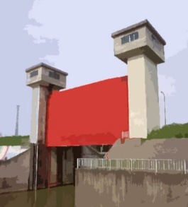
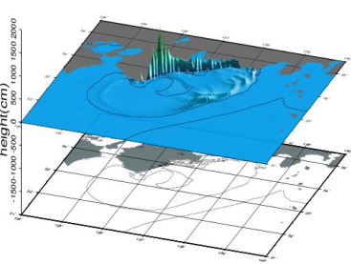
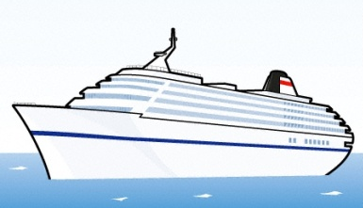
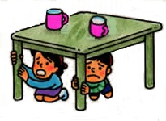




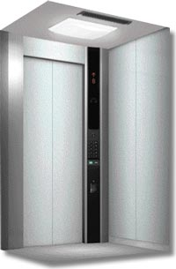




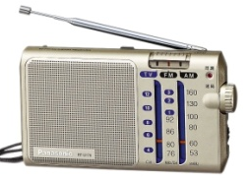
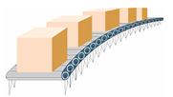

Importance of public awareness and collaboration with our partners
Tsunami warning
Precautionary measures in homes, schools, halls, shopping centers, etc..
Immediate evacuation from areas of the tsunami
Closing tide gates
Train control system
Elevator Control System
○○●
Traffic control signals, traffic regulation
Hospitals → Prevention of errors in operations
People in hazardous locations
→ Ensuring the safety
Controlｌing factory lines
→ To mitigate damage
News

Slide 16
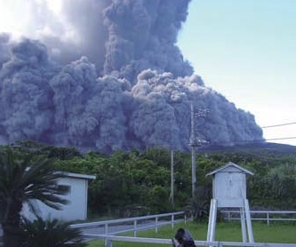
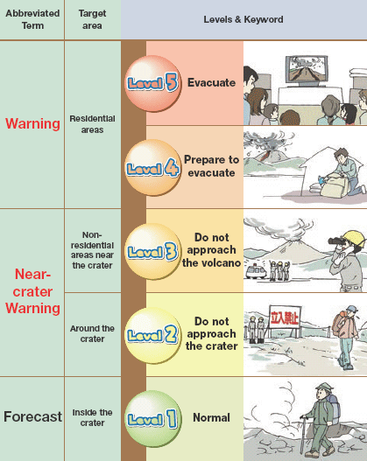

Volcanic Warning
Volcano alert levels
Observations at each volcano
Volcanic Observations and Information Center
Issurance of
Volcanic Warnings
Local Meteorological
Observatories
Japan
Coast Guard
NHK
Police
NTT
Prefectural
Offices
Local municipalities
Vessels
Citizens / Inhabitants
16

Slide 17
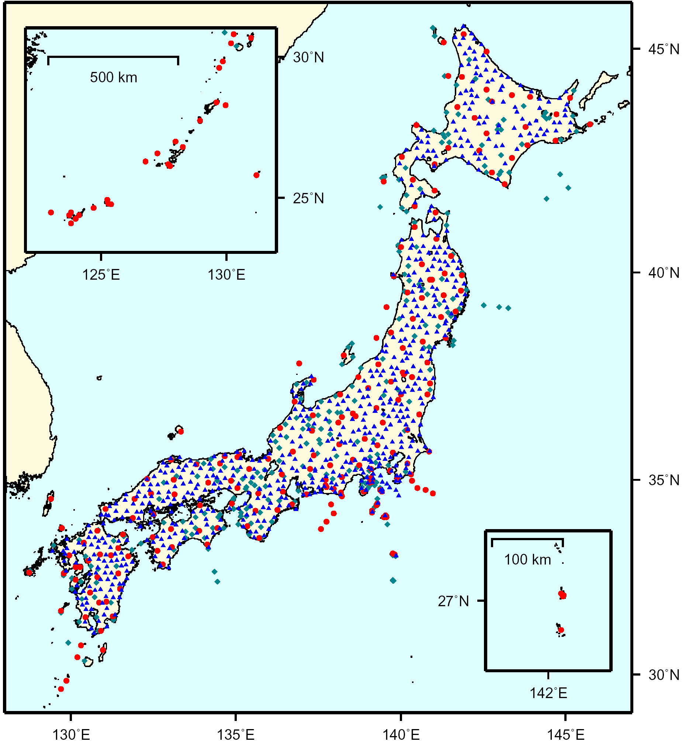
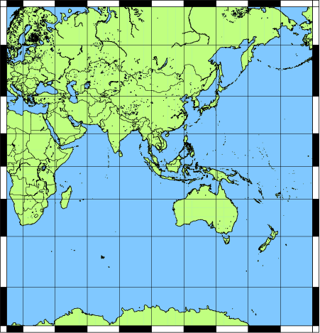
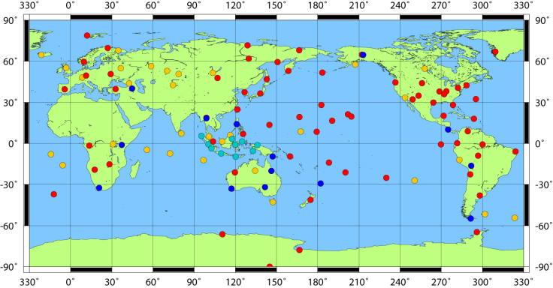
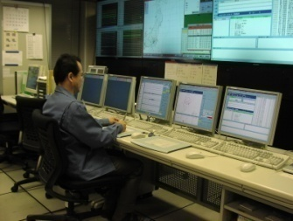
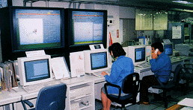
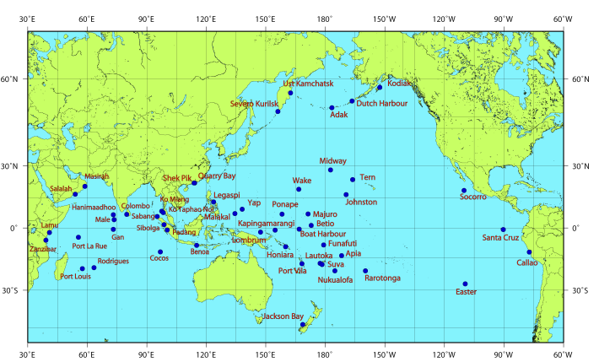
Provision of Tsunami Bulletins to countries around the Northwest Pacific and the Indian Ocean
Japanese Seismic Network
Pacific Tsunami Warning
Center (PTWC)
Information Exchange
Data
Global Seismic Network
Northwest Pacific Ocean
Tsunami Bulletins
（NWPTA）*1
（TWI）*2
Indian Ocean
Data
JMA
Sea Level Stations
Analysis
・Hypocenter
・Magnitude
・Evaluation of Tsunamigenic Potential
・Tsunami Observation etc.
Contribute to the mitigation of tsunami disasters of countries around the Northwest Pacific and the Indian Oceans
*1) NWPTA: Northwest Pacific Tsunami Advisory
*2) TWI: Tsunami Watch Information for the Indian Ocean

Slide 18
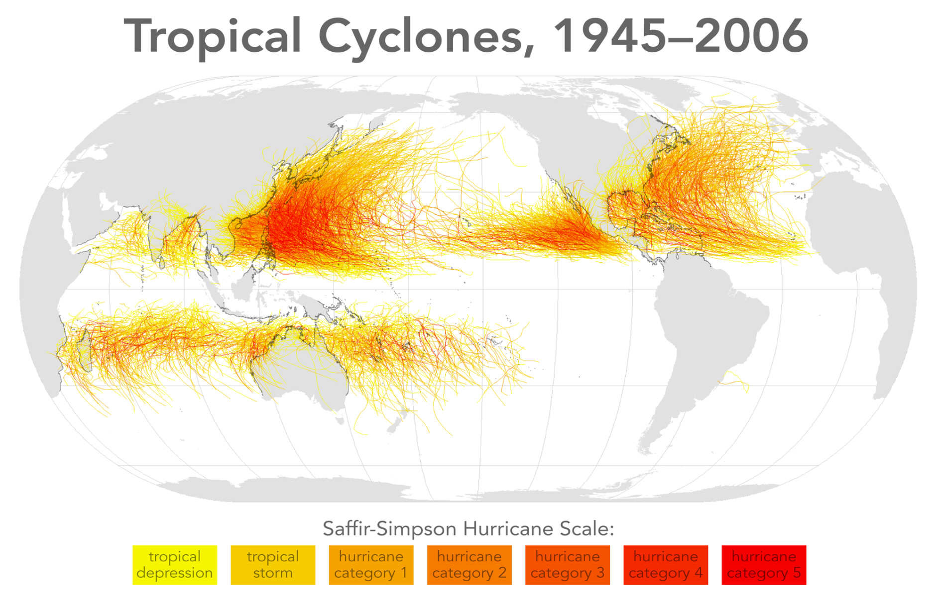
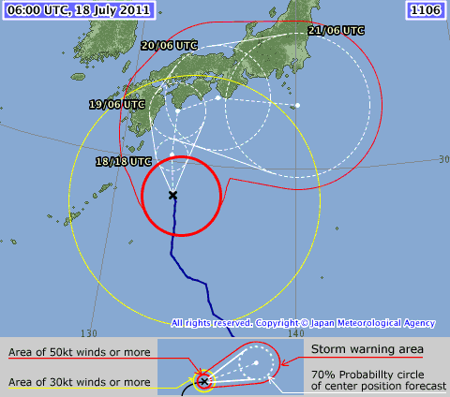
TC advisory from RSMC Tokyo
WTPQ20 RJTD 180600
RSMC TROPICAL CYCLONE ADVISORY
NAME TY 1106 MA-ON (1106)
ANALYSIS
PSTN 180600UTC 28.4N 133.2E GOOD
MOVE N 14KT
PRES 945HPA
MXWD 085KT
GUST 120KT
50KT 140NM EAST 90NM WEST
30KT 425NM EAST 300NM WEST
FORECAST
24HF 190600UTC 32.6N 132.8E 85NM 70%
MOVE N 10KT
PRES 950HPA
MXWD 080KT
GUST 115KT
48HF 200600UTC 33.5N 135.2E 160NM 70%
MOVE ENE 06KT
PRES 960HPA
MXWD 075KT
GUST 105KT
72HF 210600UTC 33.3N 140.1E 220NM 70%
MOVE E 10KT
PRES 975HPA
MXWD 055KT
GUST 080KT =
Tropical Cyclones 1945 - 2006
RSMC Tokyo
25.6/year
（1981-2010）
10.1/year
3.0/year
16.4/year
4.4/year
RSMC TC advisory (WTPQ20-25)
(for 3-day forecast)
issued within 50 minutes from
observation times at 00, 06, 12, 18 UTC
from Wikipedia
http://en.wikipedia.org/wiki/Tropical_cyclone

Slide 19
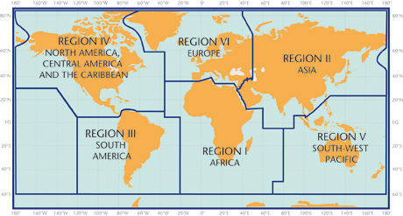
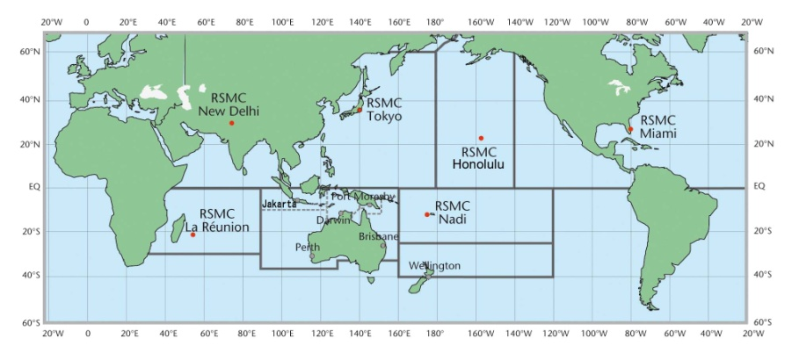
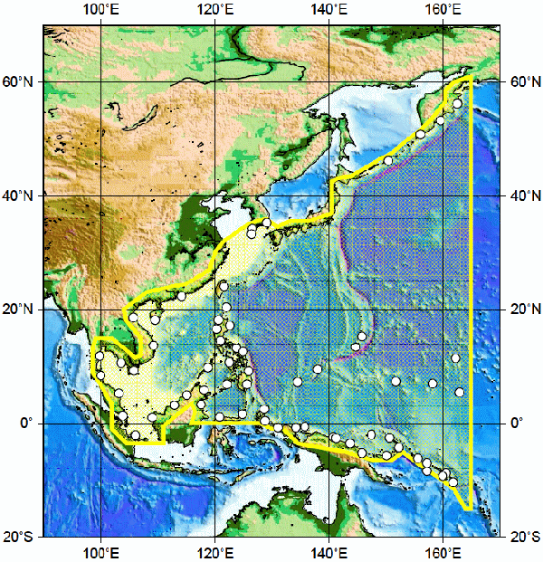
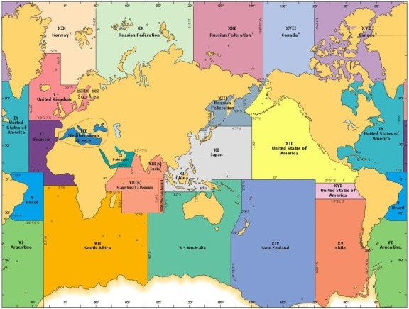
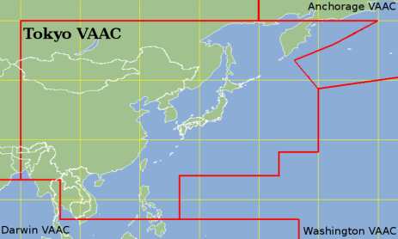
JMA’s international mission
JMA
NMHS
people
advisory
warning
Tropical Cyclone Warning Centres
WMO region
Telecommunication,
Environmental Emergency Response,
etc.
Northwest Pacific Tsunami Advisory center
The Global Maritime Distress and Safety System (GMDSS) Services
Volcanic Ash Advisory Center

Slide 20
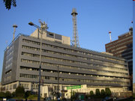
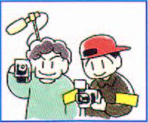
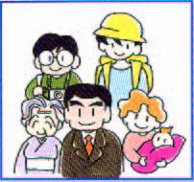
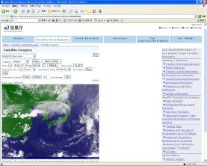
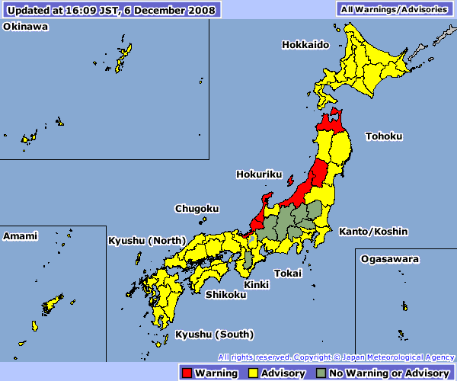


Dissemination of Information
Government
Information System
Prefectures/Cities
Official Single Voice
Media
Public
JMA
Private activities
JMA website
>Rapid progress in ICT
>Each media has its own advantage
>International visitors in Japan
Weather Warning
Typhoon information
Volcanic Warning
Notes:
JMA is the official single voice of warning in Japan for various types of warnings, such as earthquake, tsunami, volcanic eruption, heavy rain or flooding.
JMA uses the same dissemination system for all of different disasters.
The warnings are used by the central and local governments to make their decisions.
At the same time, citizens can receive the same message using various media.
As the tsunami warning is a vital information, we use a highly reliable information system.
In spite of the very strong earthquake, the tsunami warning were successfully transmitted to all 70 organizations in Tohoku region.

Slide 21

3.11
<<Inundated Area>>
Population: 16,640
Death and Missing: 2,170
Photo by JMA from the helicopter of JSDF
As of 12 March

Slide 22
What we have learnt from 3.11
Information should be linked to disasters so that the people can understand what they act
  Tide level, precipitation forecast map, inundation forecast map, tide level calendars etc.
Appropriate information dissemination system should be established.
  Use of portal site and mobile phones
  Ensure several routes of communications
Appropriate support to citizens and disaster management agencies (including municipalities) is important.
  To enhance public awareness including children
  To provide best suitable products

Slide 23

JMX (Japan disaster prevention information XML)
Our concept
  Profitableness to users:
    adaptability to users’ system and working.
    cost-effective system in the long run
  Unified Format:
    from various forms of conventional texts to a unified and comprehensive format.
  Consolidated description:
    Multiple information in one single bulletin; from observations to forecasts
  Flexible format:
    Format allowing new elements to be added for future services
Project collaborators
  Technical support from the XML Consortium on XML standardization
  Coordination with governmental organizations and the mass media
<Control>
-Title
-Datetime
- …
<Head>
-Headline
-TargetArea
- …
Basic elements
<Pressure>,<WindSpeed>,
<Magunitude>,<Tsunami>,
…
Ref.
<Body>
*meteorology
*seismology
*volcanology

Slide 24


JMX and CAP
All Hazards
CAP
natural hazards such as severe weather, earthquakes, and tsunami
law enforcement
Detail
public safety
time-sequential values
quantitative estimates
JMX
CAP can be generated from JMX
  JMX to domestic users
  CAP to international users (outside or inside Japan)
  Typhoon information will be served in CAP as a trial this year through internet

Slide 25
Our perspective to the global standard
It is reasonable to optimize the emergency alerts considering the domestic requirements.
  Natural features, government, law, culture, history, etc.
Emergency alerts must be reached to everyone who needs
  After the huge disaster, ways of dissemination are limited due to various reasons
  Disseminate the information to people who cannot understand Japanese
Standardization may help the various media to deliver the information
  Multiple ways of dissemination from a single authentic voice
  May support the people in the country lacking proper alert information
Tasks to be solved in future
  How to inform the meaning and the required action of the alert
    Which is the most important aspect for saving the lives!
  National authority International authority
  National standard International standard

