Slide 1
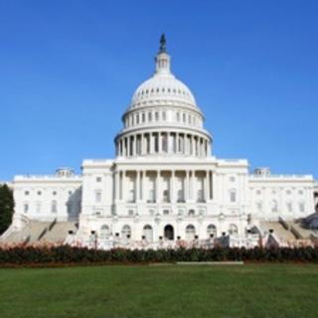
Legal, Policy and Procedural Challenges in
Building CAP Warning Systems, with example systems

Slide 2
Why are we in this business?
Assumption:
Disasters will continue to happen.
People will continue to live in known disaster zones
Hence:
Warning Alert and Warning Systems in the various forms are a common ingredient in community for many years to come.
Community expectations:
Alert and warning are becoming a part of the community culture, getting to be a standard service that the public expect from the government. The “fire alarm” is changing to “all hazard alarm”.
Building the infrastructure:
Warning process (and infrastructure) involves everyone in the community, from the top leader to last civilian.
Notes:
New Orleans after Katrina
Flood zones in normal neighborhood

Slide 3
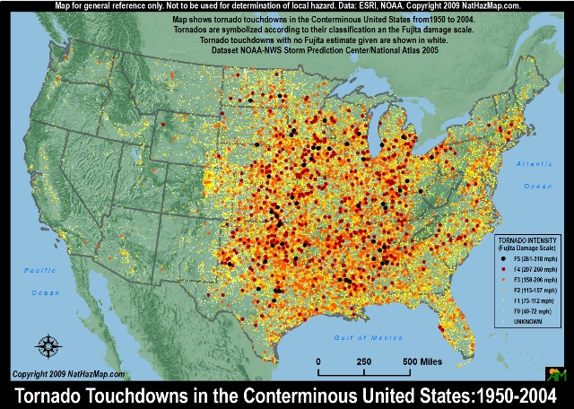
Example
USA

Slide 4
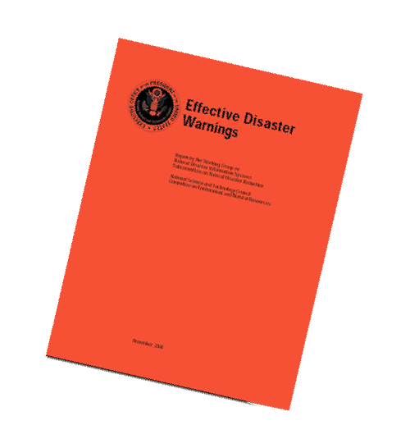
NSTC Report: “Effective Disaster Warnings”
Published November 2000
Survey of prior social science on warning effectiveness
Recommendations for warning message content
Importance of coordinated use of multiple warning technologies
NSTC - National Science and Technology Council, chaired by the President

Slide 5
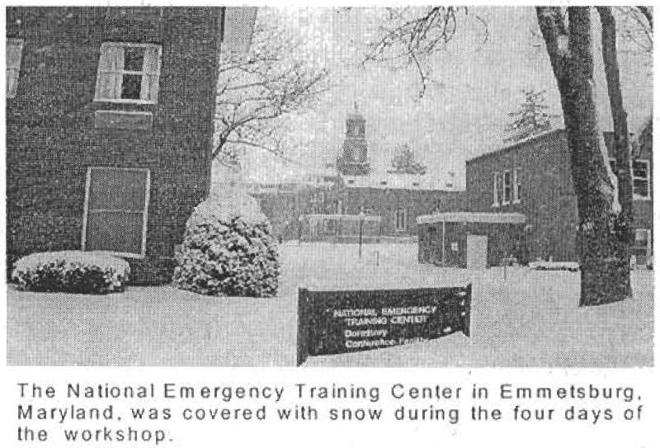
National non-profit organization
Local, state and federal officials
Leading academics
Broadcast, electronic and Internet companies
Strategic Plan (2003) recommends:
Identify lead federal agency for public warning
Develop standard protocol and terminology
Develop standards of practice for warning

Slide 6
History that did not happen
January 9, 2003
EMERGENCY WARNING ACT OF 2003
MR. EDWARDS. I rise to introduce, together with SENATOR HOLLINGS, the Emergency Warning Act of 2003.
In the event of a terrorist attack or natural disaster, Americans must know how to respond. In the first terrible hours on September 11, 2001, in Washington, in New York, and across the country, most of us didn’t know what to do. We didn’t know whether it was safer to pick our children up from school or safer to leave them there. We didn’t know if we should stay at work or head for home.

Slide 7
USA Legislation 1/2
Executive Order 13407 of June 26, 2006
Public Alert and Warning System
By the authority vested in me as President by the Constitution and the laws of the United States of America, including the Robert T. Stafford Disaster Relief and Emergency Assistance Act, as amended (42 U.S.C. 5121 et seq.), and the Homeland Security Act of 2002, as amended (6 U.S.C. 101 et seq.), it is hereby ordered as follows:

Slide 8
USA Legislation 2/2
Section 1. Policy. It is the policy of the United States to have an effective, reliable, integrated, flexible, and comprehensive system to alert and warn the American people in situations of war, terrorist attack, natural disaster, or other hazards to public safety and well-being (public alert and warning system), taking appropriate account of the functions, capabilities, and needs of the private sector and of all levels of government in our Federal system, and to ensure that under all conditions the President can communicate with the American people.
….
[signed:] George W. Bush
THE WHITE HOUSE,

Slide 9
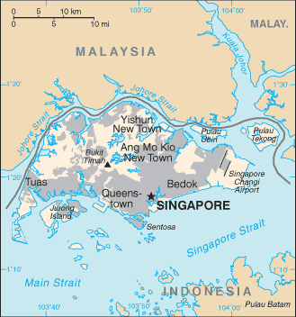
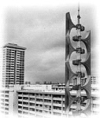
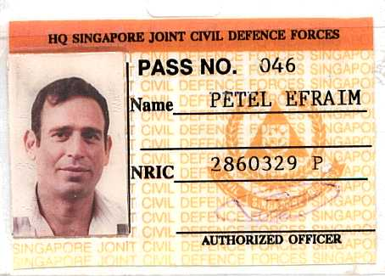
Another example: Singapore

Slide 10
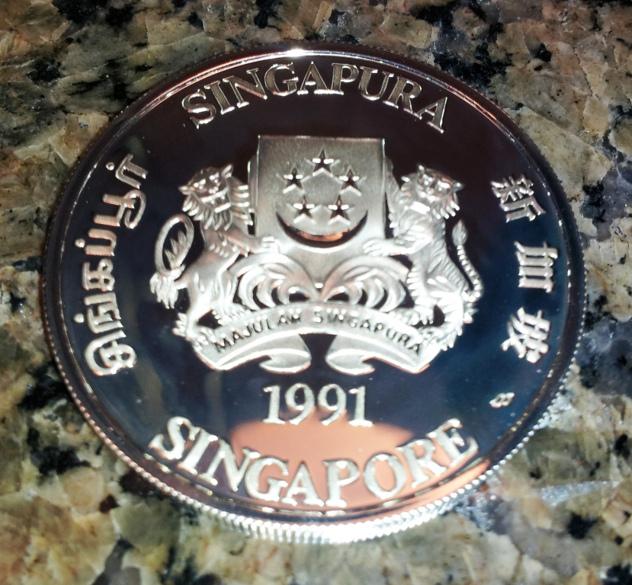
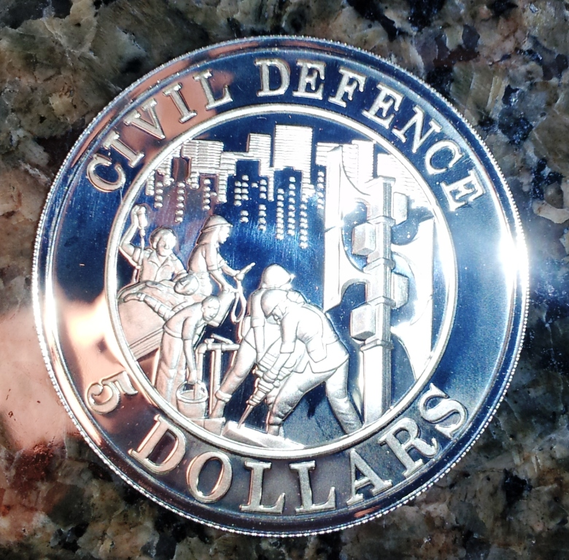
When a country takes it seriously

Slide 11
The kind of news we want:
http://www.csmonitor.com/World/Americas/2012/0321/Better-prepared-Mexico-s-7.4-quake-causes-damage-but-no-deaths
Better prepared: Mexico's 7.4 quake causes damage, but no deaths.
Mexico's worst earthquake in nearly 30 years was met by stricter building codes and a city prepared by evacuation drills and early warning systems.
By Sara Miller Llana, Staff writer, Lauren Villagran, Correspondent / March 21, 2012 MEXICO CITY
By the time the powerful 7.4 earthquake rumbled in Mexico City Tuesday, the 56 students ages 6 months to 6 years attending the Montessori Kid's Place in Mexico City were already evacuated, gathered in the front lobby of the school, a location city engineers had earlier indicated as the safest spot.
“For a few seconds, nothing happened, and we thought it might be a false alarm,” says Claudia Yañez, the school director.
If an earthquake strikes, an alarm sounds and a voice warns “earthquake,” as it did Tuesday, giving them a minute of time to implement the drills they practice monthly. “This minute is very valuable,” Ms. Yañez says.

Slide 12
Mexico drill
Movie

Slide 13
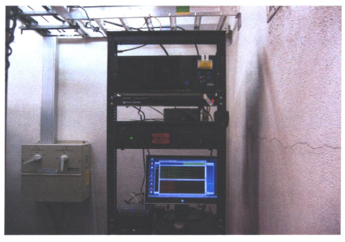
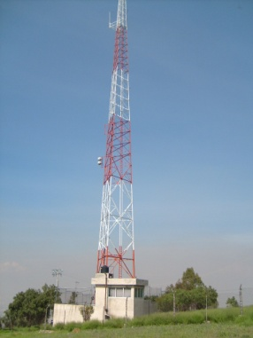
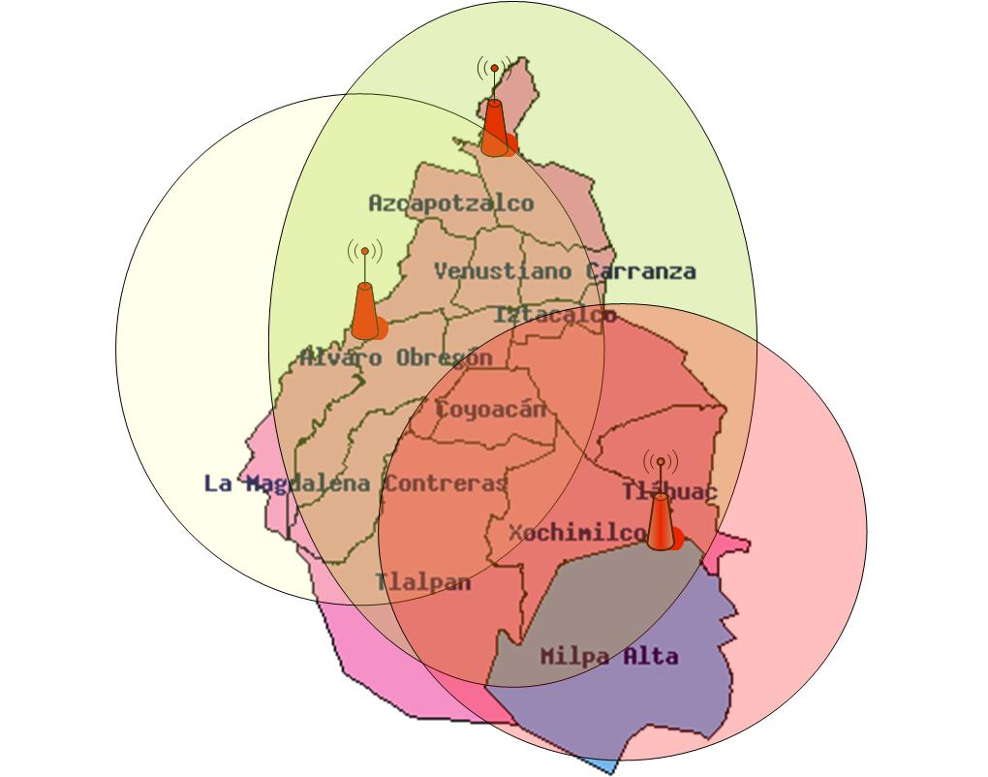
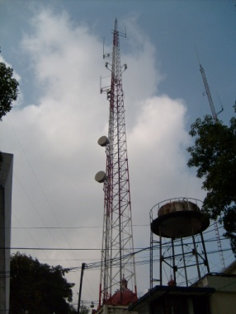
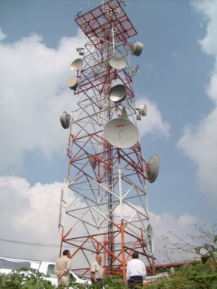
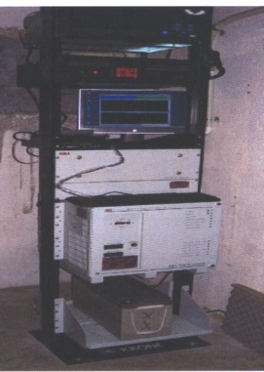
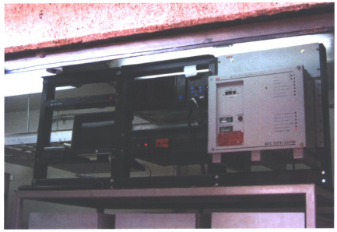
Mexico city alert system

Slide 14
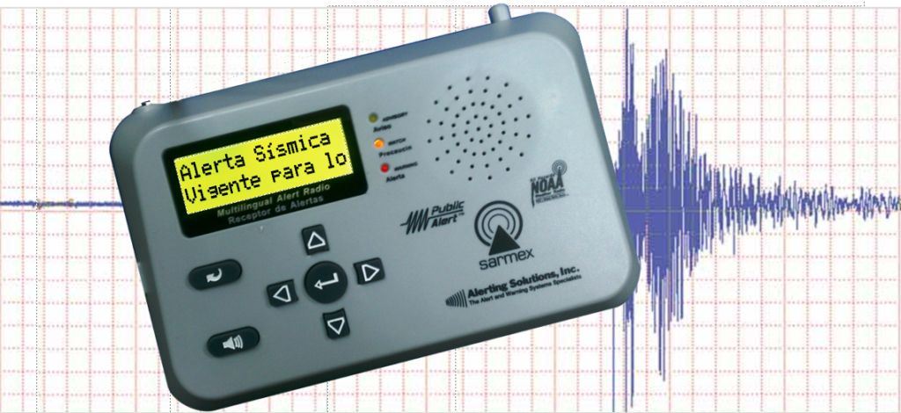
All hazard alert radio

Slide 15
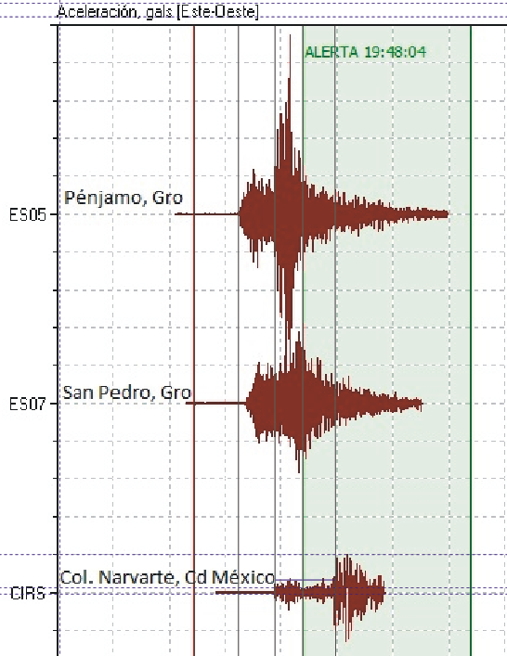
Case study in Mexico city
December 10, 2011, 19:47:25 local time
Major EQ 110 miles from Mexico City
Warning System activated at 19:48: 04
Arrival of EQ wave: 12 seconds after activation
In this case:
Alert activation: <1 second
Human react in: 2-4 seconds
Response time: >7-9 seconds
12 sec

Slide 16
What good is a few seconds?
EQ DETECTION / WARNING
Start automated processes
Shut off a gas valve
Stabilize a surgery patient
Immobilize a conveyor belt
Pause a Lasik eye-laser
Move away from a stove
Drop-cover-hold
Stop a punch press
Close a fume hood
Halt an escalator
Recall an elevator
0
1
2
3
4
5
6
7
Seconds after warning
0
1
2
3
4
5
6
7
8
Seconds after detection
EQ ALERT RADIO
ACTIVATION
STANDARD RADIO
START ACTIVATION PROCESS
16

Slide 17
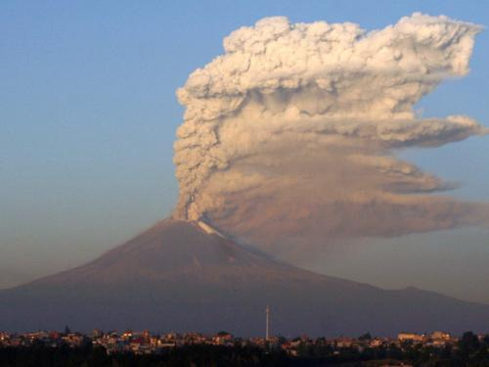
Erupcion Volcanica
Se informa a la poblacion del Valle de Mexico que el volcan
Popocatepetl hizo erupcion a las 16:35 horas del dia de hoy arrojando material incandescente a 10 KM del crater asi como grandes emisiones de ceniza la cual se espera sean esparcidas en todo el Valle de Mexico, esto, sin provocar mayores danos a la poblacion
Se pide a todos los habitantes del valle de Mexico, no arrojar estas cenizas en las coladeras, asi como no barrerlas con aguas si no unicamentecon escoba. Cualquier anomalia o emergencia referente a esta situacion por favorcomunicarlo a Proteccion Civil
Notes:
Informing the population of the Valley of Mexico to the volcano Popocatepetl erupted at 16:35 hours of the day today throwing incandescent material and 10 KM from the crater as well as large ash emissions which are expected to be scattered throughout the Valley of Mexico, this, without causing major damage to the population It calls on everyone in the valley of Mexico, not to throw these ashes into sewers, so as not sweep with water if unicamentecon broom. Any anomaly or emergency concerning this situation by favorcomunicarlo to Civil Protection

Slide 18
Analytic approach for warning system planning

Slide 19
Challenges in designing cap
Identifying the need
Survey of legal, regulatory and policy environment
Document local and external alert sources and originators
Document languages for alerting
Document sources for sustaining funding
Identification of Lead Agency Identification of existing alerting codes or practices
General Warning Policy
Multilingual Alert Templates

Slide 20
Introduction to the role of TWFP
SOP Diagram
SOP Example

Slide 21
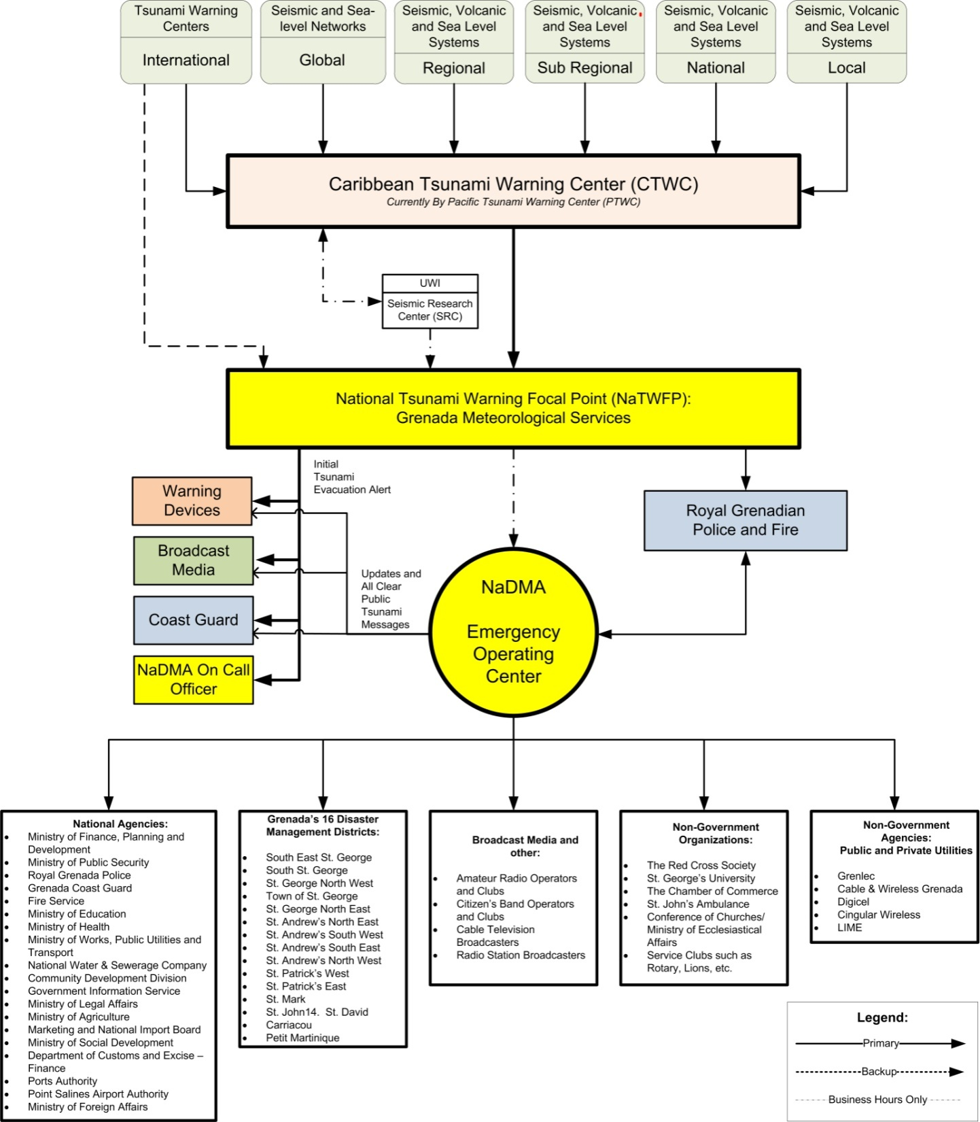
Data Collection
Communications
Alerting

Slide 22
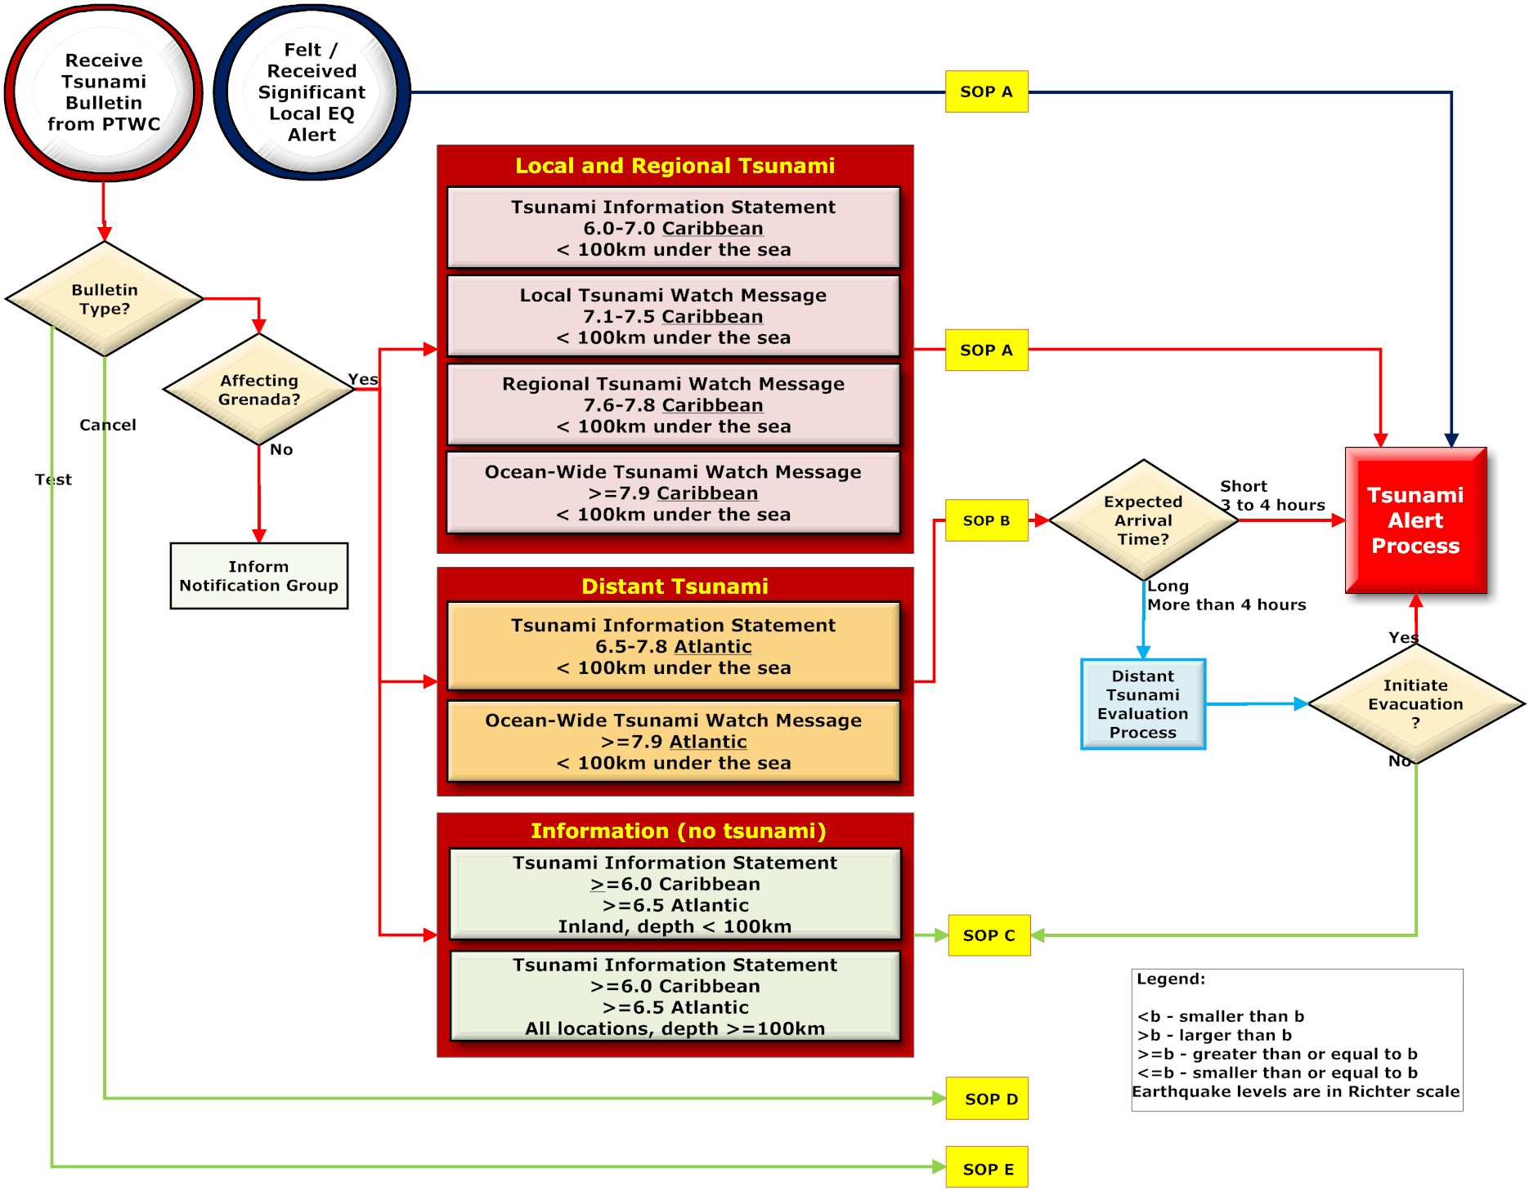
TSUNAMI SOP DIAGRAM

Slide 23
Tsunami Watch Bulletin Process Example
TSUNAMI MESSAGE NUMBER 001
PACIFIC TSUNAMI WARNING CENTER/NOAA/NWS
ISSUED AT 1351Z 24 APR 2006
THIS MESSAGE IS FOR ALL AREAS OF THE CARIBBEAN
... A REGIONAL TSUNAMI WATCH IS IN EFFECT ...
A TSUNAMI WATCH IS IN EFFECT FOR …GRENADA
Header →
For Whom? →
Type of Bulletin (Banner) →
Countries Affected →

Slide 24
Tsunami Watch Bulletin Process Example
AN EARTHQUAKE HAS OCCURRED.
PRELIMINARY PARAMETERS
ORIGIN TIME - 1310Z 24 APR 2006
COORDINATES - 17.2 NORTH 61.6 WEST
LOCATION - LEEWARD ISLANDS
MAGNITUDE - 7.7
Preliminary Earthquake Parameters →
Tsunami Arrival
Location and Time →
LOCATION COORDINATES ARRIVAL TIME:
GRENADA 17.2N 62.0W 1326Z 24 APR
Tsunami Watch Bulletin Example

Slide 25
TSUNAMI SOP DIAGRAM
Tsunami Watch Bulletin Example

Slide 26
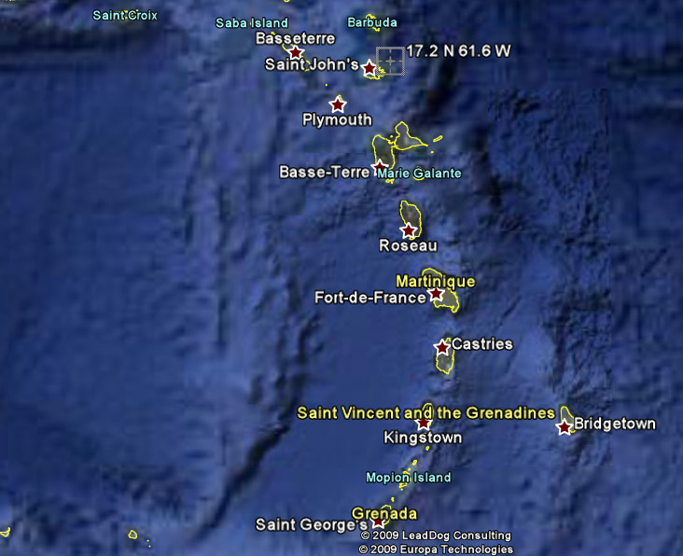
Tsunami Watch Bulletin Process Example
[ ] Section B.
TWFP Duty Officer must review the message from the PTWC and learn if the tsunami is forecast to arrive at Grenada.

Slide 27
Tsunami Watch Bulletin Process Example
If the event threatens Grenada’s coastal areas, then an evacuation of.
[ ] All coastal areas must be initiated immediately
OR
.
[ ] All Vulnerable coastal areas
List the names of vulnerable coastal areas
[ ]________________________________________________________
[ ]________________________________________________________

Slide 28
Tsunami Watch Bulletin Process Example
Tsunami Watch Bulletin Public Alert Logbook Example
Alert Device | Activator Emergency Contact Name | Activator 24x7 Telephone Number | Activator 24x7 Cell Phone Number | Name of Recipient and Time Message Received.
“Heavenly” church bells | 23342342342 | 3422423234 | 34234234344 | ______________
Radio station A | 23342342342 | 3422423234 | 34234234344 | ______________

Slide 29
Tsunami Watch Bulletin Process Example
Tsunami Watch Bulletin Staff Alert Logbook Example
AGENCY NAME | Emergency Contact Name | 24x7 Telelphone Number | 24x7 Cell Phone Number | Via Radio | Name of Recipient and Time Message Received.
National Disaster Management Agency (NaDMA) | John Doe | 1234567890 | 1234567890 | Callsign:
Grenada Fire Brigade | (DISPATCH) | 1234567890 | 1234567890 | Callsign:
Grenada Coast Guard | (DISPATCH) | 1234567890 | 1234567890 | Callsign:
Grenada Police Force |  | 1234567890 | 1234567890 | Callsign:

Slide 30
Tsunami Watch Bulletin Process Example
Duty Officer must contact the primary broadcast stations (radio, TV, Cable and Cell Providers) and provide the Tsunami Alert Message.
Tsunami Watch Bulletin Example

Slide 31
Tsunami Watch Bulletin Process Example
URGENT TSUNAMI WARNING
BROADCAST SCRIPT
A TSUNAMI WARNING HAS BEEN ISSUED. THIS IS AN URGENT TSUNAMI WARNING FOR ALL COASTAL AREAS.....
A TSUNAMI HAS BEEN GENERATED. IMMEDIATELY EVACUATE ALL BEACHES AND ALL LOW LYING COASTAL AREAS. MOVE INLAND TO HIGHER GROUND.
Tsunami Watch Bulletin Example

Slide 32
Tsunami Watch Bulletin Process Example
Duty Officer must contact Coast Guard and provide the following message:
URGENT TSUNAMI WARNING
MARINERS WARNING SCRIPT
A TSUNAMI WARNING HAS BEEN ISSUED. THIS IS AN
URGENT TSUNAMI WARNING FOR GRENADA, CARRICOU, AND PETIT MARTINIQUE ISLANDS.
A TSUNAMI HAS BEEN GENERATED. DO NOT APPROACH HARBORS UNTIL THE TSUNAMI ALL CLEAR HAS BEEN ANNOUNCED. IF YOU ARE NEAR THE HARBORS MOVE AWAY FROM LAND TO A LOCATION FURTHER OUT. STAY TUNED FOR FURTHER INFORMATION.
Tsunami Watch Bulletin Example

Slide 33
Tsunami Watch Bulletin Process Example
Duty Officer reports to the National Office of Disaster Management Agency at the NEOC to provide continuing assistance throughout the remainder of the alert.
Tsunami Watch Bulletin Example

Slide 34
Above information is collected to enable the design and implementation of a comprehensive, long-term CAP warning system.
Example of implemented system in the Caribbean, funded by UNDP:

Slide 35
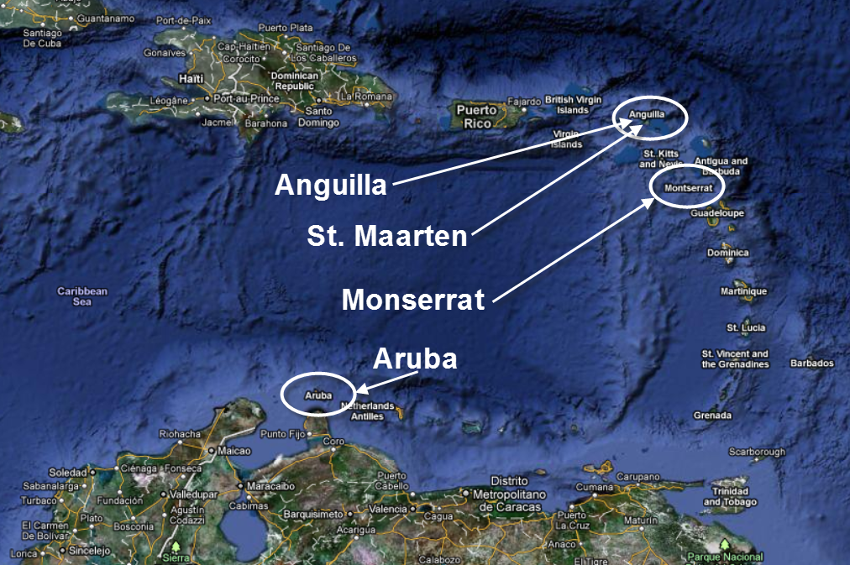

Slide 36
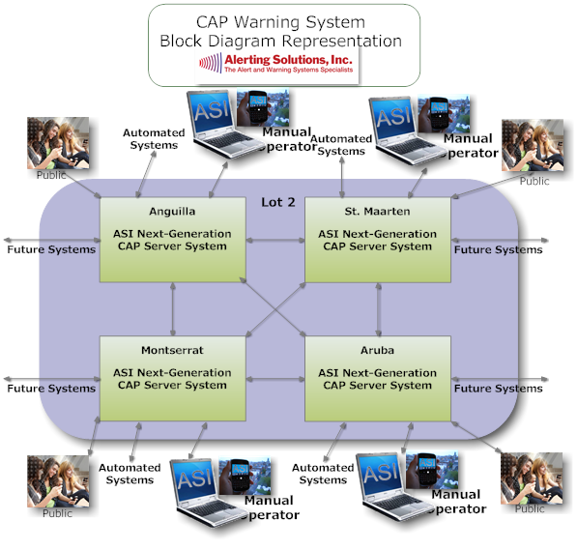

Slide 37
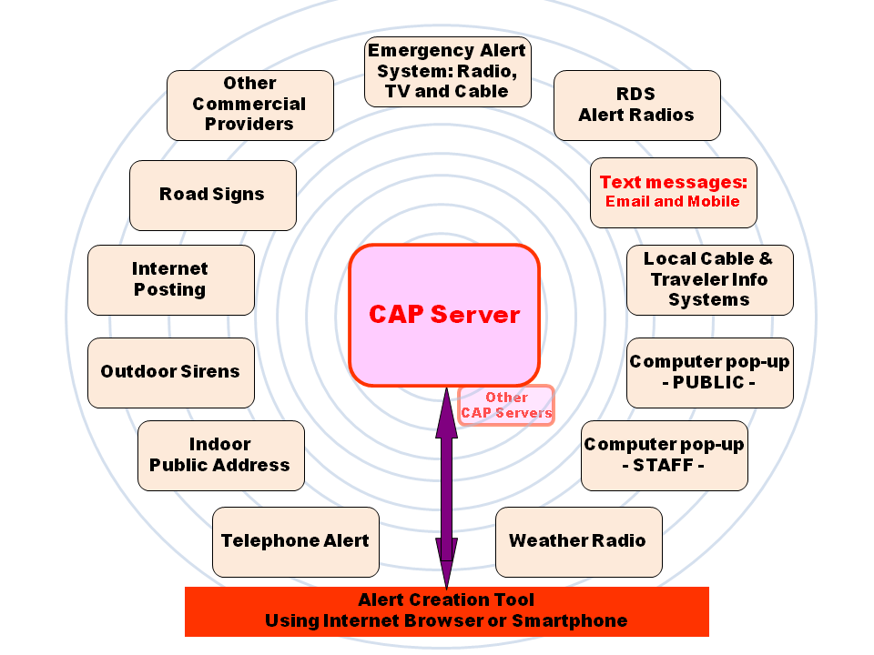

Slide 38
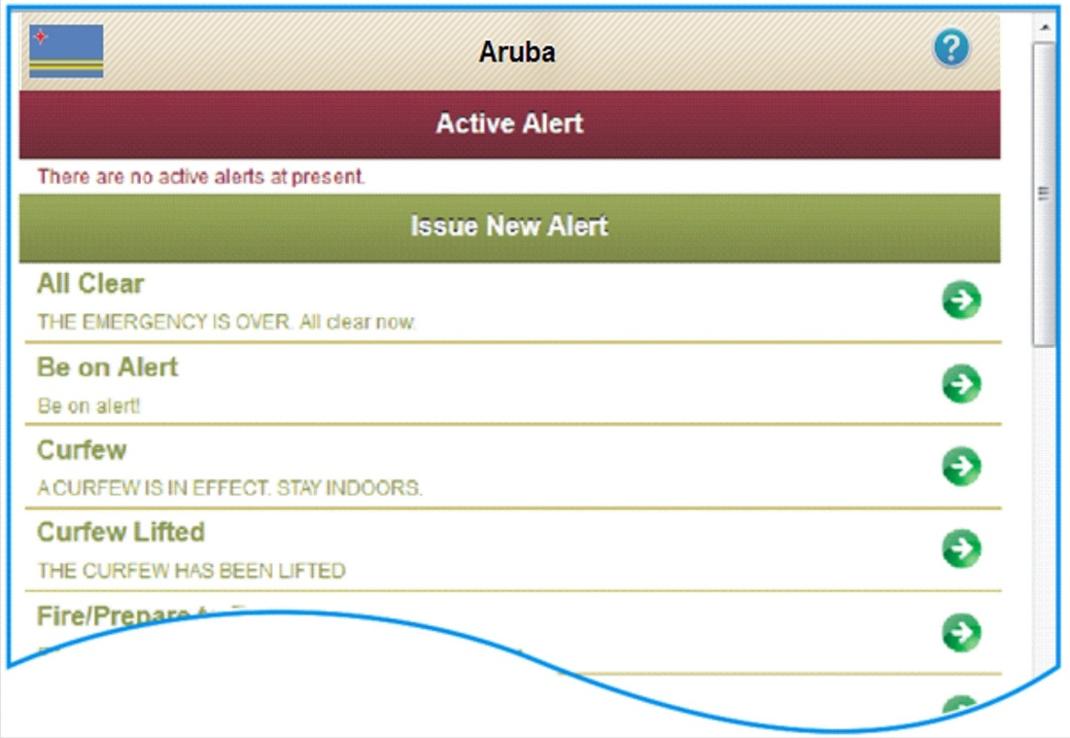
Posting Alerts

Slide 39
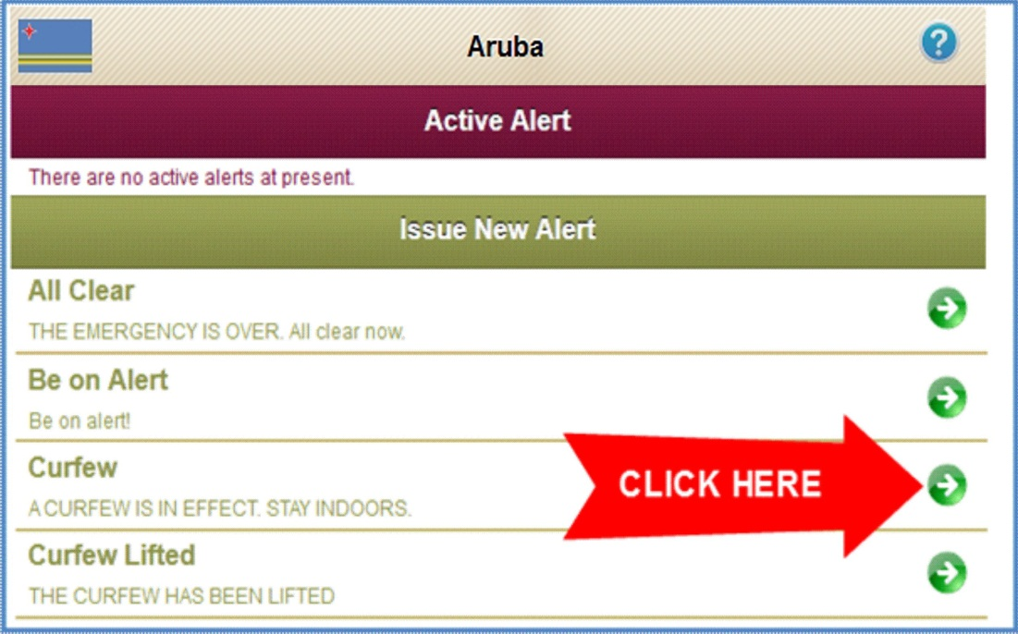

Slide 40
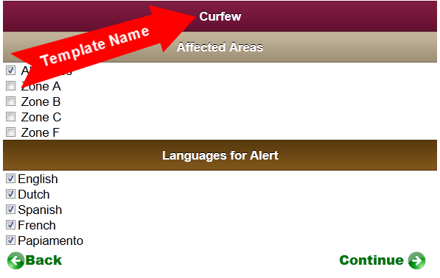

Slide 41
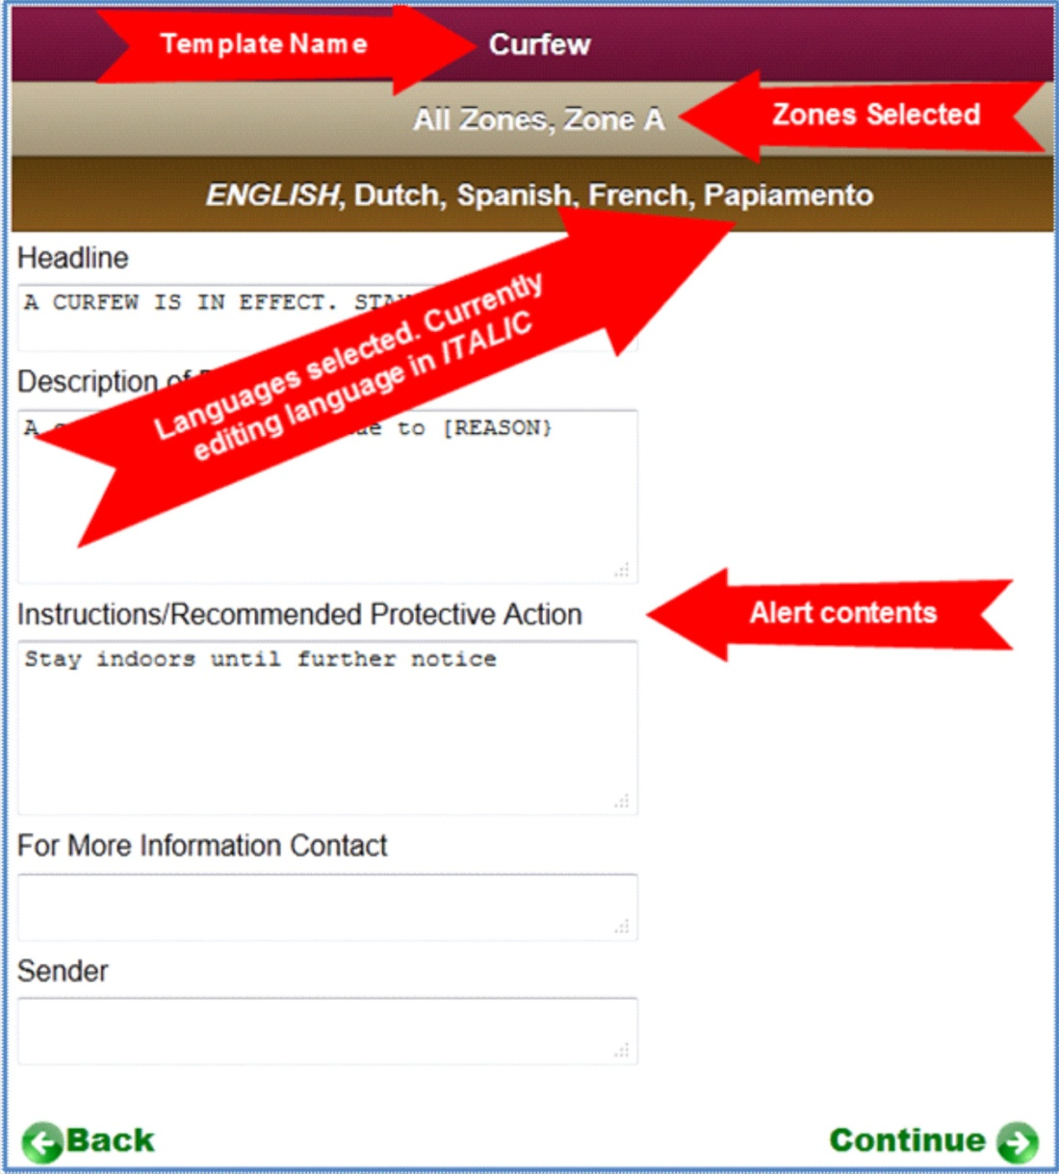

Slide 43
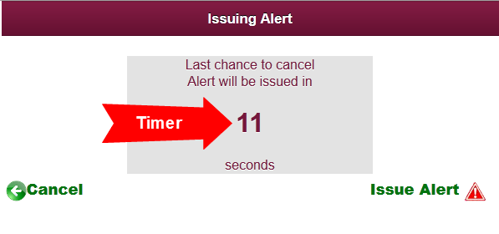

Slide 44
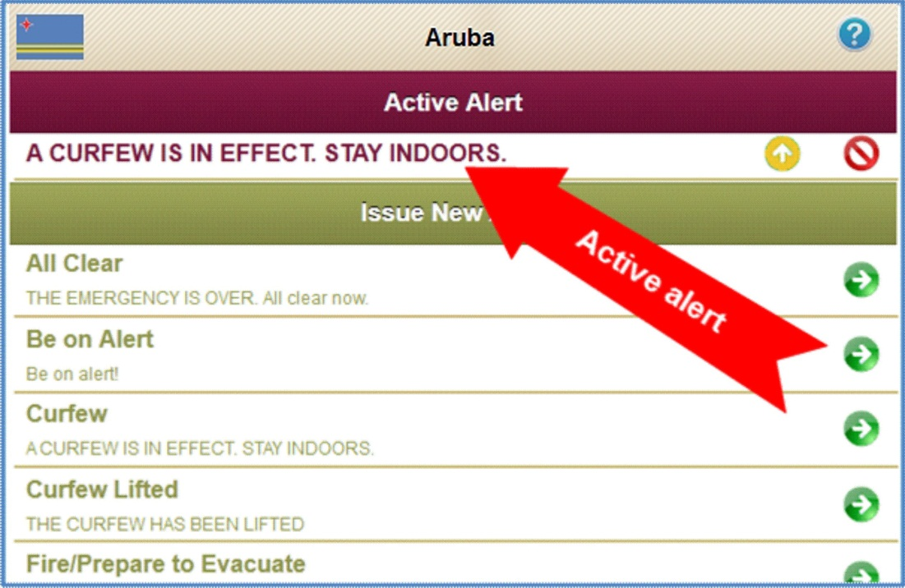

Slide 45
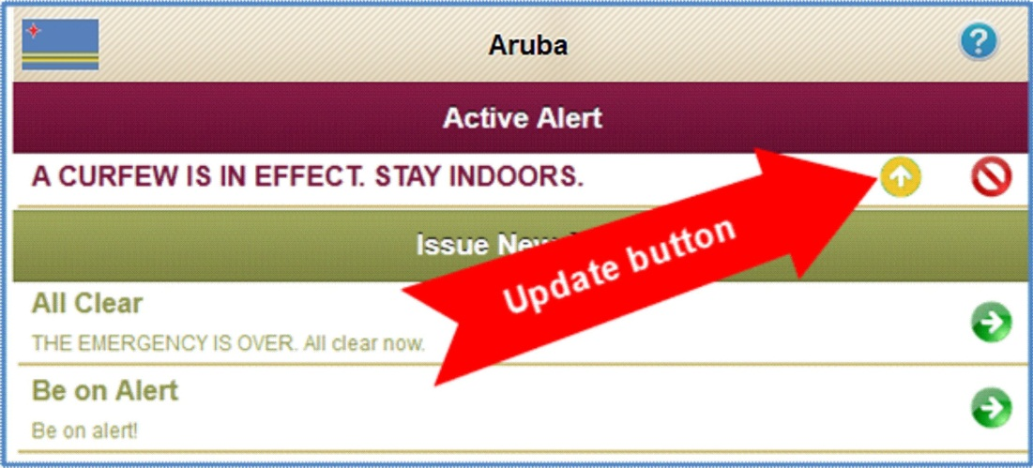

Slide 46
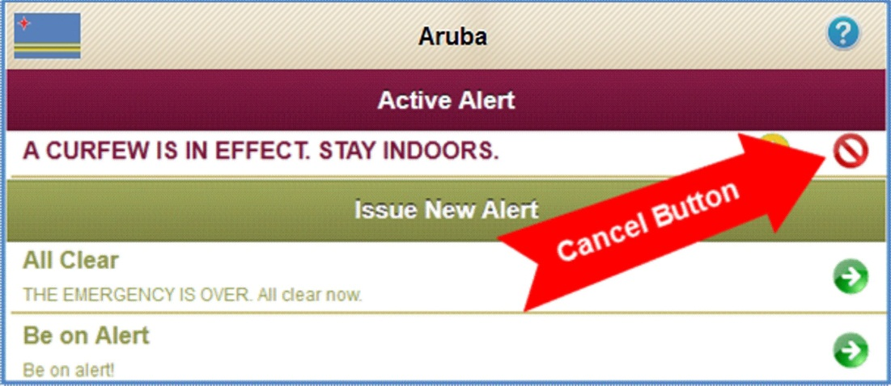

Slide 47
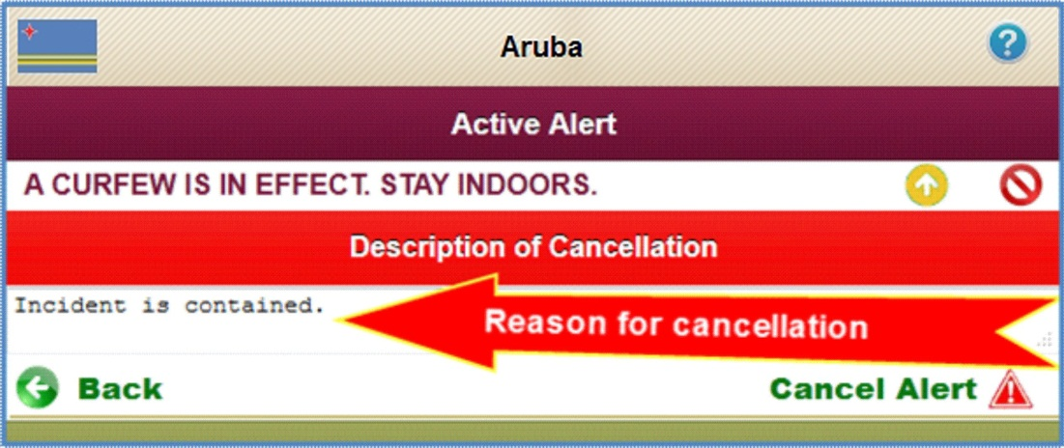

Slide 48
Editing Templates

Slide 49
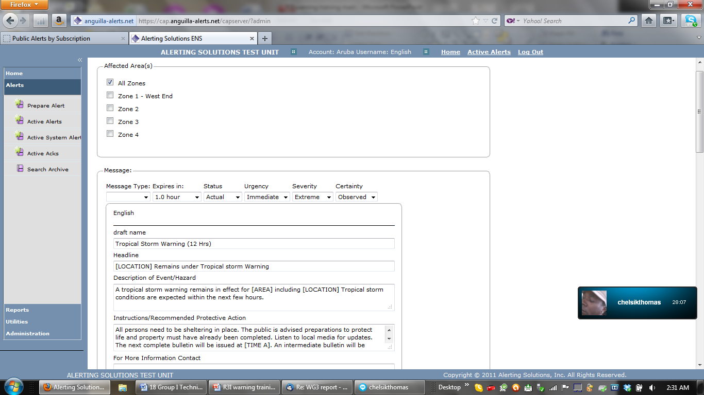
Edit Existing Template

Slide 50
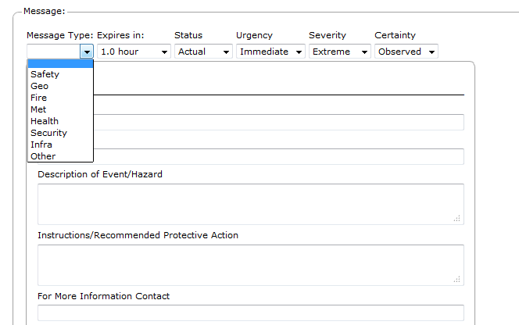
Building A New Template

Slide 51
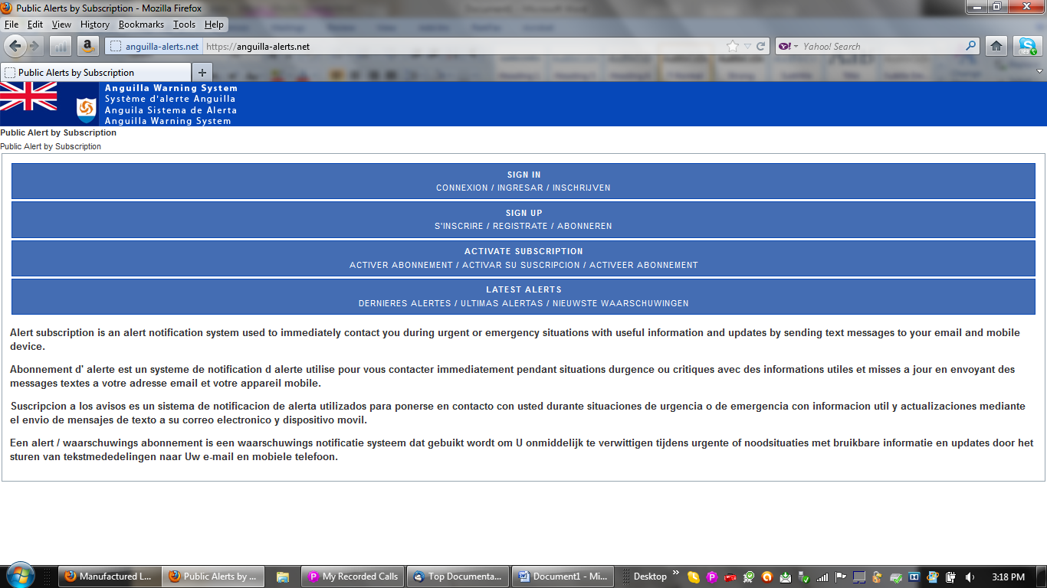

Slide 52
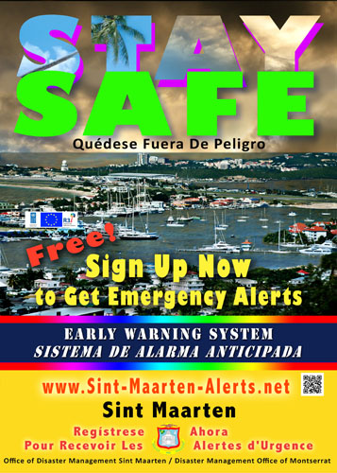
Public
Outreach
Education
Campaign
Print, broadcast, Social Media
Over 60 products in 5 languages

Slide 53
Thank you for your attention

