Slide 1
CAP Policy Workshop
May 2nd 2012

Slide 2
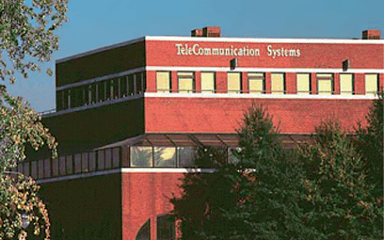
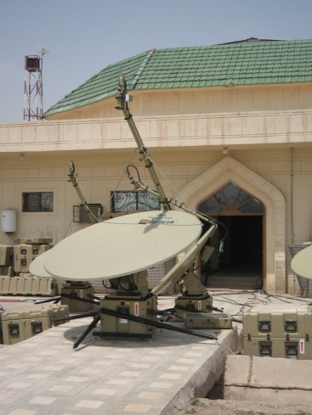
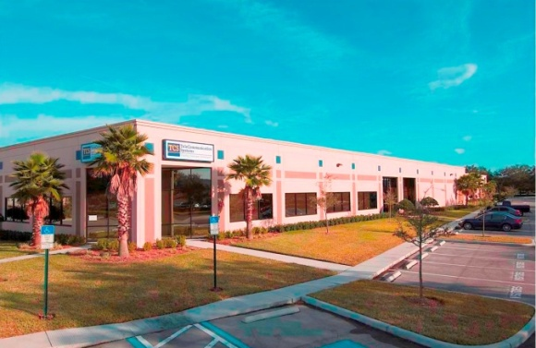
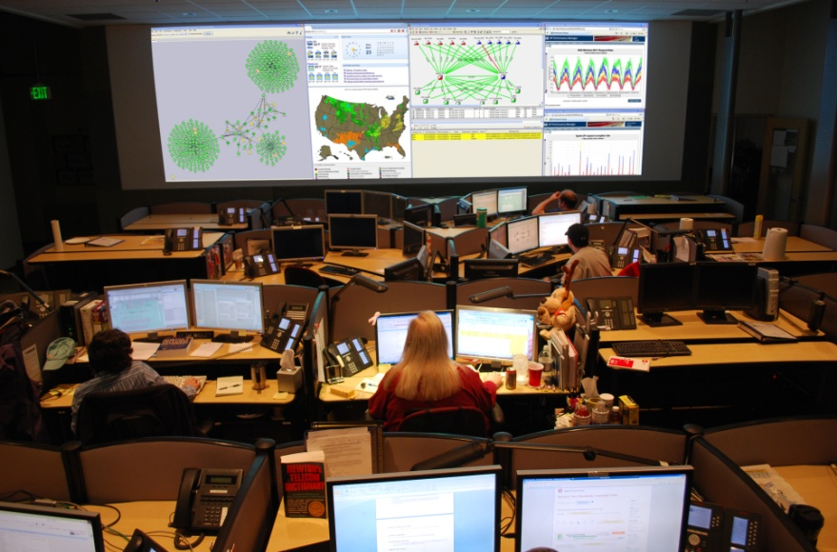
Twenty Five Years of Excellence
Established in 1987
1600+ Employees
ISO 9001:2008, ISO 27001, and TL 9000
Public Company
NASDAQ: (TSYS) August 2000
Russell 2000

Slide 3
What We Do
Highlights
Commercial
Provide software, systems and hosted services that support wireless carriers for inter-carrier messaging, location based solutions, and applications for handheld devices
Provide mission-critical total communication solutions from the desktop to the most forward edge of the enterprise network, down to the individual communicator
Government
Provide Emergency Alerts for 6M Wireless Subscribers
Process 50% of the US E911 Cellular Calls; approx 150,000 Per Day
Largest US based provider of text messaging and last year powered delivery of nearly 900B text messages
TCS Manages over 60,000 Cell Sites Throughout the USA Via Cloud Technology
173 patents, 300+ patents pending
Premier SATCOM Provider on WWSS – won over 60% of all tasks in past four years, Over 600 TCS SNAP systems deployed
Selected by Cisco to Commercialize the IRIS service
Developed Private Network for CENTCOM Commander
Worldwide Private Networks for Dept of State
Operate COOP Sites for DHS, Army, and Other Civilian Agencies
Over 200 Field Support Engineers Deployed Globally

Slide 4
TCS CMAS Overview
TCS has been actively working with the Standards bodies on the development of CMAS
TCS Hosted CMAS system is now connected to FEMA / DHS production network
TCS customer are now able to deliver geo-targeted CMAS alerts
TCS currently has wireless carriers in the deployment of CMAS

Slide 5
CMAS Feedback THUS FAR…

Slide 6
Mobile Carriers Challenges…
Alert Generation
Does the Alert clearly and concisely explain the situation
Ensuring that the message in the alert doesn’t cause:
Subsequent traffic on the network
Calls into E911
An overload of calls being made at one time
Ultimately what’s the cause and effect
Are there internationally defined best practices are used for Alert generation

Slide 7
Mobile Carriers Challenges…
Alert Generation
Is the Emergency Management Authoring tool providing the same customer experience (message content and format) when customers roam, leave a County, State, or Country?
Consumer calls to Carrier Customer Care
Are there policies surrounding each alert category and the frequency they are being issued?
Will or can it loose it’s effectiveness to the subscribers?

Slide 8
When the Alert is Over…

Slide 9
Should there be…
“All Clear” Messages
Each alert utilizes network resources
It’s possible the consumer may have left the effected area
Additional confusion could be created by delivering an “All Clear” message to people who just entered the area where the message is active

Slide 10
Q & A

Slide 11
Thank you!

