Slide 1

Google Crisis Response
May 2, 2012
2012 Emergency Alerting Policy Workshop
Montreal
Steven Hakusa
Nigel Snoad
google-cap@googlegroups.com
Notes:
Welcome
Names

Slide 2

Agenda
First 15 minutes
Brief intro
Google Public Alerts
Tools for the CAP community
Last 10 minutes
Questions

Slide 3
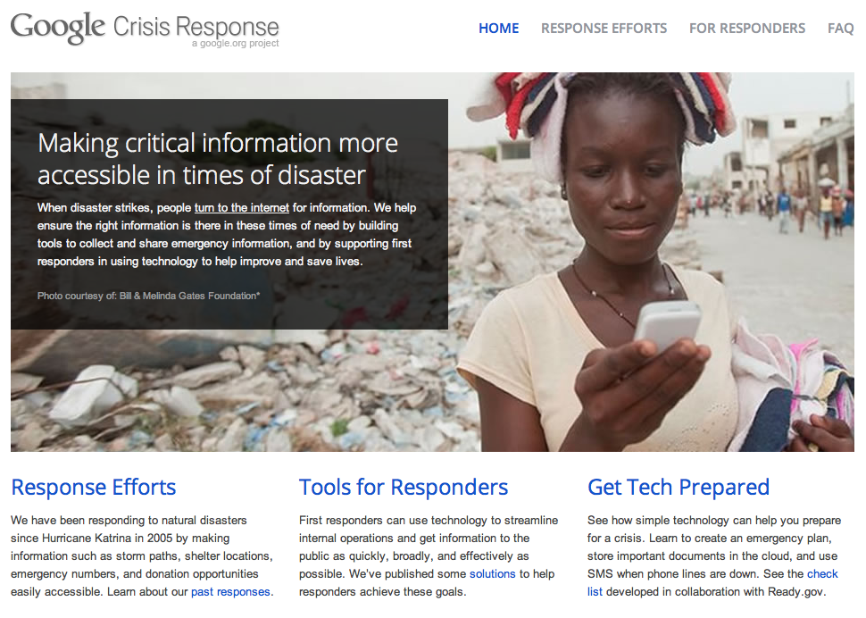

Google Crisis Response
Notes:
Our team tries to make Google and the Internet in general more useful when disasters strike.
Since the January, 2010 Haiti earthquake when our team was founded, we've seen that the Internet has been surprisingly available during major crises, at times more available than phone or SMS.

Slide 4

Information needs in a disaster
What’s happening?
Where are the
people I care about?
Where are the resources I need?
How bad is the event?
What should I do now?
What roads are out?
What areas will get worse or better?
How do I contact them?
Where are they now?
Does anyone else know where they are?
I need shelter.
I need water, power, food, medicine.
I have resources; what can I do?
How can I volunteer?
Notes:
Working with some UX researchers, we've identified core information needs in a disaster.
We've focused on authoritative information about what's happening, in real-time

Slide 5
What we do
Build tools that enable crisis information discovery, generation, sharing, and management
Promote open data & data standards: CAP,EDXL,PFIF,KML
No ads, no selling
Notes:
We have an eng team, who builds tools to help satisfy some of those information needs.

Slide 6
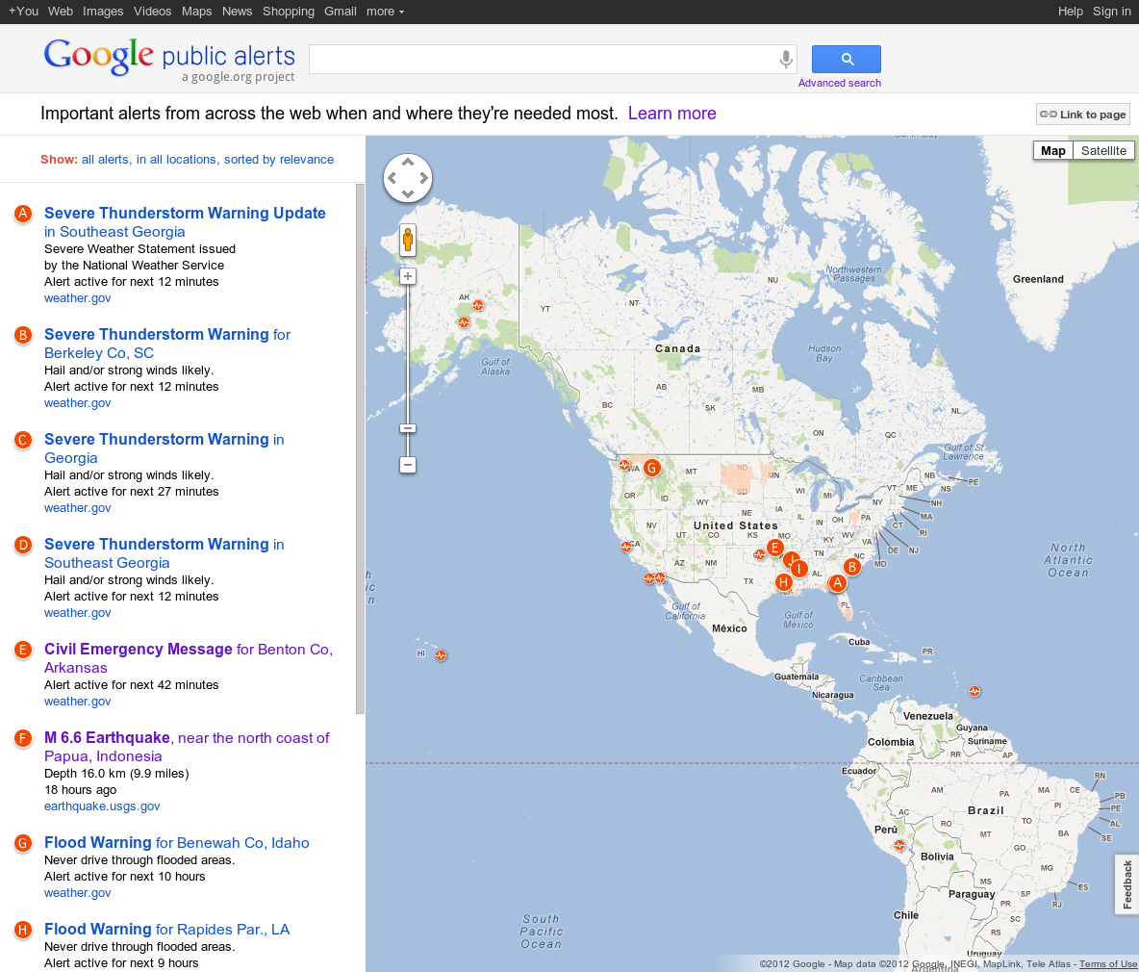
Google Public Alerts
Notes:
One of the main tools we work on is public alerts

Slide 7
Google Public Alerts
Lots of people query Google in an emergency
No Emergency Broadcast System on the Internet
Our goal:
Deliver accurate, relevant, credible information to the public
for all emergency events affecting life and property
as fast as possible
across many Google products

Slide 8
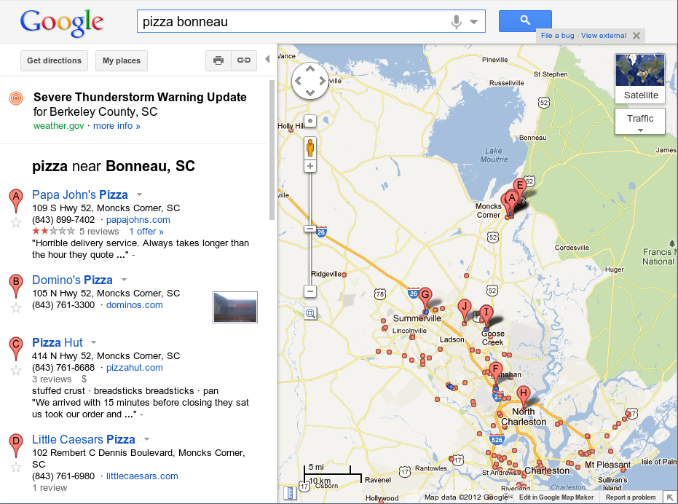
Google Public Alerts

Slide 9
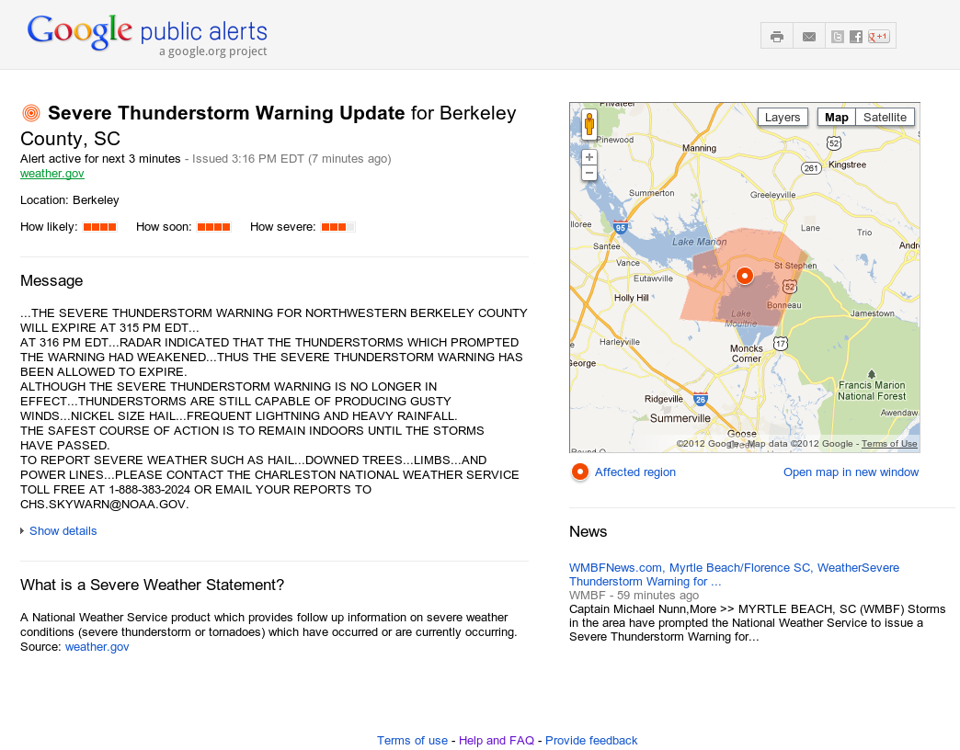
Google Public Alerts

Slide 10
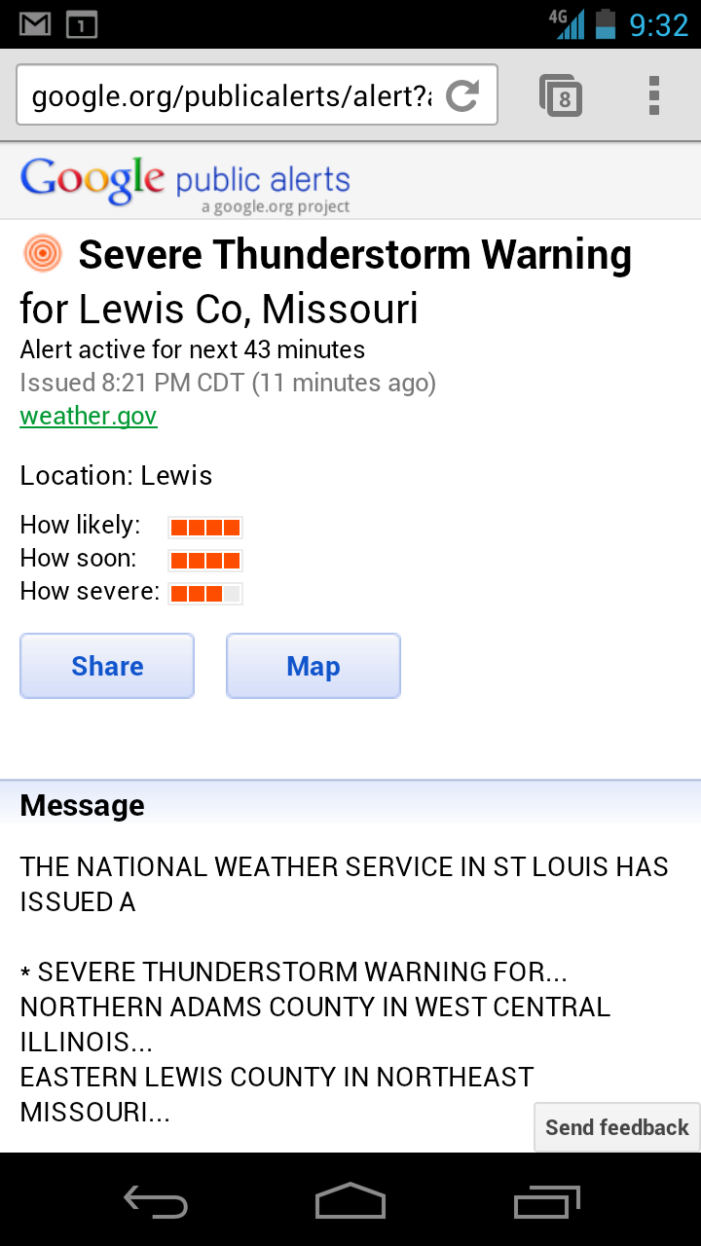
Notes:
We see mobile as a very important use case for us.
CMAS

Slide 11
How it Works
CAP via
Atom,
RSS, or
EDXL-DE
Alerting Authority
Alert Hub
Publish/Subscribe
http://alert-hub.appspot.com
Google Public Alerts
Google Maps
Google
User
tornado dallas

Slide 12
Triggering
Alerts are scored based on type, urgency, severity, and certainty
Score is adjusted based on
  Keyword match with user's query
  Overlap with user's search area
  Distance of alert from center of user's search area
  Rarity of event
  Population density
  User preferences
Score determines triggering level
  [pizza ny] (only for very high scores = significant alerts)
  [ny] (less significant alerts)
  [flood near ny] (most alerts trigger on keyword only)
Notes:
The presence of alert can also let us influence search results

Slide 13
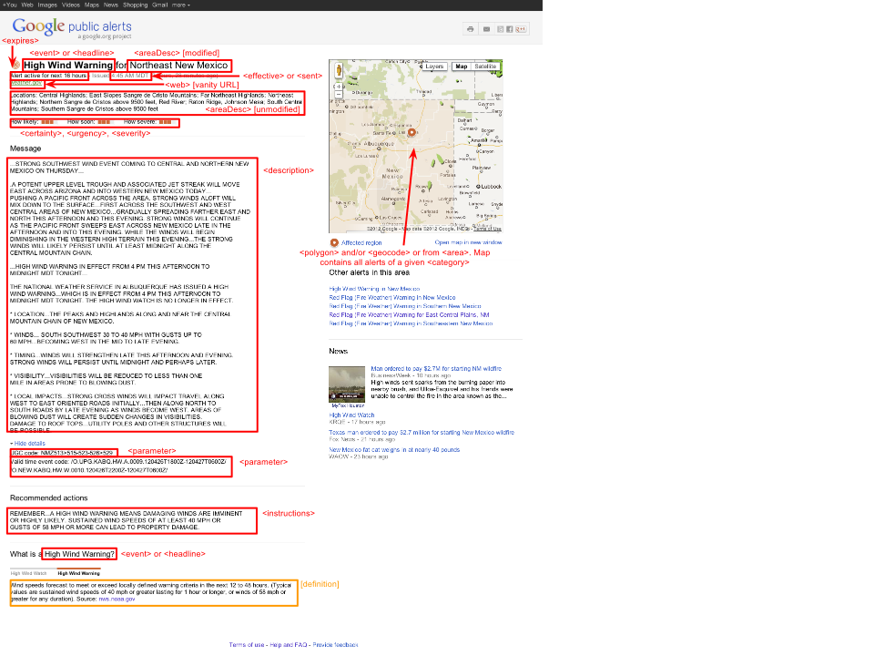
CAP for the Web
Notes:
Here's how data from a CAP alert makes it onto our web page; note the importance of each of the optional CAP fields

Slide 14
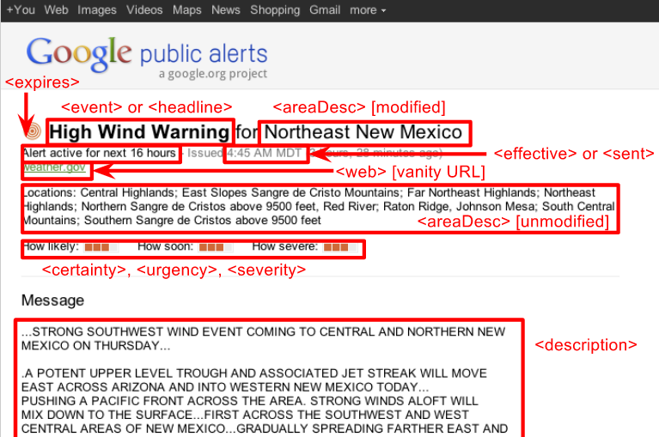
CAP for the Web
Notes:
Close-up. Start with the title line. We want to identify 1. What's the event and 2. Where is it happening. We only have about 50 characters of room. This ends up being trickier than it should be. For the "what" we use either the <event> or a portion of the <headline>. The "where" is harder. What's the best way to summarize that large list of locations into about 30 characters? It's certainly a solved problem, but it's a bunch more work on our side to try to do this summary, and it would be nice if it were provided for us in the CAP alert.
Event end vs alert end
How we try to handle timezones
How we handle updates and potential concurrency issues
How we handle errors

Slide 15
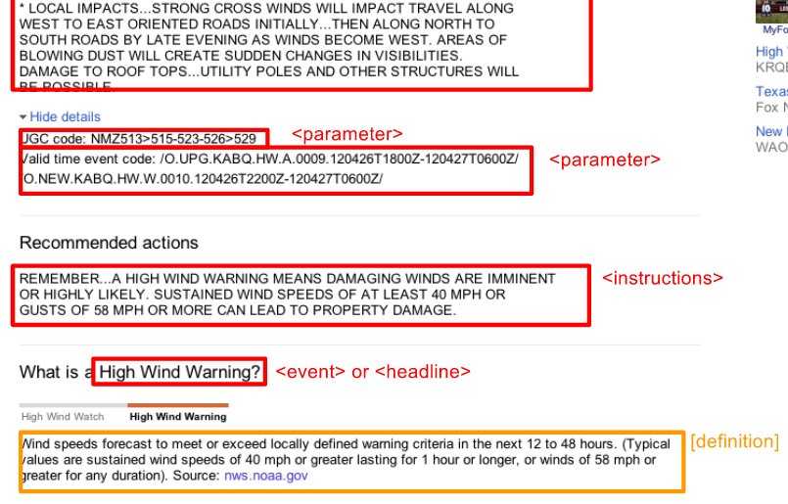
CAP for the Web
Notes:
Instructions
Static content

Slide 16
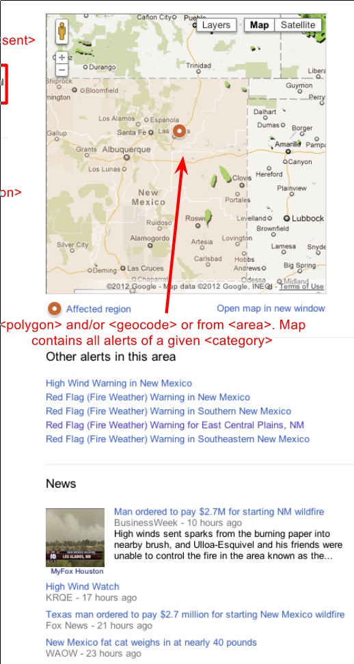
CAP for the Web
Notes:
How we render alerts on a map
Other alerts in this area, news

Slide 17
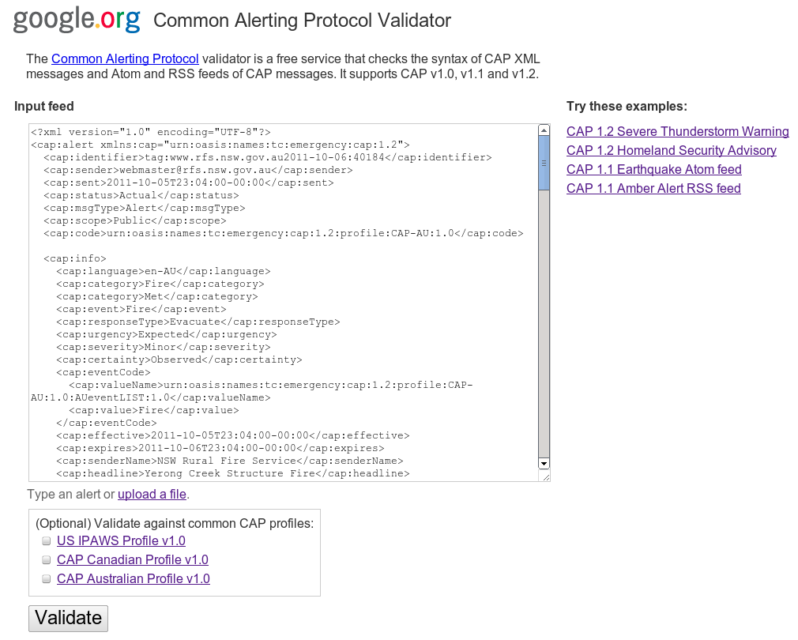
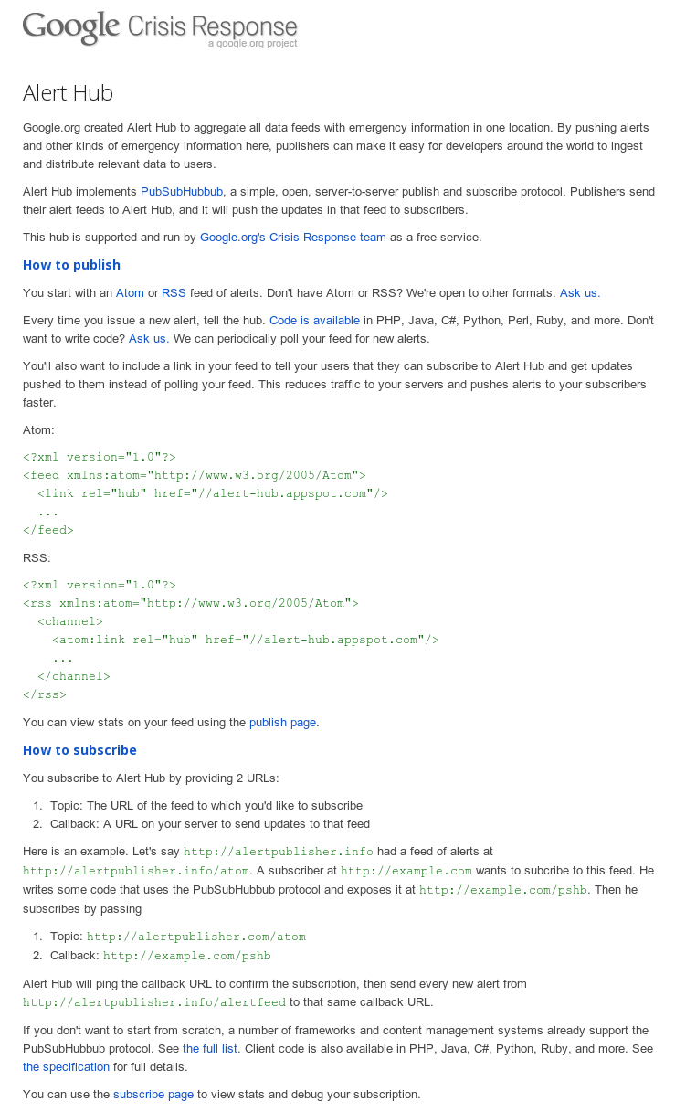
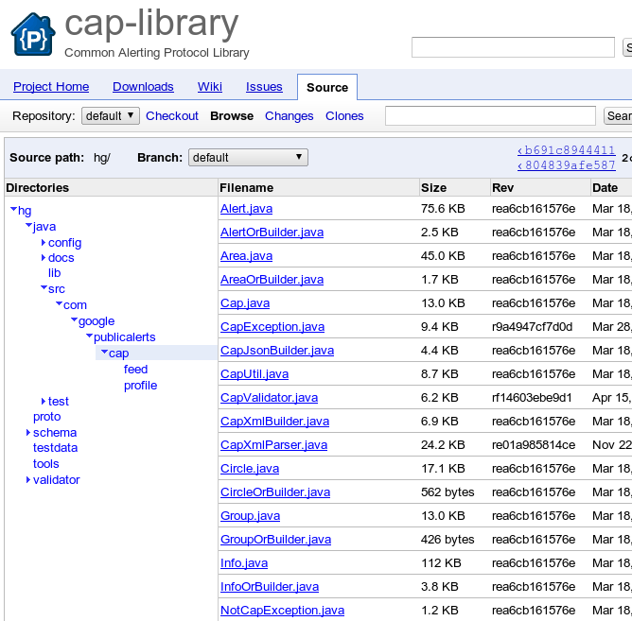
Tools for the CAP Community
http://cap-validator.appspot.com
http://alert-hub.appspot.com
http://code.google.com/p/cap-library
Notes:
The presence of alert can also let us influence search results

Slide 18
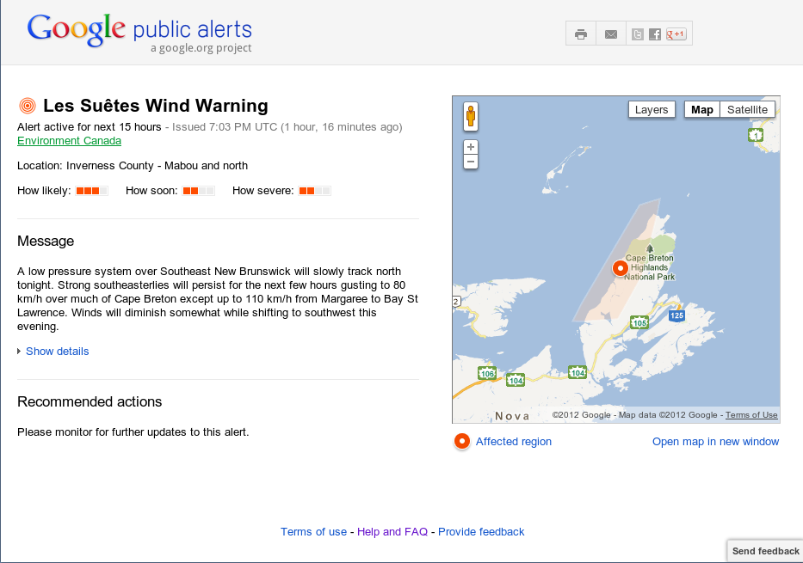
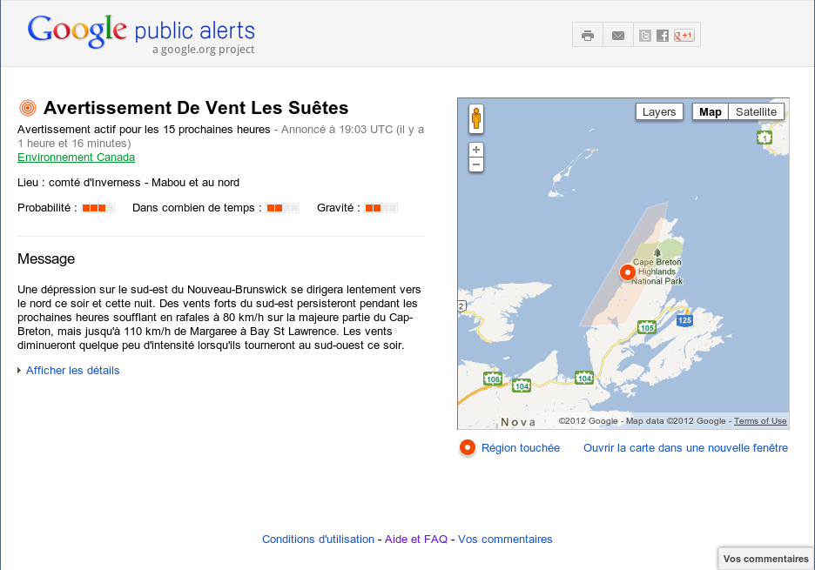
What's Next for Google Public Alerts
More content, both national and local
Integration across more Google properties
Localization
Notes:
The presence of alert can also let us influence search results

Slide 19
Thank you!
google-cap@googlegroups.com
http://google.org/crisisresponse

