Slide 1
National Identity Management in Pakistan
Identity Management Conference, Wahington D.C.
September 27, 2010
National Database and Registration Authority
Muhammad Tariq Malik
Deputy Chairman NADRA
Government of Pakistan
NADRA Headquarters, Islamabad

Slide 2
A Brief History of National Identification in Pakistan
First system of Identity Cards introduced
Paper-based and manual
1973

Slide 3
A Brief History of National Identification in Pakistan
First system of Identity Cards introduced
Paper-based and manual
National Database and Registration Authority (NADRA) established
All management and registration functions transferred to NADRA
National Datawarehouse and Network established
Online Enrolment Centres introduced
Biometric enrolment
Online Verification Service launched
Face and Fingerprint Identification Systems introduced
1973
1999
2002

Slide 4
A Brief History of National Identification in Pakistan
National Database and Registration Authority (NADRA) established
All management and registration functions transferred to NADRA
National Datawarehouse and Network established
Online Enrolment Centres introduced
Biometric enrolment
Online Verification Service launched
Face and Fingerprint Identification Systems introduced
100 Million identities issued
Focus on use of system for
Good governance
National Security
Law Enforcement
Social Support
Smart Identity Cards
Automated, Transparent, and Secure Issuance
1999
2002
2004
2009
2010

Slide 5
National Database and Registration Authority
Thirteen Thousand Employees
235 Million Fingerprints
374 Registration Centres; 10 Overseas
92 Million Facial Images
201 Mobile Vans; 199 Semi-Mobile Units
NADRA
81 Million Identity Cards Issued
Two data-centres 150 miles apart
115 Million Identities Issued
1,000 servers and 8,000 computers

Slide 6
Registration Centres

Slide 7
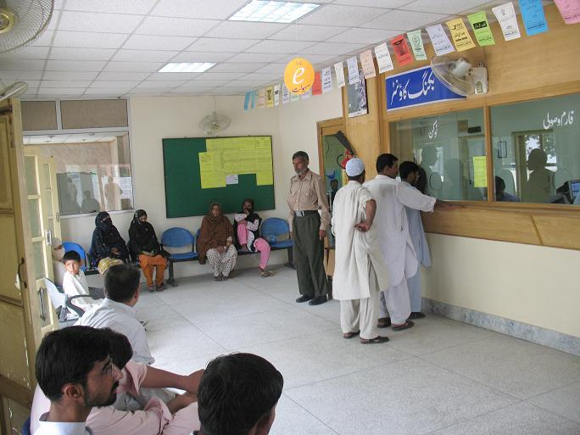
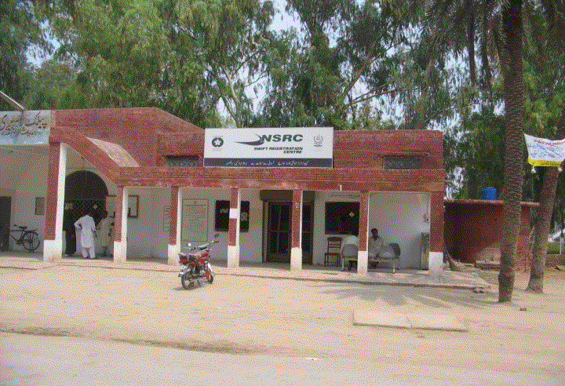
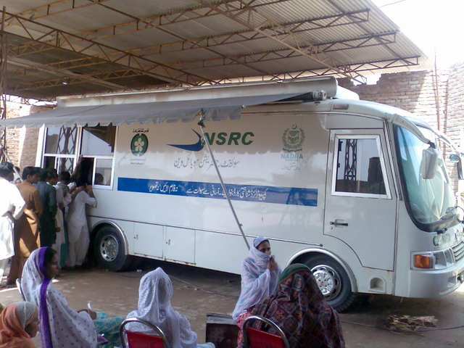
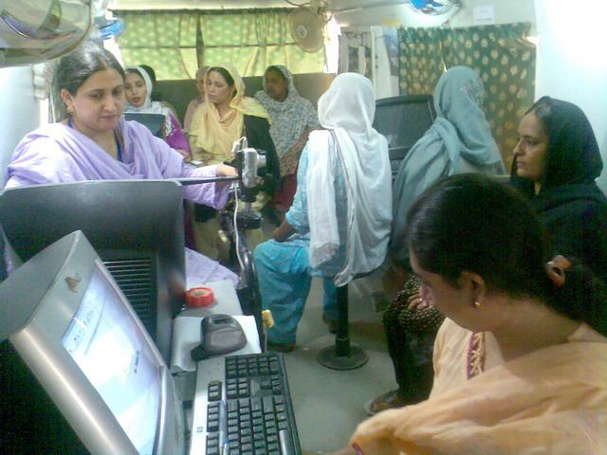
Reaching Everyone
Registration Centres and Mobile Registration Vans

Slide 8
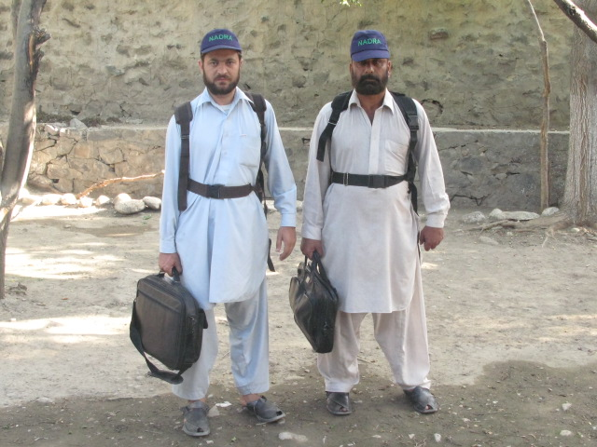
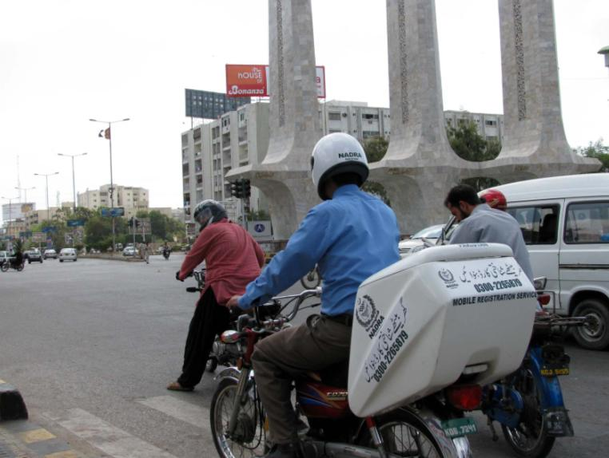
Reaching Everyone
Backpack Units and Mobile Registration Motorcycles

Slide 9
Identity Card Coverage
Men | Women
47 Million | 34 Million

Slide 10
Major Projects
Machine Readable Passports and Visas (Pakistan)
Civil Registration System (Sudan)
Passport Issuance and Control System (Kenya)
National Drivers License System (Bangladesh)
Biometric Refugee Registration System for UNHCR
Identity Cards and Civil Registration (Pakistan)

Slide 11
Major Projects
Electronic Highway Toll Collection (NHA)
Identity Card Issuance System (Nigeria)
Flood Relief System (Pakistan)
IDP Registration and Cash Disbursement
Kiosk and e-Sahulat
Benazir Income Support Program

Slide 12
Identity cards and the national database

Slide 13
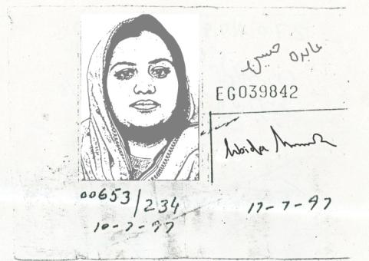
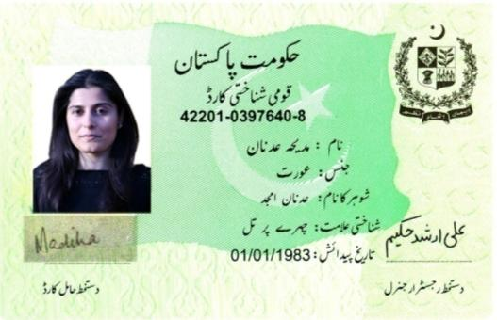
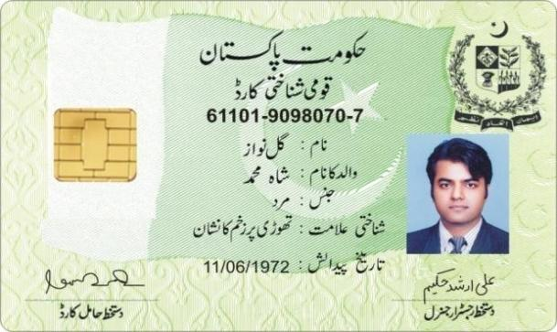
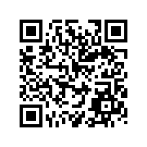
ID Cards through Times
1973
2002
2010

Slide 14
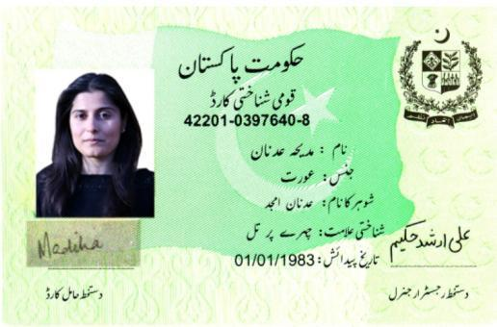
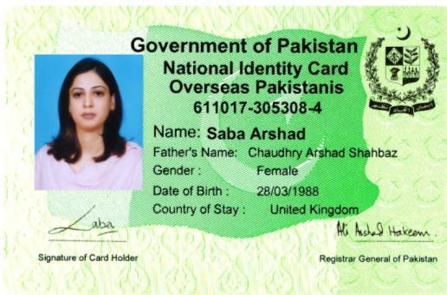
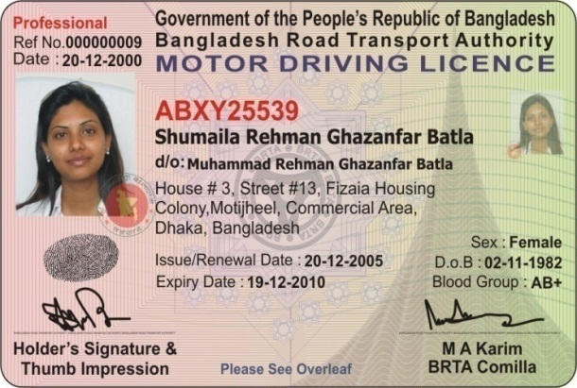
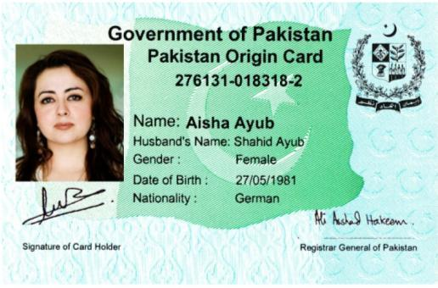
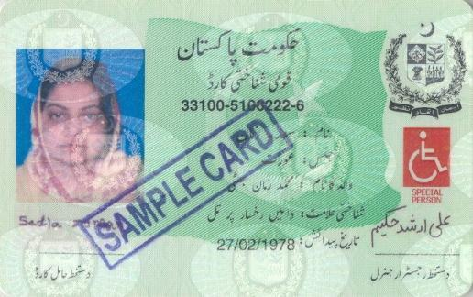
NADRA’s Products
National Identity Cards 81 Million
Identity Cards for Overseas Pakistanis 4 Million
Drivers Licenses
600,000
Pakistan Origin Cards 100,000
IDs for Citizens with Special Needs 67,000
Social Support Cards
400,000
(c) 2010, Government of Pakistan

Slide 15
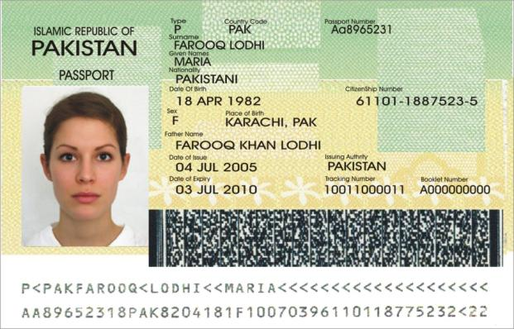
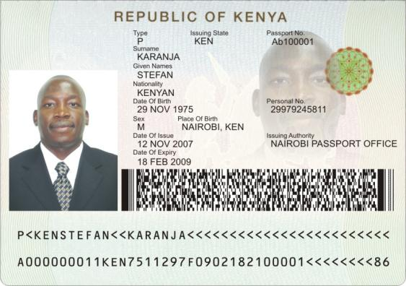
NADRA’s Products
Passports
Pakistan Passports
10 Million
Kenyan Passports
200,000

Slide 16
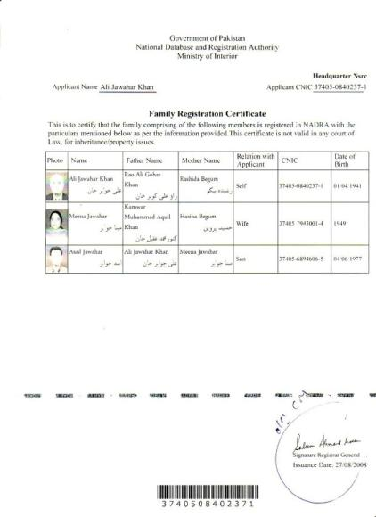
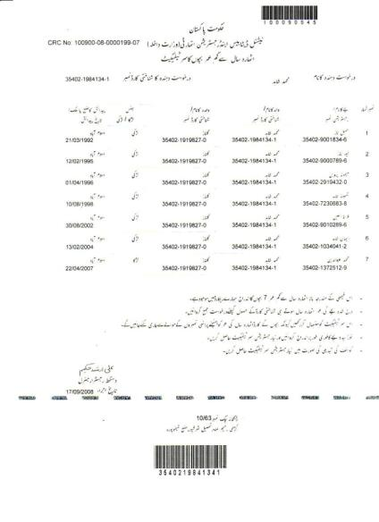
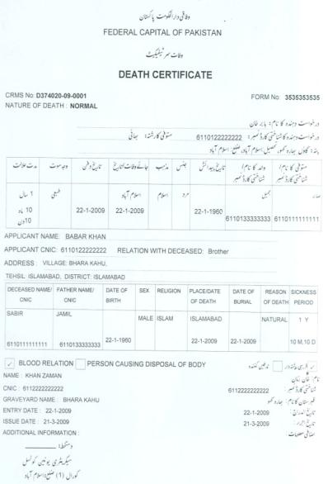
NADRA’s Products
Civil Registration Documents
Family Registration Certificates
Children Registration Certificates
Birth and Death Certificates

Slide 17
Smart National Identity Cards
Higher Security
Card Security through Digital Certificates
Owner Security through Biometrics
Services for Everyone
Savings (and Financial Services)
Hajj
Life and Health Insurance
Access Control and Loyalty Programs
Convenience to Citizens
Reduction in Identity Fraud
Capturing of the Informal Economy
Financial Inclusion

Slide 18
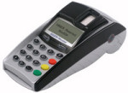
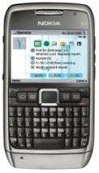
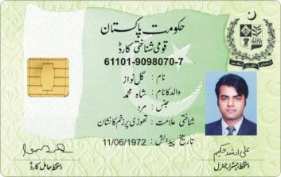
Service Delivery Strategy
Biometric POS
Franchisee Network(s)
Mobile Phones
Social Services
Banks
Balance: Rs.1,000
Government Services
Insurance, and other services

Slide 19
Benefits to citizens and the state

Slide 20
Benefits to Citizens and the State
1
2
3
Law Enforcement and National Security
Good Governance
Efficient Social Support

Slide 21
Good Governance
1
Benefits to Citizens and the State

Slide 22
Improvement of the Electoral Rolls
The existing electoral rolls of 80+ Million records has potentially missing, duplicate, and inserted entries
No Missing Entries
No Duplicate Entries
No Inserted Entries
NADRA is helping the Election Commission clean the electoral rolls by removing the records that are duplicate and not verified, and inserting the records that are missing using the Identity Cards database
No Missing Entries
No Duplicate Entries
No Inserted Entries

Slide 23
Broadening the Tax Net
Using Data Mining Techniques
List of known tax-payers
Taxpayer profile
NADRA Datawarehouse
List of people who should be paying taxes
Taxpayer profile

Slide 24
Law enforcement and national security
2
Benefits to Citizens and the State

Slide 25
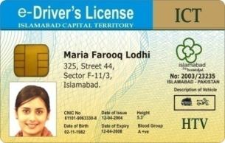
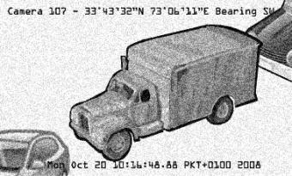
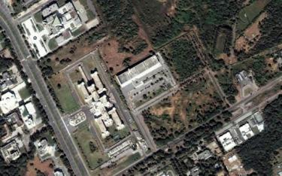
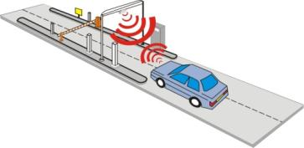
Islamabad Security Project
Customs
NADRA
Database
Excise
Smart Registration Books and Drivers Licenses
Video Surveillance
Access Control and License Plate Recognition
Integrated Database of Vehicles
Improved License Plates and RFID Vehicle Tags
Risk Management System and Control Centre
GH-084

Slide 26
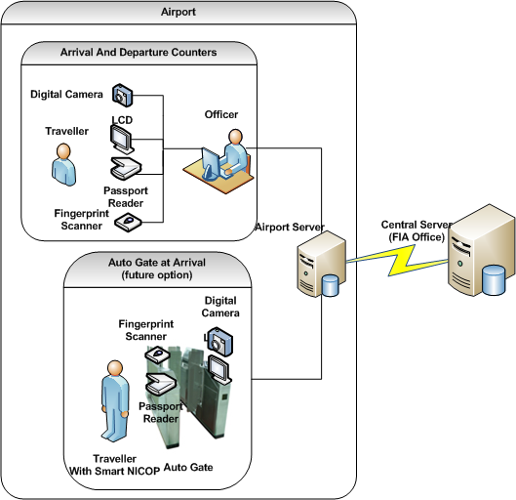
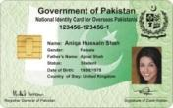
Integrated Border Management System
Deployed at Islamabad Airport as a Pilot
NADRA Database
Visa Database
Exit Control Database
Advance Passenger Information (SITA)
Passports Database
IBMS Central Server
ASF Surveillance Feeds

Slide 27
Forensic Applications
Muzaffarabad- 26 June 2009
A suicide bomber ripped through an Army vehicle near Shuakat Lines, Muzaffarabad, killing two soldiers and injuring three others.
NADRA was able to identify suicide bomber through his remains within three hours of incident.
Name: Abid
S/O: Abdul Rahim
DOB: 1st Jan 1990
CNIC: 21706-1333491-3
MRP: CR1074911
Address: Baroond, Teyarza, SWA
Attester: Ali Akber (11201-5916450-9)

Slide 28
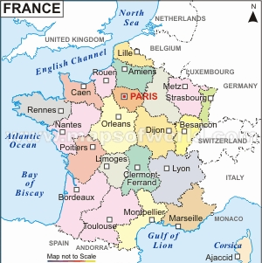
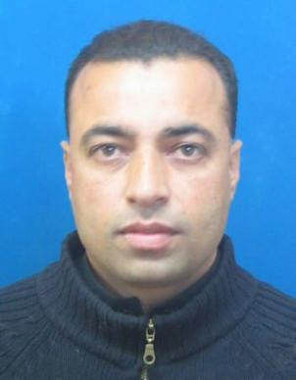
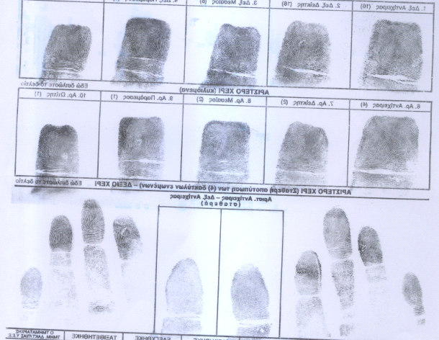
Forensic Applications
Islamabad, 20th February 2009: French Embassy in Pakistan approached NADRA through MOI to identify and trace a suspect of multiple rape and murder cases in France.
NADRA was able to identity suspect through his fingerprints.
Name: Syed Abdullah Adam
S/O: Syed Afzal Hussain DOB: 02-10-1977
CNIC: 34201-3884478-1
MRP: AA1454781
Expiry on: 30-11-2017

Slide 29
Efficient social support
3
Benefits to Citizens and the State

Slide 30
Income Support to the Poor
Benazir Income Support Program
Income support to the poorest population of Pakistan
4.3 Million beneficiary forms received from elected representatives
NADRA’s database used to validate the eligibility of nominated beneficiaries
2.3 Million determined eligible

Slide 31
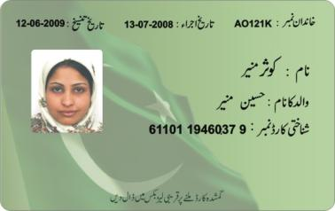
The Benazir Smart Card with Barcode
Balance: Rs.1,000

Slide 32
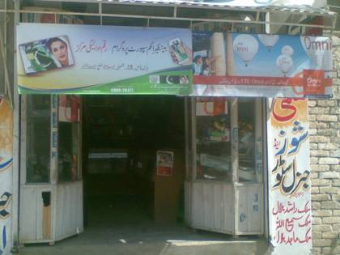
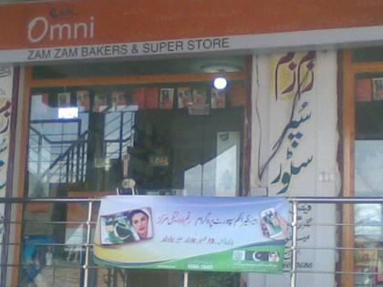
Partner Shops

Slide 33
Poverty Scorecards
The BISP World Bank Poverty Scorecards Project
NADRA is developing a Poverty Database of Pakistan based on World Bank’s Poverty Scorecard
The Scorecard employs Proxy Mean Testing based on 13 variables or factors
These variables include the number of people in the household, the type of toilets, whether the household has a freezer, ownership of livestock, and so on
Poverty Results obtained by running the Proxy Mean Test on 1,717,160 households
Households
Poorest
Poverty Score
Richest

Slide 34
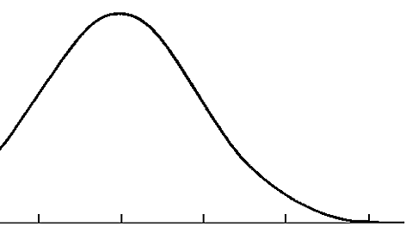
Effective Subsidy Management
Using the Poverty Database
Since poverty scorecards assign a score to every household, we can have a targeted and tiered approach to subsidy: the poorest get more subsidy; the less poor get less subsidy; and the well-off get no subsidy
Lower Subsidies
Higher Subsidies
Population
Income Support
Poverty
Richest
Poorest

Slide 35
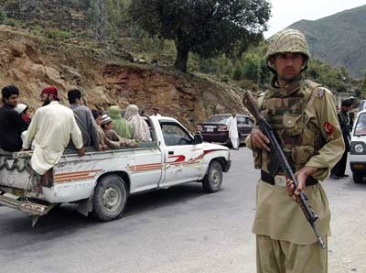
Financial Support to IDPs
2009
Operations against the Taliban launched in Swat
Millions of people displaced
755,464 families registered as IDPs
NADRA directed to verify registration
May 21
May 27
June 2
June 10

Slide 36
IDP Registration
Not on terrorist watch-list
No duplicate registration
Resident of affected area
One benefit per family
Total Registered | 755,464 | 100%
Eligible | 329,792 | 43.65%
Non Eligible - CNIC not available | 44,697 | 5.92%
Non Eligible - Multiple Registrations | 224,895 | 29.77%
Non Eligible - Invalid CNIC | 43,966 | 5.82%
Non Eligible - Unclear CNIC in Data Warehouse | 1,314 | 0.17%
Non Eligible - Addresses not from affected area | 37,216 | 4.93%
Non Eligible - Duplicate within family (husband-wife or unmarried Children) | 73,584 | 9.74%

Slide 37
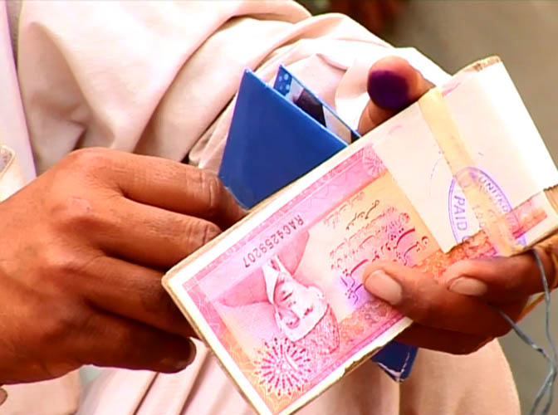
Financial Support to IDPs
2009
NADRA directed to design and implement cash disbursement to IDPs in a manner that ensures transparency
May 21
May 27
June 2
June 10

Slide 38
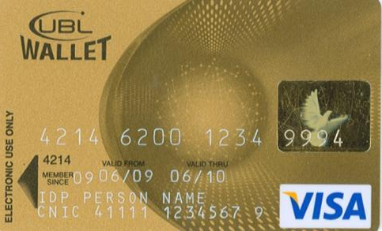
Financial Support to IDPs
2009
NADRA finishes design of cash disbursement system; Visa Debit cards to be issued to beneficiaries, backed by virtual accounts in collaboration with a partner bank
Features of NADRA’s design
Transparent
Secure
Cost Effective
Does not make cash grant look like charity
May 21
May 27
June 2
June 10

Slide 39
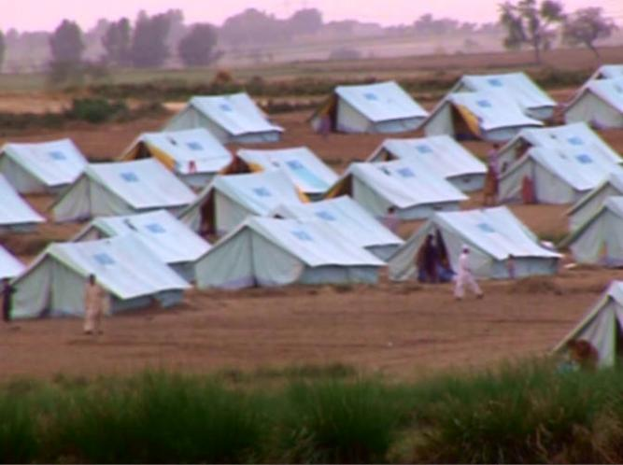
Financial Support to IDPs
2009
Visa cards distributed at the first camp
Cards activated after biometric verification of beneficiaries
Time from Program Start till the First Payment:
14 days
May 21
May 27
June 2
June 10

Slide 40
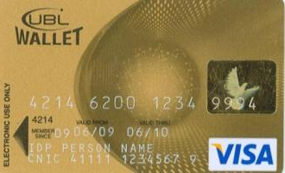
Financial Support to IDPs
2009
Total Amount Distributed:
Rs. 10,579,687,775
Male
Female

Slide 41
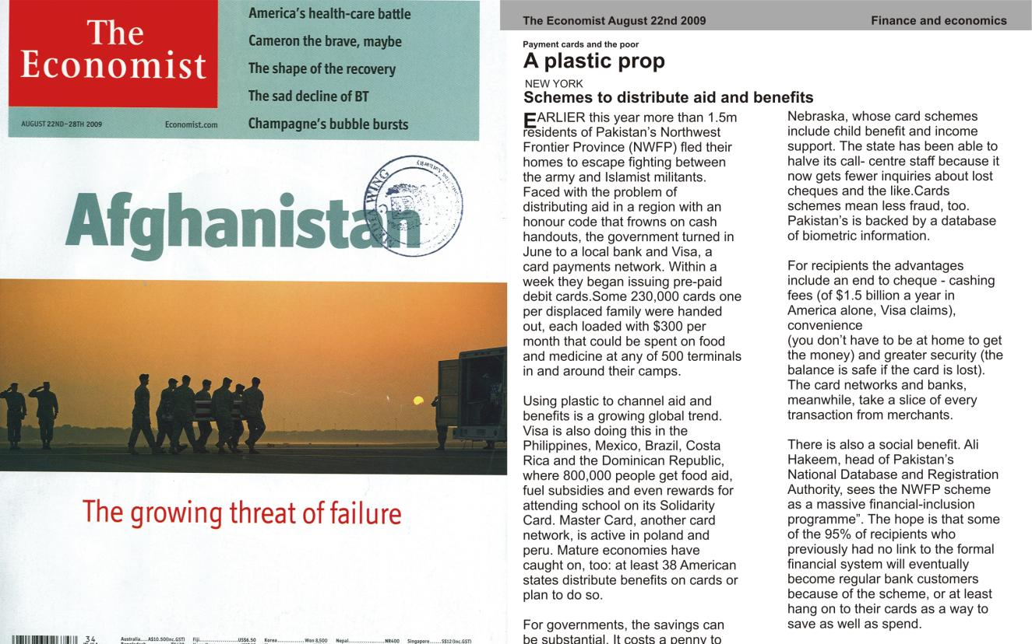
Financial Support to IDPs
Recognition as One of the Best Cash Disbursements in the World

Slide 42
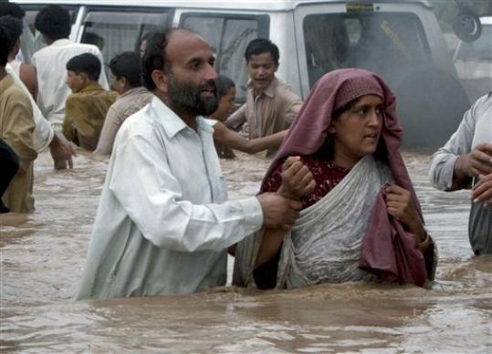
Financial Support to Flood Victims
2010
Pakistan is hit by the worst floods in its recorded history
Over 20 Million people affected
August
September 6
September 9

Slide 43
Financial Support to Flood Victims
2010
NADRA is given the go-ahead to implement a financial support system which is transparent and efficient
August
September 6
September 9

Slide 44
Financial Support to Flood Victims
2010
First beneficiary card issuance site launched
First card activated
Time from Program Start till the First Payment:
3 days
Total Money Distributed till September 27, 2010:
Rs. 2,077,160,000
August
September 6
September 9

Slide 45
Thank you

