Slide 1
Advancing public cloud computing:
What to do now?
Priorities for industry and government
Chiemi Hayashi
Head of Research, Risk Response Network
World Economic Forum

Slide 2
The World Economic Forum is an
independent, international organization integrating business, political, intellectual and other leaders of society into a community committed to improving the state of the world

Slide 3
Reality check
$55 billion ⁽¹⁾
Forecasted worldwide revenue from public IT cloud services by 2014, a compound annual growth rate of 27.4%.
30% ⁽¹⁾
The rate at which cloud computing will grow in 2011, or more than 5 times the rate of IT industry as a whole
33% ⁽²⁾
Global companies have deployed or are piloting the more mature layer of cloud, SaaS. 23% of high performing IT companies have already deployed SaaS
2.3 million jobs ⁽⁴⁾
The net new jobs created by cloud on a cumulative basis over the period 2010 to 2015 across the top five EU economies
25% ⁽³⁾
Global companies which will be deploying cloud computing for critical applications within 2 years
2.1% ⁽⁴⁾
The average improvement in efficiency of an average employee because of cloud
44% (3)
Executives from global companies who believe cloud computing can provide their company with a lasting competitive advantage
Sources: ¹IDC [Worldwide and Regional Public IT Cloud Services 2010 – 2014 Forecast, June 2010], ² Accenture [“Mind the Gap - Insights from the 3rd global High Performance IT research study, Nov. 2010], ³ Accenture [Cloudrise: Rewards and Risks at the Dawn of Cloud Computing” Nov. 2010], ⁴ Center for Economics and Business Research [The cloud dividend”, Dec. 2010]
Copyright © 2011 The World Economic Forum and Accenture. All Rights Reserved.

Slide 4
Potential benefits of public cloud
Long-term benefits
accelerate innovation
transform R&D and science
better services for citizens
contribute to GDP growth
lower cost of failure
create new jobs / businesses
improve government effectiveness
empower individuals
Immediate benefits
increase IT flexibility
improve competitiveness
drive productivity gains
improve IT / business process efficiency
enhance collaboration
transform education
Cloud
facilitate business agility
promote sustainability
reduce IT costs
level
playing field
enhance
user experience
provide leapfrogging opportunities
Copyright © 2011 The World Economic Forum and Accenture. All Rights Reserved.

Slide 5
Challenges: clouds around cloud
1. Data governance
2. Security
Authorized access
Integrity & availability
Data loss
Data destruction
Data location & jurisdiction
Privacy & confidentiality
Data ownership
3. Business environment
Interoperability & portability
Reliability
Service level commitment
Ecosystem maturity
Copyright © 2011 The World Economic Forum and Accenture. All Rights Reserved.

Slide 6
Eight priorities
Explore and facilitate the realization of cloud benefits
5. Ensure data portability
2. Advance understanding and management of cloud related risks
6. Facilitate interoperability
7. Accelerate adaptation and harmonization of regulatory frameworks related to cloud
3. Promote service transparency
4. Clarify and enhance accountability across all relevant parties
8. Provide sufficient network connectivity to cloud services
Copyright © 2011 The World Economic Forum and Accenture. All Rights Reserved.

Slide 7
Examples of tangible actions
Experimental programs to document empirical evidence about cloud’s positive social and economic impacts
Industry investment in research into system-wide security risks
Service providers reaching agreement on minimum transparency best practices
Telecoms providers working to identify connectivity needs by geography
Copyright © 2011 The World Economic Forum and Accenture. All Rights Reserved.

Slide 8
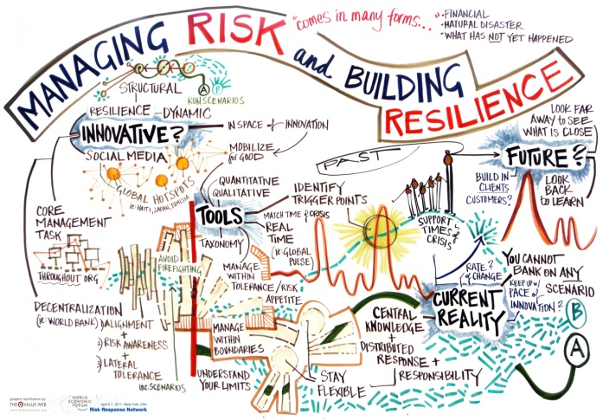
Next Steps
Risk Response Network
Risk and Responsibility in a Hyper-connected World

Slide 9
Thank you
For further references
Advancing Cloud Computing: What To Do Now?
http://www.weforum.org/reports/advancing-cloud-computing-what-do-now?fo=1
Exploring the Future of Cloud Computing
https://members.weforum.org/pdf/ip/ittc/Exploring-the-future-of-cloud-computing.pdf
Copyright © 2011 The World Economic Forum and Accenture. All Rights Reserved.

Slide 10
Backup slides

Slide 11
What is the Cloud?
“Cloud computing refers to both the applications delivered as services over the Internet and the hardware and systems software in the data centers that provide those services”¹. ~ Above the Clouds: A Berkeley View of Cloud Computing (2009)
110101010
110101010
1011111000110
11010100
00110011101001
01101
0110101
¹ a) Access to the cloud can be provided via multiple technologies (Internet or other)
b) “Services” can include processing, storage, access to applications, and business processes
Copyright © 2011 The World Economic Forum and Accenture. All Rights Reserved.

Slide 12
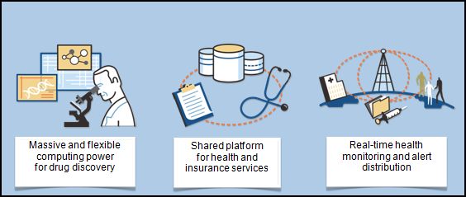
Cloud impact across sectors
HEALTH CARE
Copyright © 2011 The World Economic Forum and Accenture. All Rights Reserved.

Slide 13
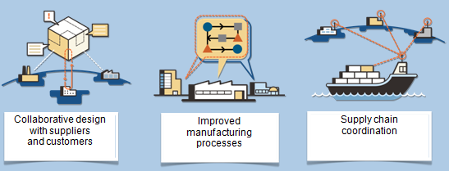
Cloud impact across sectors
MANUFACTURING
Copyright © 2011 The World Economic Forum and Accenture. All Rights Reserved.

Slide 14
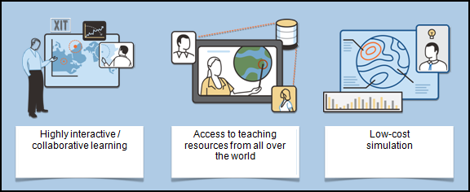
Cloud impact across sectors
EDUCATION
Copyright © 2011 The World Economic Forum and Accenture. All Rights Reserved.

Slide 15
1. Data Governance
It is not always clear which legal jurisdiction data in the cloud falls under – especially if the data is split up and stored in multiple locations.
Data location & jurisdiction
Privacy & Confidentiality
In the cloud, data is stored on remote machines which are shared with other users. Concerns about data privacy & confidentiality restrict some users’ willingness to use cloud for sensitive data.
Data Ownership
When a client moves data to the cloud, it is not always clear what rights the cloud service provider gains to access, modify or distribute that data.
Copyright © 2011 The World Economic Forum and Accenture. All Rights Reserved.

Slide 16
2. Security
Users are concerned that data in the cloud is more susceptible to cyber attacks, as aggregating multiple users’ data and services on a single platform makes it a more attractive target.
Authorized access
When users store their data in the cloud, it is not always clear who is accountable if the data is corrupted, lost or temporarily inaccessible. As many users’ data may be shared on one machine, users are concerned about the possibility of problems with one user’s services affecting another’s.
Integrity & availability
Data Loss
Data deletion is more challenging in the cloud, because cloud providers are the only ones with access to the physical infrastructure on which users’ data is stored, and often data may be mirrored on multiple machines.
Data Destruction
Copyright © 2011 The World Economic Forum and Accenture. All Rights Reserved.

Slide 17
3. Business Environment
Government and users have lock-in concerns. Industry is concerned that a premature focus on standardization to promote interoperability & portability could hold back innovation
Interoperability & Portability
Many users perceive that the reliability of cloud solutions is not yet sufficient for them to trust the cloud with their mission-critical needs. Industry believes that the market will quickly adapt.
Reliability
Users are held back by the lack of clear commitments from providers regarding such issues as uptime, response times, bandwidth, reliability and security – or by the lack of stipulated penalties
Service level commitment
There are some concerns about cloud evolution, which include lack of understanding about cloud; speed, reliability and availability of network access; availability of expertise; underdevelopment of insurance solutions; threats to intellectual property
Ecosystem maturity
Copyright © 2011 The World Economic Forum and Accenture. All Rights Reserved.

Slide 18
Governments are ready to act...
“
I want to make Europe not just "cloud-friendly" but "cloud-active”
Neelie Kroes, European Commission, Davos 2011
Industry could take the initiative for a cloud “code of conduct” and regulation could then review it
“
Viviane Redding, European Commission, Davos 2011
Copyright © 2011 The World Economic Forum and Accenture. All Rights Reserved.

Slide 19
...and Industry is eager to move forward
“
There is a need to be transparent with roles, relationships, locations, and ownership of data.
Industry Participants, Brussels 2010
“
To create fair global competition, there is a need for a globally coordinated effort
Industry Participants, London 2010
Copyright © 2011 The World Economic Forum and Accenture. All Rights Reserved.

Slide 20
A few real benefit cases
Cost reductions and savings
The Swedish Red Cross estimates return on investment into switching to cloud within 2 years and 20% in overall cost savings over the next 5 years
New innovative business models
Evernote (a service that allows capturing of all sorts of notes - such as text, scans, and snapshots)
Wokai is a cloud-based non-profit organization that links up donor money with microfinance institutions in rural China
NASA uses “crowd-sourcing” to help it analyze its large collection of photos of the surface of Mars
Solving complex social problems
Empowering research and innovation
Stanford University School of Medicine found that in the long run cloud computing can support clinical researchers who need to analyze large datasets
Reducing the environmental impact
Users of different Microsoft cloud services can reduce energy consumption per computing user by 30% to 90%, a study found
Copyright © 2011 The World Economic Forum and Accenture. All Rights Reserved.

Slide 21
A few industry-specific benefit cases
Healthcare
With services such as HealthVault, electronic health records can follow patients from doctor to doctor, allowing more coordinated care
Retail
Laser Red app allows consumers to scan product barcode and instantaneously find out if product is cheaper somewhere else, online or brick-and-mortar
Banking
The split-the-bill app allows diners to divvy up the check from their individual accounts electronically
Energy
Cloud-based applications are now available that can automatically monitor video footage and apply logic to assess risks and accordingly trigger alerts
Government
Institutions will have the IT power to use data analytic techniques to detect data errors and potential fraud quickly and easily
Media & Entertainment
Analytics for one-to-one marketing—Pandora and Genius for iTunes—can aggregate and analyze user feedback in real time at the volume necessary requires the cloud
Copyright © 2011 The World Economic Forum and Accenture. All Rights Reserved.

